Slide 1
Job Pack Senior Support Worker – YPFS (Young People and Family Support) (December 2024)

Slide 2
Job Purpose Senior Support Worker-
Grow Your Own Routes
In partnership with Scottish Families Grow Your Own Routes Project, this post will lead, manage and deliver a Young Person’s Programme, working alongside young people across Orkney mainland and Orkney isles, and maintain the co-designed programme of support for 12–26-year-olds affected by others alcohol and drug use, to ensure the right support is available at the right time, offering a flexible and person-centred approach.
The Senior Support Worker will work in partnership with Grow Your Own Routes (GYOR) employees in other areas of Scotland either online or in person, to share learning and development and help young people thrive.
The Senior Support Worker will lead a team of support workers to provide a high-quality support service to the people we support in the GYOR programme and be a part of Right There’s Orkney Management team.
Locality Manager
Service Manager
(current vacancy)
Senior Support Workers x 2 (1 current vacancy)
Support Workers, Counsellors, Wellbeing Workers

Slide 3
What’s Inside
4 - 5
Our Vision, Mission and Values
6 - 7
8 - 9
Requirements
10
Role Details
11
Our People Benefits
12
How to Apply
13
14

Slide 4
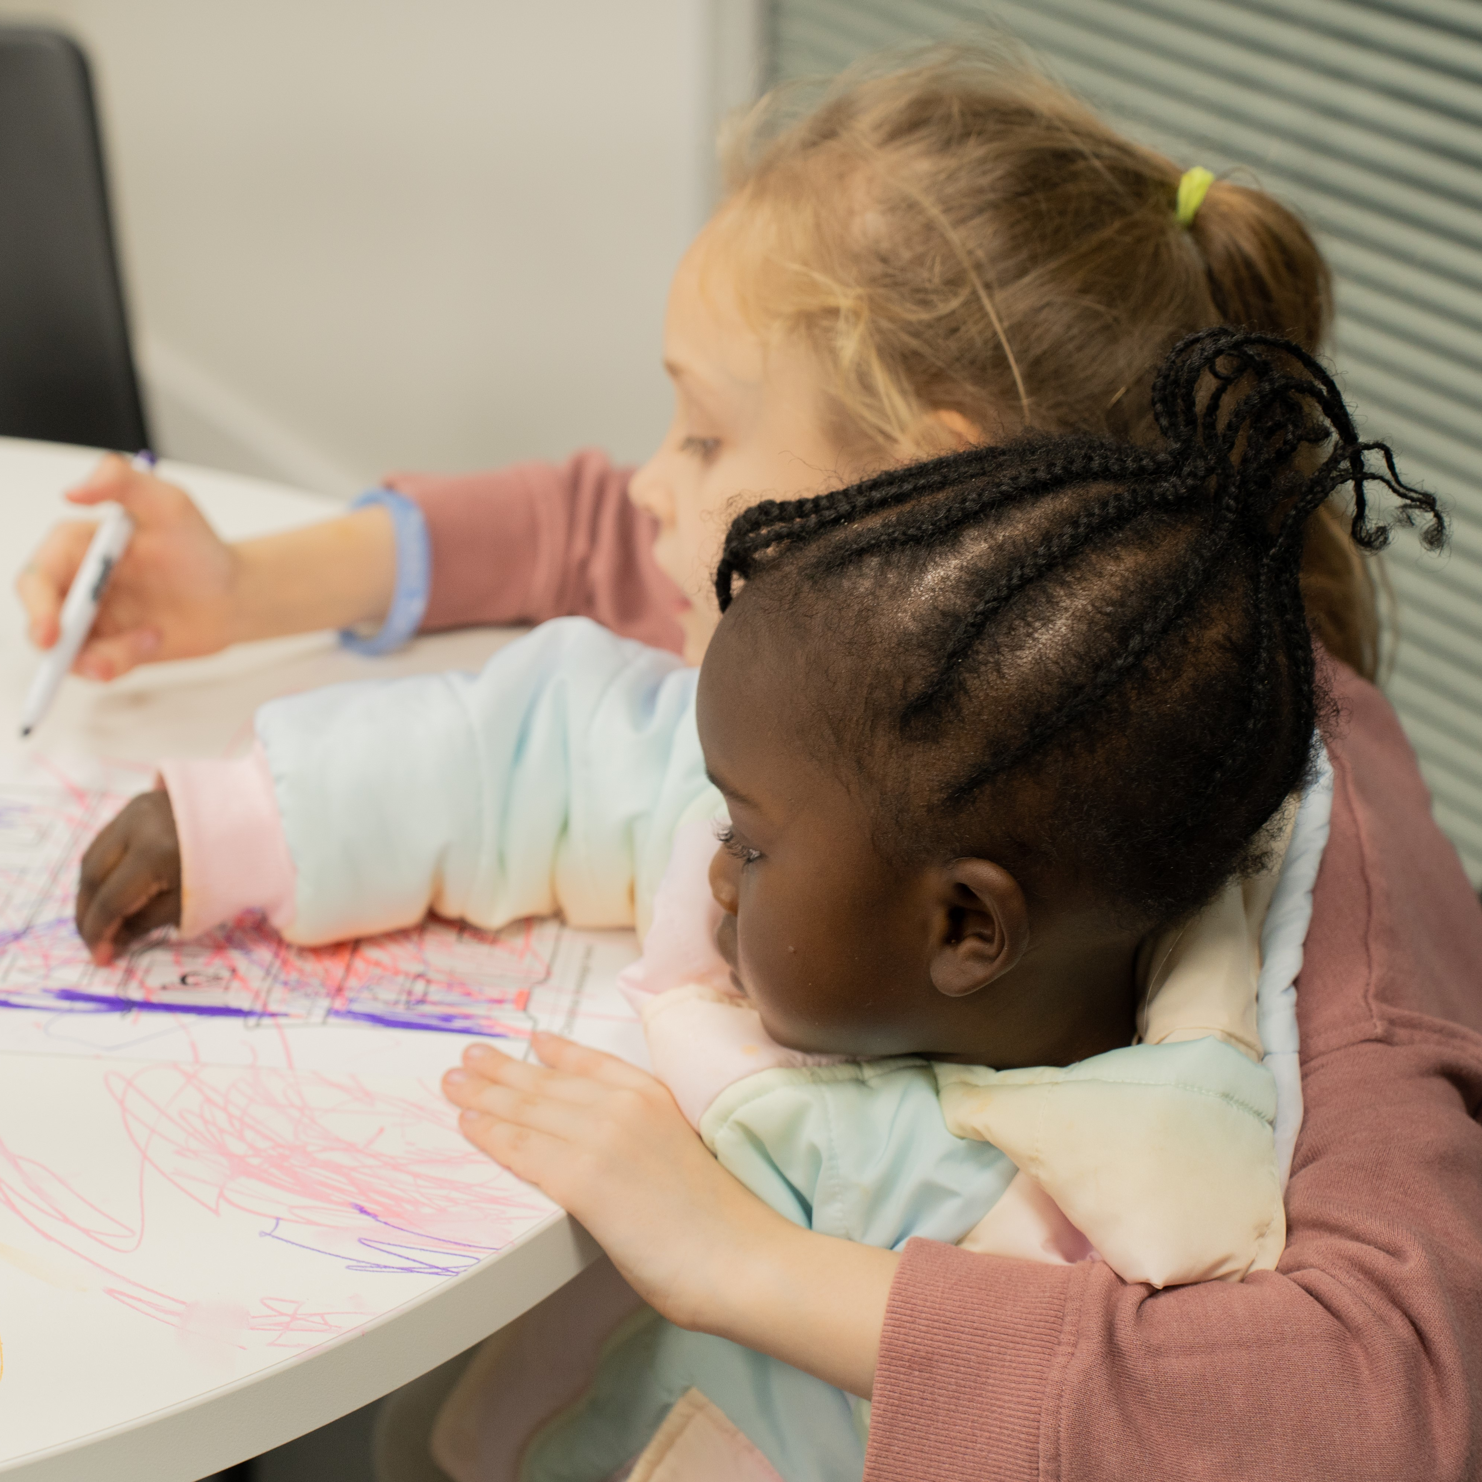
About Right There
We are Right There, a charity celebrating our 200th anniversary in 2024. We provide tailored support for people, at home, and in the community. We are here for people who are living with the effects of homelessness, poverty, addiction, or family breakdowns. Last year we supported almost 4,000 individuals, helping to prevent them from becoming homeless or separated from the people they love.
We are here to offer the right support at the right time, including breaking down financial barriers; accessing the private rental market; linking up with local health, employment and training services to help people make connections within the community; and, helping people feel happier, safer, and more confident to take steps to improve their own lives.
Every person’s story is unique, and everyone’s route home is different, so we tailor our response to the individual. We want to challenge stereotypes – it doesn’t matter what the situation is – we’re not here to judge, only to help.
Our approach is about creating trusting relationships and nurturing people’s strengths, and our 200 dedicated staff, mentors and volunteers play a crucial role in this.

Slide 5
Our key areas of focus
For People
We provide tailored support for children and adults to help individuals and families feel happier, create stronger bonds and stay together.
At Home
We provide safe and supportive places to call home for people of all ages, from any circumstances, for as long as they might need it.
In The Community
We provide the tools for people to live independently and build their lives within their community, creating their own safe and secure homes.

Slide 6
Our Vision A world where everyone has an equal chance to create a safe and supportive place to call home.
Our Mission We meet people where
they are in life with no judgement; walking alongside those who need support, and preventing them becoming homeless
or separated from the people they love.

Slide 7
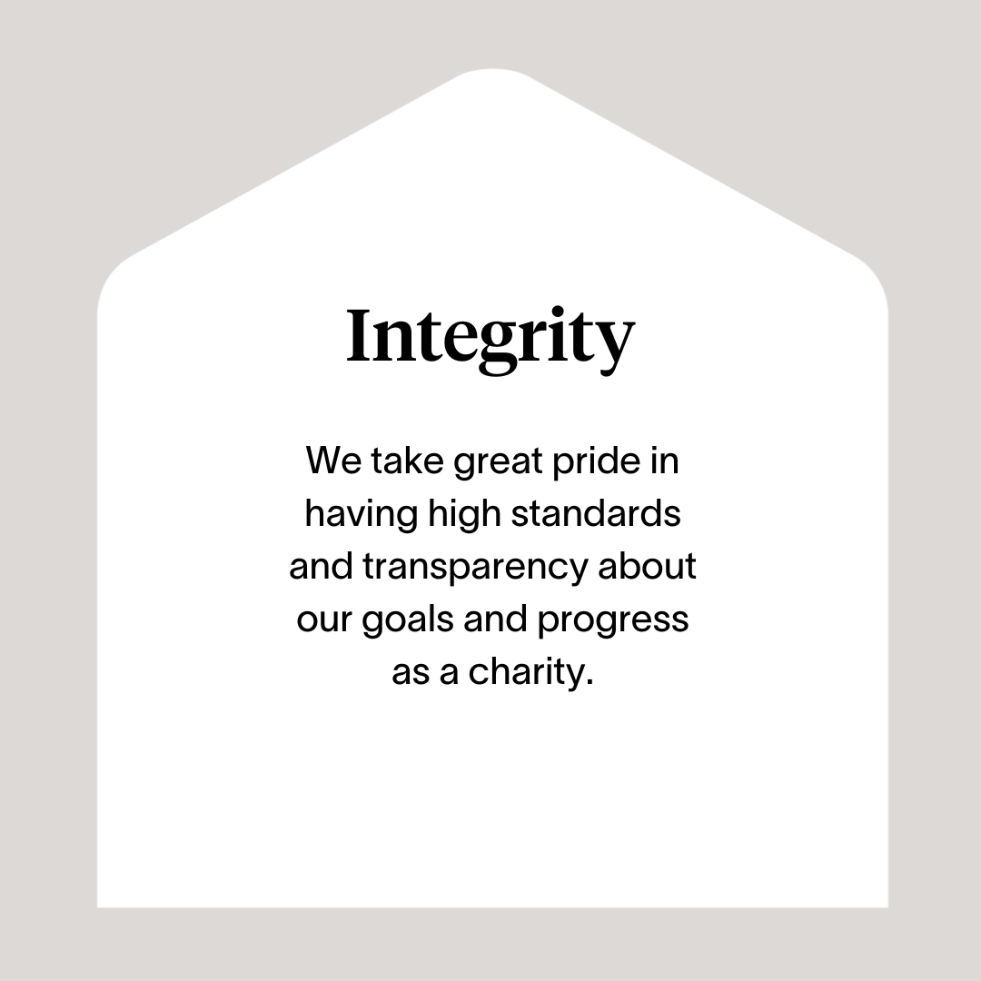

Slide 8
Roles & Responsibilities
Programme Delivery
To lead, develop and deliver Grow Your Own Routes Project, with the assistance of support partner organisations and the Service Manager.
Responsible for coordinating and providing appropriate levels of high-quality support to young people in their homes and community, supporting specific issues relating to alcohol and drug use in their families. This will include face-to-face and telephone/online support
Ensure positive, respectful and compassionate relationships are developed with the people we support, focusing on their strengths and aspirations as individuals, supporting emotional development, resilience and coping strategies, helping them to increase their self-esteem and confidence.
Use a flexible approach so that young people receive support whenever is best for them including evenings and weekends.
To provide advocacy to individual young people and also advocate for young people in general affected by family substance use.
To participate in local forums to ensure the views of young people and their families are represented.
Ensure delivery is aligned with the UN Convention on The Rights of The Child.
To represent the Project – and support young people to do so – at local and national levels.
Actively contribute to programmes Orkney wide and the organisation’s development and improvement..
On-Call rota responsibilities (shared across all Right There Programmes)

Slide 9
Main Role Responsibilities
Responsibility to the programme:
To work closely with local stakeholders, service providers and commissioners and positively represent Right There to local partnership agencies including local authority, Social Work, Housing providers and other local authority
Maintain case files and ensure all relevant documentation is completed to the highest standards and within agreed timescale and regularly audit the files of those who we support.
Accurately record matters relating to the people we support and report as appropriate through the development of support plans and case notes.
Work collaboratively with partner agencies and muti disciplinary teams
Establish clear professional boundaries with the people we support.
Have a high standard of professional integrity with colleagues and other professionals
People Management
Develop positive and supportive relationships with your staff team.
Develop positive relationships with other senior support workers and management team.
Arranging and facilitating regular support and supervision sessions with your team members, utilising best practice in performance management to ensure staff are supported to undertake their roles.
Completing yearly appraisals and personal development plans with your staff team.
Investigating any issues of misconduct within the organisation.
Responsibility for information and Finance
Compiling Right There Key Performance Indicators (KPI) and maintain appropriate monitoring and evaluation mechanisms for the project , complete reporting to funders and line manager as required.
Supporting Service Manager with reporting required Care Inspectorate notifications.

Slide 10
Roles & Responsibilities
Being part of the Right There strengths-based team:
Facilitate team meetings.
Engage in reflective practice.
Promote and represent Right There services positively.
Be a proactive team member actively contributing to your service working collaboratively with your colleagues across the organisation.
Have a high standard of professional integrity with colleagues and other providers.
Work towards performance targets to achieve agreed results
Strive for continuous professional development and reflection on the approach, caseload and evaluation outcomes with line manager and working in tandem with Right There’s People First Team for support and guidance.
Share knowledge of strengths-based work with the wider organisation and sector
Participate in training and share learnings with team
Contribute to the organisations' development and improvement with feedback on the review of organisational policies and procedures and local guidelines
Engage with any organisational initiatives or working groups
Adhere to Right There Policies and Procedures, Scottish Social Programmes Council (SSSC) Codes of Practice, Health and Social Care Standards (My Support, My Life), Health and Safety legislation and practices
Always apply safeguarding principles and maintain awareness of child protection and adult protection processes.
Register with any required government bodies and ensure membership is updated and any attributed costs are paid for

Slide 11
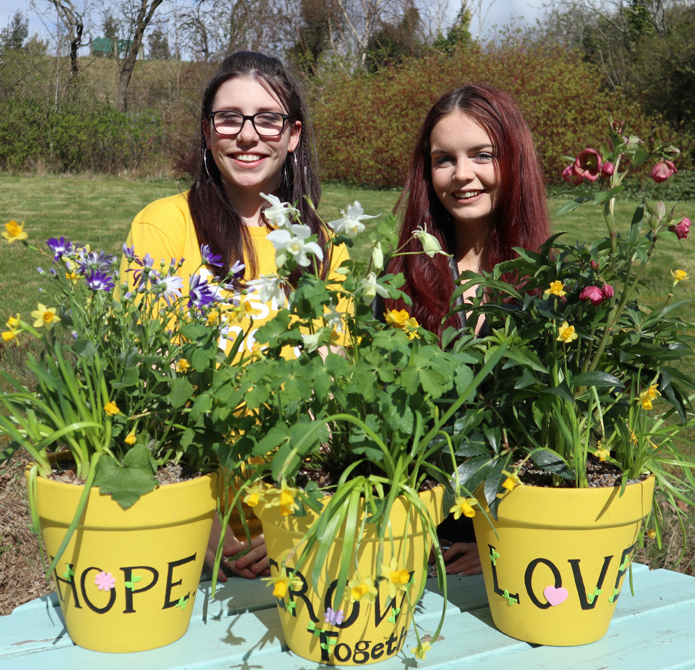
Essential skills and experience
Qualified or willing to work towards a relevant professional qualification at SCQF level 7 or above, for example SVQ 3 Social Services (Children and Young People) or relevant HNC or equivalent and qualified or willing to work towards a supervision qualification, specifically for a supervisor of a care service .e.g. PDA Health and Social Care Supervision
Understanding and respecting the importance of confidentiality
Ability to successfully manage own workload and work to deadlines, including working flexibility with regards to working patterns
Ability to work towards performance targets to achieve agreed outcomes, managing or leading projects/ initiatives.
Computer literate and competent with Microsoft Office software packages
Experience of supervising and supporting a staff team and ability to manage staffing issues on daily basis (performance, sickness absence, time management.
Ability to work as part of a designated team to develop skills in assessment, support planning, risk assessment, objectives and reviews
Experience and knowledge of working with vulnerable people supporting key areas such as effects of trauma, poverty and substance use, providing a culture of compassion and unconditional positive regard.
Planning and delivering structured programmes of support and participation groups for children and young people that promotes their personal development, self-esteem and resilience.
Supporting young people to engage in planning, developing and evaluating projects.
Experience of promoting service development to the public or media

Slide 12
Essential skills and experience
Ability to respond at short notice to crisis situations
Understanding of children and young people’s rights including current relevant legislation and policies relating to children, young people and families, including GIRFEC, UNCRC, The Promise.
Full UK driving licence and Ability to travel within agreed geographical area
Flexibility with regards to working patterns
Desirable Skills and Experience
Understanding of the principles of working within a Psychologically Informed Environment (PIE).
Experience of establishing or administering systems for assessment, monitoring and evaluation.
Delivering one-to-one and/or group interventions to young people.
Good knowledge of statutory and voluntary agencies and organisations which support young people and their families.
Presentation skills – able to prepare and convey information in a way which is accessible to both young people and professionals.
Ability to support young people with additional support needs.
Experience of using management information tools for social care

Slide 13
Role Details
Contract: Full time, permanent, 35 hours per week. Salary: SCP 23-26 (£26,036 - £28,571 per annum) Reporting to: Service Manager
Working hours are Monday to Friday – worked flexibly between the hours of 8.00am to 6.00pm, depending on the needs of the programme.
Your core place of work will be 18 Queen Street, Kirkwall, Orkney, KW15 1JE
You may be required to work from such other place as the organisation may reasonably require from time to time.
Annual leave entitlement of 210 hours holiday (equivalent to 6 weeks) pro rata per year in the first year rising to 280 hours (equivalent to 8 weeks) pro rata per year in the second. This includes public holidays.
All appointments are subject to a minimum of a 12-week probationary period.
You will be automatically enrolled into the People’s Pension. Deductions will be taken from your salary in the month you will complete 3-months of employment
It is the nature of the work of Right There that tasks and responsibilities are, in many circumstances unpredictable and varied. All employees are, therefore, expected to work in a flexible way when the occasion arises.

Slide 14
Our People Benefits
We know how dedicated our people are and we want to help you achieve a good work/life balance – and make it easier to enjoy life’s special moments!
That’s why we’ve got a range of enhanced family-friendly and wellbeing benefits to give you some well deserved perks of being a Right There employee. Benefits include:
Hybrid working – work where is best for you and your role
Enhanced maternity, paternity, adoption, and shared parental leave
Employee 24-hour counselling and wellbeing services
6 weeks annual leave, rising to 8 after a year (plus you can purchase up to 5 more days)
Life insurance 4x your salary
Dedicated training and development plans
Cycle to work scheme
Refer a Friend

Slide 15
How to Apply
To apply send your CV and a cover letter outlining why you want to work with us, and how you meet the experience, skills and behaviours expected for this role.
Deadline 5pm on Friday 27th December 2024 Email recruitment@rightthere.org

Slide 16
Thank you. Good luck with your application.

