Slide 1
Job Pack Service Manager-Orkney (November 2024)

Slide 2
Job Purpose Service Manager
To oversee the management and ongoing development of supported accommodation, counselling and mentoring services across Orkney, ensuring each programme is delivered to a high standard which meets the needs of the people we support, whilst ensuring all relevant standards and requirements are being met.
The Service Manager will provide a highly responsive and professional service, working flexibly and collaboratively and be a positive member of the programme team. The role is responsible for leading day to day delivery of the services, driving delivery performance and providing a high-quality support service. They will encourage a culture of support with dignity and respect towards the people we support, stakeholders and colleagues.
Locality Manager
Service Manager
(current vacancy)
Senior Support Workers x 2
Support
Workers/Wellbeing Workers/Counsellors

Slide 3
What’s Inside
4 - 5
Our Vision, Mission and Values
6 - 7
8 - 9
Requirements
10
Role Details
11
Our People Benefits
12
How to Apply
13
14

Slide 4
About Right There
We are Right There, a charity celebrating our 200th anniversary in 2024. We provide tailored support for people, at home, and in the community. We are here for people who are living with the effects of homelessness, poverty, addiction, or family breakdowns. Last year we supported almost 4,000 individuals, helping to prevent them from becoming homeless or separated from the people they love.
We are here to offer the right support at the right time, including breaking down financial barriers; accessing the private rental market; linking up with local health, employment and training services to help people make connections within the community; and, helping people feel happier, safer, and more confident to take steps to improve their own lives.
Every person’s story is unique, and everyone’s route home is different, so we tailor our response to the individual. We want to challenge stereotypes – it doesn’t matter what the situation is – we’re not here to judge, only to help.
Our approach is about creating trusting relationships and nurturing people’s strengths, and our 200 dedicated staff, mentors and volunteers play a crucial role in this.

Slide 5
Our key areas of focus
For People
We provide tailored support for children and adults to help individuals and families feel happier, create stronger bonds and stay together.
At Home
We provide safe and supportive places to call home for people of all ages, from any circumstances, for as long as they might need it.
In The Community
We provide the tools for people to live independently and build their lives within their community, creating their own safe and secure homes.

Slide 6
Our Vision A world where everyone has an equal chance to create a safe and supportive place to call home.
Our Mission We meet people where
they are in life with no judgement; walking alongside those who need support, and preventing them becoming homeless
or separated from the people they love.

Slide 8
Main Role Responsibilities
People Management
Provide leadership and management and act as a role model to Right There staff, by developing supportive relationships with your team.
Develop positive, respectful and compassionate relationships with those that we support, focusing on their strengths and aspirations as individuals.
Develop strong partnerships with external agencies and have detailed knowledge of relevant local/national agencies.
Have a high standard of professional integrity with colleagues and other professionals and establish clear boundaries with the people we support.
Providing support and leadership to Senior Support Workers and Support Workers, Wellbeing Workers and Counsellors
Ensuring person centred support planning and unconditional positive regard is undertaken by all staff, ensuring the people we support are provided with a high standard of support.
Taking a Psychologically Informed Environment (PIE) approach to service delivery.
Investigating and resolving any complaints by those we support
Arranging and facilitating regular support and supervision sessions with your team members, utilising best practice in performance management to ensure staff are supported to undertake their roles.
Completing annual appraisals and personal development plans with your staff team.
Lead the teams to deliver a high-quality service and a People First Approach
Build your team taking responsibility for recruitment, induction and performance using support and supervision and appraisal tools.
Responsibility for the learning and continued professional development of yourself and your teams, actively encouraging reflective practice for team learning
Embrace a positive working culture working collaboratively, promoting inclusiveness, cooperation, trust and open exchange of ideas to fulfil Right There’s strategic aims supporting line managers and delivery staff to do likewise.
Be accountable for a safe environment for employees and those people what we support through applying Health and Safety legislation and practices.
Investigating any issues of misconduct within the organisation.

Slide 9
Main Role Responsibilities
Programme Delivery
Maintain all contractual obligations ensuring that individual needs are met through a process of regular review and support
Ensuring a high standard of accommodation is provided and safe environment.
Support the development of and manage local community participation by people we support
Assist in the development of new programme activity across a wider local authority base through research, engagement and rent service promotion
Lead and support new initiatives and the development and implementation of policies, procedures and guidelines as they impact on the programme.
Support Senior Management in developing the strategic Annual Business Plans, actively contributing to your service and the organisations development and improvement.
Ensure those we support are involved in the development and improvement of the service and that feedback mechanisms are in place for people we support, investigating and resolving any complaints received
On-Call rota responsibilities (shared between all managers across the locality)
Compiling Right There Key Performance Indicators (KPI) data to support decision making, planning for programme development and completion of required local authority returns within agreed timescales.
Ensuring services work within budget.
Actively contribute to your service and the organisations development and improvement and attend and participate in training and share learning experiences.
Feedback on the review of organisational polices & procedures and local guidelines.

Slide 10
Main Role Responsibilities
External Relationships
Represent Right There in a positive, professional manner to other agencies or services including Local Authority, Social Work, Housing Services and other relevant services, support building the profile of the service externally and its key features and benefits
Develop positive strong working partnerships with external agencies and have detailed knowledge of relevant local/national agencies that can positively impact on the programme.
Day to day working in partnership with key commissioners involved in service review and reporting
Represent Right There in a positive, professional manner and ensure a detailed knowledge of all other relevant services.
Responsibility for information and finance
Report to the Care Inspectorate, ensuring all required reports, returns and documentation are completed and submitted within timescales.
Accountable for programme specific data collection, analysis and regular agreed reporting, compiling, Right There Key Performance Indicators (KPI) and required local authority returns, completed within agreed timescales.
Support the compiling and associated management of approved annual budgets
Manage budgets for all aspects of the programme, ensuring the programme operates within agreed financial parameters and targets
Lead staff in their understanding and responsibilities in development of budgets and managing resources
Responsible for identifying and securing local grant and associated funds that supports activities within services.
Being part of the Right There Team
Facilitate team meetings.
Attend and participate in training and share learning experiences, striving for continuous personal and professional development
Register with any required government bodies and ensure membership is updated and any attributed costs are paid on time
Engage in reflective practice.
Feedback on the review of organisational polices & procedures and local guidelines.
Engage with any organisational initiatives or working groups

Slide 11
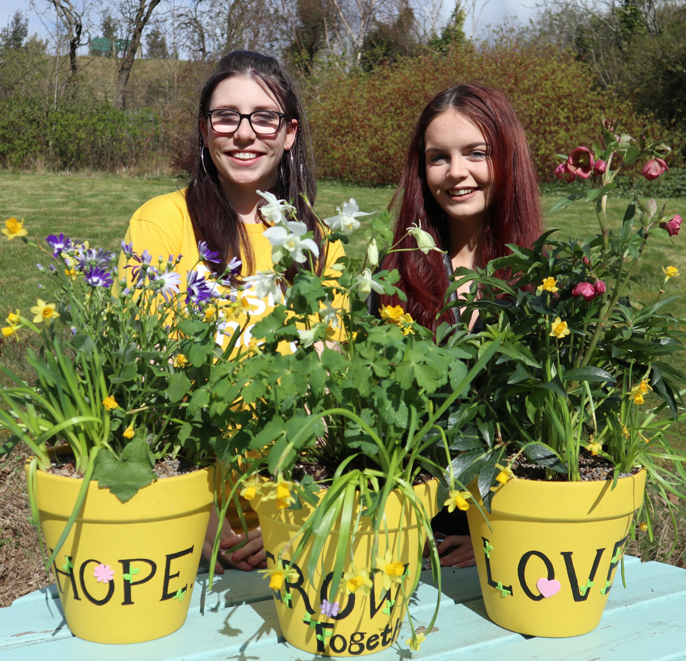
Essential skills and experience
Qualified to SVQ 3 in Social Services and Health Care SCQF Level 7 or HNC in Social Services (minimum requirement to be a registered manager with SSSC)
Qualified to (or willing to work towards) SVQ 4 Social Services and Healthcare SCQF Level 9
And willing to work towards any award in management that is certificated at or above SCQF Level 9 (min 60 credits) and mapped against the National Occupational Standards: Leadership and Management for Care Services SCQF 10 OR SVQ Care Services Leadership and Management SCQF Level 10
Proven track record in effective coaching and people management with skill and ability to implement effective performance measures.
Ability to recruit, build and lead a team in line with organisational policy and procedure
Experience of managing a service with proven track record in effective service planning and performance, and quality assurance
Ability to lead and take ownership and accountability for a programme ensuring the service is delivered in accordance with corporate policy and organisational objectives
Ability to set and manage service budgets efficiently and effectively
Ability to collate and analyse data for decision making purposes
Proven ability in effective planning, prioritisation and organisation with effective time management and can meet deadlines
Proven effective communicator both verbally and written with the ability to compile comprehensive reports as required
Ability to build strong professional relationships both within the organisation and externally

Slide 12
Essential skills and experience cont..
Computer literate and competent with Microsoft Office software package
Flexibility with regards to working patterns
Ability to travel within agreed geographical area
Ability to respond at short notice to crisis situations
Has a high standard of professional integrity
Desirable skills and experience
Management experience in Third Sector/ Not-for-Profit organisations providing housing, social care and support services
Experience of using management information tools for social care
Understanding of the principles of working within a Psychologically Informed Environment (PIE)

Slide 13
Role Details
Contract: Full time, permanent, 35 hours per week. Salary: SCP 29-32 (£31,601 - £34,616 per annum) Reporting to: Locality Manager
Your normal working hours are 35 per week. These hours are usually worked Monday to Friday, and flexibly between the hours of 8.00am to 6.00pm, depending on the needs of the service.
Your core place of work will be in Glaitness Farmhouse, Glaitness Road, Kirkwall, KW15 1TN. Working arrangements are in agreement with the line manager based on the needs of the service.
You may be required to work from such other place as the organisation may reasonably require from time to time.
Annual leave entitlement of 210 hours holiday (equivalent to 6 weeks) pro rata per year in the first year rising to 280 hours (equivalent to 8 weeks) pro rata per year in the second. This includes public holidays.
All appointments are subject to a minimum of a 12-week probationary period.
You will be automatically enrolled into the People’s Pension. Deductions will be taken from your salary in the month you will complete 3-months of employment
It is the nature of the work of Right There that tasks and responsibilities are, in many circumstances unpredictable and varied. All employees are, therefore, expected to work in a flexible way when the occasion arises.

Slide 14
Our People Benefits
We know how dedicated our people are and we want to help you achieve a good work/life balance – and make it easier to enjoy life’s special moments!
That’s why we’ve got a range of enhanced family-friendly and wellbeing benefits to give you some well deserved perks of being a Right There employee. Benefits include:
Hybrid working – work where is best for you and your role
Enhanced maternity, paternity, adoption, and shared parental leave
Employee 24-hour counselling and wellbeing services
6 weeks annual leave, rising to 8 after a year (plus you can purchase up to 5 more days)
Life insurance 4x your salary
Dedicated training and development plans
Cycle to work scheme
Refer a Friend

Slide 15
How to Apply
To apply send your CV and a cover letter outlining why you want to work with us, and how you meet the experience, skills and behaviours expected for this role.
Deadline 12pm on Monday 23rd December 2024 Email recruitment@rightthere.org

Slide 16
Thank you. Good luck with your application.

