Slide 1
Job Pack Family Support Worker (February 2025)

Slide 2
Job Purpose Family Support Worker
Service Manager
Our team provides flexible intensive family support that enables children and young people on the edges of care, and their families, to receive the right support at the right time, building on their strengths and reducing the need for statutory supports. A key part of this role will be working in partnership with the Health and Social Care Partnership (HSCP) and other family support providers as part of the GIFSS (Glasgow Intensive Family Support Service) model by sharing resources, learning and creating solutions that help children, young people and families to thrive.
Senior Family Support Workers
Administrator
Family Support Workers

Slide 3
What’s Inside
4 - 5
Our Vision, Mission and Values
6 - 7
8 - 9
Requirements
10-11
Role Details
12
Our People Benefits
13
How to Apply
14
15

Slide 4
About Right There
We are Right There, a charity celebrating our 200th anniversary in 2024. We provide tailored support for people, at home, and in the community. We are here for people who are living with the effects of homelessness, poverty, addiction, or family breakdowns. Last year we supported almost 4,000 individuals, helping to prevent them from becoming homeless or separated from the people they love.
We are here to offer the right support at the right time, including breaking down financial barriers; accessing the private rental market; linking up with local health, employment and training services to help people make connections within the community; and, helping people feel happier, safer, and more confident to take steps to improve their own lives.
Every person’s story is unique, and everyone’s route home is different, so we tailor our response to the individual. We want to challenge stereotypes – it doesn’t matter what the situation is – we’re not here to judge, only to help.
Our approach is about creating trusting relationships and nurturing people’s strengths, and our 200 dedicated staff, mentors and volunteers play a crucial role in this.

Slide 5
Our key areas of focus
For People
We provide tailored support for children and adults to help individuals and families feel happier, create stronger bonds and stay together.
At Home
We provide safe and supportive places to call home for people of all ages, from any circumstances, for as long as they might need it.
In The Community
We provide the tools for people to live independently and build their lives within their community, creating their own safe and secure homes.

Slide 6
Our Vision A world where everyone has an equal chance to create a safe and supportive place to call home.
Our Mission We meet people where
they are in life with no judgement; walking alongside those who need support, and preventing them becoming homeless
or separated from the people they love.

Slide 8
Main Role Responsibilities
Develop good communication and working relationships with children and families, colleagues and other professionals
Work alongside all immediate family members and extended family/support network as required
Advocate on behalf of children and families
Support children and families in the local community
Represent Right There to local partnership agencies including Local Authority, Social Work, Housing Programmes and other relevant bodies
Provide appropriate levels of high-quality support to families in their homes and community
Use a flexible approach so that families receive support whenever is best for them including evenings and weekends
Deliver evidenced based family support that helps families overcome current challenges and build resilience for the future
Maintain accurate case files for all family members and consistently assess progress across all outcomes for all family members
Plan, implement and continuously develop packages of tailored interventions for families to meet the needs of the individual child, their parent(s)/carer(s), siblings and wider family network. Including: practical support; parenting education and support; and emotional health and wellbeing, as well as other factors that are unique to that family
Assist individuals accessing the Programme to engage and integrate into their local community and become active citizens.
Undertake whole family assessments that focus on strengths and continuous assessment of progress towards outcomes for all family members

Slide 9
Main Role Responsibilities
Have comprehensive local knowledge of other relevant Programmes and support family members to access these
Commit to ensuring that that all support provided is Right There’s approach to ensuring a Psychologically Informed Environment
Adopt a person-centred approach and participate in reflective practice
Contribute to our commitment to work together with peers from other organisations delivering family support in the community by sharing resources, contributing to meetings, working together to create opportunity and share learning
Ensure delivery is aligned with the UN Convention on The Rights of The Child
Encourage and promote people accessing the Programme to be involved in improvement and development of the Programme.
Actively contribute to your Programme and the organisation’s development and improvement.
Participate in team meetings.
Attend and participate in training and share learning experiences.
Engage in reflective practice.
Feedback on the review of organisational polices & procedures and local guidelines.
Promote and represent Right There Programmes positively.
Strive for continuous personal and professional development
Engage with any organisational initiatives or working groups such as NHS Healthy Working Lives, Investors In people etc.
Retain up to date knowledge so that you can provide evidence-based family support

Slide 10
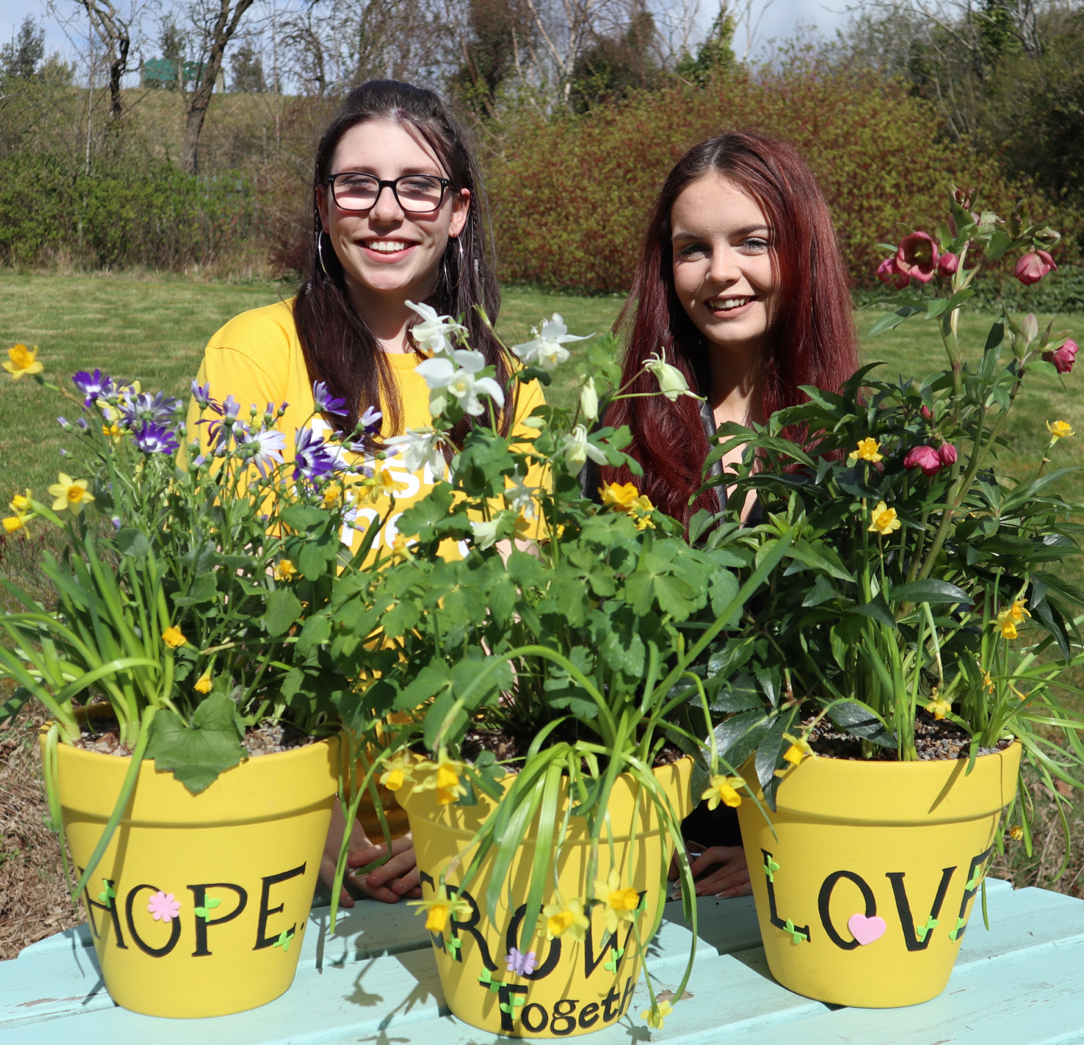
Essential skills and experience
Qualified, or willing to work towards a relevant professional qualification for example SVQ 2 Social Services and Healthcare (Children and Young People) relevant HNC or equivalent.
Experience of working with children, young people and families facing challenges and on the edges of care.
Understanding of current relevant legislation and policies relating to children, young people and families, including GIRFEC, UNCRC, The Promise.
Knowledge of the key issues facing children, young people and families such as the effects of trauma and poverty.
Working knowledge of SSSC Codes of Practice.
Able to demonstrate skills and experience in prioritizing resources to meet the needs of children, young people and families.
Computer literate and competent with Microsoft Office software packages
Ability to ensure the Programme is delivered in accordance with corporate policy and organisational objectives.

Slide 11
Essential skills and experience
Skills and ability in effective time management and working to deadlines.
Ability to compile comprehensive reports as required.
Flexibility with regards to working patterns.
Ability to travel within agreed geographical area.
Ability to respond at short notice to crisis situations.

Slide 12
Role Details
Contract: Full time, permanent, 35 hours per week. Salary: SCP 19-22 (£23,660 - £25,328 per annum) Pay award pending effective from 01/04/2025 (£24,252 - £25,961 per annum) Reporting to: Senior Family Support Worker
Your normal working hours are an average of 35 per week. These hours will be worked between the hours of 8am and 10pm, Monday to Sunday, in shifts which are defined by your line manager on a rolling rota, over a 52-week period.
Your core place of work will be 15 Dava Street, Glasgow, G51 2JA. You are also required to work in the local community, and you will be paid travel expenses between your usual place of work and appointments undertaken in the course of your duties. Alternatively, you may choose to work remotely from your home address where appropriate. Working arrangements must be agreed with your line manager based on the needs of the service.
You may be required to work from such other place as the organisation may reasonably require from time to time.
Annual leave entitlement of 210 hours holiday (equivalent to 6 weeks) pro rata per year in the first year rising to 280 hours (equivalent to 8 weeks) pro rata per year in the second. This includes public holidays.
All appointments are subject to a minimum of a 12-week probationary period.
You will be automatically enrolled into the People’s Pension. Deductions will be taken from your salary in the month you will complete 3-months of employment
It is the nature of the work of Right There that tasks and responsibilities are, in many circumstances unpredictable and varied. All employees are, therefore, expected to work in a flexible way when the occasion arises.

Slide 13
Our People Benefits
We know how dedicated our people are and we want to help you achieve a good work/life balance – and make it easier to enjoy life’s special moments! That’s why we’ve got a range of enhanced family-friendly and wellbeing benefits to give you some well deserved perks of being a Right There employee. Benefits include:
Hybrid working – work where is best for you and your role
Enhanced maternity, paternity, adoption, and shared parental leave
Pension after 3-months provided you meet the auto-enrolment criteria
Employee 24-hour counselling and wellbeing services
6 weeks annual leave, rising to 8 after a year (plus you can purchase up to 5 more days)
Life insurance 4x your salary
Dedicated training and development plans
Cycle to work scheme
Refer a Friend

Slide 14
How to Apply
To apply send your CV and a cover letter outlining why you want to work with us, and how you meet the experience, skills and behaviours expected for this role.
Deadline 5pm on Monday 3rd March 2025 Email recruitment@rightthere.org

Slide 15
Thank you. Good luck with your application.

