Slide 1
Job Pack Support Worker Supported Accommodation Glasgow (February 2025)

Slide 2
Job Purpose Support Worker
Locality Manager
Supported Accommodation Glasgow provides 24-hour support and accommodation for Glasgow’s young people. We offer a safe environment for 26 young people, many of whom have experienced significant tough times in their lives.
Our Support Workers help to end homelessness through providing a high-quality support service for Glasgow’s young homeless individuals transitioning from temporary to permanent or other suitable long-term accommodation.
Service Manager
Senior Support Workers
Support Workers

Slide 3
What’s Inside
4 - 5
Our Vision, Mission and Values
6 - 7
8 - 9
Requirements
10-11
Role Details
12
Our People Benefits
13
How to Apply
14
15

Slide 4
About Right There
We are Right There, a charity celebrating our 200th anniversary in 2024. We provide tailored support for people, at home, and in the community. We are here for people who are living with the effects of homelessness, poverty, addiction, or family breakdowns. Last year we supported almost 4,000 individuals, helping to prevent them from becoming homeless or separated from the people they love.
We are here to offer the right support at the right time, including breaking down financial barriers; accessing the private rental market; linking up with local health, employment and training services to help people make connections within the community; and, helping people feel happier, safer, and more confident to take steps to improve their own lives.
Every person’s story is unique, and everyone’s route home is different, so we tailor our response to the individual. We want to challenge stereotypes – it doesn’t matter what the situation is – we’re not here to judge, only to help.
Our approach is about creating trusting relationships and nurturing people’s strengths, and our 200 dedicated staff, mentors and volunteers play a crucial role in this.

Slide 5
Our key areas of focus
For People
We provide tailored support for children and adults to help individuals and families feel happier, create stronger bonds and stay together.
At Home
We provide safe and supportive places to call home for people of all ages, from any circumstances, for as long as they might need it.
In The Community
We provide the tools for people to live independently and build their lives within their community, creating their own safe and secure homes.

Slide 6
Our Vision A world where everyone has an equal chance to create a safe and supportive place to call home.
Our Mission We meet people where
they are in life with no judgement; walking alongside those who need support, and preventing them becoming homeless
or separated from the people they love.

Slide 8
Main Role Responsibilities
Actively practicing person-centred planning and unconditional positive regard.
Taking a Psychologically Informed Environment (PIE) approach.
Arranging and facilitating key work meeting to develop and review support plans in collaboration with the people we support to meet their individual needs both within the service and out with.
Developing life skills with the people we support, including how to maximise income, involvement in meaningful activities, budgeting, shopping, cooking and any other skills that aid to independence.
Advocating on behalf of the people we support.
Assist the people we support to engage and integrate into the local community and become active citizens.
Utilising support plans to record and assess the progress of the people we support.
Having detailed knowledge of other relevant services; signposting or referring the people we support when required.
Maintaining a safe environment for the people we support, colleagues and others.
Undertaking household duties to maintain the accommodation to a high standard.
Planning, implementing and developing workshops or programme activities with the people we support.
Compiling and reviewing risk assessments.
Promoting involvement in the improvement and development of the service by the people we support.
Represent Right There to other agencies or services including Local Authority, Social Work, Housing Services and other relevant services.
Actively contribute to your service and the organisations development and improvement.
Participate in team meetings.
Attend and participate in training and share learning experiences.
Engage in reflective practice.
Feedback on the review of organisational policies and procedures and local guidelines.
Promote and represent Right There services positively.
Strive for continuous personal and professional development.
Engage with any organisational initiatives or working groups such as NHS Healthy Working Lives, Investors in People, the LGBT Charter, etc.

Slide 9
Main Role Responsibilities
Right There strives for best practice within social care and expects all staff to adhere to:
Right There’s policies and procedures.
Scottish Social Services Council (SSSC) Codes of Practice.
Health and Social Care Standards (My Support, My Life).
Health & Safety legislation and practices.
Register with any required government bodies and ensure memberships is updated and any attributed costs are paid for.

Slide 10
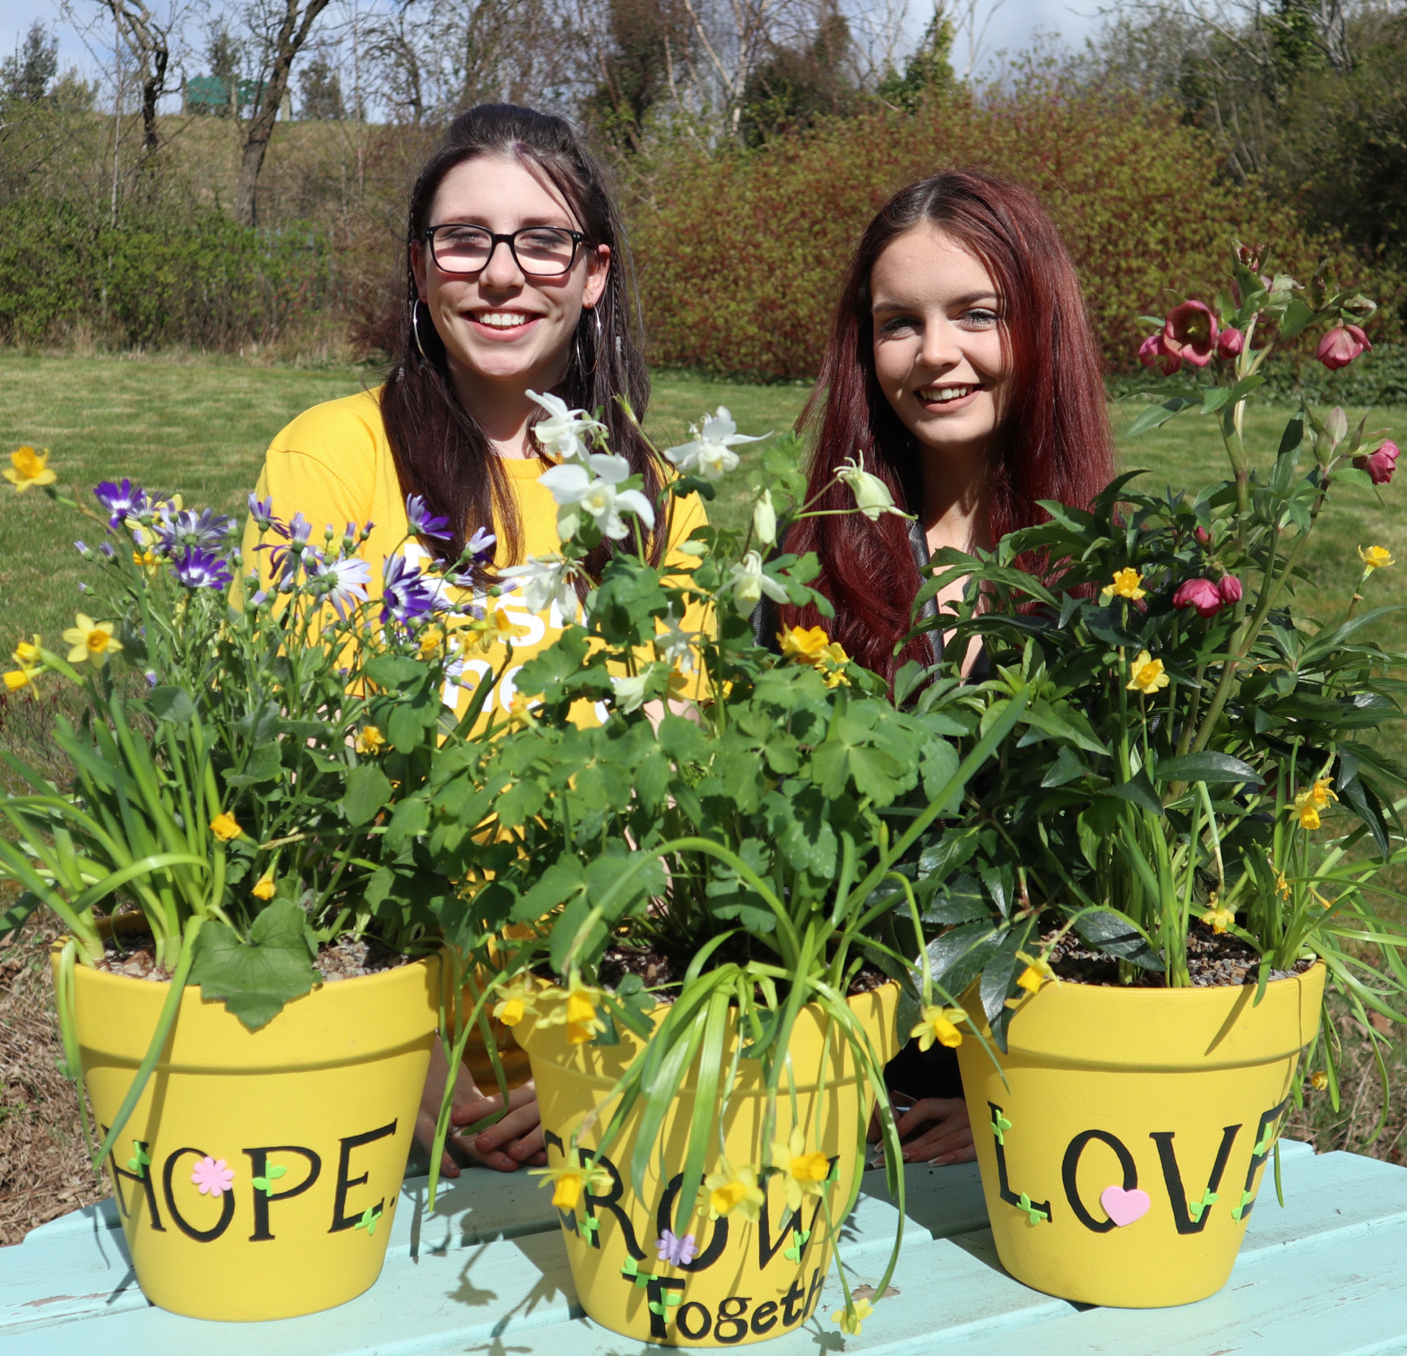
Essential skills and experience
Qualified to SVQ Level 2 H&SC or SCQF equivalent or working towards attainment
Knowledge of current relevant legislation and policies relating to housing and social care.
Knowledge of issues surrounding homelessness.
Experience of crisis work with vulnerable people.
Ability to ensure the service is delivered in accordance with corporate policy and Right There values.
Skills and ability in effective time management and working to deadlines.
Ability to compile comprehensive reports as required.
Knowledge of local resources.
Computer literate and competent with Microsoft Office software package.
Flexibility with regards to working patterns.
Ability to respond at short notice to crisis situations.
Ability to travel within agreed geographical area.

Slide 11
Desirable Knowledge
First Aid Certificate.
Other relevant training.
Experience of working in a similar environment.
Understanding of working within a Psychologically Informed Environment (PIE).
Counselling skills in drugs, alcohol and mental health

Slide 12
Role Details
Contract: Full time, permanent, 35 hours per week. Salary: SCP 19-22 (£26,364 – £28,223 per annum) Reporting to: Senior Support Worker
Your normal working hours are an average of 39 per week. These hours will be worked between Monday to Sunday, in shifts which are defined by your line manager on a rolling rota, over a 52-week period. The rota will be available to you a minimum of one week in advance. You may be required to work different shift times, with reasonable notice, in agreement with your line manager.
Your core place of work will 95 Panmure Street, Glasgow, G20 7SJ.
You may be required to work from such other place as the organisation may reasonably require from time to time.
Annual leave entitlement of 234 hours holiday (equivalent to 6 weeks) pro rata per year in the first year rising to 312 hours (equivalent to 8 weeks) pro rata per year in the second. This includes public holidays.
All appointments are subject to a minimum of a 12-week probationary period.
You will be automatically enrolled into the People’s Pension. Deductions will be taken from your salary in the month you will complete 3-months of employment
It is the nature of the work of Right There that tasks and responsibilities are, in many circumstances unpredictable and varied. All employees are, therefore, expected to work in a flexible way when the occasion arises.

Slide 13
Our People Benefits
We know how dedicated our people are and we want to help you achieve a good work/life balance – and make it easier to enjoy life’s special moments!
That’s why we’ve got a range of enhanced family-friendly and wellbeing benefits to give you some well deserved perks of being a Right There employee. Benefits include:
Hybrid working – work where is best for you and your role
Enhanced maternity, paternity, adoption, and shared parental leave
Employee 24-hour counselling and wellbeing services
6 weeks annual leave, rising to 8 after a year (plus you can purchase up to 5 more days)
Life insurance 4x your salary
Dedicated training and development plans
Cycle to work scheme
Refer a Friend

Slide 14
How to Apply
To apply send your CV and a cover letter outlining why you want to work with us, and how you meet the experience, skills and behaviours expected for this role.
Deadline 5pm on Friday 21st February 2025 Email recruitment@rightthere.org

Slide 15
Thank you. Good luck with your application.

