Slide 1
Job Pack Property Maintenance and Health & Safety Manager (December 2024)

Slide 2
Job Purpose Property Maintenance and
Health & Safety Manager
The property team is responsible for the management of the portfolio of over 400 properties across the Glasgow area, as well as Orkney/Inverness/Edinburgh. The team includes property Administrators, Maintenance Workers, Technicians, Painters and Joiner.
There is also an Admin Supervisor and a Maintenance Supervisor .
The Property Maintenance/Health & Safety Manager will oversee the day-to-day operations of the team via the Property Maintenance Supervisor. This role will also involve covering for the Head of property during holiday periods or meetings that cannot be attended.
The health and safety element will feed into the wider organisation and will be the go-to person for anything health and safety related that the programmes need to have reviewed. Working closely with the audit and risk team to highlight where there are any potential risks to the wider organisation/programmes.
Looking for areas of improvement within the property structure, working alongside the Head of Property to deliver on the yearly business plan.
Head of Property
Property Maintenance and Health & Safety Manager
Property Administration Supervisor
Maintenance Supervisor
Administrators
Technicians, Maintenance Workers, Joiner, Painters

Slide 3
What’s Inside
4 - 5
Our Vision, Mission and Values
6 - 7
8 - 9
Requirements
10
Role Details
11
Our People Benefits
12
How to Apply
13
14

Slide 4
About Right There
We are Right There, a charity celebrating our 200th anniversary in 2024. We provide tailored support for people, at home, and in the community. We are here for people who are living with the effects of homelessness, poverty, addiction, or family breakdowns. Last year we supported almost 4,000 individuals, helping to prevent them from becoming homeless or separated from the people they love.
We are here to offer the right support at the right time, including breaking down financial barriers; accessing the private rental market; linking up with local health, employment and training services to help people make connections within the community; and, helping people feel happier, safer, and more confident to take steps to improve their own lives.
Every person’s story is unique, and everyone’s route home is different, so we tailor our response to the individual. We want to challenge stereotypes – it doesn’t matter what the situation is – we’re not here to judge, only to help.
Our approach is about creating trusting relationships and nurturing people’s strengths, and our 200 dedicated staff, mentors and volunteers play a crucial role in this.

Slide 5
Our key areas of focus
For People
We provide tailored support for children and adults to help individuals and families feel happier, create stronger bonds and stay together.
At Home
We provide safe and supportive places to call home for people of all ages, from any circumstances, for as long as they might need it.
In The Community
We provide the tools for people to live independently and build their lives within their community, creating their own safe and secure homes.

Slide 6
Our Vision A world where everyone has an equal chance to create a safe and supportive place to call home.
Our Mission We meet people where
they are in life with no judgement; walking alongside those who need support, and preventing them becoming homeless
or separated from the people they love.

Slide 7
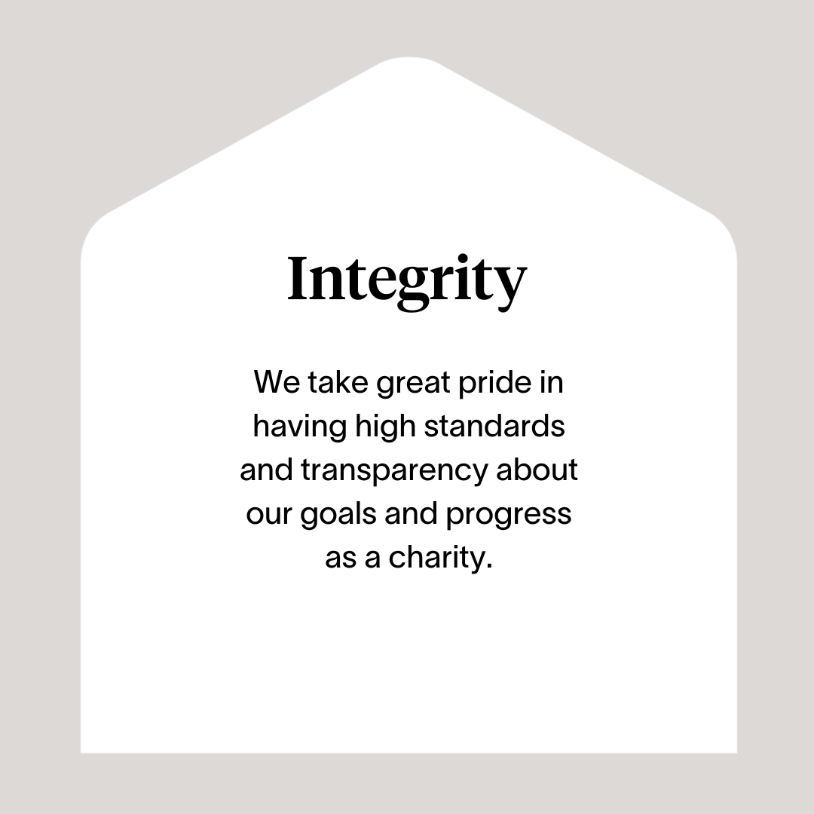

Slide 8
Main Role Responsibilities
Maintenance Management
Lead the day to day property function while supporting the supervisor and internal colleagues in the property team
Meet and set up contracts with external contractors , build rapport and relationship with external contractors , reviewing works and scheduling review meetings.
Co-ordinate and oversee maintenance schedules and preventative maintenance plans.
Liaise with contractors to ensure timely completion of works and maintenance tasks.
Maintain records of all maintenance activities and contractor agreements.
Regular updates to Head of Property on all maintenance activities both internal and external .
Ensure services are delivered in line with the legislative and regulatory standards whilst meeting service level agreements . In addition you will be required to complete a schedule of compliance audits in a timely fashion , taking corrective action as required whilst driving process and supporting the training of all direct reports.
Ensure all tools and equipment necessary are available to deliver both reactive and planned works.
Ensure under performance against KPIs is understood and action plans are in place to drive improvement, deliver progress reports
Hold regular team meetings/121s with direct reports.
Deputise for the Head of Property when required
Health and safety compliance.
Ensure all activities comply with the relevant health and safety legislation and regulations.
Conduct regular safety audits and risk assessments of facilities and work processes.
Provide training to staff on health and safety procedures, emergency preparedness and proper equipment use.
Ensure compliance with occupational health and safety standards and review and update polices as required.
Manage administrative tasks related to safety audits , write compliance reports and update maintenance records
Review any accidents where property related and look at any possible outcomes that would have mitigated the risk.
Financial responsibility
Review all quotes from contractors and review against scope of works.
Review all internal costs generated by the internal property team.
Support on financial costings for any internal projects.
Support Head of Property to review ongoing spend within the full property structure.

Slide 9
Main Role Responsibilities
People Management
Manage team conduct and capability also apply any disciplinary procedure in accordance with the company processes.
Manage team absence levels through direct reports.
Develop positive and supportive relationships with your staff team.
Develop positive relationships within your team and work collaboratively with your colleagues across the organisation.
Arrange and facilitating regular support and supervision sessions with your team members, utilising best practice in performance management to ensure staff are supported to undertake their roles.
Completing yearly appraisals and personal development plans with your staff team.
Investigating any issues of misconduct within the organisation.
Being part of the Right There Team
Attend and participate in training and reflective practice and share learning experiences.
Promote and represent Right There services positively.
Be a proactive team member actively contributing to the property team development and improvement
Have a high standard of professional integrity, work towards performance targets to achieve agreed result
Participate in training, strive for continuous personal and professional development
Adhere to Right There Policies and Procedures with feedback on the review of organisational policies and procedures and local guidelines
Engage with any organisational initiatives or working groups
Always apply safeguarding principles and maintain awareness of child protection and adult protection processes.

Slide 10
Essential skills and experience
Recognised technical background with experience of Facilities Management
Strong PC literacy with experience of extracting , collating and presenting performance data.
Experience of using a CAFM system
Proven experience in a similar role , blending maintenance and contractor management along with health and safety oversight.
Strong health and safety regulations and risk management practices.
Strong problem-solving skills and the ability to handle a variety of maintenance issues.
Excellent organisational and administrative skills.
Effective communication skills for liaising with contractors and team members .
Ability to work independently and as part of a team.
Experience of leading an internal team.
Strong results standards focus takes accountability for own performance and that of the team.
Experience of managing budgets
Full UK drivers’ licence & use of own vehicle for business use
(Note: Employees must hold insurance that covers domestic and business use).
Desirable skills and experience
IOSH or NEBOSH qualified.
Membership of CIBSE, BIFM or equivalent

Slide 11
Role Details
Contract: Full time, permanent, 35 hours per week. Salary: SCP 34-38 (£37,545 - £41,583 per annum) Reporting to: Head of Property
Working hours are worked Monday to Friday, flexibly between the hours of 8.00am and 6.00pm, depending on the needs of the service, with 1-hour unpaid break.
Your core place of work will be Rosemount Business Park, Charles Street, Glasgow, G21 2QA.
You may be required to work from such other place as the organisation may reasonably require from time to time.
Annual leave entitlement of 210 hours holiday (equivalent to 6 weeks) pro rata per year in the first year rising to 280 hours (equivalent to 8 weeks) pro rata per year in the second. This includes public holidays.
All appointments are subject to a minimum of a 12-week probationary period.
You will be automatically enrolled into the People’s Pension. Deductions will be taken from your salary in the month you will complete 3-months of employment
It is the nature of the work of Right There that tasks and responsibilities are, in many circumstances unpredictable and varied. All employees are, therefore, expected to work in a flexible way when the occasion arises.

Slide 12
Our People Benefits
We know how dedicated our people are and we want to help you achieve a good work/life balance – and make it easier to enjoy life’s special moments!
That’s why we’ve got a range of enhanced family-friendly and wellbeing benefits to give you some well deserved perks of being a Right There employee. Benefits include:
Hybrid working – work where is best for you and your role
Enhanced maternity, paternity, adoption, and shared parental leave
Employee 24-hour counselling and wellbeing services
6 weeks annual leave, rising to 8 after a year (plus you can purchase up to 5 more days)
Life insurance 4x your salary
Dedicated training and development plans
Cycle to work scheme
Refer a Friend

Slide 13
How to Apply
To apply send your CV and a cover letter outlining why you want to work with us, and how you meet the experience, skills and behaviours expected for this role.
Deadline 5pm on Friday 4th April 2025 Email recruitment@rightthere.org

Slide 14
Thank you. Good luck with your application.

