Slide 1
Job Pack Casual Support Worker (April 2025)

Slide 2
Job Purpose Casual Support Worker
The Casual Worker will provide relief cover to assist in the continuation of high-quality residential support within the cultural and ethical framework of Right There. Our programmes provide 24-hour accommodation support for people currently homeless or at risk of becoming homeless and to people transitioning from temporary to permanent or other suitable long-term accommodation.

Slide 3
What’s Inside
4 - 5
Our Vision, Mission and Values
6 - 7
8 - 9
Requirements
10
Role Details
11
Our People Benefits
12
How to Apply
13
14

Slide 4
About Right There
We are Right There, a charity celebrating our 200th anniversary in 2024. We provide tailored support for people, at home, and in the community. We are here for people who are living with the effects of homelessness, poverty, addiction, or family breakdowns. Last year we supported almost 4,000 individuals, helping to prevent them from becoming homeless or separated from the people they love.
We are here to offer the right support at the right time, including breaking down financial barriers; accessing the private rental market; linking up with local health, employment and training services to help people make connections within the community; and, helping people feel happier, safer, and more confident to take steps to improve their own lives.
Every person’s story is unique, and everyone’s route home is different, so we tailor our response to the individual. We want to challenge stereotypes – it doesn’t matter what the situation is – we’re not here to judge, only to help.
Our approach is about creating trusting relationships and nurturing people’s strengths, and our 200 dedicated staff, mentors and volunteers play a crucial role in this.

Slide 5
Our key areas of focus
For People
We provide tailored support for children and adults to help individuals and families feel happier, create stronger bonds and stay together.
At Home
We provide safe and supportive places to call home for people of all ages, from any circumstances, for as long as they might need it.
In The Community
We provide the tools for people to live independently and build their lives within their community, creating their own safe and secure homes.

Slide 6
Our Vision A world where everyone has an equal chance to create a safe and supportive place to call home.
Our Mission We meet people where
they are in life with no judgement; walking alongside those who need support, and preventing them becoming homeless
or separated from the people they love.

Slide 8
Main Role Responsibilities
Develop positive, respectful and compassionate relationships with all support staff, wider staff teams and those we support, focusing on their strengths and aspirations as individuals.
Have a high standard of professional integrity with colleagues and other professionals.
Establish clear professional boundaries with staff and those we support.
Have a high standard of professional integrity with colleagues, the people we support and other professionals.
Ensuring person centred planning and unconditional positive regard is undertaken by staff.
Taking a Psychologically Informed Environment (PIE) approach.
Ensuring support needs of the people we support are being met.
Ensuring risk assessments are completed and updated.
Advocating on behalf of those we support.
Having detailed knowledge of other relevant services.
Ensuring a safe environment for the people we support, colleagues and others including a high standard of accommodation is provided.
Regularly auditing files.
Assist in the collation of data for Right There Key Performance Indicators (KPI) and any required local authority returns / reports.
Reporting all required Care Inspectorate notifications
Representing Right There to other agencies or services including Local Authority, Social Work, Housing Services and other relevant services.
Actively contribute to your service and the organisations development and improvement.

Slide 9
Main Role Responsibilities
Participate fully in team meetings.
Attend and participate in training and share learning experiences.
Engage in reflective practice.
Feedback on the review of organisational polices & procedures and local guidelines.
Promote Right There services through agreed mediums.
Strive for continuous personal and professional development.
Engage with any organisational initiatives or working groups such as NHS Healthy Working Lives, Investors in People, etc.

Slide 10
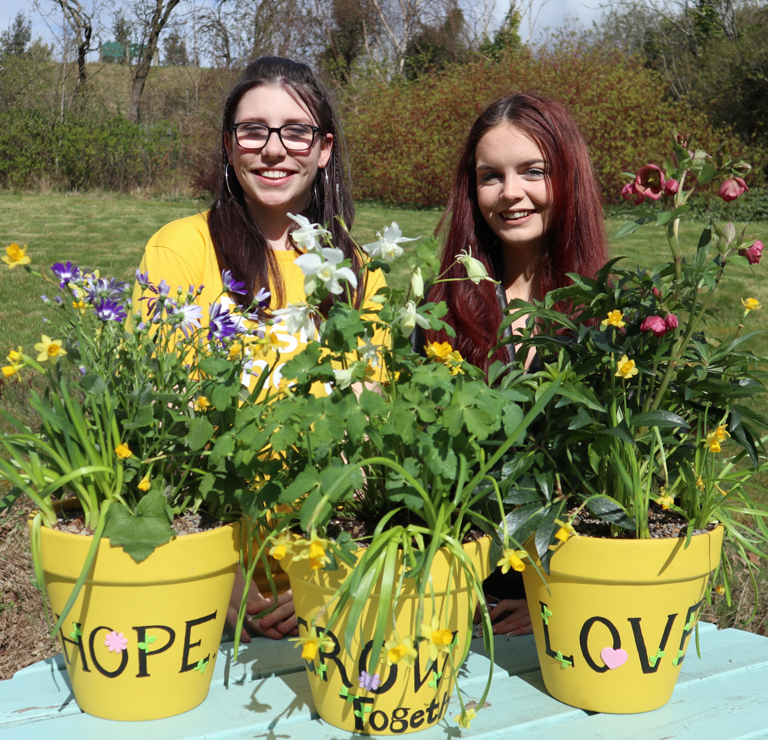
Essential skills and experience
Qualified to SVQ Level 2 H&SC or SCQF equivalent (or are willing to work towards).
Ability to contribute towards/assist in meeting performance targets as required
Ability to contribute towards competing demands and priorities as required
Ability to compile reports as required
Computer literate and competent with Microsoft Office software package
Ability and skills to work effectively, manage time and contribute to meeting deadlines as required
Ability to respond/contribute at short notice to crisis situations

Slide 11
Desirable skills and experience
First Aid Certificate
Experience of working in a similar environment
Understanding of working within a Psychologically Informed Environment (PIE).

Slide 12
Role Details
Contract: Casual Salary: £13.33 per hour Reporting to: Senior Support Worker
The hours we offer you will be ad hoc and infrequent. You will work for Right There at times and on days to be agreed between you and Right There.
Your core place of work will be 95 Panmure Street, Glasgow, G20 7SJ
You may be required to work from such other place as the organisation may reasonably require from time to time.
In accordance with the Working Time Regulations, you are entitled to be paid for annual leave. You are entitled to 6 weeks in a full annual leave year. Payment for annual leave is calculated based on 13.04% of your total pay in a pay period and will be paid in addition to wages accrued for that month. This includes if you leave your position at Right There part way through a pay period.
Legally, Right There must enrol workers into a pension if their earnings reach the criteria for 3 consecutive months.
It is the nature of the work of Right There that tasks and responsibilities are, in many circumstances unpredictable and varied. All employees are, therefore, expected to work in a flexible way when the occasion arises.

Slide 13
How to Apply
To apply send your CV and a cover letter outlining why you want to work with us, and how you meet the experience, skills and behaviours expected for this role.
Email recruitment@rightthere.org

Slide 14
Thank you. Good luck with your application.

