Slide 1
Job Pack Contracts and Tendering Manager (March 2025)

Slide 2
Job Purpose Contracts and Tendering Manager
The Contracts and Tendering Manager is part of Right There’s Senior Management team with responsibility for taking ownership of the development and end to end submission of tender opportunities & grant funding on behalf of Right There, managing associated monitoring processes, contract management responsibility and timely reporting to funders whilst collaborating with the internal relationship manager.
Line management of the Income Generation Officer
Oversight of Mapping and tracking income opportunities through tenders, bids, grants, corporate opportunities coupled with supporting fundraising initiatives on behalf of the organisation will ensure that Right There evolves in line with its vision of ending homelessness, where everyone has an equal chance to create a safe and supportive place to call home.
Director of Income Diversification and Messaging
Marketing and Communications Co-ordinator
Contracts and Tendering Manager
Supporter Engagement Manager
Income Generation Officer

Slide 3
What’s Inside
4 - 5
Our Vision, Mission and Values
6 - 7
8 - 10
Requirements
11-12
Role Details
13
Our People Benefits
14
How to Apply
15
16

Slide 4
About Right There
We are Right There, a charity celebrating our 200th anniversary in 2024. We provide tailored support for people, at home, and in the community. We are here for people who are living with the effects of homelessness, poverty, addiction, or family breakdowns. Last year we supported almost 4,000 individuals, helping to prevent them from becoming homeless or separated from the people they love.
We are here to offer the right support at the right time, including breaking down financial barriers; accessing the private rental market; linking up with local health, employment and training services to help people make connections within the community; and, helping people feel happier, safer, and more confident to take steps to improve their own lives.
Every person’s story is unique, and everyone’s route home is different, so we tailor our response to the individual. We want to challenge stereotypes – it doesn’t matter what the situation is – we’re not here to judge, only to help.
Our approach is about creating trusting relationships and nurturing people’s strengths, and our 200 dedicated staff, mentors and volunteers play a crucial role in this.

Slide 5
Our key areas of focus
For People
We provide tailored support for children and adults to help individuals and families feel happier, create stronger bonds and stay together.
At Home
We provide safe and supportive places to call home for people of all ages, from any circumstances, for as long as they might need it.
In The Community
We provide the tools for people to live independently and build their lives within their community, creating their own safe and secure homes.

Slide 6
Our Vision A world where everyone has an equal chance to create a safe and supportive place to call home.
Our Mission We meet people where
they are in life with no judgement; walking alongside those who need support, and preventing them becoming homeless
or separated from the people they love.

Slide 7
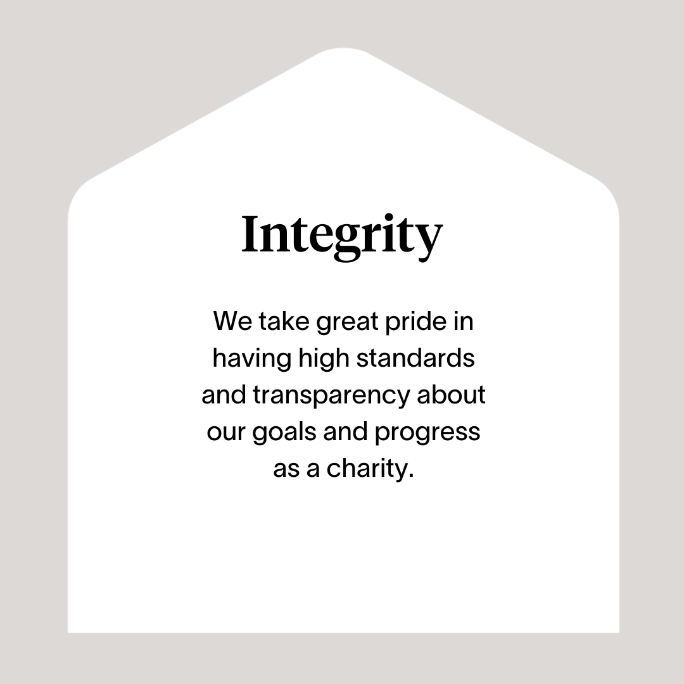

Slide 8
Roles & Responsibilities
Income Diversification Delivery
Implement the Income Generation strategic plan toward meeting performance objectives
Support the Director of Income Diversification and Messaging with scoping, understanding and analysing funding/income ‘pipeline’ portfolio opportunities in new and current geographical areas, identifying and evaluating new business opportunities developing business case justifications
Ensure that risk is appropriately evaluated and minimised in all business development propositions
Support the ongoing review of organisational competitiveness and identify areas for development
Maintain a full audit trail for all projects, to ensure effective contract implementation, management and compliance
Support the implementation of a CRM solution for Right There income generation in collaboration with colleagues across the organisation
Maintain up to date knowledge of current trends and developments across the sector and political landscape, creating a live knowledge bank that benefits the organisation
Tendering and bids
Support the Director of Income Diversification and Messaging to identify, evaluate and analyse tender opportunities and when agreed, transfer to live projects
Oversee the scoping & risk and presentation process, contributing to an increased level of bid opportunities and awards appropriate to Right There’s mission and vision
Responsible for scoping, preparing and submitting high quality tenders, funding proposals and grants demonstrating the skills and value of Right There as an established service provider whilst supporting the development of new approaches towards programme delivery
Provide an excellent internal consultancy and support service to operational colleagues in the commissioning and procurement cycles
Project manage, coordinate and facilitate the tender processes, including specialist knowledge from operations, people and finance colleagues
Responsible for the management and monitoring of contracts and grants including active mapping and tracking of income streams and effective resubmission process
Coordinating the completion of grant reports in line with contractual compliance and liaising with relationship managers to ensure timely submission
Develop the process and procedure for preparation, submission, recording and tracking of contract tenders and funding
Take part in post bid analysis of scores and success rates in cross functional reflection and learning sessions and apply learnings subsequently to processes, content and working approaches to support the ongoing review of organisational competitiveness and areas for improvement

Slide 9
Roles & Responsibilities (continued)
Contract Oversight
Ensure that all contracts, expectations and commissioning plans are managed effectively with support to the contract relationship manager
Co-ordinate, manage and present all contract reporting requirements, highlighting and encouraging good practice
Ensure that all aspects of the contract are compliant with relevant regulatory frameworks, legislation and Right There policies and procedures, including a strong focus on Health and Safety and the Safeguarding of clients.
Stakeholder Engagement
Represent Right There at all stages of the public sector commissioning and procurement cycles
With the Director of Income Diversification and Messaging represent Right There as required building meaningful strategic networking relationships aligned with the organisational strategic aims to ensure long-term, sustainable support
Developing engaging partnerships with external agencies and funders
Work cross-functionally developing strong internal relationships to bring a comprehensive range of perspectives to plans being developed to deliver Right There goals
Collaborate with the Income Diversification and Messaging team colleagues to support an integrated approach to income generation, fundraising and communications.
Team Management
Manage line report(s), fostering a collaborative and results-driven culture to ensure high performance and innovation in all areas and the highest level of delivery at all times
Promote best practice and continuous learning, harnessing and developing the full potential of staff under your remit ensuring team and individual performance delivery of the annual business plan
Ensure the team can manage multiple tendering projects simultaneously delivering on each one
Act as a role model with high standards of professional integrity, establishing and maintaining professional boundaries at all times, working in a manner that acknowledges and preserves the commercial confidentiality of Right There’s work
Demonstrate that personal ways of working are consistent with the aims and values of Right There, leading a culture that supports Right There’s vision, mission and values together with delivering on its strategic objectives

Slide 10
Roles & Responsibilities (continued)
Governance, Risk & Compliance
Ensure governance is in place for management information, data security, systems integrity, risk management and business continuity planning
Ensuring legislative and regulatory requirements with respect to contracts are met
Contribute to ensuring a full audit trail for all projects, to ensure effective contract implementation, management and compliance
Responsible for agreed reporting and contribution towards the Annual Business Plan to include implementation, monitoring and reviewing the progress of objectives & KPI’s throughout the year in line with strategic priorities
Financial Responsibility
Support the development of annual income budgets, tracking income performance against targets

Slide 11
Essential skills and experience
Educated to degree level, or highly literate with equivalent experience in undertaking a role that involves analysis or research
Demonstrable track record of developing and submitting tenders and grant applications or public tender responses
Experience of bid management from identifying opportunities to successful completion/submission
Ability to analyse tender documents and reflect key customer requirements in tender submissions
Excellent communication skills both verbal with the ability to quickly develop strong, successful and collaborative working relationships with a wide range of stakeholders and written with experience of report writing and production of management reports
Ability to research, collate and evaluate appropriate material to strengthen bids
Ability to facilitate & manage a cross functional project from beginning to end
Excellent knowledge of public sector commissioning and procurement processes
Discretion and understanding of the commercial sensitivity of the work
Excellent organisational skills, attention to detail, effective time management and the ability to prioritise work, and be able to respond to tight deadlines
Strong IT skills with experience of Microsoft Word, Excel, PowerPoint, Outlook and database systems
Highest standards of professional integrity with colleagues and other professionals
A pragmatic problem solver with intellectual flexibility and agility to move easily between significant details and the bigger picture
Ability to deal appropriately with sensitive and confidential materials and issues
Flexibility of working patterns and a willingness to travel to programmes when required

Slide 12
Desirable Knowledge
A certified qualification in project management/management
Experience of working with local authority funding streams and targets
Understanding of organisational structures, and their impact on tender appraisal
Experience in identifying and securing alternative funding streams and co-writing tender submissions
A sound understanding of the issues related to people experiencing homelessness
An understanding of the landscape in which Right There operates with specialist expertise and understanding of social/health care provision
Understanding of current legislation, policies and strategies relating to housing, social work, social care and family support services

Slide 13
Role Details
Contract: Full time, permanent, 35 hours per week. Salary: SCP 44-47 (£48,533 - £51,908 per annum) Reporting to: Director of Income Diversification and Messaging
Working hours are Monday to Friday – worked flexibly between the hours of 8.00am to 6.00pm, with core hours over the period from 10am to 4pm, with one-hour unpaid break.
Your core place of work will be in 15 Dava Street, Glasgow G51 2JA
You may be required to work from such other place as the organisation may reasonably require from time to time.
Annual leave entitlement of 210 hours holiday (equivalent to 6 weeks) pro rata per year in the first year rising to 280 hours (equivalent to 8 weeks) pro rata per year in the second. This includes public holidays.
All appointments are subject to a minimum of a 12-week probationary period.
You will be automatically enrolled into the People's Pension in the month that you will complete 3-months of employment, provided you meet the auto-enrolment criteria.
It is the nature of the work of Right There that tasks and responsibilities are, in many circumstances unpredictable and varied. All employees are, therefore, expected to work in a flexible way when the occasion arises.

Slide 14
Our People Benefits
We know how dedicated our people are and we want to help you achieve a good work/life balance – and make it easier to enjoy life’s special moments!
That’s why we’ve got a range of enhanced family-friendly and wellbeing benefits to give you some well deserved perks of being a Right There employee. Benefits include:
Hybrid working – work where is best for you and your role
Enhanced maternity, paternity, adoption, and shared parental leave
Employee 24-hour counselling and wellbeing services
6 weeks annual leave, rising to 8 after a year (plus you can purchase up to 5 more days)
Life insurance 4x your salary
Dedicated training and development plans
Cycle to work scheme
Refer a Friend

Slide 15
How to Apply
To apply send your CV and a cover letter outlining why you want to work with us, and how you meet the experience, skills and behaviours expected for this role.
Deadline 5pm on Thursday 24th April 2025 Email recruitment@rightthere.org

Slide 16
Thank you. Good luck with your application.

