Slide 1
Job Pack Joiner (April 2025)

Slide 2
Job Purpose Joiner
The Property team is responsible for the management of a portfolio of 470+ properties of various size, predominantly in the Glasgow area and includes general administration, maintenance workers, technicians, painters and joiners.
The Joiner will carry out all aspects of joinery work as and when required, support and assist with minor repairs of properties helping to maintain a high quality of accommodation. Be fully participatory in Right There’s aims of ending homelessness and providing holistic support to people across Scotland
Head of Property
Property Maintenance and Health and Safety Manager
Maintenance Supervisors
Maintenance Workers, Painters, Joiner,Technicians

Slide 3
What’s Inside
4 - 5
Our Vision, Mission and Values
6 - 7
8 - 9
Requirements
10-11
Role Details
12
Our People Benefits
13
How to Apply
14
15

Slide 4
About Right There
We are Right There, a charity celebrating our 200th anniversary in 2024. We provide tailored support for people, at home, and in the community. We are here for people who are living with the effects of homelessness, poverty, addiction, or family breakdowns. Last year we supported almost 4,000 individuals, helping to prevent them from becoming homeless or separated from the people they love.
We are here to offer the right support at the right time, including breaking down financial barriers; accessing the private rental market; linking up with local health, employment and training services to help people make connections within the community; and, helping people feel happier, safer, and more confident to take steps to improve their own lives.
Every person’s story is unique, and everyone’s route home is different, so we tailor our response to the individual. We want to challenge stereotypes – it doesn’t matter what the situation is – we’re not here to judge, only to help.
Our approach is about creating trusting relationships and nurturing people’s strengths, and our 200 dedicated staff, mentors and volunteers play a crucial role in this.

Slide 5
Our key areas of focus
For People
We provide tailored support for children and adults to help individuals and families feel happier, create stronger bonds and stay together.
At Home
We provide safe and supportive places to call home for people of all ages, from any circumstances, for as long as they might need it.
In The Community
We provide the tools for people to live independently and build their lives within their community, creating their own safe and secure homes.

Slide 6
Our Vision A world where everyone has an equal chance to create a safe and supportive place to call home.
Our Mission We meet people where
they are in life with no judgement; walking alongside those who need support, and preventing them becoming homeless
or separated from the people they love.

Slide 7
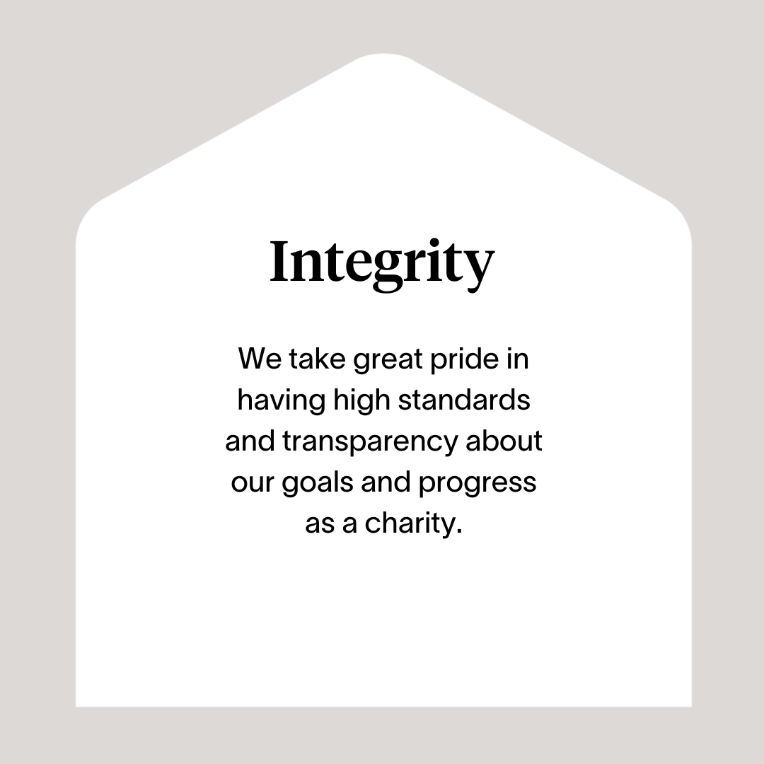

Slide 8
Roles & Responsibilities
Joinery and repair of void properties and maintenance of tenanted properties
Effective delivery of a sustainable, quality joinery and repair service for all domestic and commercial properties within the Right There Estate.
Ensure a high quality of accommodation is provided to the people we support and that service outcomes are achieved
Carry out routine joinery repairs and maintenance
Provide a quick response to reported emergencies and urgent works
Replacement of doors, windows and damaged sections of internal or external joinery items.
Maintenance and repairs/replacement of locks, catches and mechanical closing devices.
Carry out general planned maintenance when required
Record time, materials and consumables used to carry out jobs
Ensure works are carried out to completion in line with agreed standards
Reporting and Compliance
Consistent adherence to all relevant policies and procedures ensuring best practice and legal compliance
Report any health and safety concerns or incidents using the reporting mechanisms in place
Use of internal Housing Management System to log all time, materials and consumables used in carrying out duties
Comply with relevant Health & Safety legislation
Ensure Right There’s guidelines, policies and procedures are adhered to
Comply with requirements of relevant external agencies

Slide 9
Roles & Responsibilities (continued)
Maintenance Team Member
Develop good communication and working relationships with colleagues, programmes and people we support
Develop good communication and working relationships with approved contractors and service providers
Have a high standard of professional integrity with colleagues and other providers
Establish and uphold clear professional boundaries at all times.
Be proactive in personal development, use feedback from others and identify own development objectives
Contribute to proposals for service improvement
Actively participate in regular team meetings and other meetings as required to meet the needs of the service
Develop and maintain good communication and working relationships with line manager and colleagues
Promote Right There services through agreed mediums
Attend and participate in training and share learning experiences.
Engage in reflective practice.
Feedback on the review of organisational polices & procedures and local guidelines.

Slide 10
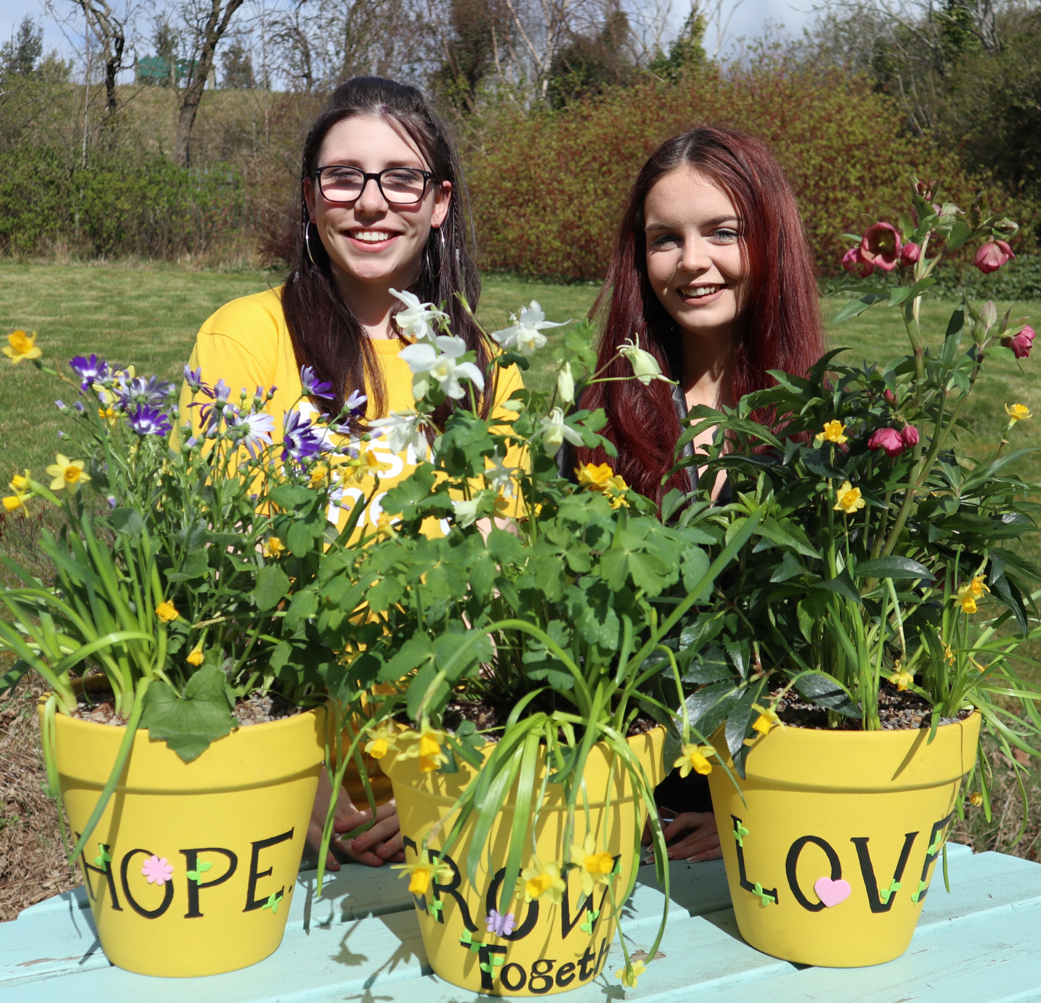
Essential skills and experience
City and guilds /SVQ 2
Trade experience in joinery
Experience of carrying out minor repairs and have all round DIY skills
Can maintain commitment and complete undertakings, accepting responsibility for own actions
Ability to work cooperatively with others as part of a team demonstrating commitment to group objectives
Ability to work towards performance targets to achieve agreed results
Ability to show initiative, effective time management, and work in a high paced environment
A commitment to our aim of continuous improvement and reflective practice in all areas of our work
Commitment to continuous personal and professional development
Understanding and respecting the importance of confidentiality
Ability to understand and consider the views, concerns and needs of others when taking action
Ability to build relationships with people we support , gaining their trust and understanding their needs
Commitment to provide a safe and trusting environment for those using our services
Ability to ensure the service is delivered in accordance with corporate policy and Right There values
Ability to be flexible with regards to working patterns
Ability to respond at short notice to crisis situations
Full UK driving license

Slide 11
Desirable skills and experience
Experience of working in a similar environment
Understanding the needs and rights of people we support
Awareness of issues surrounding homelessness
Computer literate
Knowledge of Health and Safety issues.
Health and Safety Training
First Aid Certificate

Slide 12
Role Details
Contract: Full time, permanent, 35 hours per week. Salary: SCP 25-28 (£28,379 - £31,187 per annum) Reporting to: Maintenance Supervisor
Working hours are 35 hours, Monday to Friday – worked flexibly between the hours of 8.00am to 6.00pm depending on the needs of the service with 1-hour unpaid break.
Your core place of work will be Rosemount Business Park, 141-145 Charles Street, Unit E2, Glasgow, G21 2QA
You may be required to work from such other place as the organisation may reasonably require from time to time.
Annual leave entitlement of 210 hours holiday (equivalent to 6 weeks) pro rata per year in the first year rising to 280 hours (equivalent to 8 weeks) pro rata per year in the second. This includes public holidays.
All appointments are subject to a minimum of a 12-week probationary period.
You will be automatically enrolled into the People’s Pension. Deductions will be taken from your salary in the month you will complete 3-months of employment
It is the nature of the work of Right There that tasks and responsibilities are, in many circumstances unpredictable and varied. All employees are, therefore, expected to work in a flexible way when the occasion arises.

Slide 13
Our People Benefits
We know how dedicated our people are and we want to help you achieve a good work/life balance – and make it easier to enjoy life’s special moments!
That’s why we’ve got a range of enhanced family-friendly and wellbeing benefits to give you some well deserved perks of being a Right There employee. Benefits include:
Hybrid working – work where is best for you and your role
Enhanced maternity, paternity, adoption, and shared parental leave
Employee 24-hour counselling and wellbeing services
6 weeks annual leave, rising to 8 after a year (plus you can purchase up to 5 more days)
Life insurance 4x your salary
Dedicated training and development plans
Cycle to work scheme
Refer a Friend

Slide 14
How to Apply
To apply send your CV and a cover letter outlining why you want to work with us, and how you meet the experience, skills and behaviours expected for this role.
Deadline 5pm on Tuesday 6th May 2025 Email recruitment@rightthere.org

Slide 15
Thank you. Good luck with your application.

