Slide 1
Job Pack Risk & Quality Assurance Manager (April 2025)

Slide 2
Job Purpose Risk & Quality Assurance Manager
The Risk & Quality Assurance Manager reports to the Head of Strategic Initiatives and Governance and will:
Ensure timely risk management of organisational activities, including identifying risks, seeking decisions and/or recommending actions, to ensure outcomes are achieved.
Ensure effective internal audit and evaluation of the quality and regulatory compliance of all programme and central service functions.
Be accountable for the development and implementation of a dynamic quality framework aligned with strategic and programme risk registers and regulatory compliance. Building a system and process of review and reflection using information from audits, complaints and compliments, engagement and participation activities and internal and external reviews, including the Care Inspectorate.
Lead internal audits and any reviews, analysing findings and reporting SMART outcomes and actions for improvement.
Head of Strategic Initiatives and Governance
Risk & Quality Assurance Manager
Project Manager
Administrators

Slide 3
What’s Inside
4 - 5
Our Vision, Mission and Values
6 - 7
8 - 9
Requirements
10 - 11
Role Details
12
Our People Benefits
13
How to Apply
14
15

Slide 4
About Right There
We are Right There, a charity celebrating our 200th anniversary in 2024. We provide tailored support for people, at home, and in the community. We are here for people who are living with the effects of homelessness, poverty, addiction, or family breakdowns. Last year we supported almost 4,000 individuals, helping to prevent them from becoming homeless or separated from the people they love.
We are here to offer the right support at the right time, including breaking down financial barriers; accessing the private rental market; linking up with local health, employment and training services to help people make connections within the community; and, helping people feel happier, safer, and more confident to take steps to improve their own lives.
Every person’s story is unique, and everyone’s route home is different, so we tailor our response to the individual. We want to challenge stereotypes – it doesn’t matter what the situation is – we’re not here to judge, only to help.
Our approach is about creating trusting relationships and nurturing people’s strengths, and our 200 dedicated staff, mentors and volunteers play a crucial role in this.

Slide 5
Our key areas of focus
For People
We provide tailored support for children and adults to help individuals and families feel happier, create stronger bonds and stay together.
At Home
We provide safe and supportive places to call home for people of all ages, from any circumstances, for as long as they might need it.
In The Community
We provide the tools for people to live independently and build their lives within their community, creating their own safe and secure homes.

Slide 6
Our Vision A world where everyone has an equal chance to create a safe and supportive place to call home.
Our Mission We meet people where
they are in life with no judgement; walking alongside those who need support, and preventing them becoming homeless
or separated from the people they love.

Slide 7
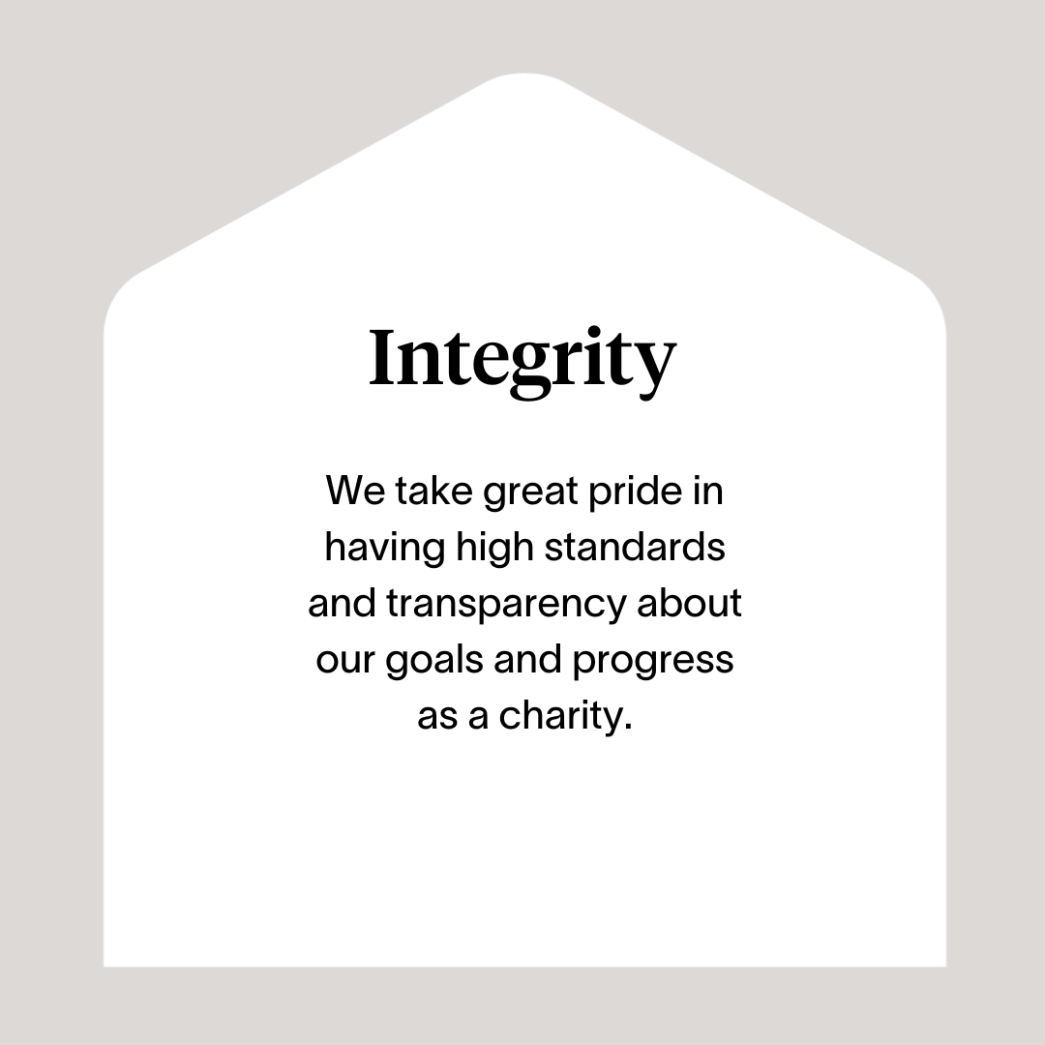

Slide 8
Roles & Responsibilities
Develop and Implement Quality Assurance Strategies
Develop, implement and continuously improve Right There’s Quality framework ensuring they are efficient, true to our Values and aligned to our vision and strategic aims
Formulate, implement, and manage the overall quality assurance strategy to ensure compliance with industry standards and regulations
Define and implement quality standards and procedures to ensure compliance with relevant legislation and regulation
Collaborate with cross-functional teams to integrate quality assurance into the development and operational processes
Create a positive quality improvement culture and drive high calibre performance now and for the future
2. Risk Management
Develop, implement and continuously improve Right There’s Risk Management frameworks ensuring they are efficient, true to our Values and aligned to our vision and strategic aims
Identify, assess, and prioritise risks associated with organisational processes, projects, and operations
Develop and implement risk management plans, including mitigation strategies and contingency plans
Regularly monitor and report on the status of identified risks to key stakeholders
Support risk owners to actively identify, assess and capture key risks
3. Internal Audit
Perform assurance reviews of key risk areas and provide internal audit assurance in line with principles of good governance, all regulatory bodies, and care inspectorate standards
Support risk owners to actively identify, assess and capture key risks

Slide 9
Roles & Responsibilities (continued)
4. Cross-functional collaboration
Work closely with managers at all levels across the organisation and other stakeholders to integrate risk management and quality assurance into annual plans
Provide guidance on risk and quality considerations during the development and implementation of new processes, programmes or projects
Collaborate cross-functionally to ensure that risk and quality considerations are integrated into workflows
5. Documentation and reporting
Maintain accurate and up-to-date documentation related to risk assessments, quality standards, and mitigation plans
Lead, advise and monitor organisational policies, protocols and guidelines, quality improvement initiatives, risk management and accreditation cycles and processes
Prepare and present regular reports on risk and quality metrics to leadership
Communicate findings and recommendations in a clear and concise manner
6. Training and education
Work with the People team to develop and deliver training programmes to enhance the understanding of risk and quality principles across the organisation
Foster a culture of accountability and responsibility regarding risk and quality among team members

Slide 10
Essential skills and experience
Proven experience in risk management and quality assurance roles
Degree or equivalent
Excellent organisational and leadership skills
Strong analytical and problem-solving skills
Proactive, solution focused and driven
Detail-orientated and thorough
Strong credibility and capable of working at all levels
Well developed communication, influencing and communication skills
Familiarity with relevant sector regulations and standards, including the Care Inspectorate

Slide 11
Desirable Knowledge
Certification in risk management or risk assurance
Experience of working in a large, complex values-driven organisation
Understanding of housing, social care and family support services
An understanding of the principles of a Psychologically Informed Environment (PIE)

Slide 12
Role Details
Contract: Full time, permanent, 35 hours per week. Salary: SCP 38–42 (£41,583 - £46,269) Reporting to: Head of Strategic Initiatives and Governance
Working hours are Monday to Friday – usually worked between the hours of 8am to 6pm depending on the needs of the service, with one-hour unpaid break. Contracted hours can be worked flexibly in agreement with your line manager.
Your core place of work will be in 15 Dava Street, Glasgow G51 2JA
You may be required to work from such other place as the organisation may reasonably require from time to time.
Annual leave entitlement of 210 hours holiday (equivalent to 6 weeks) pro rata per year in the first year rising to 280 hours (equivalent to 8 weeks) pro rata per year in the second. This includes public holidays.
All appointments are subject to a minimum of a 12-week probationary period.
You will be automatically enrolled into the People's Pension following successful completion of your probationary period, provided you meet the auto-enrolment criteria.
It is the nature of the work of Right There that tasks and responsibilities are, in many circumstances unpredictable and varied. All employees are, therefore, expected to work in a flexible way when the occasion arises.

Slide 13
Our People Benefits
We know how dedicated our people are and we want to help you achieve a good work/life balance – and make it easier to enjoy life’s special moments!
That’s why we’ve got a range of enhanced family-friendly and wellbeing benefits to give you some well deserved perks of being a Right There employee. Benefits include:
Hybrid working-3 days per week in the workplace (at Dava Street but can include site visits) and flexible working as agreed with your line manager to meet the requirements of the role
Enhanced maternity, paternity, adoption, and shared parental leave
Employee 24-hour counselling and wellbeing services
6 weeks annual leave, rising to 8 after a year (plus you can purchase up to 5 more days)
Life insurance 4x your salary
Dedicated training and development plans
Cycle to work scheme
Refer a Friend

Slide 14
How to Apply
To apply send your CV and a cover letter outlining why you want to work with us, and how you meet the experience, skills and behaviours expected for this role.
Deadline 5pm on Wednesday 7th May 2025 Email recruitment@rightthere.org

Slide 15
Thank you. Good luck with your application.

