Slide 1
Job Pack Tenant Liaison Worker-Short Term Housing Glasgow (January 2025)

Slide 2
Job Purpose Tenant Liaison Worker
Short-Term Housing Glasgow provides a service between private property owners and tenants. Our goal is to end homelessness by improving access to the private rented sector.
There are two parts to the Service: Help to Rent and Short-Term Housing. Through both of these areas, we provide tenancy sustainment support to people who are experiencing homelessness, or who are in danger of becoming homeless.
We provide high standards of accommodation and, crucially, create a platform for some of society’s most under-represented people with the ultimate aim of making a genuine difference in their lives.
This role is to ensure a high quality, customer focused housing management service within your individual property portfolio. Ensuring effective customer liaison and promotion of tenant participation.
Housing Services Manager
Housing Team Leads
Administrators
Tenant Liaison Workers

Slide 3
What’s Inside
4 - 5
Our Vision, Mission and Values
6 - 7
8 - 9
Requirements
10-11
Role Details
12
Our People Benefits
13
How to Apply
14
15

Slide 4
About Right There
We are Right There, a charity celebrating our 200th anniversary in 2024. We provide tailored support for people, at home, and in the community. We are here for people who are living with the effects of homelessness, poverty, addiction, or family breakdowns. Last year we supported almost 4,000 individuals, helping to prevent them from becoming homeless or separated from the people they love.
We are here to offer the right support at the right time, including breaking down financial barriers; accessing the private rental market; linking up with local health, employment and training services to help people make connections within the community; and, helping people feel happier, safer, and more confident to take steps to improve their own lives.
Every person’s story is unique, and everyone’s route home is different, so we tailor our response to the individual. We want to challenge stereotypes – it doesn’t matter what the situation is – we’re not here to judge, only to help.
Our approach is about creating trusting relationships and nurturing people’s strengths, and our 200 dedicated staff, mentors and volunteers play a crucial role in this.

Slide 5
Our key areas of focus
For People
We provide tailored support for children and adults to help individuals and families feel happier, create stronger bonds and stay together.
At Home
We provide safe and supportive places to call home for people of all ages, from any circumstances, for as long as they might need it.
In The Community
We provide the tools for people to live independently and build their lives within their community, creating their own safe and secure homes.

Slide 6
Our Vision A world where everyone has an equal chance to create a safe and supportive place to call home.
Our Mission We meet people where
they are in life with no judgement; walking alongside those who need support, and preventing them becoming homeless
or separated from the people they love.

Slide 7
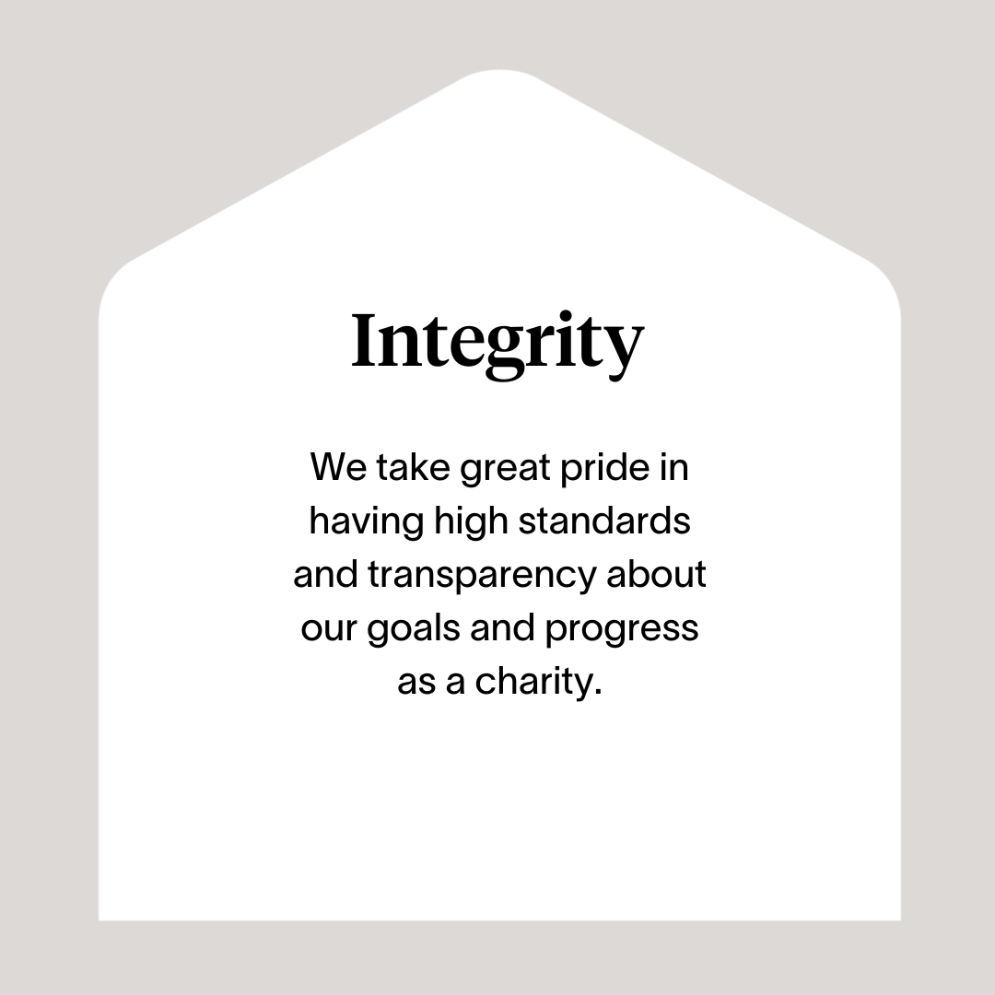

Slide 8
Main Role Responsibilities
Provide a Housing Management service:
Maintaining occupancy levels through efficient allocation and void management of properties.
Carry out housing management inspections prior to allocations of housing.
Carry out viewings of void properties with prospective tenants and initiate the book-in process.
Visit tenants in their own home and carry out tenancy inspections a minimum of every 28 days.
Carry out home visits of new tenants after a specified time to ensure they are occupying the property and adhering to all tenancy conditions as detailed in their tenancy agreement.
Ensure tenants are complying with their tenancy agreement and take appropriate action where necessary.
Be contact officer for all tenants and landlords/letting agents within the patch and resolve any issues they may have.
Investigate Neighbour Disputes and complaints of Anti-Social Behaviour and take appropriate action in accordance with Right There’s policy and procedures. Make appropriate referrals to specialist teams as appropriate in support of tenant’s wellbeing.
Ensure all rent arrears recovery and early intervention activities are carried out in accordance with policies and procedures.
Provide general advice on matters to Tenants & our Property Team in relation to the Repairs Service
Have final overview of void properties and ensure they are at a satisfactory standard of repair & cleanliness.
Upload accurate and detailed property and tenant reports to our Housing Management System. I.e. 28 days visits, book-ins, check-outs etc.
Arrange temporary rehousing of tenants in appropriate circumstances.
Responsibility to the People we Support:
Develop positive, respectful and compassionate relationships with the people that we support.
Establish clear and professional boundaries with the people that we support.
Ensuring tenants meet the obligations outlined in their lease agreement and liaise with internal (eg Right There Property team) & external (eg case work team at Glasgow City Council) service providers when services are not provided to an appropriate standard.
Have appropriate knowledge and understanding of the issues facing homeless persons in order to signpost to correct agencies and services and support tenancy sustainment appropriately.
Provide advice and assistance to Tenants on matters relating to all aspects of Housing Finance including Housing Benefits, Rent Arrears and Rent Accounts and refer cases to specialist officers or intervention where necessary.
Encourage and promote tenant participation in customer satisfaction surveys.
Identify vulnerable tenants and ensure referrals are made to appropriate services and external agencies to assist.

Slide 9
Main Role Responsibilities
Responsibility to the programme:
Ensure all Housing Management functions are carried out in accordance with Right There’s policy and procedures.
Undertake a wide range of general administrative duties e.g. answering the telephone, photocopying, scanning, uploading data, filing, editing records, maintaining case notes etc
Identify areas for service improvements and make recommendations to Manager.
Contribute to continuous service improvements and development
Ensure that equal opportunities are applied in the delivery of the service.
Being a part of the Right There team:
To adhere to the Right There’s commitment to health and safety, supporting attendance, equal opportunities and compliance with all relevant policies.
Be a proactive team member actively contributing to your service working collaboratively with your colleagues across the organisation.
Have a high standard of professional integrity with colleagues and other providers upholding clear professional boundaries at all times.
Ability to work towards performance targets to achieve agreed result
Participate in training and reflective practice, share your learning experiences, strive for continuous personal and professional development
Contribute to the organisations' development and improvement with feedback on the review of organisational policies and procedures and local guidelines
Engage with any organisational initiatives or working groups
Always apply safeguarding principles and maintain awareness of child protection and adult protection processes.
This description is indicative of the nature and level of responsibilities associated with this job. The job holder may be required to undertake other duties and responsibilities commensurate with the grade.

Slide 10
Essential skills and experience
Essential Skills and Abilities
Good communication, interpersonal & team-working skills
Effective time management & work prioritisation
Competent in the use of the Microsoft Office Suite, in particular Word & Excel and ability to adapt to and use bespoke software systems
Full UK drivers’ licence & use of own vehicle for business use
(Note: Employees must hold insurance that covers domestic and business use).
Experience of working to a high degree of accuracy, paying close attention to detail
A positive approach to problem solving and commitment to providing a high level of customer service.
Essential Personal Attributes
Flexible attitude and the ability to cope well with change
Able to deal with difficult situations openly and constructively
Ability & confidence to prioritise and work on your own initiative
Ability to build a rapport with tenants from a wide variety of cultures and backgrounds

Slide 11
Desirable skills and experience
Desirable Education & Qualifications
Evidence of continued professional development
A housing related qualification
Desirable Experience
Experience of working in a Housing environment
Experience of working in the third sector
Experience of working in partnership with others
Experience of carrying out property visits/inspections
Worked in a busy environment that involves a wide range of tasks

Slide 12
Role Details
Contract: Full time, permanent, 35 hours per week. Salary: SCP 19-22 (£24,252 - £25,961 per annum) Reporting to: Senior Tenant Liaison Worker
Working hours are Monday to Friday – worked flexibly between the hours of 8.00am to 6.00pm depending on the needs of the service with one-hour unpaid break.
Your core place of work will be Rosemount Business Park, 141-145 Charles Street, Unit E3, Glasgow, G21 2QA The role involves lone working and travelling in your own vehicle between properties and being out in the community.
You may be required to work from such other place as the organisation may reasonably require from time to time.
Annual leave entitlement of 210 hours holiday (equivalent to 6 weeks) pro rata per year in the first year rising to 280 hours (equivalent to 8 weeks) pro rata per year in the second. This includes public holidays.
All appointments are subject to a minimum of a 12-week probationary period.
You will be automatically enrolled into the People’s Pension. Deductions will be taken from your salary in the month you will complete 3-months of employment
It is the nature of the work of Right There that tasks and responsibilities are, in many circumstances unpredictable and varied. All employees are, therefore, expected to work in a flexible way when the occasion arises.

Slide 13
Our People Benefits
We know how dedicated our people are and we want to help you achieve a good work/life balance – and make it easier to enjoy life’s special moments!
That’s why we’ve got a range of enhanced family-friendly and wellbeing benefits to give you some well deserved perks of being a Right There employee. Benefits include:
Hybrid working – work where is best for you and your role
Enhanced maternity, paternity, adoption, and shared parental leave
Employee 24-hour counselling and wellbeing services
6 weeks annual leave, rising to 8 after a year (plus you can purchase up to 5 more days)
Life insurance 4x your salary
Dedicated training and development plans
Cycle to work scheme
Refer a Friend

Slide 14
How to Apply
To apply send your CV and a cover letter outlining why you want to work with us, and how you meet the experience, skills and behaviours expected for this role.
Email recruitment@rightthere.org

Slide 15
Thank you. Good luck with your application.

