Slide 1
Job Pack Property Clearance and Maintenance Worker (January 2025)

Slide 2
Job Purpose Property Clearance and
Maintenance Worker
The Property team is responsible for the management of a portfolio of 470+ properties of various size, predominantly in the Glasgow area and includes general administration, maintenance workers, technicians, painters and joiners
The Property Clearance and Maintenance Worker is part of the uplift and removal team and will carry out clearance and minor repairs of properties to provide a high-quality accommodation function facilitating and supporting Right There’s vision of a world where everyone has an equal chance to create a safe and supportive place to call home as well as providing holistic support to people across Scotland
Head of Property
Maintenance Supervisors
Maintenance Workers, Painters, Joiner,Technicians

Slide 3
What’s Inside
4 - 5
Our Vision, Mission and Values
6 - 7
8 - 9
Requirements
10-11
Role Details
12
Our People Benefits
13
How to Apply
14
15

Slide 4
About Right There
We are Right There, a charity celebrating our 200th anniversary in 2024. We provide tailored support for people, at home, and in the community. We are here for people who are living with the effects of homelessness, poverty, addiction, or family breakdowns. Last year we supported almost 4,000 individuals, helping to prevent them from becoming homeless or separated from the people they love.
We are here to offer the right support at the right time, including breaking down financial barriers; accessing the private rental market; linking up with local health, employment and training services to help people make connections within the community; and, helping people feel happier, safer, and more confident to take steps to improve their own lives.
Every person’s story is unique, and everyone’s route home is different, so we tailor our response to the individual. We want to challenge stereotypes – it doesn’t matter what the situation is – we’re not here to judge, only to help.
Our approach is about creating trusting relationships and nurturing people’s strengths, and our 200 dedicated staff, mentors and volunteers play a crucial role in this.

Slide 5
Our key areas of focus
For People
We provide tailored support for children and adults to help individuals and families feel happier, create stronger bonds and stay together.
At Home
We provide safe and supportive places to call home for people of all ages, from any circumstances, for as long as they might need it.
In The Community
We provide the tools for people to live independently and build their lives within their community, creating their own safe and secure homes.

Slide 6
Our Vision A world where everyone has an equal chance to create a safe and supportive place to call home.
Our Mission We meet people where
they are in life with no judgement; walking alongside those who need support, and preventing them becoming homeless
or separated from the people they love.

Slide 7
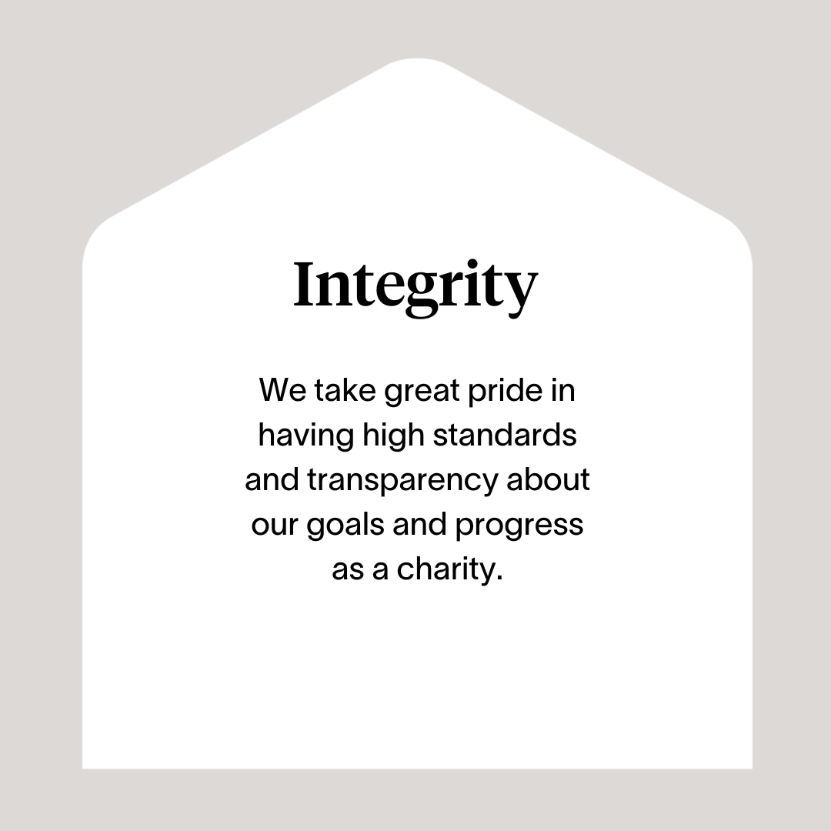

Slide 8
Roles & Responsibilities
Uplift and Removal and maintenance repair responsibilities
Carry out clearance of property contents including fixtures and fittings, furnishings, white goods, floorings, and consumables.
Deliver furniture, white goods, flooring and consumables as required.
Carry out basic clean of property on a clean as you go basis.
Use Sanondaf products in initial clearance and on final check before handover .
Keep all Right There vehicles clean and tidy using Sanondaf were required.
Keep all Right There tools and equipment in good condition, report where items are damaged or need to be replaced.
Look for ways to recycle /upcycle any equipment taken from properties .
Make sure all waste is disposed of in a timely manner with the appropriate waste transfer notes in place .
Work closely with Maintenance Supervisor advising on any timeline blockers to completion of property.
Carry out minor repairs and maintenance works.
Carry out general planned maintenance when required.
Recording of time, materials and consumables used to carry out jobs.
Ensure the Right There vehicles, tools and IT devices are kept in good condition.

Slide 9
Roles & Responsibilities (continued)
Compliance
Risk assess all areas prior to any works commencing and use the correct PPE dependant on the level of risk.
Ensuring works are carried out to a standard in line with Right There and contractors’ standards.
Ensuring compliance with all relevant health and safety legislation and report any safety concerns or incidents.
Consistent adherence to all Right There’s policies and procedures ensuring best practice and legal compliance
Right There’s policies and procedures.
Requirements of external agencies and contractors.
Maintenance Team Member
Develop and maintain good communication and working relationships with line manager, colleagues, contractors and people we support
Work cooperatively with others as part of a team demonstrating commitment to service objectives
Have a high standard of professional integrity with colleagues and other providers
Establish and uphold clear professional boundaries at all times.
Be proactive in personal development, use feedback from others and identify own development objectives
Attend and participate in training and engage in reflective practice to share learning experiences.
Actively participate in regular team meetings providing valuable input and feedback to meet the needs of the Property Team and commit to its development and improvement
Feedback on the review of organisational polices & procedures and local guidelines.
Ability to work towards performance targets to achieve agreed result
Promote Right There services through agreed mediums
Represent the Right There brand following agreed ways of working, demonstrating values led behaviours, and taking pride in wearing the Right There uniform.

Slide 10
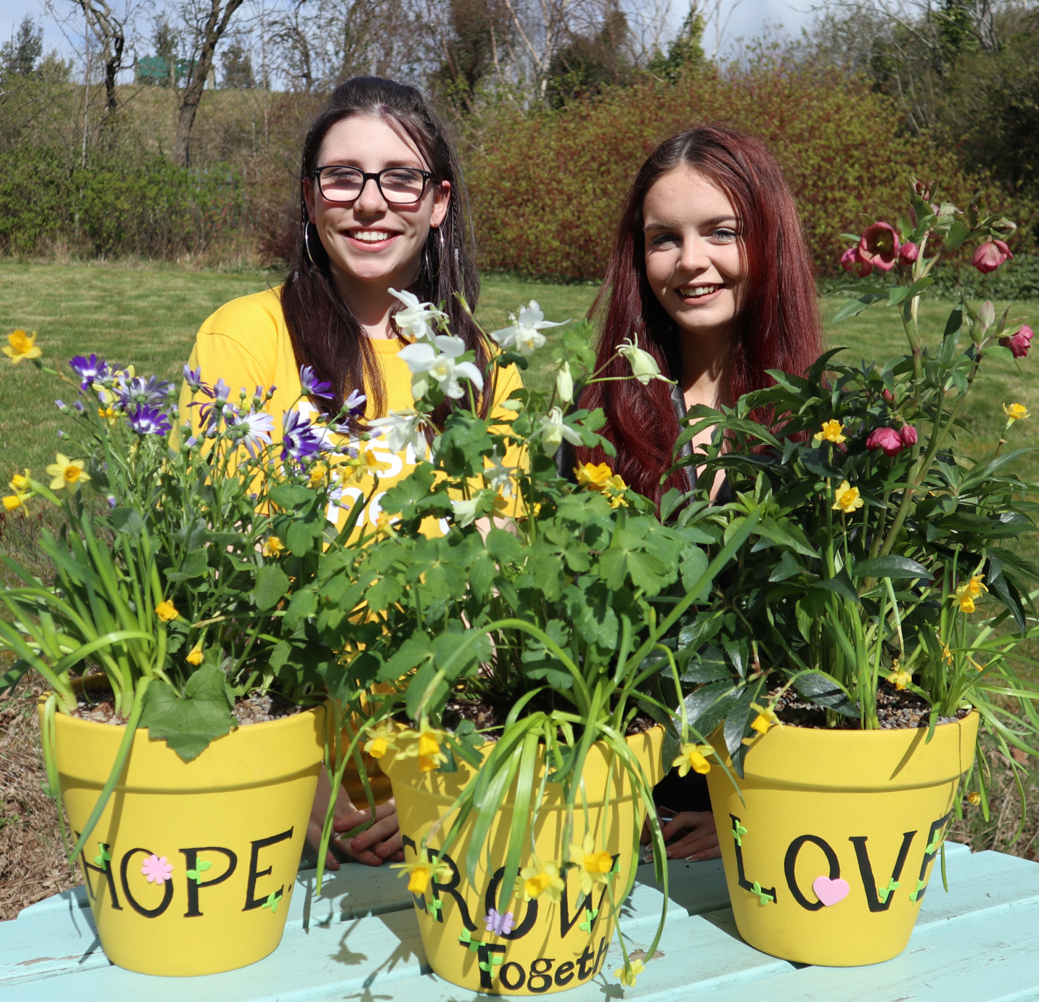
Essential skills and experience
Experience of carrying out repairs and have good DIY skills
Experience of carrying out labouring and cleaning duties
Understanding of Health and Safety issues, working to a safe and high standard in line with legislative requirements
Ability to ensure the service is delivered in accordance with housing legislation
Ability to show initiative, effective time management, and work in a high paced environment
Record use of time and materials
Computer literate
Flexibility with regards to working patterns
Full UK driving license
Ability to respond at short notice to crisis situations
Ability to build relationships with colleagues and contractors
Ability to understand and consider the views, concerns and needs of others when taking action
Commitment to provide a safe environment for the people we support and our colleagues
Commitment to training and professional development, including keeping up to date with all relevant legislation.

Slide 11
Desirable Knowledge
Health and Safety Training
First Aid Certificate
Other relevant training
Current valid CSCS card
Experience of working in a similar environment
Awareness of issues surrounding homelessness
Understanding the needs and rights of people we support

Slide 12
Role Details
Contract: Full time, permanent, 35 hours per week. Salary: SCP 19-22 (£24,252 - £25,961 per annum) Reporting to: Maintenance Supervisor
Working hours are 35 hours, Monday to Friday – worked flexibly between the hours of 8.00am to 6.00pm, with one-hour unpaid break.
Your core place of work will be Rosemount Business Park, 141-145 Charles Street, Unit M7/8, Glasgow, G21 2QA
You may be required to work from such other place as the organisation may reasonably require from time to time.
Annual leave entitlement of 210 hours holiday (equivalent to 6 weeks) pro rata per year in the first year rising to 280 hours (equivalent to 8 weeks) pro rata per year in the second. This includes public holidays.
All appointments are subject to a minimum of a 12-week probationary period.
You will be automatically enrolled into the People’s Pension. Deductions will be taken from your salary in the month you will complete 3-months of employment
It is the nature of the work of Right There that tasks and responsibilities are, in many circumstances unpredictable and varied. All employees are, therefore, expected to work in a flexible way when the occasion arises.

Slide 13
Our People Benefits
We know how dedicated our people are and we want to help you achieve a good work/life balance – and make it easier to enjoy life’s special moments!
That’s why we’ve got a range of enhanced family-friendly and wellbeing benefits to give you some well deserved perks of being a Right There employee. Benefits include:
Hybrid working – work where is best for you and your role
Enhanced maternity, paternity, adoption, and shared parental leave
Employee 24-hour counselling and wellbeing services
6 weeks annual leave, rising to 8 after a year (plus you can purchase up to 5 more days)
Life insurance 4x your salary
Dedicated training and development plans
Cycle to work scheme
Refer a Friend

Slide 14
How to Apply
To apply send your CV and a cover letter outlining why you want to work with us, and how you meet the experience, skills and behaviours expected for this role.
Applications will be considered as they are received Email recruitment@rightthere.org

Slide 15
Thank you. Good luck with your application.

