Slide 1

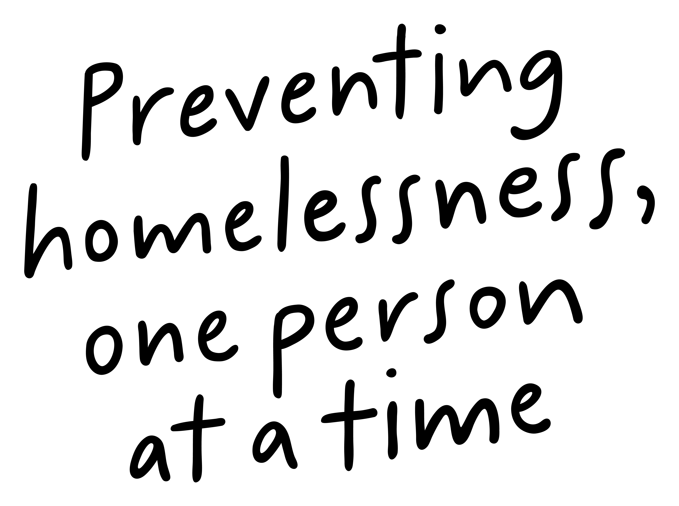
Job Pack
Support Worker
Outreach Edinburgh
(December 2024)

Slide 2
Job Purpose
Support Worker Outreach Housing
Support Edinburgh
Outreach Edinburgh programme provides support to people aged 16+ that are transitioning out of homelessness to longer term accommodation. The team also provides support to those at risk of becoming homeless.
We offer a variety of supports, depending on what each individual person needs, we understand that everyone has had a different journey, and we aim to build relationships built on trust to help people build resilience and self-worth.
Locality Manager
Registered Manager
Senior Support Worker
Administrator
Support Workers/Coach

Slide 3


What’s Inside
4 - 5
Our Vision, Mission and Values
6 - 7
8 - 9
Requirements
10-11
Role Details
12
Our People Benefits
13
How to Apply
14
15

Slide 4


About Right There
We are Right There, a charity celebrating our 200th anniversary in 2024. We provide tailored support for people, at home, and in the community. We are here for people who are living with the effects of homelessness, poverty, addiction, or family breakdowns. Last year we supported almost 4,000 individuals, helping to prevent them from becoming homeless or separated from the people they love.
We are here to offer the right support at the right time, including breaking down financial barriers; accessing the private rental market; linking up with local health, employment and training services to help people make connections within the community; and, helping people feel happier, safer, and more confident to take steps to improve their own lives.
Every person’s story is unique, and everyone’s route home is different, so we tailor our response to the individual. We want to challenge stereotypes – it doesn’t matter what the situation is – we’re not here to judge, only to help.
Our approach is about creating trusting relationships and nurturing people’s strengths, and our 200 dedicated staff, mentors and volunteers play a crucial role in this.

Slide 5

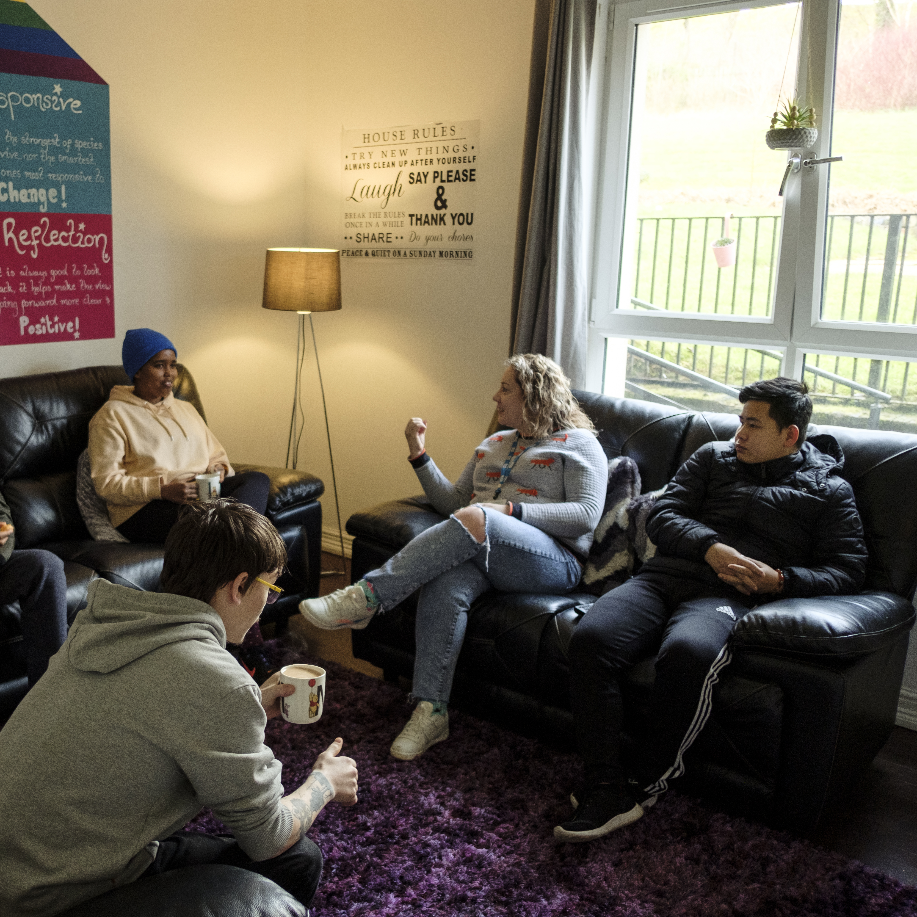
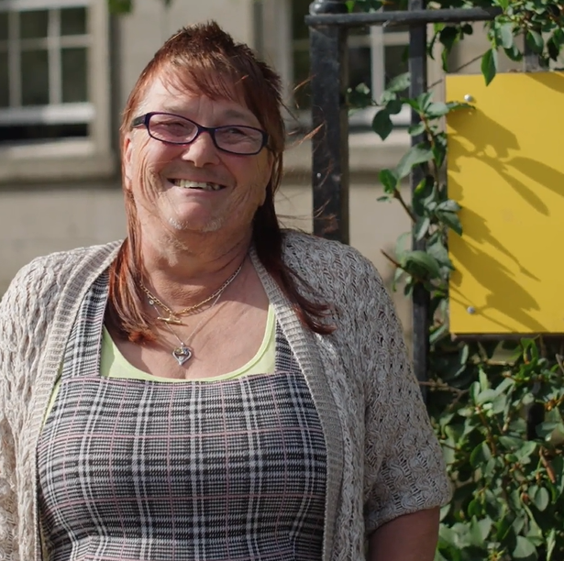
Our key areas of focus
For People
We provide tailored support for children and adults to help individuals and families feel happier, create stronger bonds and stay together.
At Home
We provide safe and supportive places to call home for people of all ages, from any circumstances, for as long as they might need it.
In The Community
We provide the tools for people to live independently and build their lives within their community, creating their own safe and secure homes.

Slide 6

Our Vision
A world where everyone has an equal chance to create a safe and supportive place to call home.
Our Mission
We meet people where
they are in life with no judgement; walking alongside those who need support, and preventing them becoming homeless
or separated from the people they love.

Slide 7



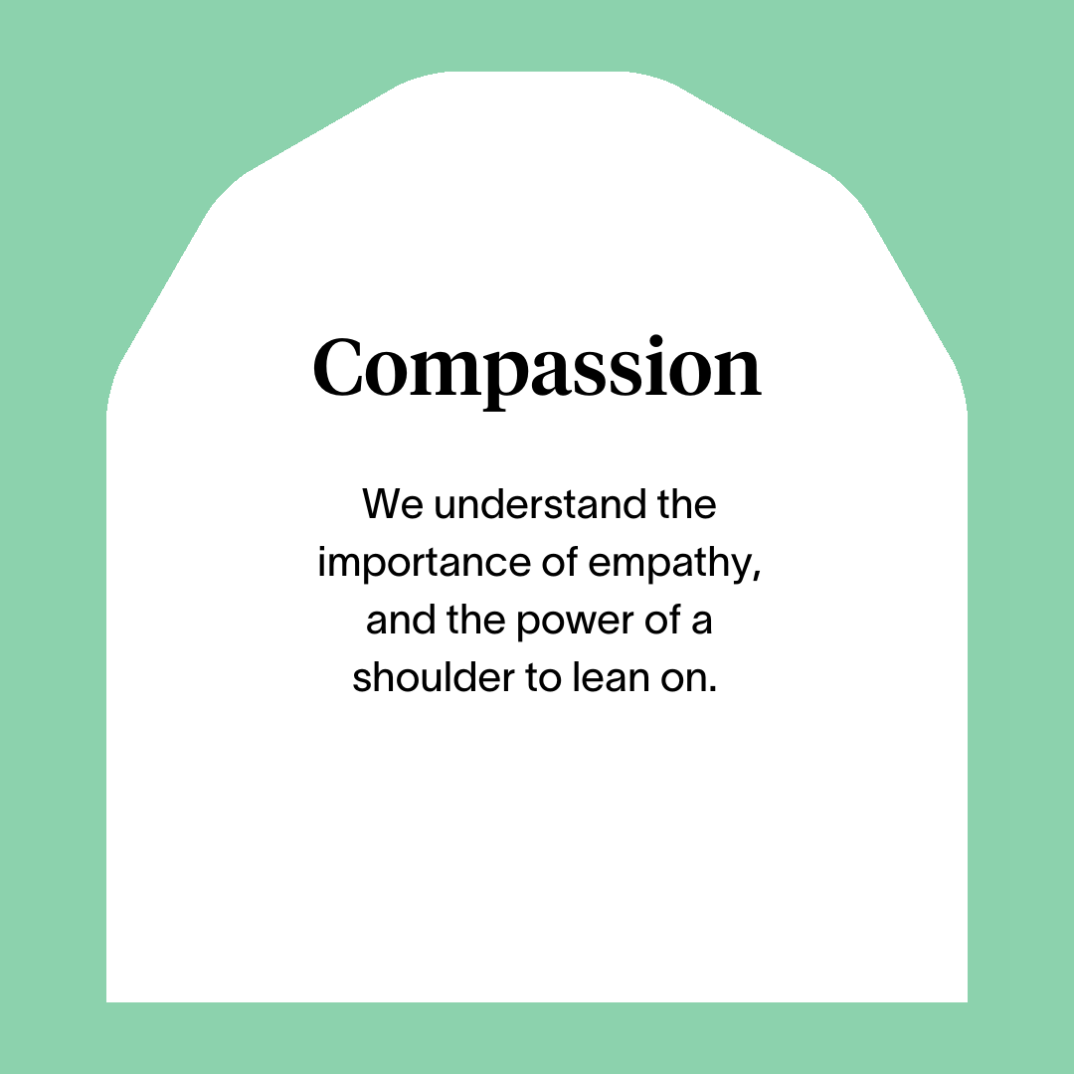



Slide 8
Main Role Responsibilities
Responsibility to the People we Support:
Actively practicing person-centered support planning, unconditional positive regard and taking a Psychologically Informed Environment (PIE) approach
Arranging and facilitating key work meetings to develop and review support plans in collaboration with the people we support to meet their individual needs
Developing life skills with the people we support including how to maximise income, budgeting, shopping, cooking, home maintenance & repair and any other skills that aid to independence.
Assisting the people we support in their transition from temporary accommodation to permanent housing.
Providing advice on a range of subjects including housing options and welfare benefits.
Assisting the people we support to engage and integrate into the local community and become active citizens
Having detailed knowledge of other relevant programmes and signposting or referring the people we support
Establish clear professional boundaries with the people we support.
Compiling and reviewing keeping yourself safe plans of those we support.
Promoting involvement in the improvement and development of the programme by the people we support.
Provide the required support with focus on ‘customer service’ and a People First person centred approach to the people we support providing a culture where the people we support are treated with compassion and unconditional positive regard
Develop good communication skills and working relationships with those we support, colleagues and other professionals
Advocate on behalf of the people we support
Support the people to be part of their local community
Ensure the people we support are aware of service provision and signposted or referred to other agencies as appropriate
Assist those we support with housing benefit form, maximising income and any other relevant support

Slide 9
Main Role Responsibilities
Responsibility to the programme:
Sourcing referrals to the programme to ensure contract outcomes are achieved.
Positively represent Right There to local partnership agencies including local authority, Social Work, Housing providers and other local authority
Maintain case files and ensure all relevant documentation is completed to the highest standards and within agreed timescales
Accurately record matters relating to the people we support and report as appropriate through the development of support plans and case notes
Have a high standard of professional integrity with colleagues and other professionals.
Being a part of the Right There team:
Be a proactive team member actively contributing to your service working collaboratively with your colleagues across the organisation.
Have a high standard of professional integrity with colleagues and other providers upholding clear professional boundaries at all times.
Work towards performance targets to achieve agreed result
Participate in training and reflective practice, share your learning experiences, strive for continuous personal and professional development
Contribute to the organisations' development and improvement with feedback on the review of organisational policies and procedures and local guidelines
Engage with any organisational initiatives or working groups
Adhere to Right There Policies and Procedures, Scottish Social Programmes Council (SSSC) Codes of Practice, Health and Social Care Standards (My Support, My Life), Health and Safety legislation and practices
Always apply safeguarding principles and maintain awareness of child protection and adult protection processes.
Register with any required government bodies and ensure membership is updated and any attributed costs are paid for

Slide 10
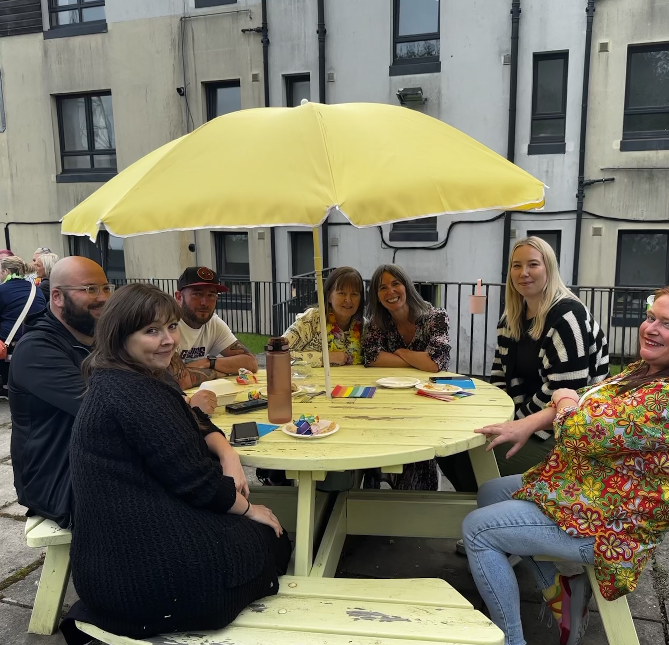
Essential skills and experience
Qualified to SVQ Level 2 H&SC or SCQF equivalent or working towards attainment
Knowledge of current relevant legislation and policies relating to housing and homelessness
Knowledge of Housing and other benefits
Demonstrable communication skills
Skills and ability in effective time management, managing a caseload and working to deadlines
Ability to ensure the service is delivered in accordance with corporate policy and Right There objectives
Knowledge of local resources and programmes
Computer literate and competent with Microsoft Office Software package
Flexibility with regards to working patterns
Experience of deescalating potential conflict situations
Ability to apply robust recording and record keeping to case files in line with organisational policy
Ability to understand and consider the views, concerns and needs of others when taking action

Slide 11
Essential skills and experience
Awareness of First Aid/ or Certificated
Awareness of Housing protocols
Experience of working in a similar environment
Awareness on Drugs, Alcohol and Mental Health and impact this has on people
Knowledge of adolescent development and the impact of trauma
Knowledge of safeguarding and working within child protection and adult protection policies and procedures.
Understanding and respecting the importance and limits of confidentiality
Desirable Knowledge
Knowledge of the application of Psychologically Informed Environments (PIE) within the work environment
Awareness of issues facing young people seeking asylum in the UK
Experience of crisis work with vulnerable people

Slide 12

Role Details
Contract: Full time, permanent, 35 hours per week.
Salary: SCP 19-22 (£24,252 - £25,961 per annum)
Reporting to: Senior Support Worker
Working hours are worked Monday to Friday and flexibly between the hours of 08.00am and 6.00pm depending on the needs of the service, with 1-hour unpaid break.
Your core place of work will Pilton Community Heath Centre, 73 Boswall Parkway, Edinburgh, EH5 2PW. You are also required to work in the local community, travel expenses are paid between your usual place of work and appointments undertaken in the course of your duties. Home working is an agreement with the line manager based on the needs of the service.
You may be required to work from such other place as the organisation may reasonably require from time to time.
Annual leave entitlement of 210 hours holiday (equivalent to 6 weeks) pro rata per year in the first year rising to 280 hours (equivalent to 8 weeks) pro rata per year in the second. This includes public holidays.
All appointments are subject to a minimum of a 12-week probationary period.
You will be automatically enrolled into the People’s Pension. Deductions will be taken from your salary in the month you will complete 3-months of employment
It is the nature of the work of Right There that tasks and responsibilities are, in many circumstances unpredictable and varied. All employees are, therefore, expected to work in a flexible way when the occasion arises.

Slide 13

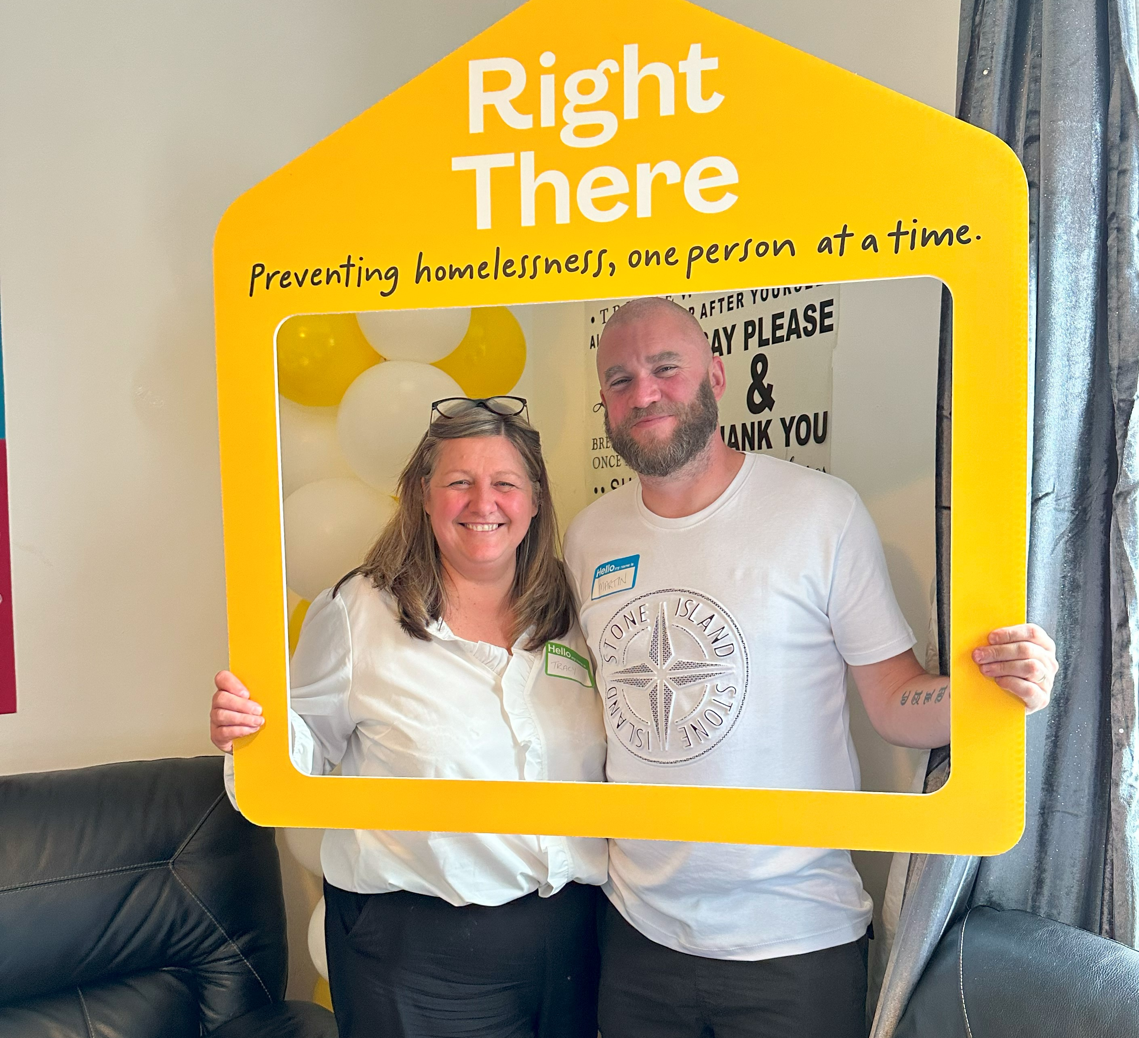
Our People Benefits
We know how dedicated our people are and we want to help you achieve a good work/life balance – and make it easier to enjoy life’s special moments!
That’s why we’ve got a range of enhanced family-friendly and wellbeing benefits to give you some well deserved perks of being a Right There employee.
Benefits include:
Hybrid working – work where is best for you and your role
Enhanced maternity, paternity, adoption, and shared parental leave
Employee 24-hour counselling and wellbeing services
6 weeks annual leave, rising to 8 after a year (plus you can purchase up to 5 more days)
Life insurance 4x your salary
Dedicated training and development plans
Cycle to work scheme
Refer a Friend

Slide 14
How to Apply
To apply send your CV and a cover letter outlining why you want to work with us, and how you meet the experience, skills and behaviours expected for this role.
Deadline 5pm on Friday 16th May 2025
Email recruitment@rightthere.org

Slide 15
Thank you.
Good luck with your application.

