Slide 1
Job Pack Maintenance Supervisor (April 2025 )

Slide 2
Job Purpose Maintenance Supervisor
The Property team is responsible for the management of a portfolio of 470+ properties of various size, predominantly in the Glasgow area and includes general administration, maintenance workers, technicians, painters and joiners
The Maintenance Supervisor will be responsible for leading the maintenance field team and overseeing their day-to-day activities.
Scoping and planning of works from void properties and reviewing works required for tenanted properties.
Supporting Head of Property to advise where there are skills gaps within the team and update on general performance .
Support the Admin supervisor on planning works for the internal team while feeding back on contractor performance.
Support the wider team to deliver on key objectives to achieve full property occupancy for Right There.
Head of Property
Property Maintenance and Health and Safety Manager
Maintenance Supervisors
Maintenance Workers, Painters, Joiner,Technicians

Slide 3
What’s Inside
4 - 5
Our Vision, Mission and Values
6 - 7
8 - 10
Requirements
11-12
Role Details
13
Our People Benefits
14
How to Apply
15
16

Slide 4
About Right There
We are Right There, a charity celebrating our 200th anniversary in 2024. We provide tailored support for people, at home, and in the community. We are here for people who are living with the effects of homelessness, poverty, addiction, or family breakdowns. Last year we supported almost 4,000 individuals, helping to prevent them from becoming homeless or separated from the people they love.
We are here to offer the right support at the right time, including breaking down financial barriers; accessing the private rental market; linking up with local health, employment and training services to help people make connections within the community; and, helping people feel happier, safer, and more confident to take steps to improve their own lives.
Every person’s story is unique, and everyone’s route home is different, so we tailor our response to the individual. We want to challenge stereotypes – it doesn’t matter what the situation is – we’re not here to judge, only to help.
Our approach is about creating trusting relationships and nurturing people’s strengths, and our 200 dedicated staff, mentors and volunteers play a crucial role in this.

Slide 5
Our key areas of focus
For People
We provide tailored support for children and adults to help individuals and families feel happier, create stronger bonds and stay together.
At Home
We provide safe and supportive places to call home for people of all ages, from any circumstances, for as long as they might need it.
In The Community
We provide the tools for people to live independently and build their lives within their community, creating their own safe and secure homes.

Slide 6
Our Vision A world where everyone has an equal chance to create a safe and supportive place to call home.
Our Mission We meet people where
they are in life with no judgement; walking alongside those who need support, and preventing them becoming homeless
or separated from the people they love.

Slide 7
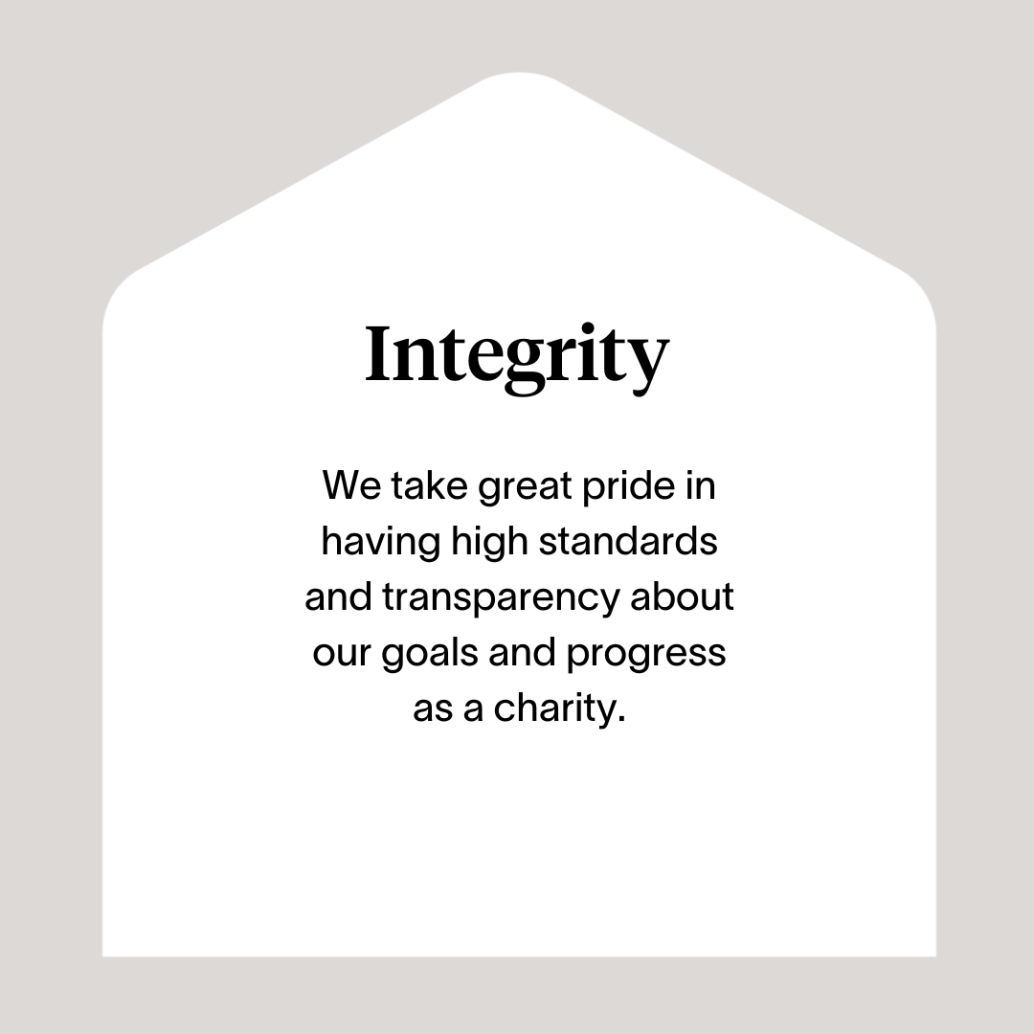

Slide 8
Roles & Responsibilities
Leading the management of void properties and maintenance of tenanted properties
Responsible for scoping void properties, carrying out a detailed review of the property with clear guidance on category rating
Advise on works required to bring void property back to agreed standard, with clear detail of whether works will be carried out by internal or external teams.
Phase works and advise if there are any barriers to stop completion of works in agreed timelines .
Plan all works and procurement, advise of any parts that can be purchased in advance thus easing the need to attend suppliers by having stock items at Charles St.
Responsibility for creation and filling of all documentation including before and after document to be sent on completion of any void repair works.
Create WGLL document of property.
Produce clear and detailed reports were applicable to support the admin team.
Review property along with standards of workmanship upon completion of the void upgrade.
Support the Head of Property with feedback on property conditions
Communicate and collaborate with the admin supervisor on updates /plans on completion of works
Review status of all properties undergoing any works via the internal field team at weekly meetings with admin team/Head of Property
Lead on change initiatives and any health and safety programmes from the wider business .
Coordinate replacement of any items taken from voids at initial clear out ensuring complete inventory. Look to recycle /upcycle were possible.
Support Maintenance Technicians to deliver on PPM schedule .

Slide 9
Roles & Responsibilities (continued)
People Management
Lead the internal maintenance field team with a clear focus on delivery performance and outcome attainment to deliver all the required works to return void properties back to Short Term Housing as soon as possible.
Build and maintain strong relationships with field team, feeding back on performance and highlight where there are skill gaps.
Lead the teams to deliver great “customer” service and a People First Approach
Work in partnership with Right There colleagues; promote clear and singular communication
Embrace a positive working culture working collaboratively, promoting inclusiveness, cooperation, trust and open exchange of ideas to fulfil Right There’s strategic aims supporting delivery staff to do likewise.
Build your team taking responsibility for recruitment, induction and performance using support and supervision and appraisal tools.
Responsibility for the learning and continued professional development of yourself and your teams, actively encouraging reflective practice for team learning
Be accountable for a safe environment for employees and those people what we support through applying Health and Safety legislation and practices.
Data and Performance
Accountable for specific data collection, analysis and regular agreed reporting
Deliver on performance, using KPI data to support decision making and planning
Lead and support new initiatives and the development and implementation of policies, procedures and guidelines as they impact on the property team.
Lead on policies and processes developments and management as they impact on the property team

Slide 10
Roles & Responsibilities (continued)
Compliance
Ensure wider team are using PPE, undertaking risk assessments and working safely, advise Head of Property of any issues that may need review.
Responsible for the issue and maintenance of PPE and keeping stock at agreed levels.
Advise, log and act on any accidents/near misses during the course of any works.
External stakeholders
Develop strong working partnerships with external agencies, promoting Right There’s work
Day to day working partnership with key suppliers
Represent Right There to other agencies or services including Local Authorities, Social Work, Housing Services and other relevant services and bodies
Take the lead in maintenance delivery matters as it applies to all properties, maintaining positive working relations with external stakeholders
Work closely with landlords and/or tenants as required

Slide 11
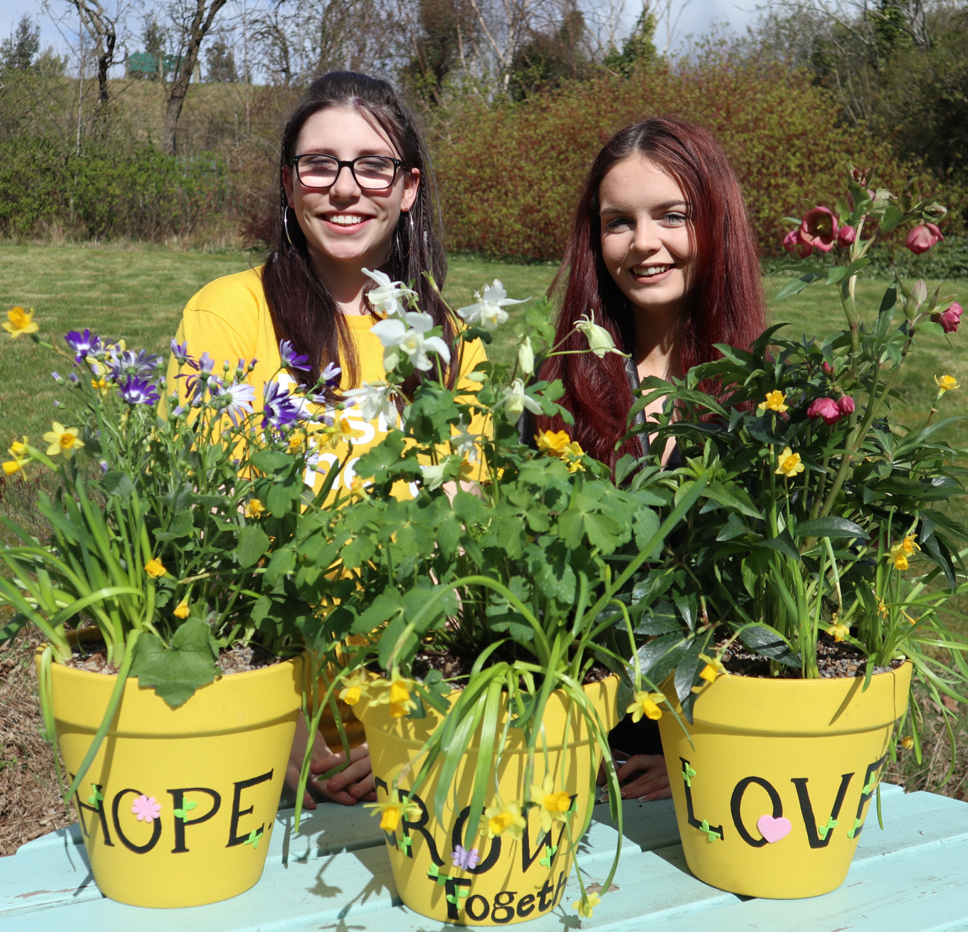
Essential skills and experience
ONC or equivalent
Demonstrate a property /building background
Working knowledge of Health & Safety
Trades Background
Clear understanding of WGLL for property repair and standards of workmanship
Experience in building, leading and managing a team
Root cause problems finding simple solutions where applicable
Full UK driving licence
Proven track record in effective coaching and people management
Proven track record in effective planning, performance management and quality assurance
Ability to lead and take ownership and accountability for a programme.
Proven effective communicator
Ability to build strong professional relationships both within the organisation and externally
Ability to collate and analyse data for decision making purposes
Proven ability in effective prioritisation and organisation
Commitment to training and professional development, including keeping up to date with all relevant legislation.

Slide 12
Skills and experience cont.
Essential
Computer literate and competent with Microsoft Office software package
Ability to ensure the service is delivered in accordance with corporate policy and objectives
Ability to respond at short notice
Desirable
Equivalent Management experience in providing housing, social care and support services
Understanding of the principles of working within a Psychologically Informed Environment (PIE)
Experience in setting and managing budgets
Knowledge of current relevant legislation, policies and strategies relating to housing and homelessness
Understanding the needs and rights of people we support
Health and Safety Qualification
Current valid CSCS card

Slide 13
Role Details
Contract: Full time, permanent, 35 hours per week. Salary: SCP 29-32 (£32,391 - £35,482 per annum) Reporting to: Property Maintenance and Heath & Safety Manager
Working hours are 35 Monday to Friday – worked flexibly between the hours of 8.00am to 6.00pm depending on the needs of the service with one-hour unpaid break.
Your core place of work will be Rosemount Business Park, 141-145 Charles Street, Unit E2, Glasgow, G21 2QA.
You may be required to work from such other place as the organisation may reasonably require from time to time.
Annual leave entitlement of 210 hours holiday (equivalent to 6 weeks) pro rata per year in the first year rising to 280 hours (equivalent to 8 weeks) pro rata per year in the second. This includes public holidays.
All appointments are subject to a minimum of a 12-week probationary period.
You will be automatically enrolled into the People’s Pension. Deductions will be taken from your salary in the month you will complete 3-months of employment
It is the nature of the work of Right There that tasks and responsibilities are, in many circumstances unpredictable and varied. All employees are, therefore, expected to work in a flexible way when the occasion arises.

Slide 14
Our People Benefits
We know how dedicated our people are and we want to help you achieve a good work/life balance – and make it easier to enjoy life’s special moments!
That’s why we’ve got a range of enhanced family-friendly and wellbeing benefits to give you some well deserved perks of being a Right There employee. Benefits include:
Hybrid working – work where is best for you and your role
Enhanced maternity, paternity, adoption, and shared parental leave
Employee 24-hour counselling and wellbeing services
6 weeks annual leave, rising to 8 after a year (plus you can purchase up to 5 more days)
Life insurance 4x your salary
Dedicated training and development plans
Cycle to work scheme
Refer a Friend

Slide 15
How to Apply
To apply send your CV and a short cover letter outlining your interest in and suitability for the role.
Applications will be considered as they are received and interviews arranged. Email recruitment@rightthere.org

Slide 16
Thank you. Good luck with your application.

