Slide 1
Job Pack Maintenance Technician (April 2025)

Slide 2
Job Purpose Maintenance Technician
The Property team is responsible for the management of a portfolio of 470+ properties of various size, predominantly in the Glasgow area and includes general administration, maintenance workers, technicians, painters and joiners.
The role of Maintenance Technician will play a key role in our Property team, ensuring that the properties within our portfolio are maintained to a high standard and meet all compliance regulations for the people we support.
The Maintenance Technician will follow a programme of planned works, alongside reactive interventions to ensure that the fabric of all properties is managed effectively. Through delivery of a range of disciplines including joinery, electrical, plumbing, and decorating, along with a range of testing programmes including PAT testing and water testing, the Maintenance Technician will be instrumental in creating safe, welcoming environments for the people we support.
Head of Property
Property Maintenance and Health and Safety Manager
Maintenance Supervisors
Maintenance Workers, Painters, Joiner,Technicians

Slide 3
What’s Inside
4 - 5
Our Vision, Mission and Values
6 - 7
8 - 9
Requirements
10-11
Role Details
12
Our People Benefits
13
How to Apply
14
15

Slide 4
About Right There
We are Right There, a charity celebrating our 200th anniversary in 2024. We provide tailored support for people, at home, and in the community. We are here for people who are living with the effects of homelessness, poverty, addiction, or family breakdowns. Last year we supported almost 4,000 individuals, helping to prevent them from becoming homeless or separated from the people they love.
We are here to offer the right support at the right time, including breaking down financial barriers; accessing the private rental market; linking up with local health, employment and training services to help people make connections within the community; and, helping people feel happier, safer, and more confident to take steps to improve their own lives.
Every person’s story is unique, and everyone’s route home is different, so we tailor our response to the individual. We want to challenge stereotypes – it doesn’t matter what the situation is – we’re not here to judge, only to help.
Our approach is about creating trusting relationships and nurturing people’s strengths, and our 200 dedicated staff, mentors and volunteers play a crucial role in this.

Slide 5
Our key areas of focus
For People
We provide tailored support for children and adults to help individuals and families feel happier, create stronger bonds and stay together.
At Home
We provide safe and supportive places to call home for people of all ages, from any circumstances, for as long as they might need it.
In The Community
We provide the tools for people to live independently and build their lives within their community, creating their own safe and secure homes.

Slide 6
Our Vision A world where everyone has an equal chance to create a safe and supportive place to call home.
Our Mission We meet people where
they are in life with no judgement; walking alongside those who need support, and preventing them becoming homeless
or separated from the people they love.

Slide 7
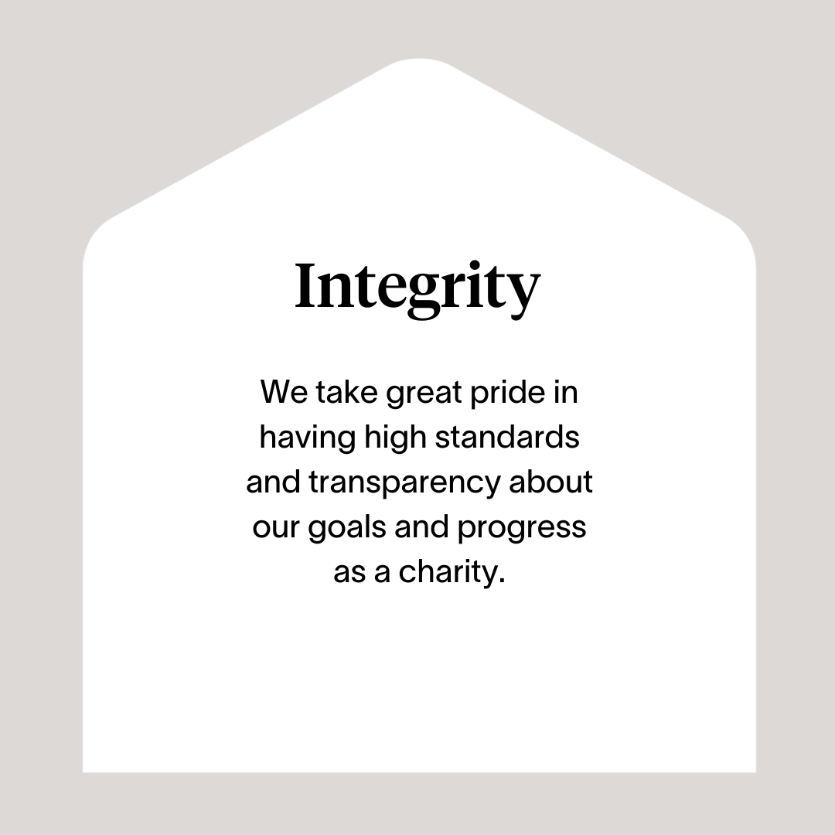

Slide 8
Roles & Responsibilities
Ensuring that maintenance in void and tenanted properties is to a high standard and meets all compliance regulations
Ensuring all Right There properties are a safe and functioning environment for our team and the people we support
Follow the planned work schedule to achieve first time fix and improving efficiencies
Delivering high quality work standards across the property estate, with year-on-year improvements
Working closely with team members, sharing standard methodology and knowledge
Proactively lead and collaborate to ensure shared ownership for the delivery of our Property plan.
Use problem solving skills and innovation to identify and develop solutions for key and common issues.
Drive sophisticated tasks at a local level through to completion/resolution, advising key collaborators through the process where required.
Use mobile technology to drive standard process in work completion and updates.
Supporting delivery of key metrics through practical application of skills.
Deliver on PPM schedule
Reporting and Compliance
Consistent adherence to all relevant policies and procedures ensuring best practice and legal compliance
Report any health and safety concerns or incidents using the reporting mechanisms in place
Use of internal Housing Management System to log all time, materials and consumables used in carrying out duties
Comply with relevant Health & Safety legislation
Ensure Right There’s guidelines, policies and procedures are adhered to
Comply with requirements of relevant external agencies

Slide 9
Roles & Responsibilities
Maintenance Team Member
Develop and maintain good communication and working relationships with line manager, colleagues, contractors and people we support
Work cooperatively with others as part of a team demonstrating commitment to service objectives
Have a high standard of professional integrity with colleagues and other providers
Establish and uphold clear professional boundaries at all times.
Be proactive in personal development, use feedback from others and identify own development objectives
Attend and participate in training and engage in reflective practice to share learning experiences.
Actively participate in regular team meetings providing valuable input and feedback to meet the needs of the Property Team and commit to its development and improvement
Feedback on the review of organisational polices & procedures and local guidelines.
Ability to work towards performance targets to achieve agreed result
Promote Right There services through agreed mediums
Represent the Right There brand following agreed ways of working, demonstrating values led behaviours, and taking pride in wearing the Right There uniform.

Slide 10
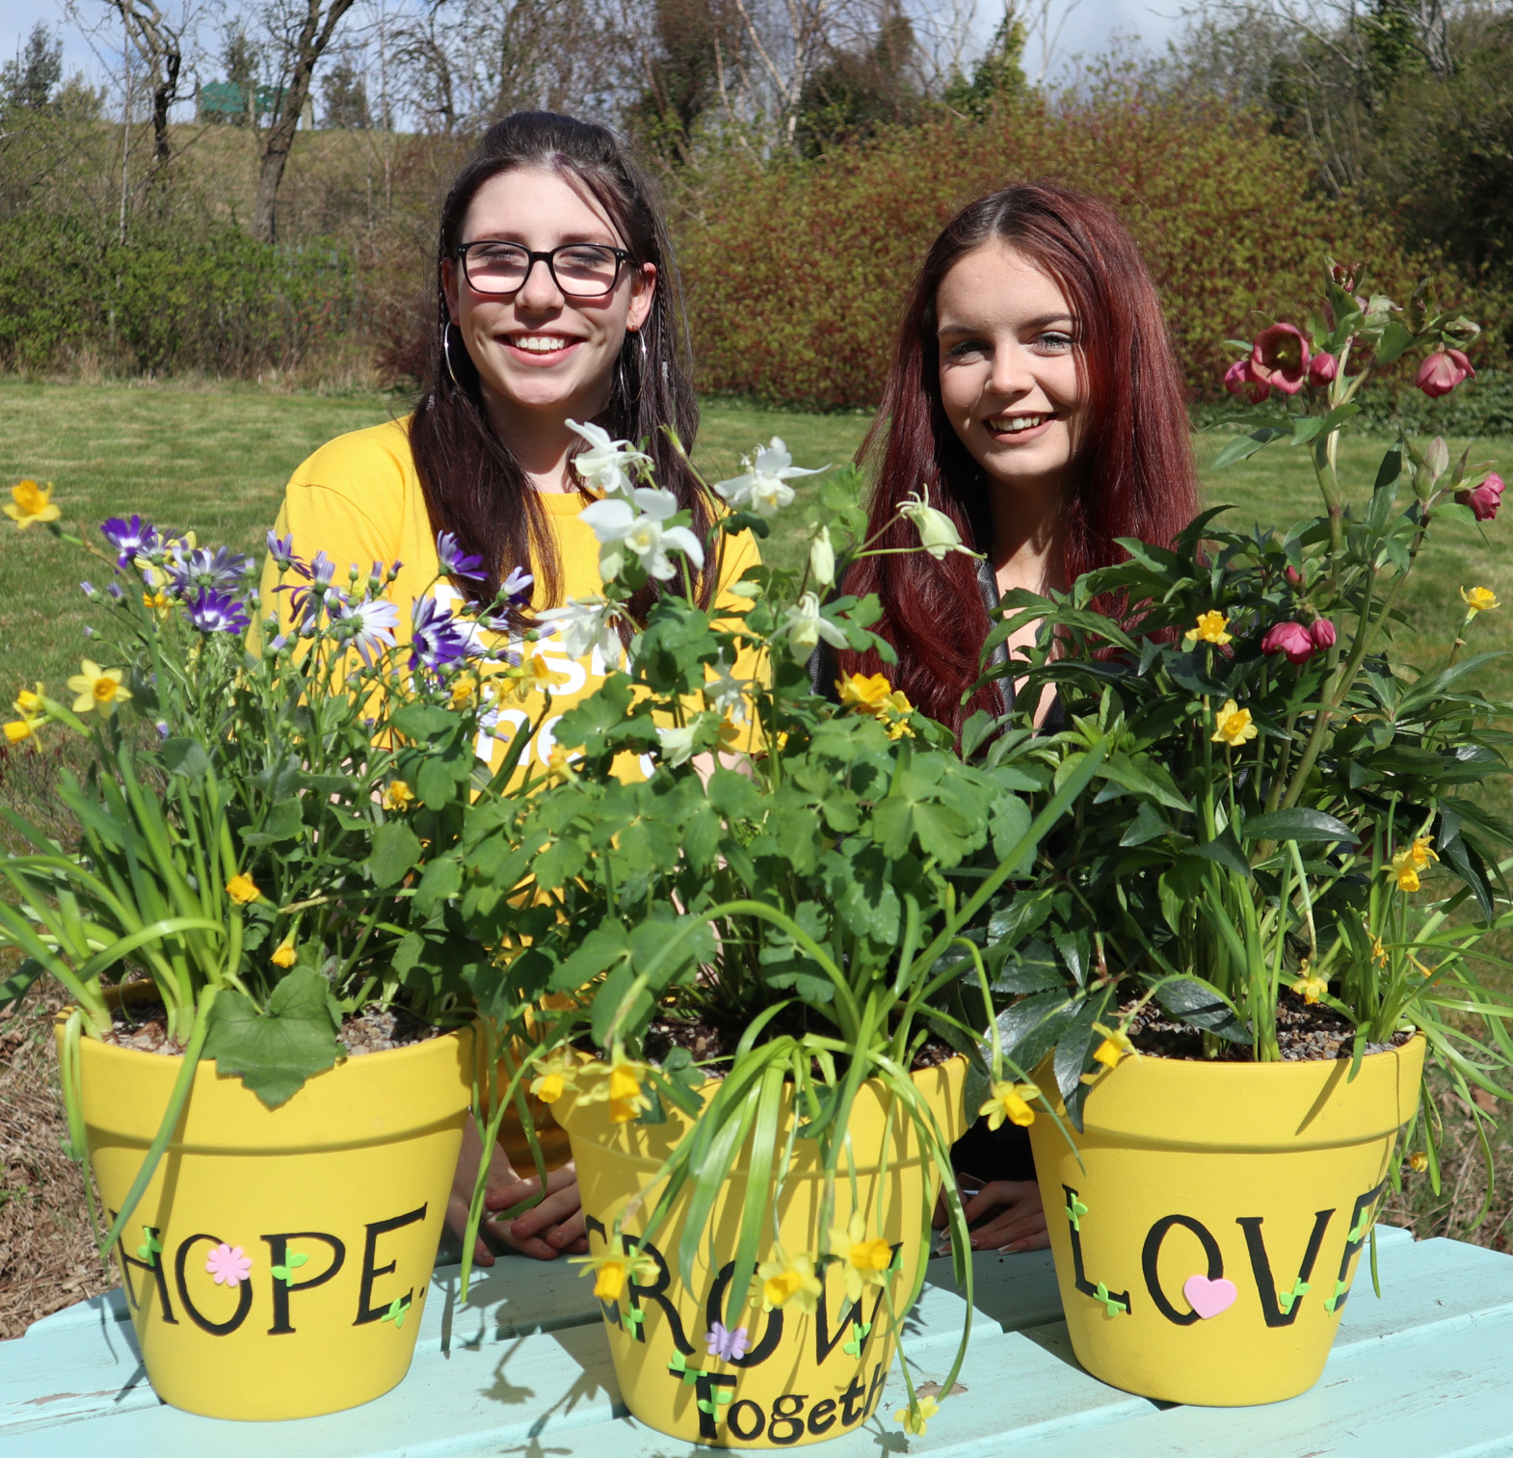
Essential skills and experience
ONC or equivalent
Full, UK driving licence
Understanding and awareness of Health & Safety issues
Completing training and upskilling modules relevant to abilities.
Validated experience in a maintenance, engineering or construction environment
Digitally confident – can comfortably operate mobile technology
Stock inventory management skills.
Ability to plan and organise a workload with competing demands and priorities utilising time and resources effectively
Demonstrate a proactive approach and ability to be solution orientated and take initiative
Ability to work cooperatively with others as part of a team demonstrating commitment to group objectives
Ability to understand and consider the views, concerns and needs of others when taking action
Ability to communicate effectively with people at all levels in a variety of situations
Ability to implement the aims and objectives of Right There at functional level
Commitment to training and professional development, including keeping up to date with all relevant legislation.

Slide 11
Desirable Knowledge
Fully qualified trade accreditation.
Understanding of rented sector
Plumbing and electrical trained or competent
Joinery experience
Knowledge of Office 365
Experience of working in a similar environment
Current valid CSCS card
Adopt a flexible approach to working hours
Understanding the needs and rights of people we support
Awareness of issues surrounding homelessness
Health and Safety Training
First Aid Certificate

Slide 12
Role Details
Contract: Full time, permanent, 35 hours per week. Salary: SCP 23-26 (£26,687 - £29,285 per annum) Reporting to: Maintenance Supervisor
Working hours are 35 er week worked Monday to Friday and flexibly between the hours of 8am and 4pm depending on the needs of the service, with 1-hour unpaid break
Your core place of work will be Rosemount Business Park, 141-145 Charles Street, Unit E2, Glasgow, G21 2QA
You may be required to work from such other place as the organisation may reasonably require from time to time.
Annual leave entitlement of 210 hours holiday (equivalent to 6 weeks) pro rata per year in the first year rising to 280 hours (equivalent to 8 weeks) pro rata per year in the second. This includes public holidays.
All appointments are subject to a minimum of a 12-week probationary period.
You will be automatically enrolled into the People’s Pension. Deductions will be taken from your salary in the month you will complete 3-months of employment
It is the nature of the work of Right There that tasks and responsibilities are, in many circumstances unpredictable and varied. All employees are, therefore, expected to work in a flexible way when the occasion arises.

Slide 13
Our People Benefits
We know how dedicated our people are and we want to help you achieve a good work/life balance – and make it easier to enjoy life’s special moments!
That’s why we’ve got a range of enhanced family-friendly and wellbeing benefits to give you some well deserved perks of being a Right There employee. Benefits include:
Hybrid working – work where is best for you and your role
Enhanced maternity, paternity, adoption, and shared parental leave
Employee 24-hour counselling and wellbeing services
6 weeks annual leave, rising to 8 after a year (plus you can purchase up to 5 more days)
Life insurance 4x your salary
Dedicated training and development plans
Cycle to work scheme
Refer a Friend

Slide 14
How to Apply
Please send your CV and a short cover letter outlining your interest in and suitability for the role.
Applications will be considered as they are received and interviews arranged. Email recruitment@rightthere.org

Slide 15
Thank you. Good luck with your application.

