Slide 1
Job Pack Support Worker (Nights) (June 2025)

Slide 2
Job Purpose Support Worker Nights
Our Programme
Supported Accommodation Glasgow programme provides a safe, secure , 24-hour supportive service to 26 young people experiencing homelessness in the Glasgow area. The accommodation is safe and homely for the people we support many of whom have experienced significant trauma throughout their lives.
The nightshift support worker will be expected to ensure the wellbeing of the people we support, maintain building security, respond to emergencies and record all relevant information to ensure continuity of support.
Locality Manager
Service Manager
Senior Support Workers
Support Workers/Nights

Slide 3
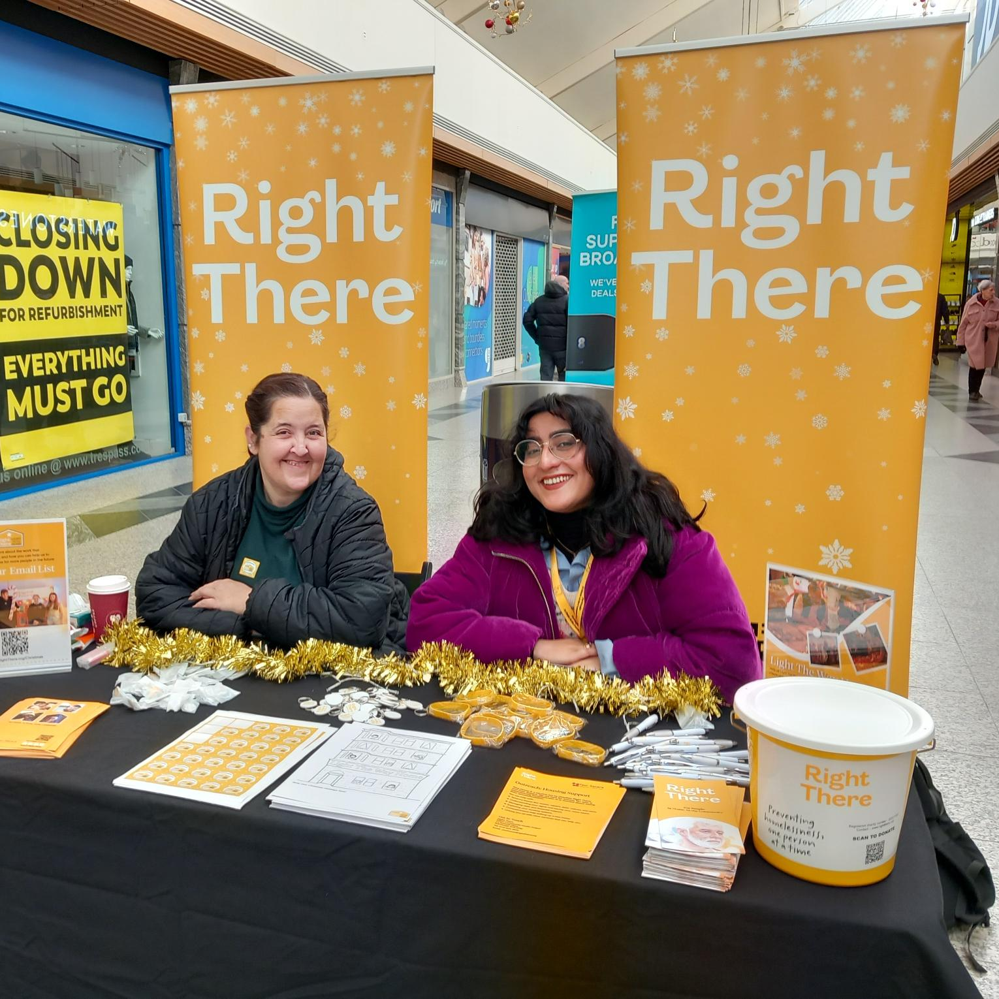
Why Join Right There?
“Working night shifts at Right There has been a rewarding experience. The role allows you to make a real difference in young peoples lives while being part of a supportive and compassionate team. There is a strong sense of belonging and purpose, and you are always encouraged to grow and develop.”
Job Title – Night Support worker
Department – Glasgow Supported Accommodation
“Working as a nightshift support worker can be both a challenging and meaningful role. It is not just about being present during the night, it is about walking alongside the young people on their individual journeys, offering a listening ear during their toughest moments and creating a space where they feel safe, seen and heard. The job can be emotionally demanding at times, but the strength and compassion of the staff team makes a huge difference. There is a real sense of support amongst colleagues. Ongoing training helps us grow both professionally and personally”
Job Title – Night Support Worker
Department – Glasgow Supported Accommodation

Slide 4
What’s Inside
5-6
Our Vision, Mission and Values
7-8
9
Requirements
10-11
Role Details
12
Our People Benefits
13
How to Apply
14
15

Slide 5
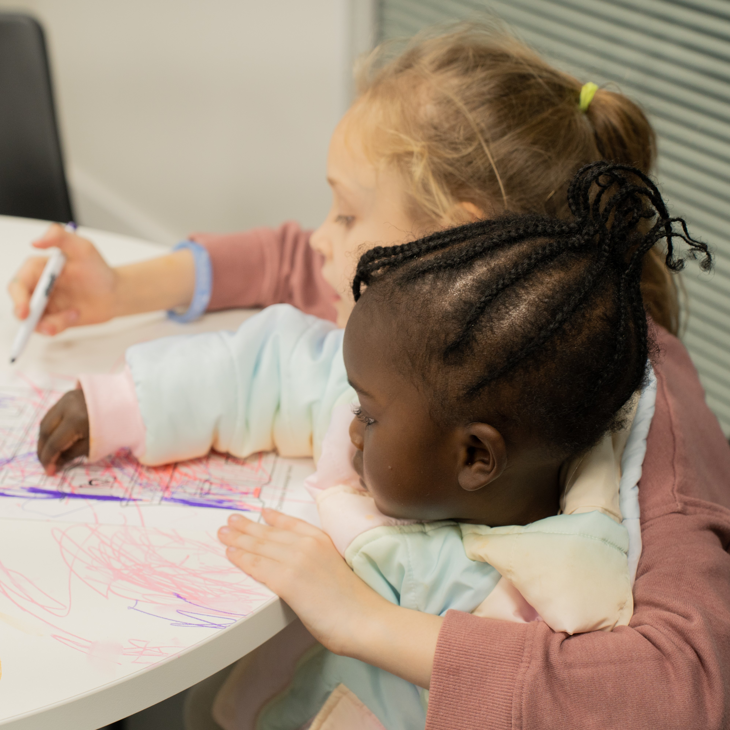
About Right There
We are Right There, a charity celebrating our 200th anniversary in 2024. We provide tailored support for people, at home, and in the community. We are here for people who are living with the effects of homelessness, poverty, addiction, or family breakdowns. Last year we supported almost 4,000 individuals, helping to prevent them from becoming homeless or separated from the people they love.
We are here to offer the right support at the right time, including breaking down financial barriers; accessing the private rental market; linking up with local health, employment and training services to help people make connections within the community; and, helping people feel happier, safer, and more confident to take steps to improve their own lives.
Every person’s story is unique, and everyone’s route home is different, so we tailor our response to the individual. We want to challenge stereotypes – it doesn’t matter what the situation is – we’re not here to judge, only to help.
Our approach is about creating trusting relationships and nurturing people’s strengths, and our 200 dedicated staff, mentors and volunteers play a crucial role in this.

Slide 6
Our key areas of focus
For People
We provide tailored support for children and adults to help individuals and families feel happier, create stronger bonds and stay together.
At Home
We provide safe and supportive places to call home for people of all ages, from any circumstances, for as long as they might need it.
In The Community
We provide the tools for people to live independently and build their lives within their community, creating their own safe and secure homes.

Slide 7
Our Vision A world where everyone has an equal chance to create a safe and supportive place to call home.
Our Mission We meet people where
they are in life with no judgement; walking alongside those who need support, and preventing them becoming homeless
or separated from the people they love.

Slide 9
Main Role Responsibilities
Develop positive, respectful and compassionate relationships with the people we support, focusing on their strengths and aspirations as individuals.
Have a high standard of professional integrity with colleagues and other professionals.
Establish clear professional boundaries with the people we support.
Advocating on behalf of the people we support
Actively practicing person-centred planning and unconditional positive regard
Taking a Psychologically Informed Environment (PIE) approach.
Carry out regular welfare and security checks during shift
Work in line with safeguarding, confidentiality and GDPR policies
Provide appropriate levels of high-quality support to those we support.
Accurately record matters relating to the wellbeing of those we support.
Completing incident reports to a high standard and following the correct sharing and escalation process
Having detailed knowledge of other relevant programmes and signpost and refer to other agencies as appropriate.
Handover relevant information to oncoming staff to ensure continuity of care and support
Manage health and safety/fire safety controls within the programme as guided.
Maintaining a safe environment for those we support, colleagues and others.
Undertaking household domestic duties to maintain the accommodation to a high standard
Actively contribute to your programme and the organisation’s development and improvement.
Participate in team meetings.
Attend and participate in training and share learning experiences.
Engage in reflective practice.
Feedback on the review of organisational policies and procedures and local guidelines.
Promote and represent Right There programmes positively.
Strive for continuous personal and professional development.
Engage with any organisational initiatives or working groups such as NHS Healthy Working Lives, Investors in People, the LGBT Charter, etc.

Slide 10
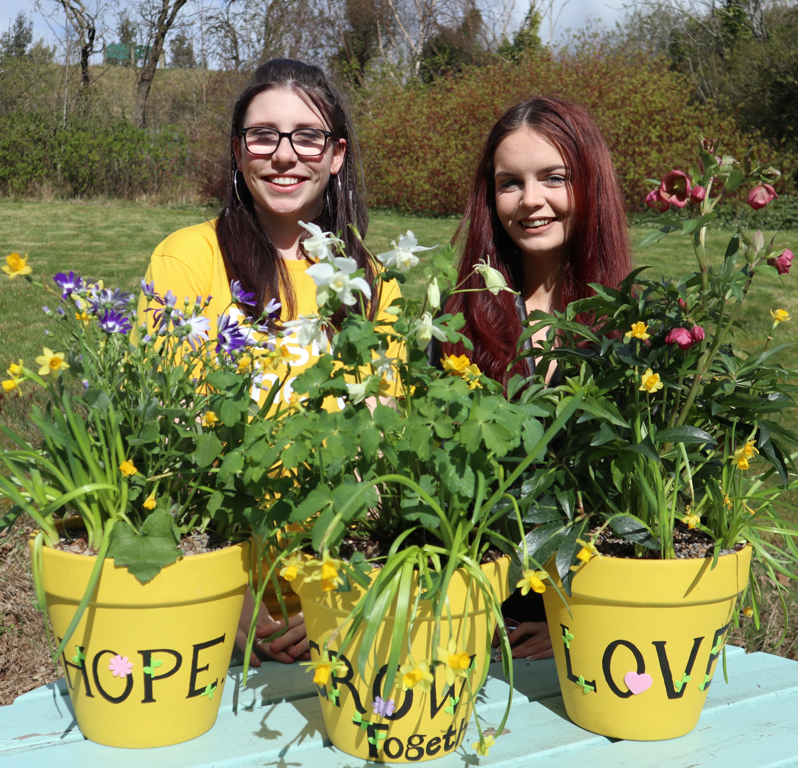
Essential skills and experience
Qualified to SVQ2 in Social Services and Healthcare or SCQF equivalent or willing to work towards this
Ability to ensure the programme is delivered in accordance with corporate policy and Right There values
Skills and ability in effective time management and working to deadlines
Ability to compile comprehensive reports as required
Knowledge of local resources and programmes
Computer literate and competent with Microsoft Office software package
Flexibility with regards to working patterns
Ability to respond at short notice to crisis situations

Slide 11
Desirable Knowledge
First Aid Certificate
Other relevant training
Counselling skills in drugs, alcohol and mental health
Knowledge of local resources and programmes
Experience of working in a similar environment
Experience of crisis work with vulnerable people

Slide 12
Role Details
Contract: Full time, permanent, 39 hours per week. Salary: SCP 19-22 (£27,023 - £28,928 per annum) Reporting to: Senior Support Worker
Your normal place of work will be Supported Accommodation Glasgow, 95 Panmure Street, Glasgow, G20 7SJ
Your normal working hours are an average of 39 per week. These hours will be worked between Monday to Sunday in shifts which are defined by your line manager on a rolling rota, over a 52-week period. The rota will be available to you a minimum of one week in advance.
You may be required to work from such other place as the organisation may reasonably require from time to time.
Annual leave entitlement of 234 hours holiday (equivalent to 6 weeks) pro rata per year in the first year rising to 312 hours (equivalent to 8 weeks) pro rata per year in the second. This includes public holidays.
All appointments are subject to a minimum of a 12-week probationary period.
You will be automatically enrolled into the People’s Pension. Deductions will be taken from your salary in the month you will complete 3-months of employment
It is the nature of the work of Right There that tasks and responsibilities are, in many circumstances unpredictable and varied. All employees are, therefore, expected to work in a flexible way when the occasion arises.

Slide 13
Our People Benefits
We know how dedicated our people are and we want to help you achieve a good work/life balance – and make it easier to enjoy life’s special moments!
That’s why we’ve got a range of enhanced family-friendly and wellbeing benefits to give you some well deserved perks of being a Right There employee. Benefits include:
Enhanced maternity, paternity, adoption, and shared parental leave
Employee 24-hour counselling and wellbeing services
6 weeks annual leave, rising to 8 after a year (plus you can purchase up to 5 more days)
Life insurance 4x your salary
Dedicated training and development plans
Cycle to work scheme
Refer a Friend

Slide 14
How to Apply
To apply send your CV and a short cover letter outlining your interest in and suitability for the role.
Applications will be considered as they are received. Email recruitment@rightthere.org

Slide 15
Thank you. Good luck with your application.

