Slide 1
Job Pack Senior Family Support Worker (June 2025)

Slide 2
Job Purpose Senior Family Support Worker
The Senior Family Support Worker will lead and coach a team of Family Support Workers whose aim is to provide flexible intensive family support that enables children and young people on the edges of care, and their families, to receive the right support at the right time, building on their strengths and reducing the need for statutory supports. The Senior Family Support Worker will also manage a small caseload of families and will work in partnership with other family support providers across the Glasgow Intensive Family Support Service (GIFSS) by sharing resources, learning and creating solutions that help families to thrive.
Head of Children and Families
Service Manager
Administrator
Senior Family Support Workers
Family Support Workers

Slide 3
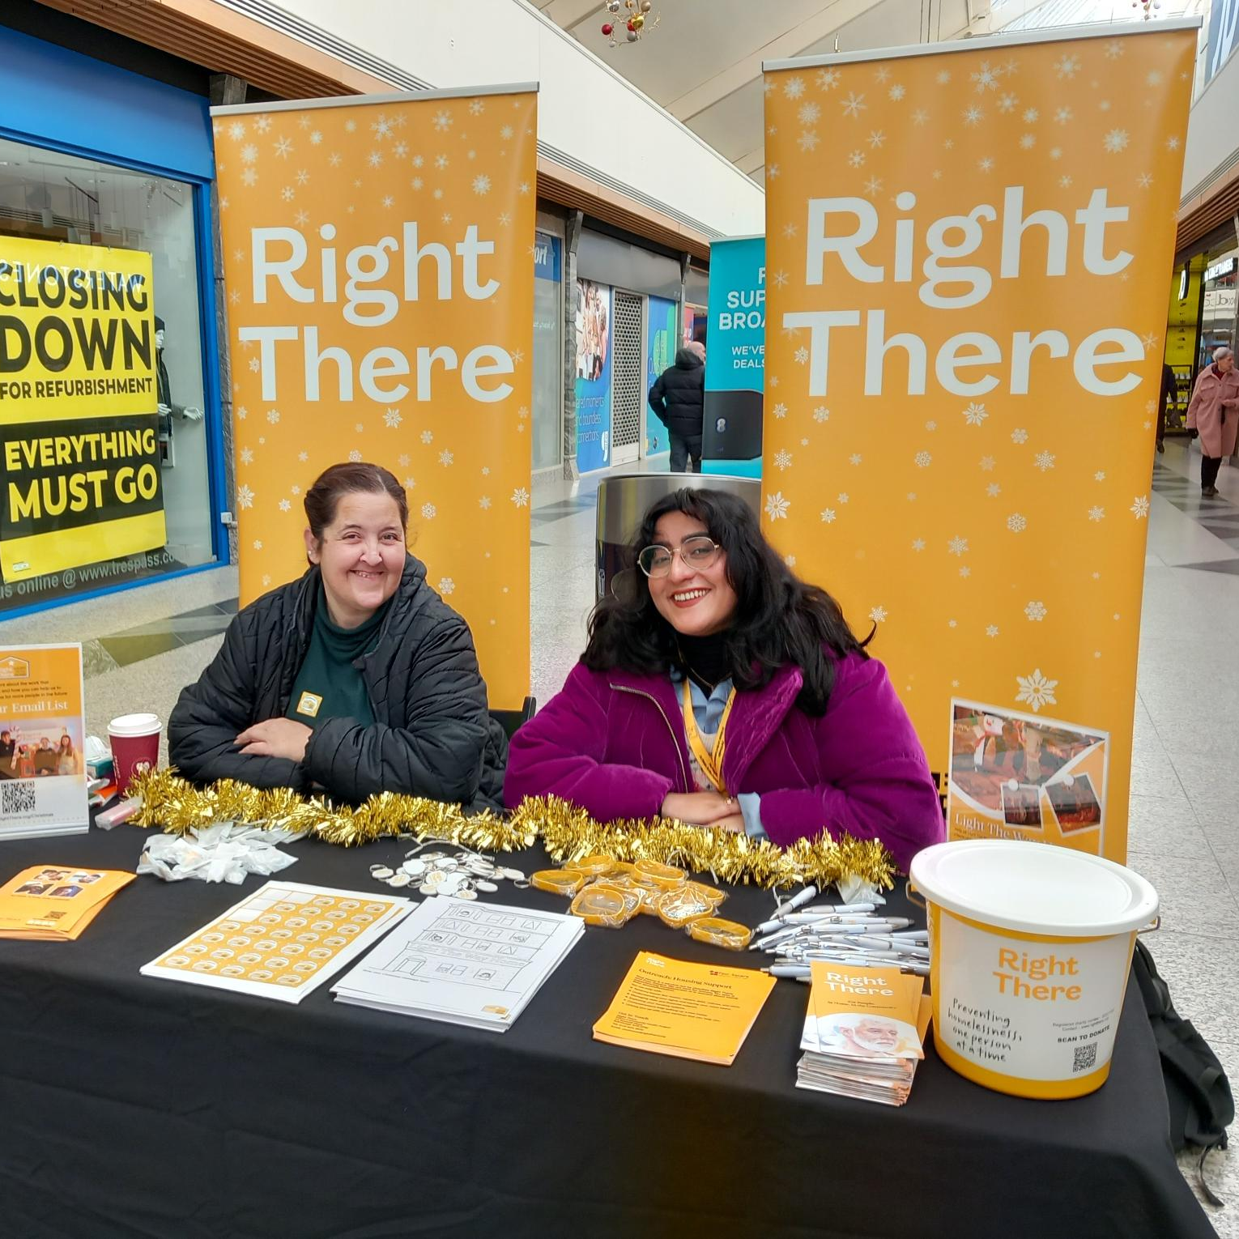
What does our team say?
I joined Right There in early 2023 and I was supported by my colleagues and management to become confident in my role. Later that year an opportunity became available for the post of Senior within the team, and I was supported and encouraged to apply internally.
Becoming a Senior Family Support Worker has made me feel fulfilled in my career goals, I have a great relationship with management, and I am always treated with respect.
I’m given an appropriate amount of responsibility, and I’m trusted to work autonomously. I feel like my opinions are valued, my goals and ambitions are considered, and I feel supported in my development. I have loved my time as a Senior Family Support Worker as I am able to share my knowledge and experience across the team and the families we support within the programme.
Katherine Wilson, Senior Family Support Worker

Slide 4
What’s Inside
4 - 5
Our Vision, Mission and Values
6 - 7
9-10
Requirements
11-12
Role Details
13
Our People Benefits
14
How to Apply
15
16

Slide 5
About Right There
We are Right There, a charity celebrating our 200th anniversary in 2024. We provide tailored support for people, at home, and in the community. We are here for people who are living with the effects of homelessness, poverty, addiction, or family breakdowns. Last year we supported almost 4,000 individuals, helping to prevent them from becoming homeless or separated from the people they love.
We are here to offer the right support at the right time, including breaking down financial barriers; accessing the private rental market; linking up with local health, employment and training services to help people make connections within the community; and, helping people feel happier, safer, and more confident to take steps to improve their own lives.
Every person’s story is unique, and everyone’s route home is different, so we tailor our response to the individual. We want to challenge stereotypes – it doesn’t matter what the situation is – we’re not here to judge, only to help.
Our approach is about creating trusting relationships and nurturing people’s strengths, and our 200 dedicated staff, mentors and volunteers play a crucial role in this.

Slide 6
Our key areas of focus
For People
We provide tailored support for children and adults to help individuals and families feel happier, create stronger bonds and stay together.
At Home
We provide safe and supportive places to call home for people of all ages, from any circumstances, for as long as they might need it.
In The Community
We provide the tools for people to live independently and build their lives within their community, creating their own safe and secure homes.

Slide 7
Our Vision A world where everyone has an equal chance to create a safe and supportive place to call home.
Our Mission We meet people where
they are in life with no judgement; walking alongside those who need support, and preventing them becoming homeless
or separated from the people they love.

Slide 8
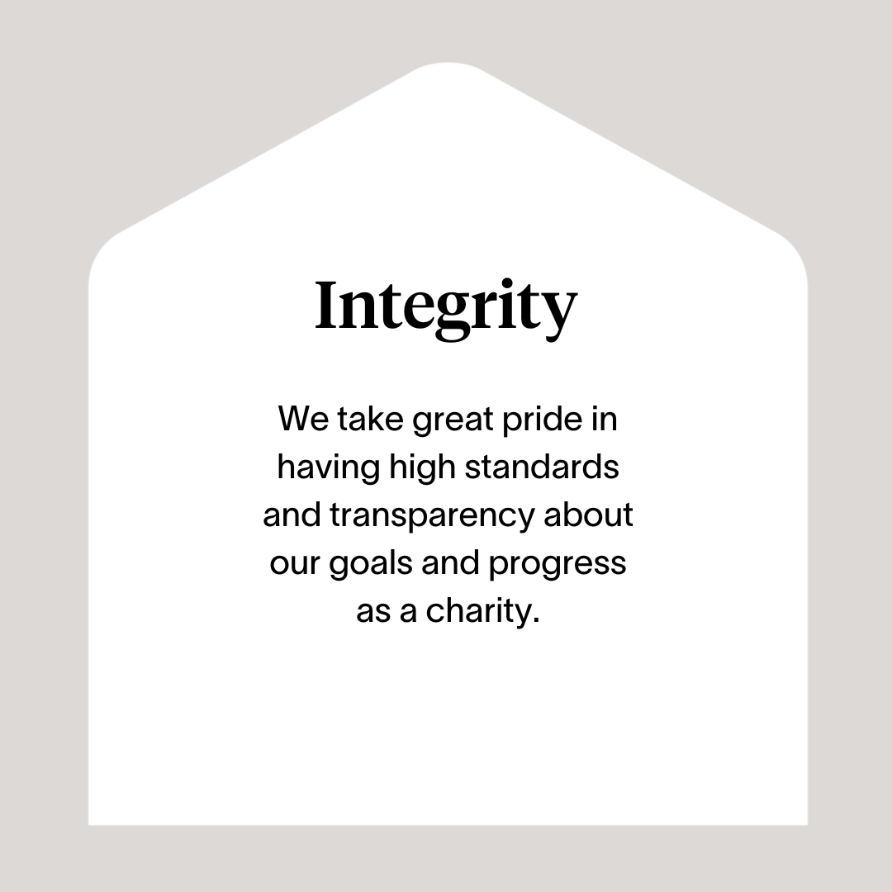

Slide 9
Main Role Responsibilities
Team Management
Provide line management and supervision to a team of Family Support Workers, ensuring clarity of role expectations and performance standards
Offer guidance, support, and regular feedback to staff, promoting professional development through coaching and reflective practice
Lead regular team meetings, fostering a positive team culture and ensuring open communication and collaborative working
Manage and support staff wellbeing, ensuring a healthy work environment and promoting a good work-life balance
Conduct performance appraisals and assist in identifying training needs and development opportunities for team members
Lead by example, delivering direct family support where necessary and ensuring best practices are maintained across all aspects of service delivery
Ensure a robust, evidence-based approach to supporting families, regularly evaluating and improving the quality of services offered
Manage the case load of the team, ensuring that families receive timely and appropriate interventions that meet their needs
Contribute to the development and implementation of service strategies, ensuring alignment with organisational goals and community needs
Take responsibility for the oversight of complex cases, providing guidance on effective interventions, risk assessments, and outcome tracking
Act as a key point of contact between your team, external agencies, and other key stakeholders, ensuring effective communication and multi-agency working.
Programme Operations
Provide appropriate levels of high-quality support to families in their homes and in the community
Adopt a flexible approach allowing families to receive support whenever is best for them including evenings and weekends
Deliver evidenced based family support that helps families overcome current challenges and build resilience for the future
Maintain accurate case files for all family members and consistently assess progress across all outcomes for all family members
Plan, implement and continuously develop packages of tailored interventions for families to meet the needs of the individual child, their parent(s)/carer(s), siblings and wider family network. Including: practical support; parenting education and support; and emotional health and wellbeing, as well as other factors that are unique to that family.
Assist individuals accessing the service to engage and integrate into their local community and become active citizens.
Undertake whole family assessments that focus on strengths and continuous assessment of progress towards outcomes for all family members

Slide 10
Main Role Responsibilities
Have comprehensive local knowledge of other relevant services and support family members to access these
Commit to ensuring that that all support provided is Right There’s approach to ensuring a Psychologically Informed Environment
Adopt a person-centred approach and participate in reflective practice
Contribute to our commitment to work together with peers from other organisations delivering family support in the community by sharing resources, contributing to meetings, working together to create opportunity and share learning
Ensure delivery is aligned with the UN Convention on The Rights of The Child
Encourage and promote people accessing the service to be involved in improvement and development of the service.
Develop good communication and working relationships with children and families, colleagues and other professionals
Work alongside all immediate family members and extended family/support network as required
Advocate on behalf of children and families
Support children and families in the local community
Represent Right There to local partnership agencies including Local Authority, Social Work, Housing Services and other relevant bodies
Actively contribute to your service and the organisation’s development and improvement.
Participate in team meetings.
Attend and participate in training and share learning experiences.
Engage in reflective practice.
Feedback on the review of organisational polices & procedures and local guidelines
Promote and represent Right There services positively.
Strive for continuous personal and professional development.
Engage with any organisational initiatives or working groups such as NHS Healthy Working Lives, Investors In people etc.
Retain up to date knowledge so that you can provide evidence-based family supports

Slide 11
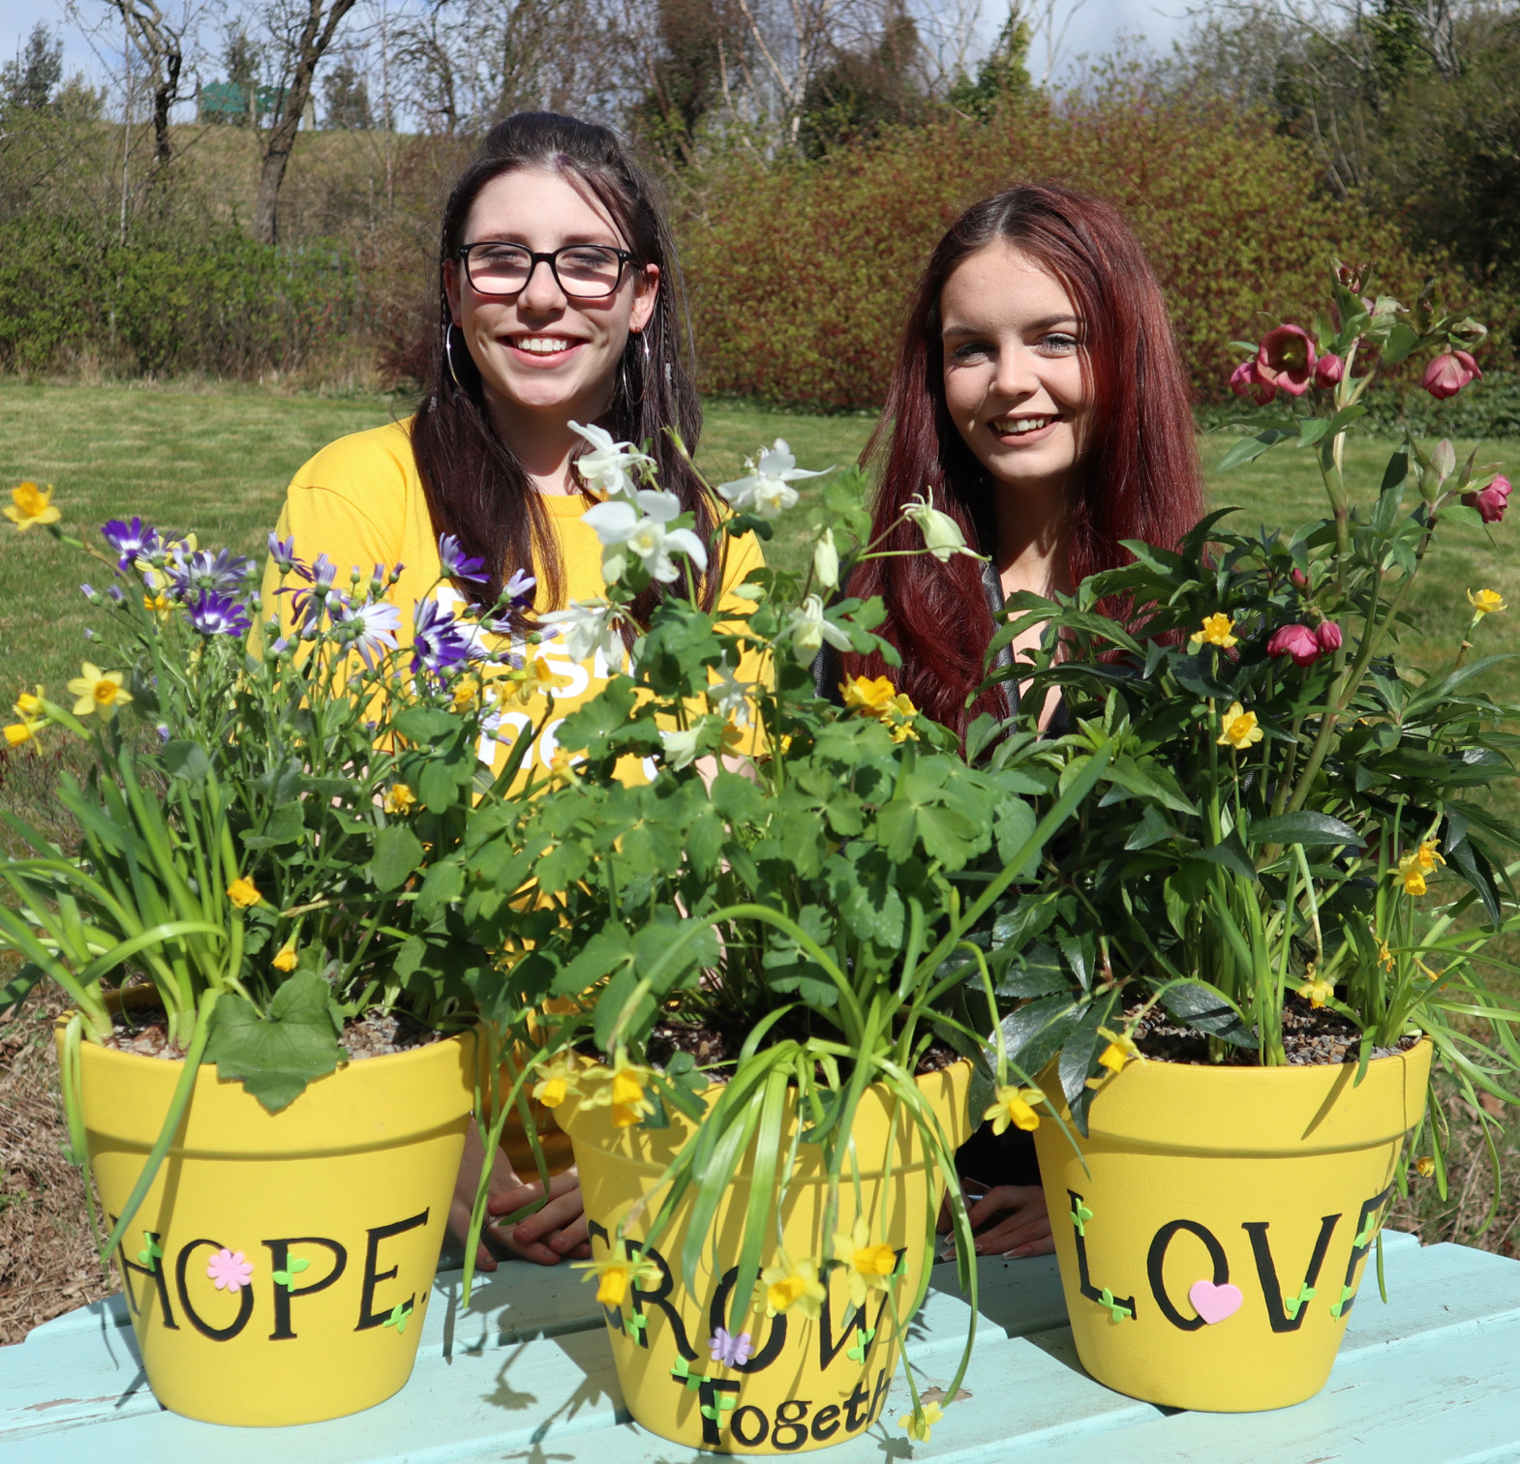
Essential skills and experience
Experience of supervising and supporting a staff team.
Experience of working with children, young people and families facing challenges and on the edges of care.
Understanding of current relevant legislation and policies relating to children, young people and families, including GIRFEC, UNCRC, The Promise.
Knowledge of the key issues facing children, young people and families such as the effects of trauma and poverty.
Understanding of, and commitment to, children and young people’s rights.
Ability to demonstrate experience of adopting a person-centred and strengths-based approach to working with people.
Ability to work as part of a designated team to develop skills in assessment, support planning, risk assessment and reviews.
Ability to influence and inform good working practices.
Working knowledge of SSSC Codes of Practice.

Slide 12
Essential skills and experience
Able to demonstrate skills and experience in prioritizing resources to meet the needs of individuals / group.
Flexibility with regards to working patterns.
Ability to travel within agreed geographical area
Ability to respond at short notice to crisis situations.
Desirable Skills and Experience
Understanding of the principles of working within a Psychologically Informed Environment (PIE).
Qualified or willing to work towards a relevant professional qualification at SCQF level 7 or above, for example SVQ 3 Social Services (Children and Young People) or relevant HNC or equivalent.
A full UK driving license and access to car for work purposes is beneficial

Slide 13
Role Details
Contract: Full time, permanent, 35 hours per week. Salary: SCP 23-26 (£26,687 - £29,285 per annum) Reporting to: Service Manager
Your normal working hours are an average of 35 per week. These hours will be worked between Monday to Sunday between the hours of 08.00am and 10.00pm in shifts which are defined by your line manager on a rolling rota, over a 52-week period. The rota will be available to you a minimum of one week in advance. You may be required to work different shift times, with reasonable notice, in agreement with your line manager.
Your usual place of work will be 15 Dava Street, Glasgow, G51 2JA. You are also required to work in the local community, and you will be paid travel expenses between your usual place of work and appointments undertaken in the course of your duties.
Alternatively, you may also choose to work remotely from your home address where appropriate. Working arrangements must be agreed with your line manager, based on the needs of the service.
Expenses are not payable for travel between your home to your usual place of work.
You may be required to work from such other place as the organisation may reasonably require from time to time.
Annual leave entitlement of 210 hours holiday (equivalent to 6 weeks) pro rata per year in the first year rising to 280 hours (equivalent to 8 weeks) pro rata per year in the second. This includes public holidays.
All appointments are subject to a minimum of a 12-week probationary period.
You will be automatically enrolled into the People’s Pension. Deductions will be taken from your salary in the month you will complete 3-months of employment
It is the nature of the work of Right There that tasks and responsibilities are, in many circumstances unpredictable and varied. All employees are, therefore, expected to work in a flexible way when the occasion arises.

Slide 14
Our People Benefits
We know how dedicated our people are and we want to help you achieve a good work/life balance – and make it easier to enjoy life’s special moments!
That’s why we’ve got a range of enhanced family-friendly and wellbeing benefits to give you some well deserved perks of being a Right There employee. Benefits include:
Hybrid working – work where is best for you and your role
Enhanced maternity, paternity, adoption, and shared parental leave
Employee 24-hour counselling and wellbeing services
6 weeks annual leave, rising to 8 after a year (plus you can purchase up to 5 more days)
Life insurance 4x your salary
Dedicated training and development plans
Cycle to work scheme
Refer a Friend

Slide 15
How to Apply
To apply send your CV and a short cover letter outlining your interest in and suitability for the role
Applications will be considered as they are received and interviews arranged.
Please also get in touch with any queries Email recruitment@rightthere.org

Slide 16
Thank you. Good luck with your application.

