Slide 1
Job Pack Funding Officer (July 2025)

Slide 2
Job Purpose Funding Officer
The Funding Officer will lead the scoping, development and submission of grant funding bids and support with tenders, generating diverse income streams and other growth opportunities on behalf of Right There.
The tracking of income opportunities and submissions coupled with mapping and prospecting opportunities across the third sector landscape, will ensure that Right There maximises its income potential across all its programmes and the organisation itself.
Support to build and develop a bid library and database and its ongoing maintenance to support the knowledge management for funding applications is required.
Reporting to the Contracts & Tendering Manager the role sits within the Income Diversification & Messaging Team which is led by our Director of Income Diversification and Messaging.
Director of Income Diversification and Messaging
Contracts and Tendering Manager
Communications and Marketing Coordinator
Supporter Engagement Lead
Funding Officer

Slide 3
What’s Inside
4 - 5
Our Vision, Mission and Values
6 - 7
8 - 9
Requirements
10-11
Role Details
12
Our People Benefits
13
How to Apply
14
15

Slide 4
About Right There
We are Right There, a charity celebrating our 200th anniversary in 2024. We provide tailored support for people, at home, and in the community. We are here for people who are living with the effects of homelessness, poverty, addiction, or family breakdowns. Last year we supported almost 4,000 individuals, helping to prevent them from becoming homeless or separated from the people they love.
We are here to offer the right support at the right time, including breaking down financial barriers; accessing the private rental market; linking up with local health, employment and training services to help people make connections within the community; and, helping people feel happier, safer, and more confident to take steps to improve their own lives.
Every person’s story is unique, and everyone’s route home is different, so we tailor our response to the individual. We want to challenge stereotypes – it doesn’t matter what the situation is – we’re not here to judge, only to help.
Our approach is about creating trusting relationships and nurturing people’s strengths, and our 200 dedicated staff, mentors and volunteers play a crucial role in this.

Slide 5
Our key areas of focus
For People
We provide tailored support for children and adults to help individuals and families feel happier, create stronger bonds and stay together.
At Home
We provide safe and supportive places to call home for people of all ages, from any circumstances, for as long as they might need it.
In The Community
We provide the tools for people to live independently and build their lives within their community, creating their own safe and secure homes.

Slide 6
Our Vision A world where everyone has an equal chance to create a safe and supportive place to call home.
Our Mission We meet people where
they are in life with no judgement; walking alongside those who need support, and preventing them becoming homeless
or separated from the people they love.

Slide 8
Main Role Responsibilities
Income diversification and Growth
Responsible for scoping, preparing, writing and submitting compelling funding proposals and grants and supporting with tender submissions
Facilitation of scoping & assessing risk of opportunities, contributing to an increased level of bid opportunities where relevant and appropriate to Right There’s mission and vision
Responsible for coordinating the completion of grant applications and reports in line with contractual compliance and liaising with internal and external colleagues to ensure timely submission
Supporting the monitoring of contracts and grants opportunities including active mapping and tracking of income streams and effective resubmission process
Supporting the development of funding/income ‘pipeline’ portfolio, providing regular review of diverse income opportunities across 3rd sector landscape and maintaining the bid library
Support with the development and review of Right There Bid Library – creating good practice response examples linked to programmes
Supporting the tender submission process where required
Maintaining up to date knowledge of current trends and developments across the sector, contributing to a live knowledge bank that benefits the organisation
Working with the communications team to promote Right There programmes through agreed media outlets
Actively contributing to the development of the organisation and of individual programmes, through supporting operational staff, managers and support services where appropriate

Slide 9
Main Role Responsibilities
Responsible for capturing feedback from commissioners, grant-makers & internal colleagues to continuously improve bids and bid process
Supporting communication with fundraising initiatives and bids linked to programme development
Relationships
Support the Contracts & Tendering Manager and Director of Income Diversification & Messaging to pursue the strategic aims of the organisation
Act as a role model to Right There staff, volunteers and the people we support
Develop positive and respectful and compassionate relationships with staff, volunteers and the people we support, focusing on their strengths and aspirations as individuals
Have a high standard of professional integrity with colleagues and other professionals
Always establish and uphold clear professional boundaries
Actively engage with service delivery and programmes to keep up to date on background and context for informing need for funding streams to benefit programmes and activities

Slide 10
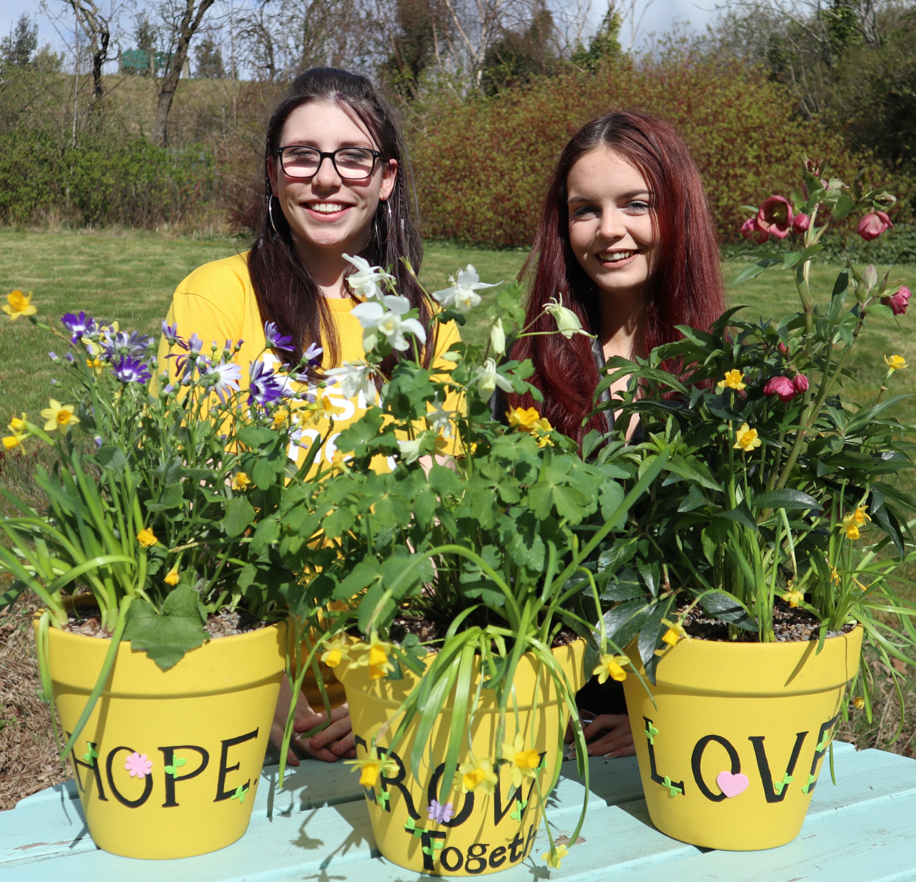
Essential skills and experience
Demonstrable track record in tender/grant fundraising or writing
Experience of bid management from identifying opportunities to successful completion
Excellent communication skills both verbal and written
Qualified to degree level, or highly literate with equivalent experience in undertaking a role that involves analysis or research
Experience of developing funding applications or public tender responses
Excellent knowledge and understanding of the landscape in which Right There operates
Understanding of current legislation, policies and strategies relating to housing, social work, social care and family support services
Experience of report writing and production of management reports
Flexibility regarding working patterns
Ability to travel to Right There programmes as and when required
Ability to research and collate appropriate material to strengthen bids

Slide 11
Personal Attributes
Solution orientated, self-motivated and results driven
Strong attention to detail
Excellent verbal and written communication skills
Highest standards of professional integrity with colleagues and other professionals
A pragmatic problem solver with intellectual flexibility and agility to move easily between significant details and the bigger picture
A strong ethos to succeed and a belief that difficult challenges can be solved
Cultural sensitivity with an ability to work well with a diverse range of people
Demonstrable commitment to Right There’s mission and values

Slide 12
Role Details
Contract: Full time, permanent, 35 hours per week. Salary: SCP 29-32 (£32,391 - £35,482 per annum) Reporting to: Contracts and Tendering Manager
Working hours are Monday to Friday – worked flexibly between the hours of 9.00am to 5.00pm depending on the needs of the service, with one-hour unpaid break.
Your core place of work will be 15 Dava Street, Glasgow, G51 2JA. Alternatively, you may choose to work remotely from your home address where appropriate, working arrangements must be agreed with the line manager based on the needs of the service.
You may be required to work from such other place as the organisation may reasonably require from time to time.
Annual leave entitlement of 210 hours holiday (equivalent to 6 weeks) pro rata per year in the first year rising to 280 hours (equivalent to 8 weeks) pro rata per year in the second. This includes public holidays.
All appointments are subject to a minimum of a 12-week probationary period.
You will be automatically enrolled into the People’s Pension. Deductions will be taken from your salary in the month you will complete 3-months of employment
It is the nature of the work of Right There that tasks and responsibilities are, in many circumstances unpredictable and varied. All employees are, therefore, expected to work in a flexible way when the occasion arises.

Slide 13
Our People Benefits
We know how dedicated our people are and we want to help you achieve a good work/life balance – and make it easier to enjoy life’s special moments!
That’s why we’ve got a range of enhanced family-friendly and wellbeing benefits to give you some well deserved perks of being a Right There employee. Benefits include:
Hybrid working – work where is best for you and your role
Enhanced maternity, paternity, adoption, and shared parental leave
Employee 24-hour counselling and wellbeing services
6 weeks annual leave, rising to 8 after a year (plus you can purchase up to 5 more days)
Life insurance 4x your salary
Dedicated training and development plans
Cycle to work scheme
Refer a Friend

Slide 14
How to Apply
To apply send your CV and a short cover letter outlining your interest in and suitability for the role.
Email recruitment@rightthere.org

Slide 15
Thank you. Good luck with your application.

