Slide 1

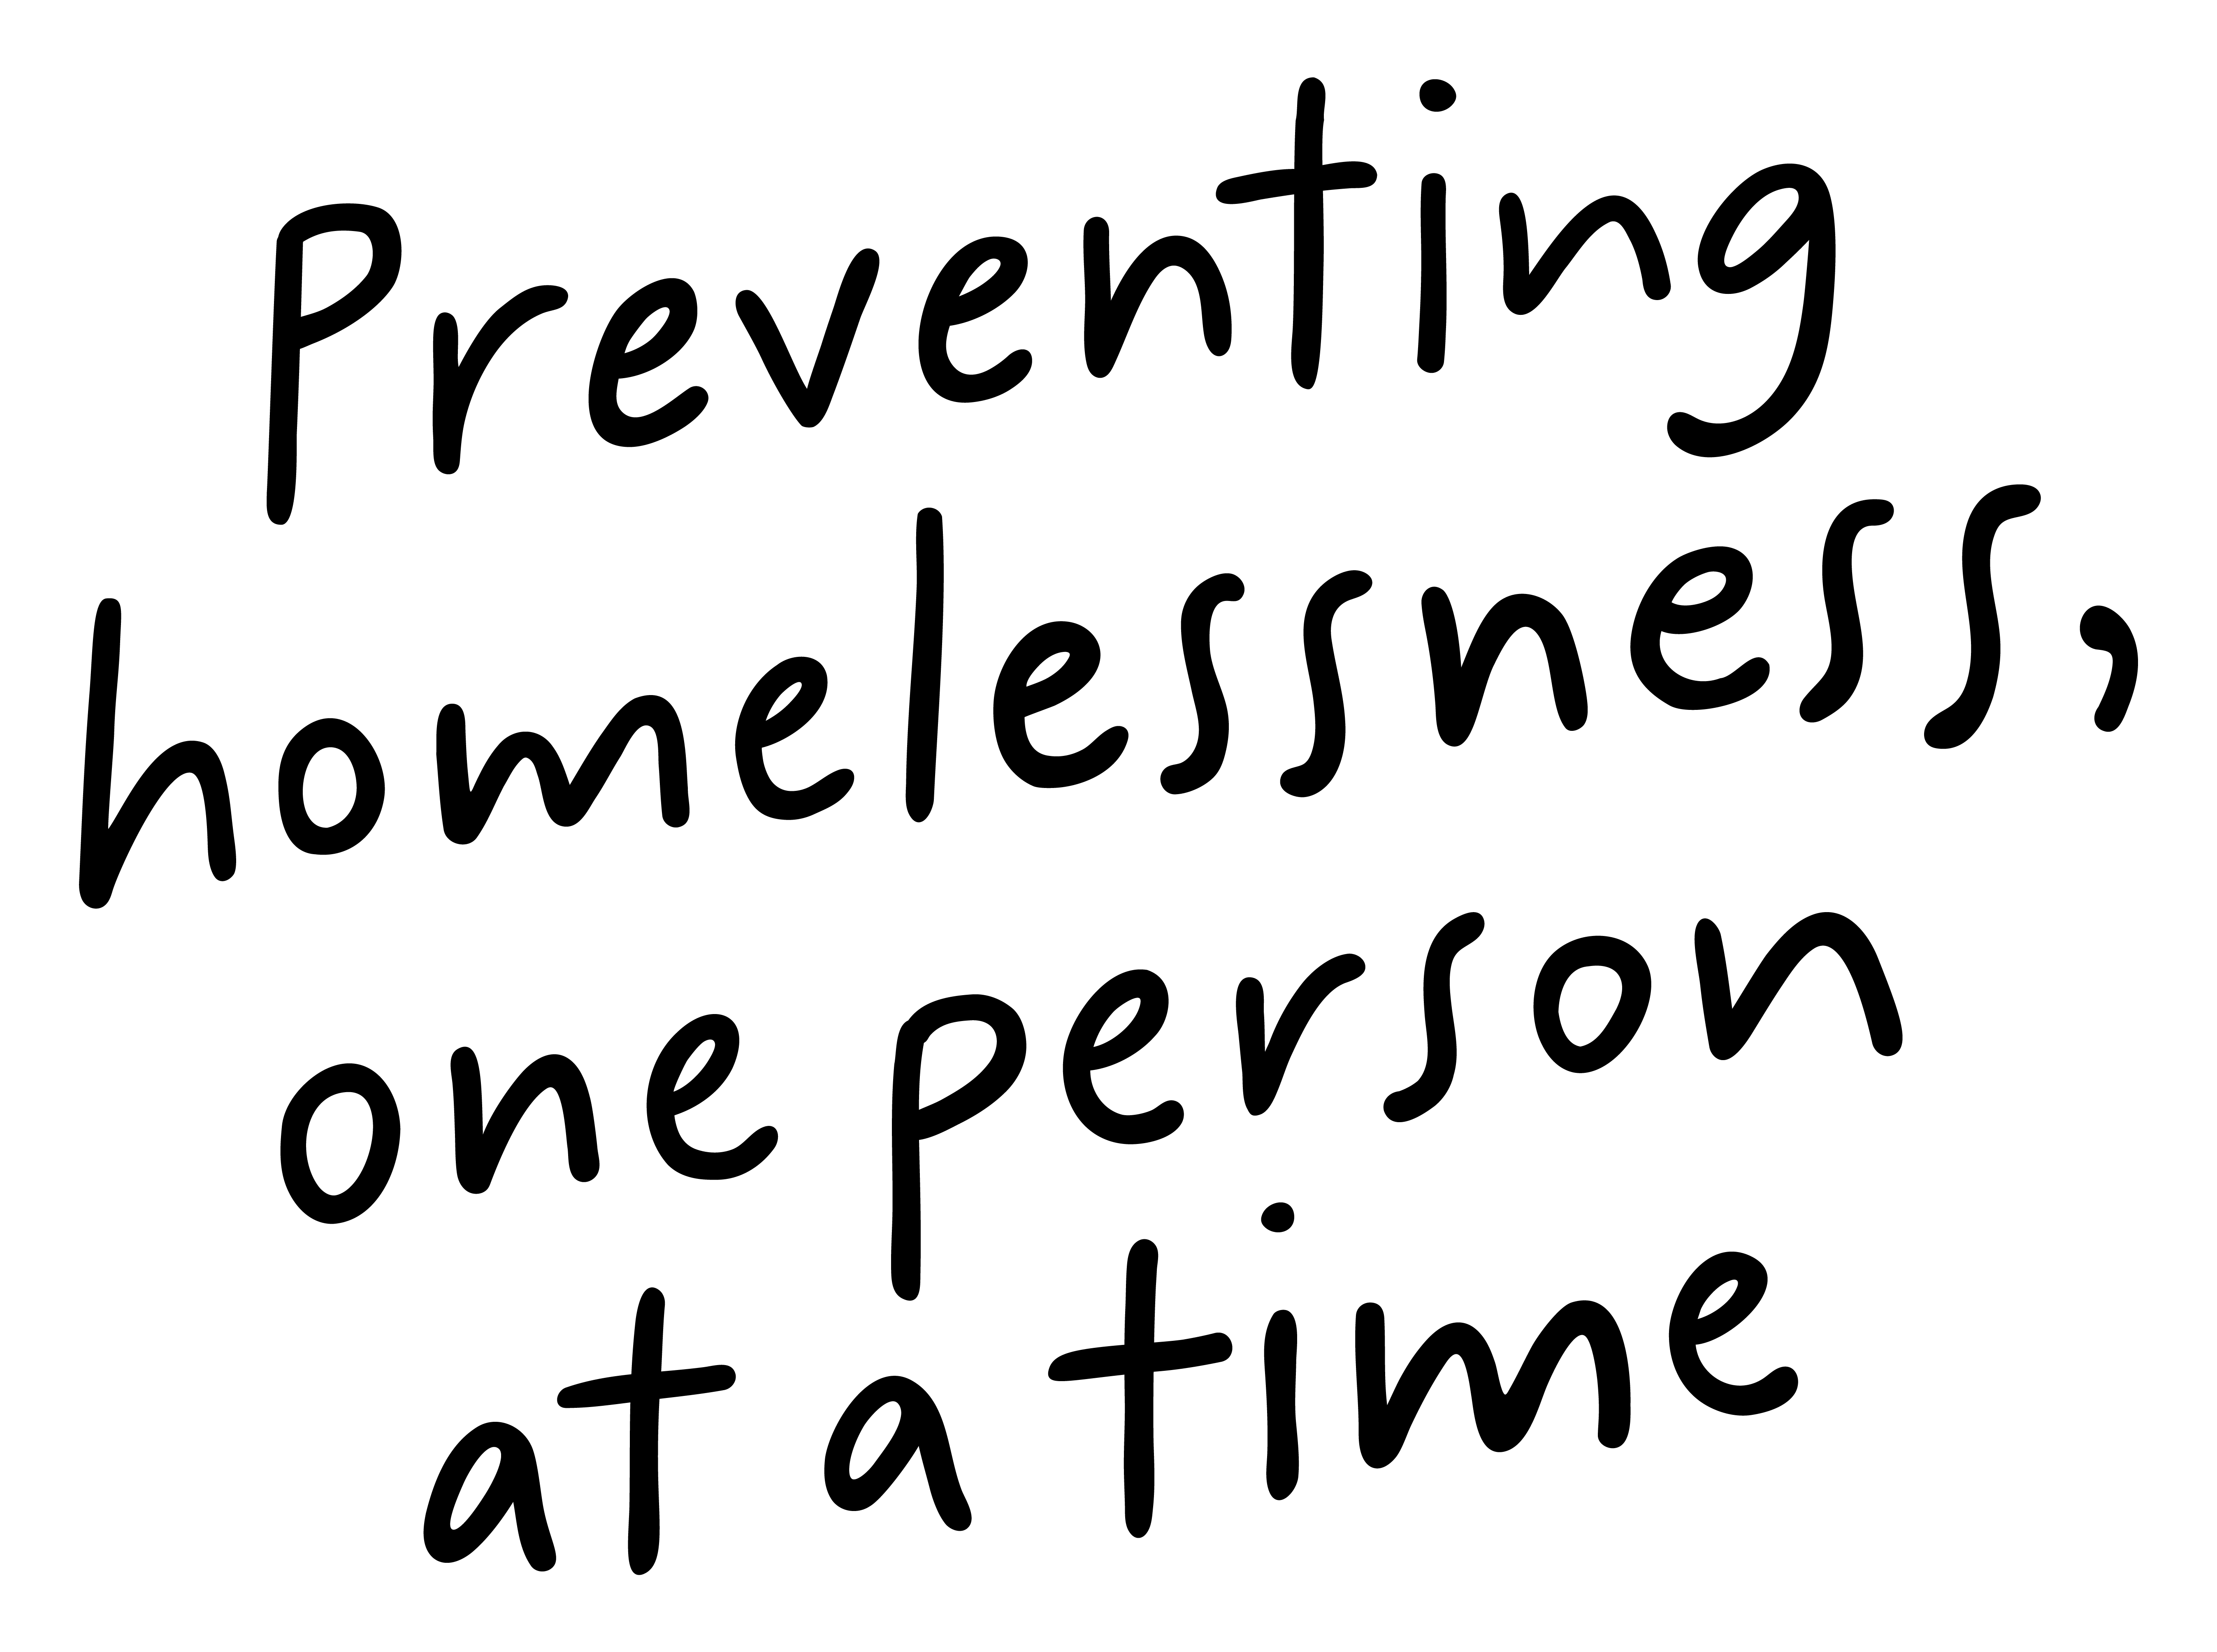
Job Pack
Housing Team Lead
(July 2025)

Slide 2
Job Purpose
Housing Team Lead-Short Term Housing Glasgow
Short-Term Housing Glasgow provides a service between private property owners and tenants.
There are two parts to the Service: Help to Rent and Short-Term Housing. Through both of these areas, we provide tenancy sustainment support to people who are experiencing homelessness, or who are in danger of becoming homeless.
We provide high standards of accommodation and, crucially, create a platform for some of society’s most under-represented people with the ultimate aim of making a genuine difference in their lives.
The Housing Team Lead will lead a programme team and manage a programme of best practice meeting expected standards and quality outcomes and implementing operational controls. Ensure staff know and implement policies and procedures. Lead programme development, actively create opportunities for the people we support to feedback and contribute to the development of the programme. Provide direct support cover as required. The Housing Team Lead will liaise with the temporary accommodation team on a weekly basis to discuss referrals and match the people we support to a suitable Right There property.
Housing Services Manager
Housing Team Leads
(Current Vacancy)
Housing Admin Supervisor
Property Sourcing Agent
Tenant Liaison Workers
Administrators

Slide 3


What’s Inside
4 - 5
Our Vision, Mission and Values
6 - 7
8 - 10
Requirements
11-12
Role Details
13
Our People Benefits
14
How to Apply
15
16

Slide 4


About Right There
We are Right There, a charity celebrating our 200th anniversary in 2024. We provide tailored support for people, at home, and in the community. We are here for people who are living with the effects of homelessness, poverty, addiction, or family breakdowns. Last year we supported almost 4,000 individuals, helping to prevent them from becoming homeless or separated from the people they love.
We are here to offer the right support at the right time, including breaking down financial barriers; accessing the private rental market; linking up with local health, employment and training services to help people make connections within the community; and, helping people feel happier, safer, and more confident to take steps to improve their own lives.
Every person’s story is unique, and everyone’s route home is different, so we tailor our response to the individual. We want to challenge stereotypes – it doesn’t matter what the situation is – we’re not here to judge, only to help.
Our approach is about creating trusting relationships and nurturing people’s strengths, and our 200 dedicated staff, mentors and volunteers play a crucial role in this.

Slide 5

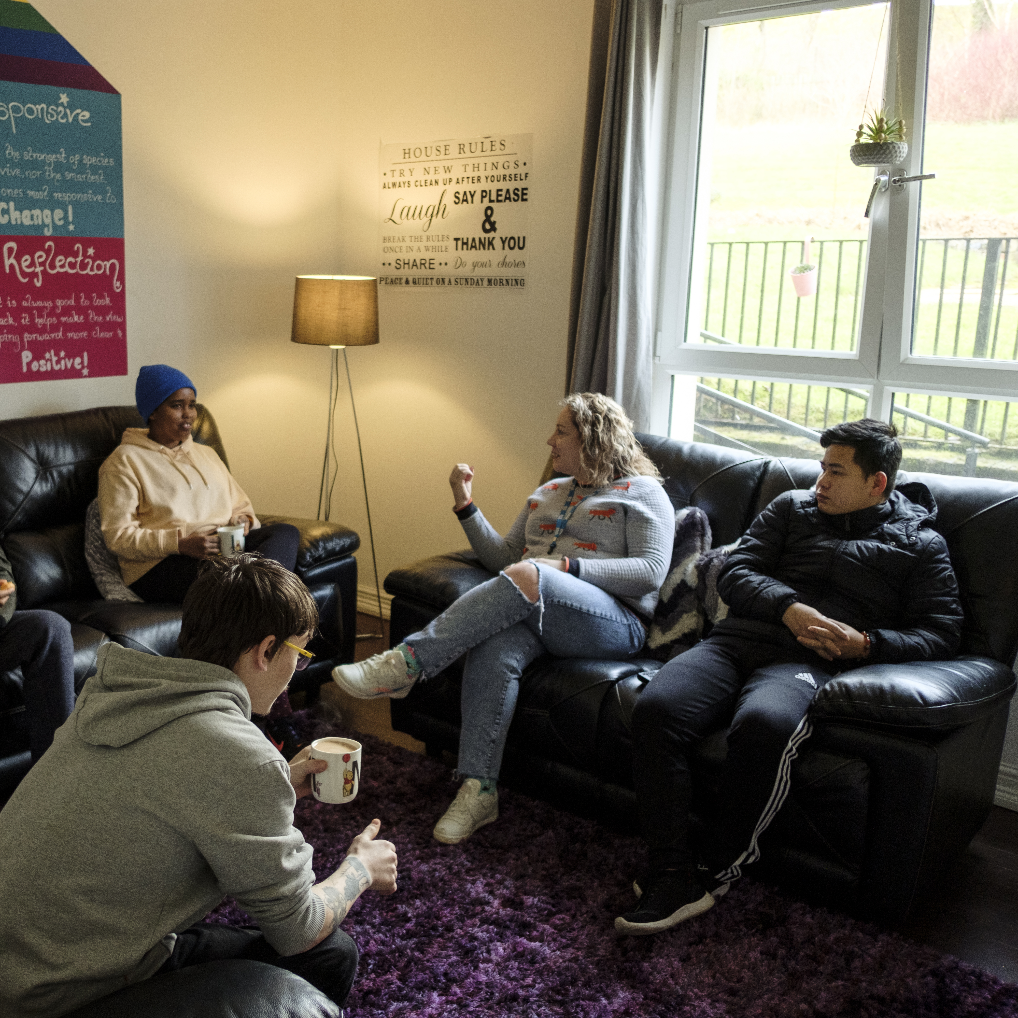
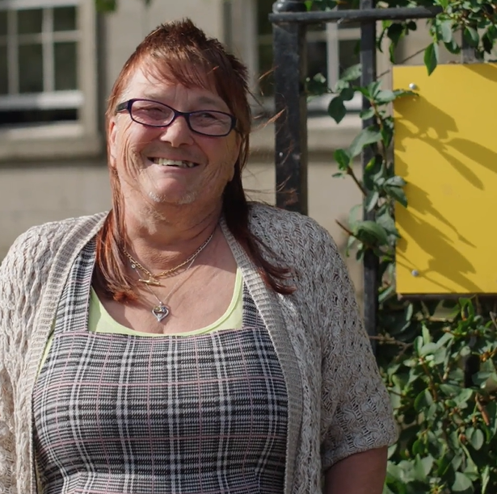
Our key areas of focus
For People
We provide tailored support for children and adults to help individuals and families feel happier, create stronger bonds and stay together.
At Home
We provide safe and supportive places to call home for people of all ages, from any circumstances, for as long as they might need it.
In The Community
We provide the tools for people to live independently and build their lives within their community, creating their own safe and secure homes.

Slide 6

Our Vision
A world where everyone has an equal chance to create a safe and supportive place to call home.
Our Mission
We meet people where
they are in life with no judgement; walking alongside those who need support, and preventing them becoming homeless
or separated from the people they love.

Slide 7







Slide 8
Main Role Responsibilities
Responsibility to the Programme
Lead a team of Tenant Liaison Workers to deliver a quality programme focused on the agreed service levels and outcomes for the people we support.
As a member of the Housing and Communities Management team prepare for and support the implementation of programme growth.
Lead your direct line reports to implement the annual business plan for the programme
Ensuring all referrals to the service are assessed and progressed in line with service specification.
Ensuring occupancy levels are maintained through efficient allocation and void management of properties.
Liaison with external agencies such as Community Homeless teams, Housing Benefit and Council Tax teams, landlords, support providers, health services, local authority and other agencies as required.
Work closely with Right There Property Team to assist in maintaining strong working relationships with Landlords and Agents.
Assist Right There Property Team with property access request arrangements with Landlords, agents and contractors for compliance, repairs and property inspections.
Ensuring that contractual obligations and the individual needs of those who we support are met by maintaining a system of regular tenancy sustainment support.
Ensuring risk assessments are completed and updated.
Model to your team and maintain trusting, trauma informed relationships with people we support within established clear professional boundaries
Advocating on behalf of the people who we support.
Investigating and resolving any complaints by the people we support, landlords, neighbours or other external parties.
Ensuring a safe environment for the people we support, colleagues and others
Establish and maintain local networks and work closely with local stakeholders, service providers and commissioners positively representing Right There to local partnership agencies including local authority, Social Work, Housing providers and other local authority

Slide 9
Main Role Responsibilities
Responsibility to the programme continued..
Ensure case files are maintained and all relevant documentation is completed to the highest standards and within agreed timescale and regularly audit the files.
Work closely with our Finance Team to manage and prevent Housing Benefit Debt and tenant rent arrears.
Have an understanding of the Welfare benefit system and be willing to undertake any additional training required.
On call responsibility, to be on an on call rota
People Management
Recruit, induct, onboard your team and manage your people resources safely
Develop a high performing team with focus on positive trusting and supportive relationships with your staff and peers.
Arranging and facilitating regular team meetings and support and supervision sessions with your team, utilising best practice in performance management to ensure staff are supported to undertake their roles.
Completing yearly appraisals and personal development plans with your staff team.
Managing staff sickness and absence issues in conjunction with People Department.
Investigating any issues of misconduct within the organisation.
Ensure a safe system of work is in place for staff who are working outside office hours and in lone working situations.

Slide 10
Roles & Responsibilities
Responsibility for planning, data, information and finance
  Contribute to the programme Annual Business Plan and ensure the full team understand and work to the agreed objectives.
  Compile Right There Key Performance Indicators (KPIs) to support agreed delivery outcomes for the programme.
  Maintain appropriate tracking, monitoring and evaluation mechanisms for the programme , complete analysis, reporting and recommendations monthly.
  Deliver required local authority returns / reports for the programme.
  Work towards performance targets to achieve agreed results
Being part of the Right There team:
  Have a high standard of professional integrity with colleagues and other professionals
  Having a detailed knowledge of other relevant services
  Engage in reflective practice.
  Be a proactive team member actively contributing to your service working collaboratively with your colleagues across the organisation.
  Strive for continuous professional development and regular reflection on the approach, caseload and evaluation outcomes with line manager and work in tandem with Right There’s People First Team for support and guidance.
  Contribute to the organisations' development and improvement with feedback on the review of organisational policies and procedures and local guidelines
  Engage with any organisational initiatives or working groups
  Adhere to Right There Policies and Procedures, Health and Safety legislation and practises and Property Repairing and Tolerable Standards.
  Always apply safeguarding principles and maintain awareness of child protection and adult protection processes.

Slide 11

Essential skills and experience
SVQ Level 3 or SCQF equivalent or an appropriate housing qualification or willingness to undertake
Demonstrable experience of housing management
Housing Law, Information and Advice Standards qualification, or willingness to undertake
An understanding of social housing field and current relevant legislation and policies
Possession of or willingness to undertake additional management training in line with the role
Ability to track, analyse and report on key performance indicators
Ability to work towards performance targets to achieve agreed results
Ability to communicate effectively both verbally and in writing with experience of delivering written and verbal reports.
Experience of working with the people we support.
Ability to influence and inform good working practices supporting staff to develop skills in delivering a quality housing service.
Ability to manage staffing issues on daily basis (performance, sickness absence, time management, etc.) including, ensuring that resource meets service demand.
Ability to work under pressure and meet timescales

Slide 12
Essential skills and experience
Ability to work as part of own staff team and local management team
Ability to communicate effectively with the Housing Services Manager to ensure timeous reporting of issues relating to the overall management of the services
Ability to induct, supervise, support, appraise and manage performance of staff
IT skills relevant to the duties of the post
Full UK drivers’ licence & use of own vehicle for business use (Note: Employees must hold insurance that covers domestic and business use).
Desirable Skills & Knowledge
Willingness to contribute to organisational training and development needs
Ability to work collaboratively with the Housing Services Manager in contributing to service reviews/inspections
Ability to work on multi-agency basis, and encourage positive partnerships with other agencies
First Aid Certificate
Knowledge and understanding of housing support requirements
Knowledge of local resources
Counselling skills in drugs, alcohol and mental health

Slide 13

Role Details
Contract: Full time, permanent, 35 hours per week.
Salary: SCP 26-29 (£29,285 - £32,391 per annum)
Reporting to: Housing Services Manager
Working hours are Monday to Friday – worked flexibly between the hours of 8.00am to 6.00pm, based on the needs of the service, with one-hour unpaid break.
Your core place of work will be Rosemount Business Park, 141-145 Charles Street, Unit E3, Glasgow, G21 2QA Home working is in agreement with the line manager based on the needs of the service. You are also required to work in the local community, and you will be paid travel expenses between your usual place of work and appointments undertaken in the course of your duties.
You may be required to work from such other place as the organisation may reasonably require from time to time.
Annual leave entitlement of 210 hours holiday (equivalent to 6 weeks) pro rata per year in the first year rising to 280 hours (equivalent to 8 weeks) pro rata per year in the second. This includes public holidays.
All appointments are subject to a minimum of a 12-week probationary period.
You will be automatically enrolled into the People’s Pension. Deductions will be taken from your salary in the month you will complete 3-months of employment
It is the nature of the work of Right There that tasks and responsibilities are, in many circumstances unpredictable and varied. All employees are, therefore, expected to work in a flexible way when the occasion arises.

Slide 14

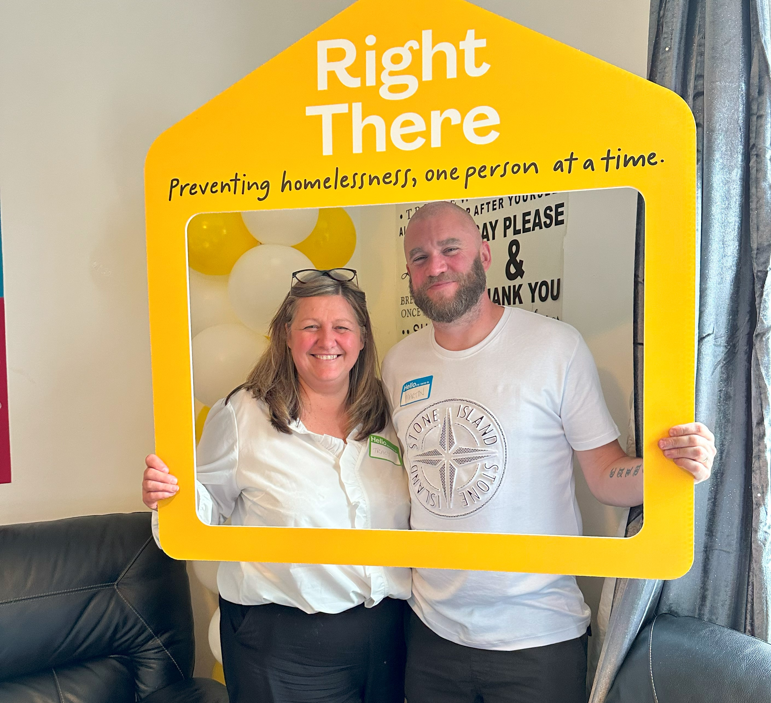
Our People Benefits
We know how dedicated our people are and we want to help you achieve a good work/life balance – and make it easier to enjoy life’s special moments!
That’s why we’ve got a range of enhanced family-friendly and wellbeing benefits to give you some well deserved perks of being a Right There employee.
Benefits include:
Hybrid working – work where is best for you and your role
Enhanced maternity, paternity, adoption, and shared parental leave
Employee 24-hour counselling and wellbeing services
6 weeks annual leave, rising to 8 after a year (plus you can purchase up to 5 more days)
Life insurance 4x your salary
Dedicated training and development plans
Cycle to work scheme
Read more about our benefits by visiting rightthere.org

Slide 15
How to Apply
To apply send your CV and a short cover letter outlining your interest in and suitability for the role.
Email recruitment@rightthere.org

Slide 16
Thank you.
Good luck with your application.

