Slide 1

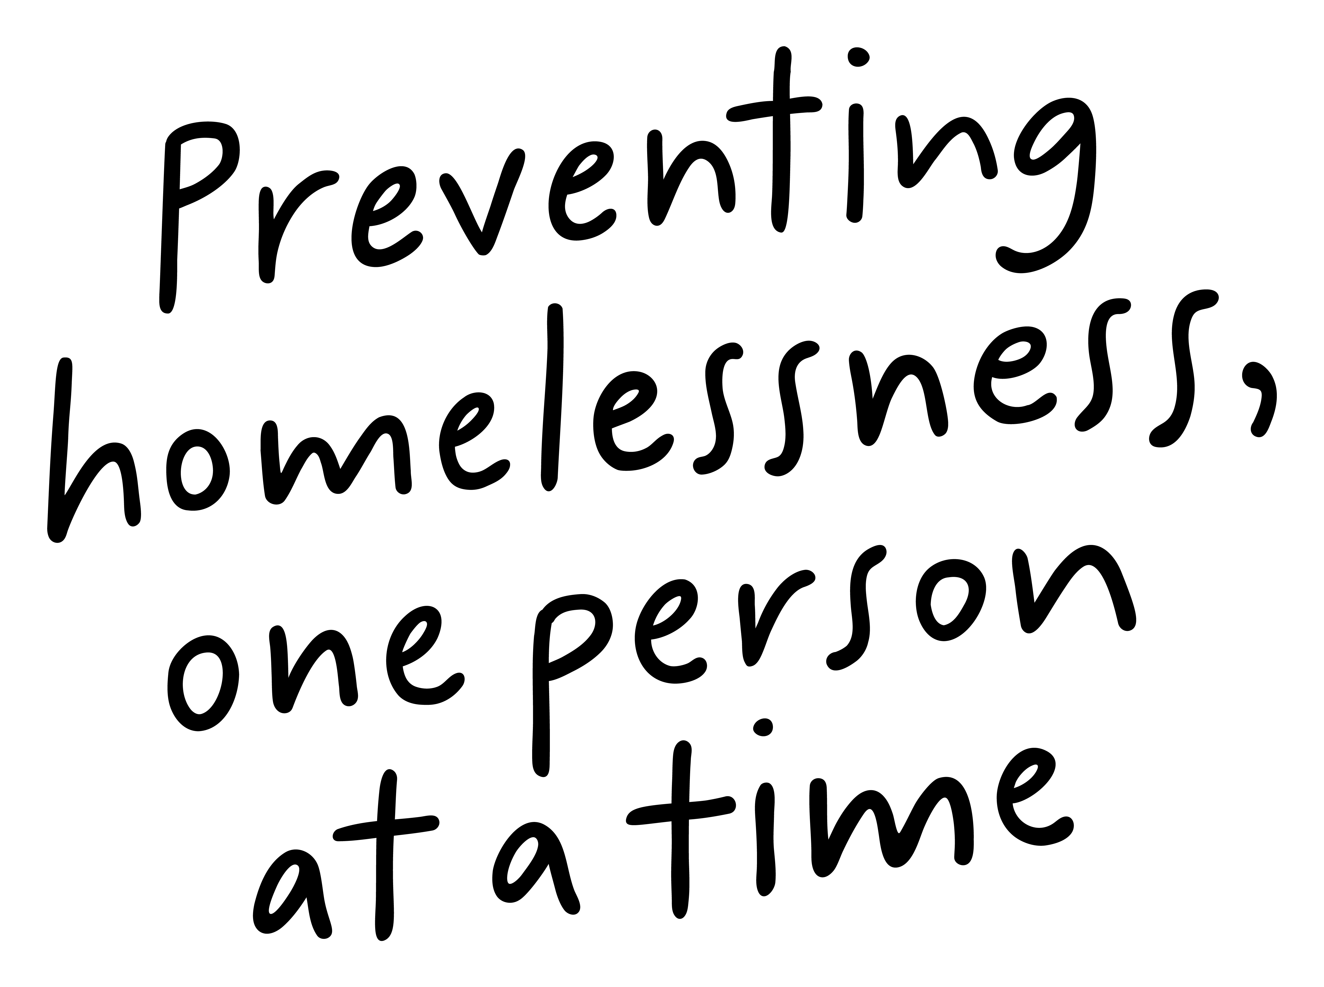
Job Pack
Senior Support Worker
Supported Accommodation Orkney
(July 2025)

Slide 2
Job Purpose
Senior Support Worker
Supported Accommodation Orkney provides a high-quality housing support service for young people aged 16-25 who are homeless in both Kirkwall and Stromness. The Senior Support Worker (SSW) plays a key role in delivering person-centred, trauma-informed support and helping young people move towards independence and recover from homelessness.
The SSW will lead by example, offering guidance to the wider support team while also managing a small caseload of young people with varying levels of need. You’ll be responsible for coordinating support plans, overseeing risk assessments, and providing support and supervision to the team. The SSW works closely with external partners, including housing teams, social workers, and health professionals, to ensure holistic support is in place for each young person.
You will also contribute to the development of life skills sessions and activities that build confidence and resilience, while assisting the Service Manager with safeguarding, quality assurance, and continuous service improvement. Accurate record-keeping and contribution to reports and evaluations will also be part of your day-to-day responsibilities.
Locality Manager
Service Manager
Senior Support Worker
Support Workers

Slide 3


What’s Inside
4 - 5
Our Vision, Mission and Values
6 - 7
8 - 9
Requirements
10-11
Role Details
12
Our People Benefits
13
How to Apply
14
15

Slide 4

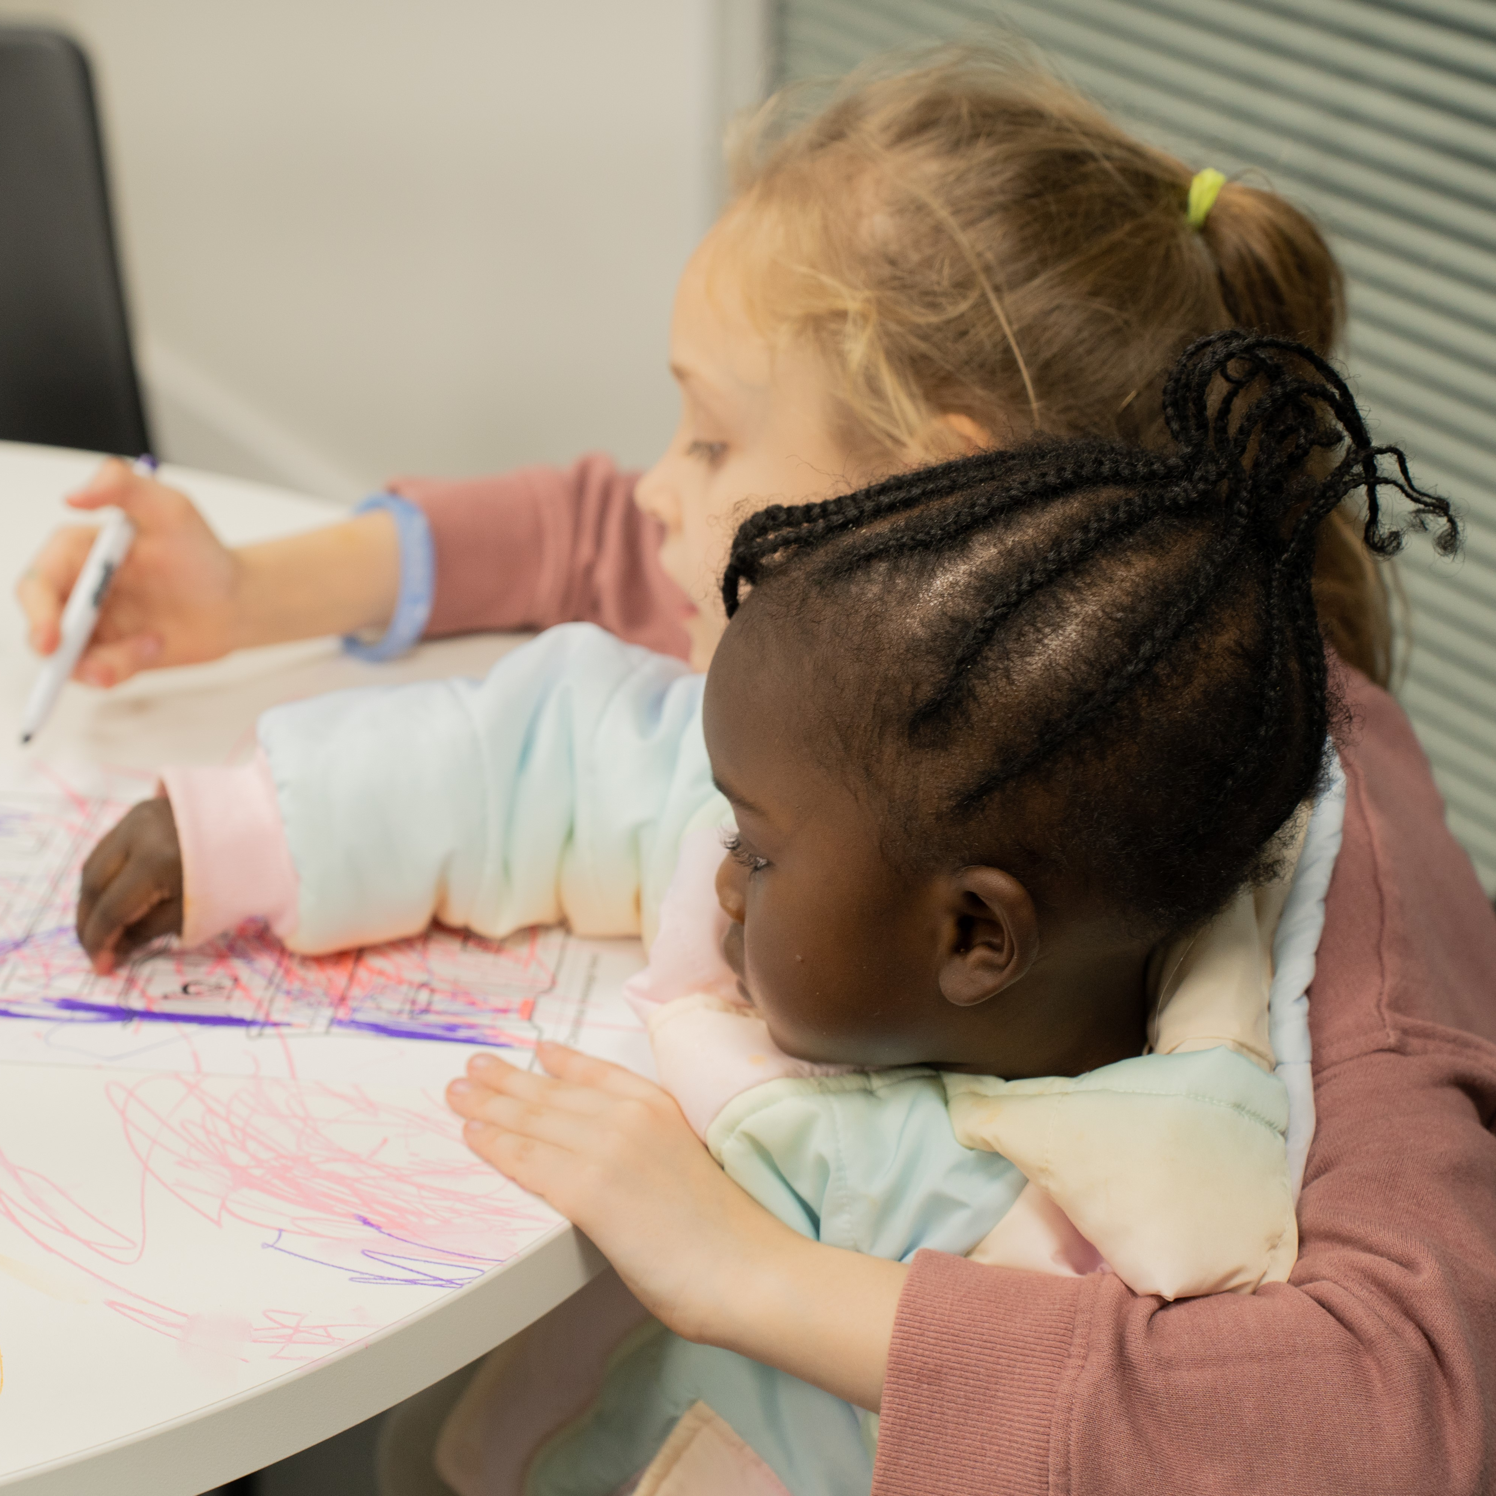
About Right There
We are Right There, a charity celebrating our 200th anniversary in 2024. We provide tailored support for people, at home, and in the community. We are here for people who are living with the effects of homelessness, poverty, addiction, or family breakdowns. Last year we supported almost 4,000 individuals, helping to prevent them from becoming homeless or separated from the people they love.
We are here to offer the right support at the right time, including breaking down financial barriers; accessing the private rental market; linking up with local health, employment and training services to help people make connections within the community; and, helping people feel happier, safer, and more confident to take steps to improve their own lives.
Every person’s story is unique, and everyone’s route home is different, so we tailor our response to the individual. We want to challenge stereotypes – it doesn’t matter what the situation is – we’re not here to judge, only to help.
Our approach is about creating trusting relationships and nurturing people’s strengths, and our 200 dedicated staff, mentors and volunteers play a crucial role in this.

Slide 5
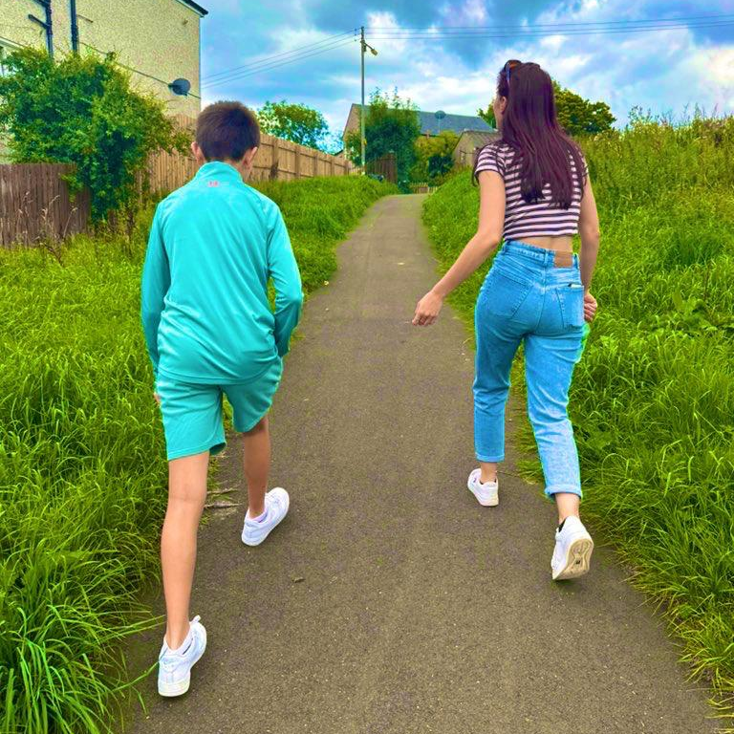
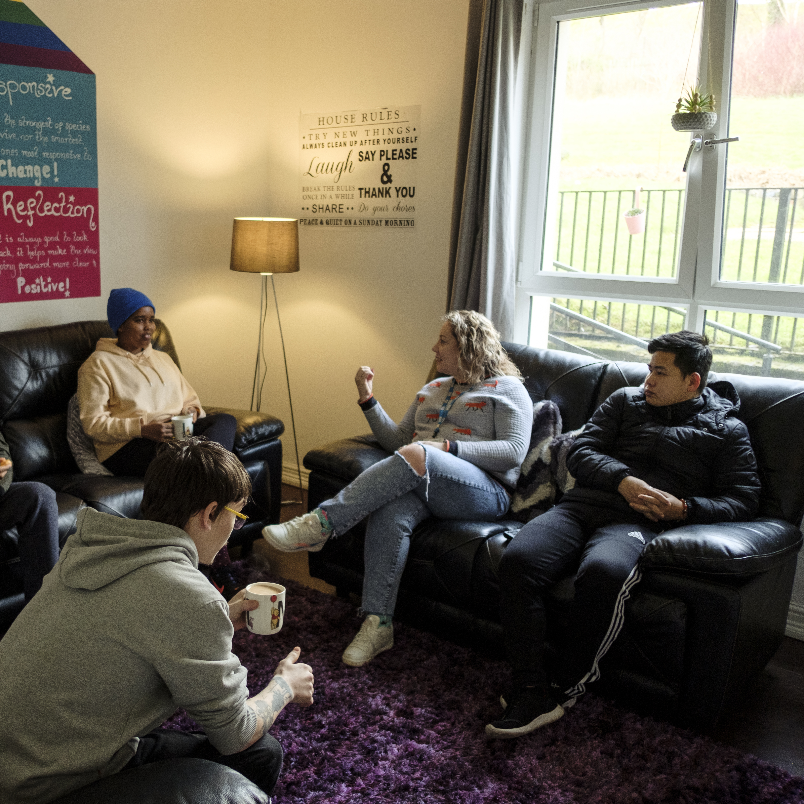
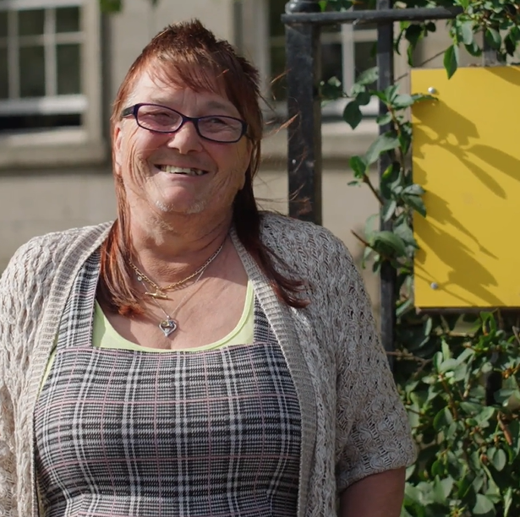
Our key areas of focus
For People
We provide tailored support for children and adults to help individuals and families feel happier, create stronger bonds and stay together.
At Home
We provide safe and supportive places to call home for people of all ages, from any circumstances, for as long as they might need it.
In The Community
We provide the tools for people to live independently and build their lives within their community, creating their own safe and secure homes.

Slide 6

Our Vision
A world where everyone has an equal chance to create a safe and supportive place to call home.
Our Mission
We meet people where
they are in life with no judgement; walking alongside those who need support, and preventing them becoming homeless
or separated from the people they love.

Slide 7


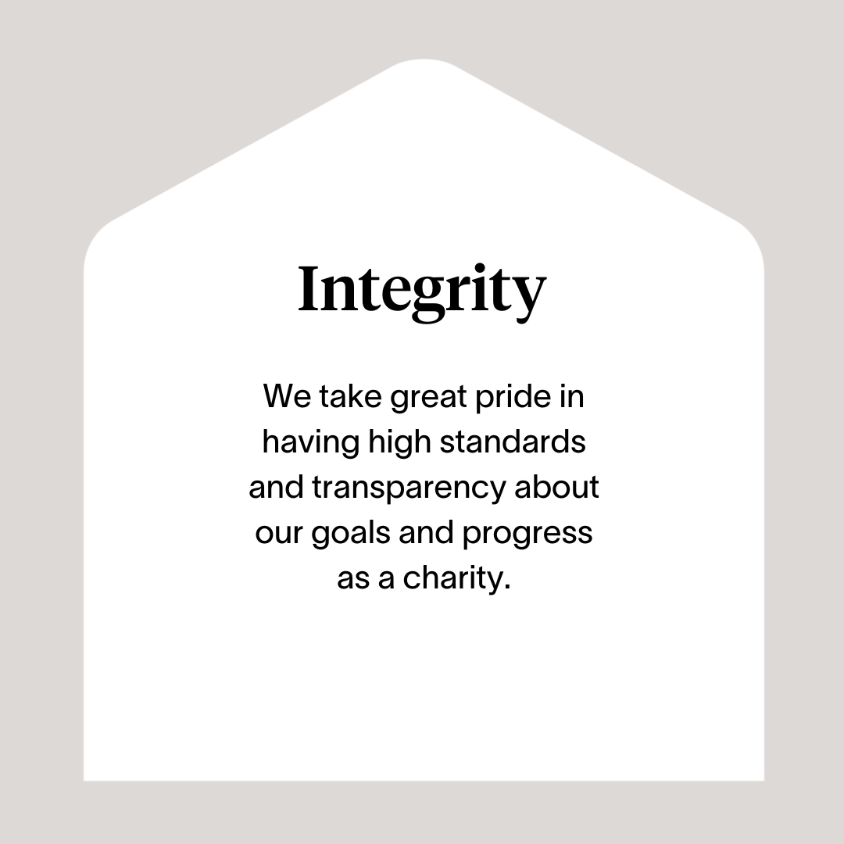
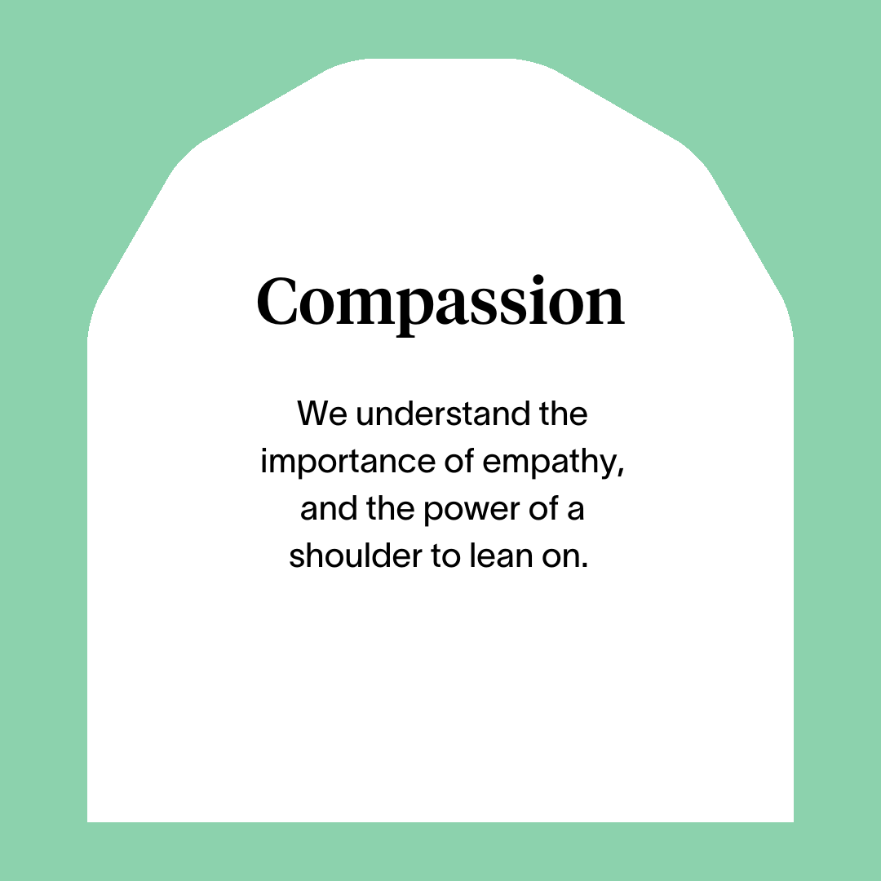



Slide 8
Main Role Responsibilities
Develop and sustain a good working relationship with the Service Manager to ensure the programme develops in line with key objectives and desired outcomes.
Develop good communication and working relationships with people we support, colleagues and other professionals.
Represent Right There programmes positively and establish professional relationships and network with key stakeholders, partnerships, forums, including Local Authority, Social Work, Housing and other relevant bodies.
Arranging and facilitating regular support and supervision sessions with your team members, utilising best practice in performance management to ensure staff are supported to undertake their roles.
Completing yearly appraisals and personal development plans with your staff team.
Complete rota planning, approve leave and plan and allocate shift cover.
Participate in the National On Call system (on average 1 week in 12 weeks).
Ensuring support planning is person-centred to identify goals and aspirations supported with a realistic timeline and inbuilt regular reviews
Ensuring support is delivered in a strengths-based way to help people identify talents, passions and interests to broker opportunities for employment, skills development, recreation, and volunteering.
Promoting involvement of those we support in the improvement and development of the programme.
Advocate on behalf of people we support when required.
Guiding Support Workers to improve access to treatment for people using drugs, to rebuild and sustain family relationships and to connect them to our counselling and in the community programmes.
Have comprehensive local knowledge of other relevant programmes and support people to access these by signposting to other appropriate agencies such as health programmes, money advice programmes and other support agencies.
Regularly review and audit files and reviewing risk assessments (keeping you safe) for those we support
Compile Right There Key Performance Indicators (KPI) and any required local authority returns / reports.
Taking a Psychologically Informed Environment (PIE) approach.
Actively contribute to your programme and the organisation’s development and improvement.
Facilitate and lead on team meetings.

Slide 9
Main Role Responsibilities
Attend and participate in training and share learning experiences.
Engage and participate in reflective practice.
Feedback on the review of organisational polices & procedures and local guidelines.
Strive for continuous personal and professional development.
Commit to ensuring that that all support provided is Right There’s approach to ensuring a Psychologically Informed Environment
Contribute to our commitment to work together with peers from other organisations delivering supported accommodation by sharing resources, contributing to meetings, working together to create opportunity and share learning.
Right There strives for best practice within social care and expects all staff to adhere to:
Right There’s policies and procedures.
Scottish Social Programmes Council (SSSC) Codes of Practice
Health and Social Care Standards (My support, My life)
Health & Safety legislation and practices.
Register with any required government bodies and ensure memberships is updated and any attributed costs are paid for.

Slide 10
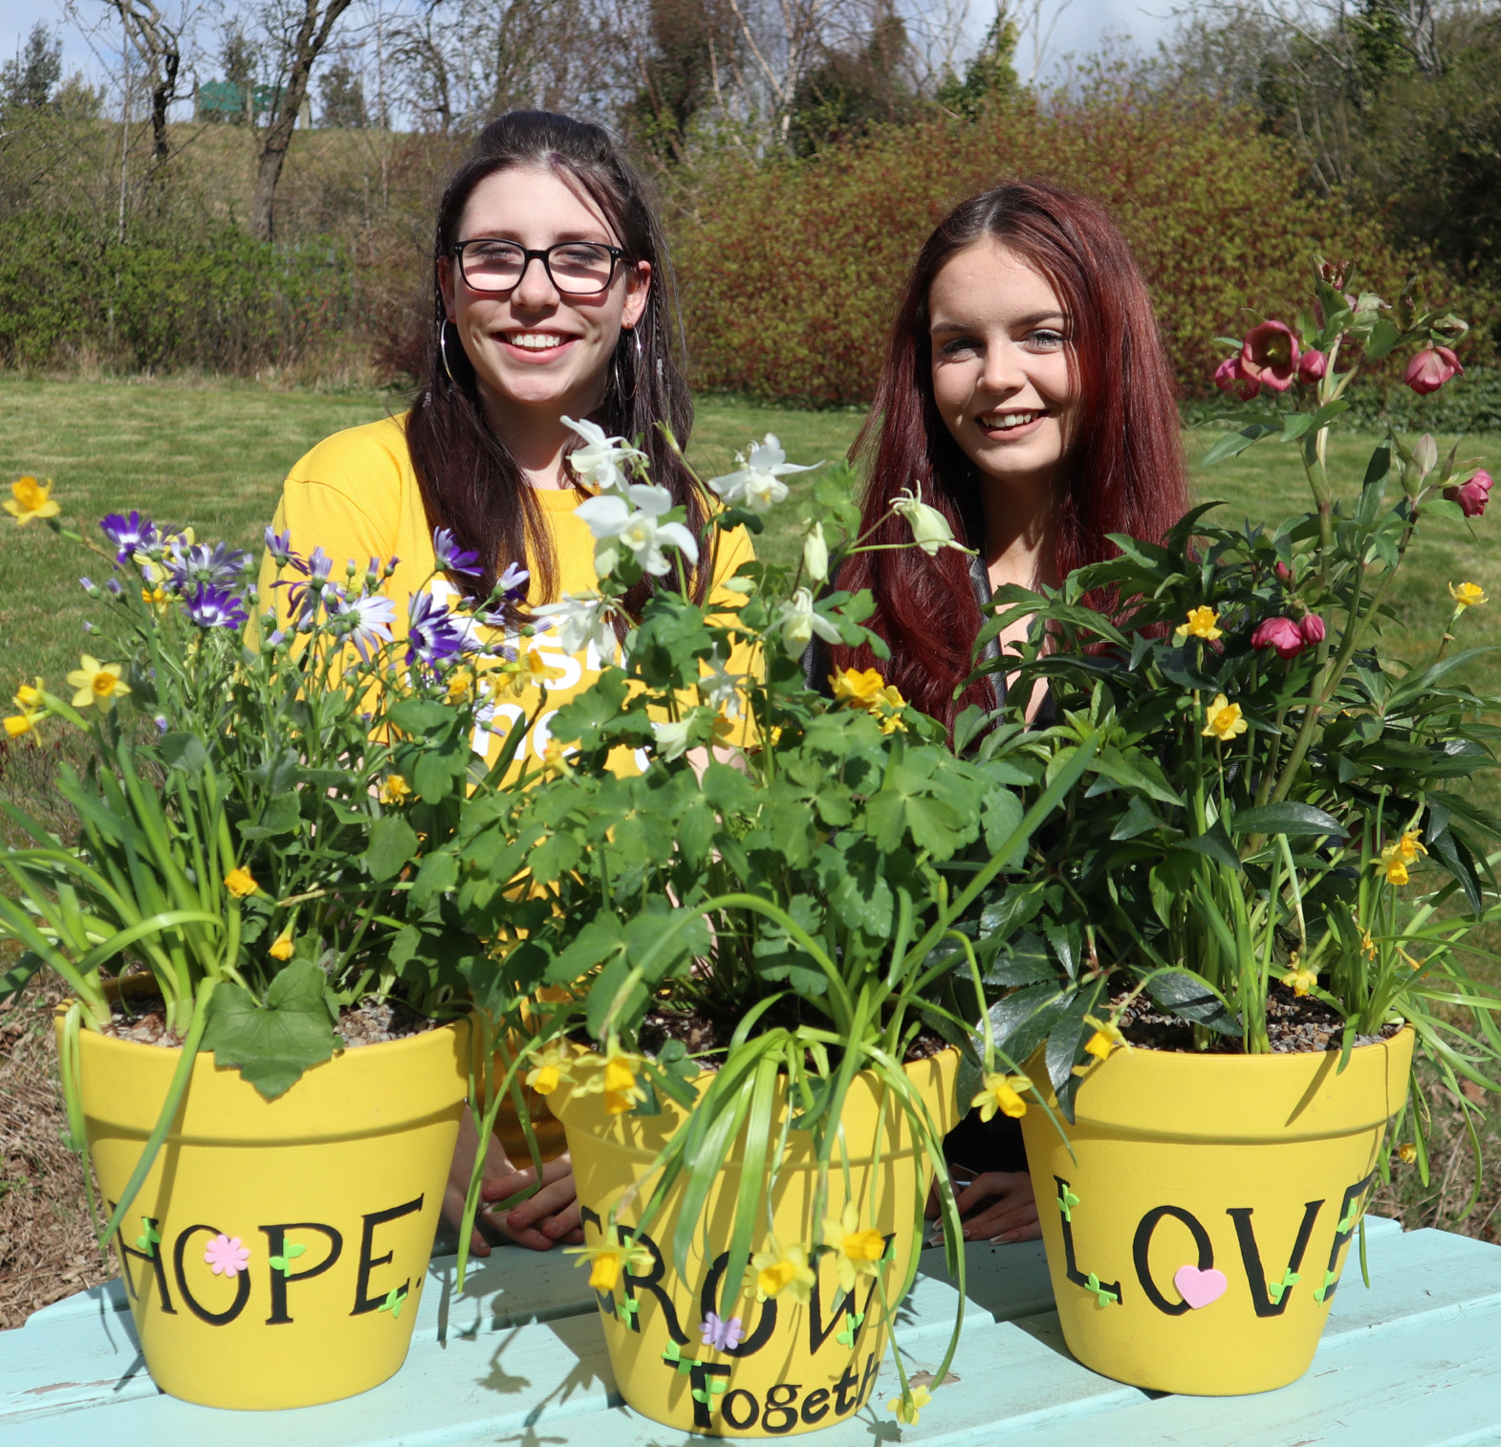
Essential skills and experience
SVQ Level 3 Social Services and Health Care or SCQF level 7 equivalent or willing to work towards
SVQ Level 4 or SCQF level 9 equivalent (or willing to work towards)
Experience of managing staff or volunteers.
Experience of working within a social care setting.
Knowledge of current relevant legislation and policies relating to addiction and mental health.
Experience of working with people facing challenges impacting on their mental wellbeing and general wellbeing.
Awareness of PIE framework
Ability to effectively lead, manage and support a staff team.
Ability to ensure the service is delivered in accordance with organisational policy and programme objectives
Skills and ability in effective time management and working to deadlines
Ability to compile comprehensive reports as required
Flexibility with regards to working patterns
Ability to travel within agreed geographical area
Ability to respond at short notice to crisis situations

Slide 11
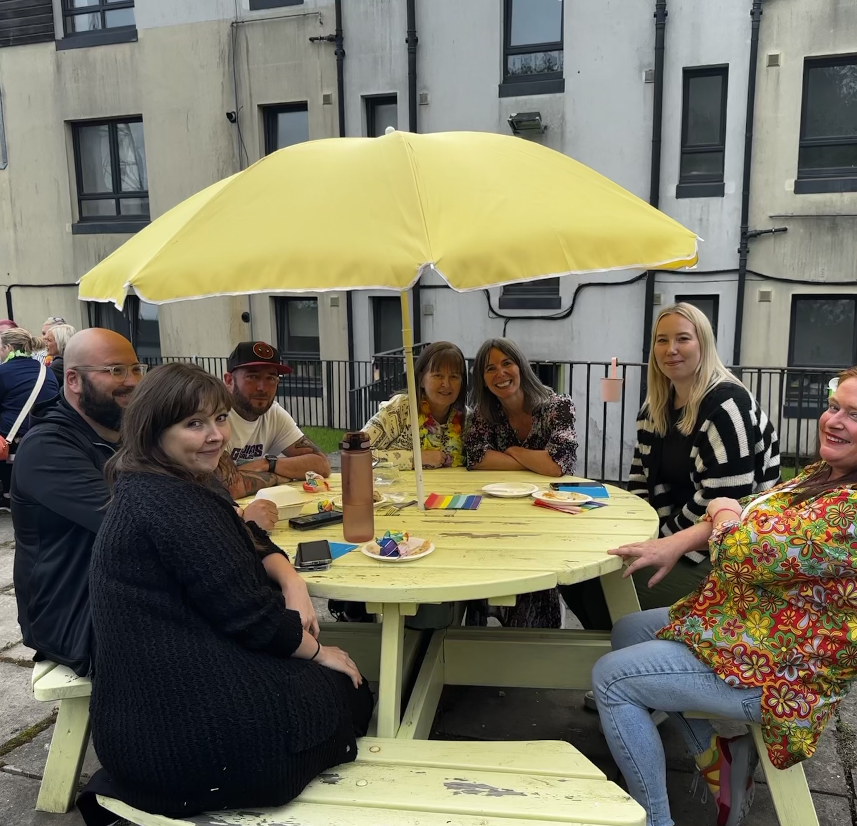
Desirable skills and experience
Experience of working in a similar environment
Awareness of issues relating to trauma and challenging behaviour
Experience of working with people who misuse substances
Knowledge of coaching and counselling skills

Slide 12

Role Details
Contract: Part Time, Permanent, 17.5 hours per week.
Salary: SCP 23-26 (£26,687 - £29,285 per annum) pro-rata
Reporting to: Service Manager
Your usual place of work will be Glaitness Farmhouse, Glaitness Road, Kirkwall, KW15
Your normal working hours are 17.5 per week. These hours are usually worked from 18.00-22.30 on a 9-week rolling rota, Monday to Sunday. 8 weeks of 4 shifts and 1 week of 3 shifts. There may be occasions of cover for the 17.00-22.30 sleep over finishing at 07.30, over time is paid for any additional hours, these could be at either of our accommodation bases in Kirkwall or Stromness.
You may be required to work from such other place as the organisation may reasonably require from time to time.
Annual leave entitlement of 210 hours holiday (equivalent to 6 weeks) pro rata per year in the first year rising to 280 hours (equivalent to 8 weeks) pro rata per year in the second. This includes public holidays.
All appointments are subject to a minimum of a 12-week probationary period.
You will be automatically enrolled into the People’s Pension. Deductions will be taken from your salary in the month you will complete 3-months of employment
It is the nature of the work of Right There that tasks and responsibilities are, in many circumstances unpredictable and varied. All employees are, therefore, expected to work in a flexible way when the occasion arises.

Slide 13

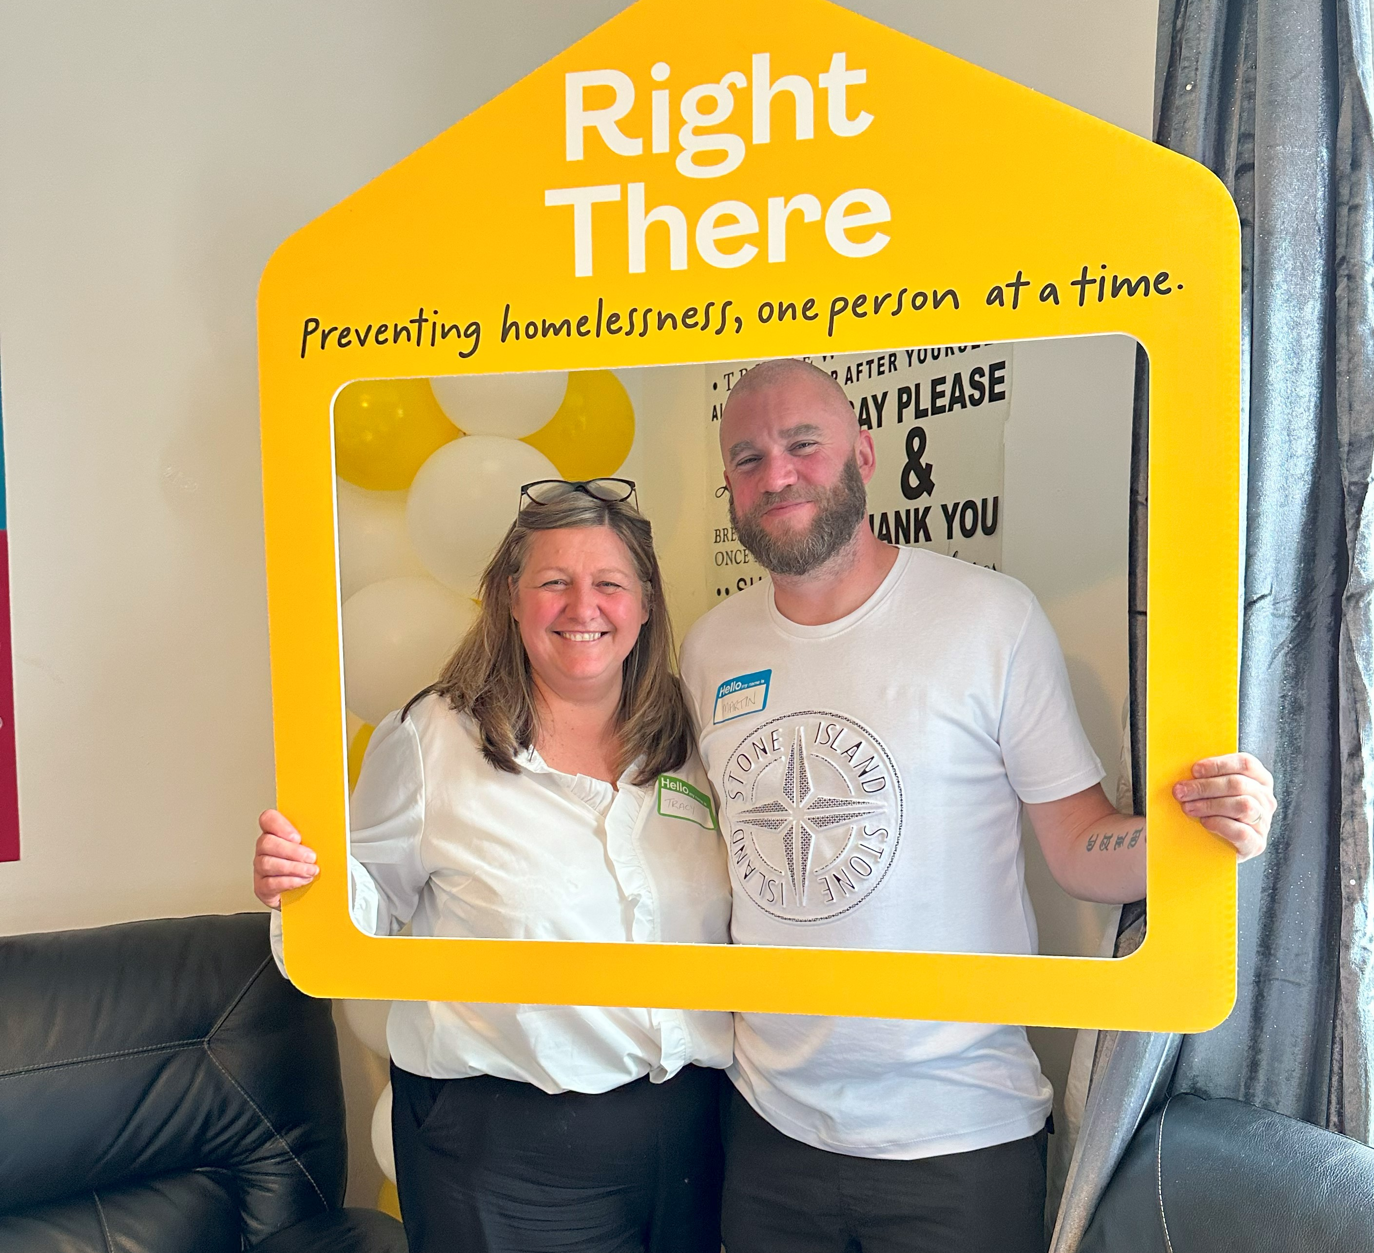
Our People Benefits
We know how dedicated our people are and we want to help you achieve a good work/life balance – and make it easier to enjoy life’s special moments!
That’s why we’ve got a range of enhanced family-friendly and wellbeing benefits to give you some well deserved perks of being a Right There employee.
Benefits include:
Hybrid working – work where is best for you and your role
Enhanced maternity, paternity, adoption, and shared parental leave
Employee 24-hour counselling and wellbeing services
6 weeks annual leave, rising to 8 after a year (plus you can purchase up to 5 more days)
Life insurance 4x your salary
Dedicated training and development plans
Cycle to work scheme
Refer a Friend

Slide 14
How to Apply
To apply send your CV and a short cover letter outlining your interest in and suitability for the role.
Email recruitment@rightthere.org

Slide 15
Thank you.
Good luck with your application.

