Slide 1
Job Pack Volunteer Coordinator intandem Mentoring (February 2025)

Slide 2
Job Purpose
Volunteer Coordinator
Responsibility for co-ordination and oversight of the effective delivery of a community-based mentoring service for care experienced children and young people.
The post holder will have responsibility for the recruitment, training and day to day supervision of volunteer mentors, the ongoing support of mentor and mentee matches and the provision of additional supports to mentee’s families as and when required.
The post holder will also assist the Service Manager with the ongoing promotion and development of the service.
Service Manager
Volunteer Coordinators
Mentors
(Volunteers)

Slide 3
What’s Inside
4 - 5
Our Vision, Mission and Values
6 - 7
8 - 9
Requirements
10-11
Role Details
12
Our People Benefits
13
How to Apply
14
15

Slide 4
About Right There
We are Right There, a charity celebrating our 200th anniversary in 2024. We provide tailored support for people, at home, and in the community. We are here for people who are living with the effects of homelessness, poverty, addiction, or family breakdowns. Last year we supported almost 4,000 individuals, helping to prevent them from becoming homeless or separated from the people they love.
We are here to offer the right support at the right time, including breaking down financial barriers; accessing the private rental market; linking up with local health, employment and training services to help people make connections within the community; and, helping people feel happier, safer, and more confident to take steps to improve their own lives.
Every person’s story is unique, and everyone’s route home is different, so we tailor our response to the individual. We want to challenge stereotypes – it doesn’t matter what the situation is – we’re not here to judge, only to help.
Our approach is about creating trusting relationships and nurturing people’s strengths, and our 200 dedicated staff, mentors and volunteers play a crucial role in this.

Slide 5
Our key areas of focus
For People
We provide tailored support for children and adults to help individuals and families feel happier, create stronger bonds and stay together.
At Home
We provide safe and supportive places to call home for people of all ages, from any circumstances, for as long as they might need it.
In The Community
We provide the tools for people to live independently and build their lives within their community, creating their own safe and secure homes.

Slide 6
Our Vision A world where everyone has an equal chance to create a safe and supportive place to call home.
Our Mission We meet people where
they are in life with no judgement; walking alongside those who need support, and preventing them becoming homeless
or separated from the people they love.

Slide 8
Main Role Responsibilities
Volunteer Management including recruitment, training and regular support and reflection with Volunteer Mentors. Ensuring Volunteers are supported to undertake their roles effectively.
Have a high standard of professional integrity with colleagues and other professionals.
Confidently manage and coordinate positive, respectful and compassionate relationships between mentor and mentee, ensuring good boundaries setting. Providing additional support(s) to the mentee’s family, as and when required. Focussing on individual strengths and aspirations and ensuring person centred planning and unconditional positive regard is undertaken by yourself and volunteers.
Building upon existing strong relationships with social work, education and virtual schools and strengthening these relationships.
Have detailed knowledge of other relevant services and create and maintain good working relationships with external partners. Representing Right There positively to other agencies or services including Local Authority, Social Work, Housing Services and other relevant services.
Liaise with referral sources, regarding new and existing Mentoring referrals.
Ensuring accurate and factual record keeping at all times. Ensuring support plans for people we support are completed and updated in accordance with GDPR and confidentiality processes. Ensuring Risk Assessments are completed and updated for people we support.
Ensuring the needs of the people we support are being met and signposting to relevant services where more support is required.
Attend multi agency meetings as required and advocating on behalf of the people we support.
Ensure that adequate safeguarding measures are in place for both mentors & mentees and participation in an On Call rota system as required.
Contribute towards the design, delivery and evaluation of our programmes. Ensuring we are adopting a co-produced approach where possible.
Contribute to the development and Coordination of a Support Group and Forum for Kinship Carers at Right There.
Adhere to and contribute towards policies and procedures
Collate both qualitative and quantitative data as requested by Right There and our Key Partners and contributing to internal and external reporting as directed by your line manager.
Ensure performance targets are continually worked towards to achieve agreed outcomes and positive destinations for the people we support.
Investigating and resolving complaints by those we support and investigating any issues of misconduct within the organisation.

Slide 9
Roles & Responsibilities (continued)
Being a part of the Right There team:
Positively Represent Right There to other agencies or services including Local Authority, Housing Services, Social Work and other relevant services.
Be a proactive team member actively contributing to your service and the organisation’s development and continuous improvement working collaboratively with your colleagues across the organisation.
Have a high standard of professional integrity with colleagues, people we support and other providers, always upholding clear professional boundaries.
Understand and respect the importance of confidentiality
Ability to work towards performance targets to achieve agreed result
Participate in meetings, training and reflective practice, share your learning experiences and strive for continuous personal and professional development
Invest sustained effort in making a significant impact on service development and improvement with feedback on the review of organisational policies and procedures and local guidelines
Engage with any organisational initiatives or working groups
Adhere to Right There Policies and Procedures, Scottish Social Programmes Council (SSSC) Codes of Practice, Health and Social Care Standards (My Support, My Life), Health and Safety legislation and practices
Always apply safeguarding principles and maintain awareness of child protection and adult protection processes.
Register with any required government bodies and ensure membership is updated and any attributed costs are paid for

Slide 10
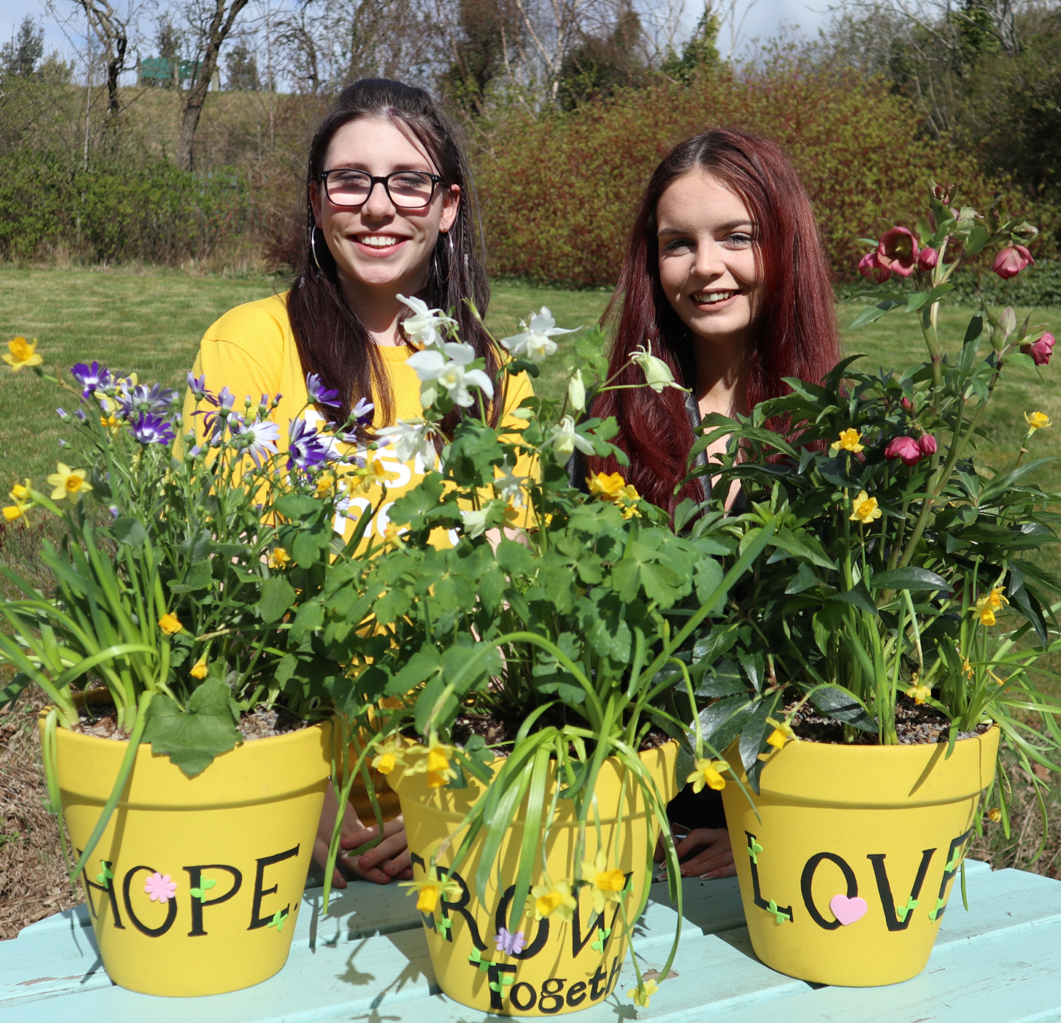
Essential skills and experience
Knowledge of trauma informed approaches
Commitment to ongoing CPD and ability to evidence this.
Ensuring continuous professional development and identifying L&D opportunities relevant to the service
Experience of volunteer and/or staff management
Excellent time management and organisational skills
Experience of supporting young people and families with complex needs.
Knowledge of the issues facing young people who are care-experienced and/or on the edges of care.
Knowledge of current relevant legislation and policies relating to children and young people.
A working knowledge of child protection procedures.
Experience of developing and delivering training programmes and/or groupwork.
Experience of multi-disciplinary working.
Experience of recording records in line with GDPR and confidentiality procedures
Full drivers’ licence & use of own vehicle for business use
(Note: Employees must hold insurance that covers domestic and business use).

Slide 11
Desirable skills and experience
Experience of Mentoring or Volunteering
Experience of coordinating events
Experience of coordinating/facilitating support groups and/or forums.
Knowledge of mentoring approaches.
Educated to SVQ Level 3 or HNC level equivalent in a relevant subject
Possession of/or willing to work towards SVQ4 management

Slide 12
Role Details
Contract: Full time, permanent, 35 hours per week. Salary: SCP 23-26 (£26,036 - £28,571 per annum) Reporting to: Service Manager
Working hours are Monday to Friday – worked flexibly between the hours of 8.00am to 6.00pm, depending on the needs of the service, with one-hour unpaid break. Flexibility will be required to meet the needs of people we support and volunteers. Some evenings and weekends will be required.
Your core place of work will be 15 Dava Street, Glasgow, G51 2JA. You are also required to work in the local community, and you will be paid travel expenses between your usual place of work and appointments undertaken in the course of your duties. Alternatively, you may choose to work remotely from your home address where appropriate. Working arrangements are in agreement with the line manager based on the needs of the service.
You may be required to work from such other place as the organisation may reasonably require from time to time.
Annual leave entitlement of 210 hours holiday (equivalent to 6 weeks) pro rata per year in the first year rising to 280 hours (equivalent to 8 weeks) pro rata per year in the second. This includes public holidays.
All appointments are subject to a minimum of a 12-week probationary period.
You will be automatically enrolled into the People’s Pension. Deductions will be taken from your salary in the month you will complete 3-months of employment
It is the nature of the work of Right There that tasks and responsibilities are, in many circumstances unpredictable and varied. All employees are, therefore, expected to work in a flexible way when the occasion arises.

Slide 13
Our People Benefits
We know how dedicated our people are and we want to help you achieve a good work/life balance – and make it easier to enjoy life’s special moments!
That’s why we’ve got a range of enhanced family-friendly and wellbeing benefits to give you some well deserved perks of being a Right There employee. Benefits include:
Hybrid working – work where is best for you and your role
Enhanced maternity, paternity, adoption, and shared parental leave
Employee 24-hour counselling and wellbeing services
6 weeks annual leave, rising to 8 after a year (plus you can purchase up to 5 more days)
Life insurance 4x your salary
Dedicated training and development plans
Cycle to work scheme
Refer a Friend

Slide 14
How to Apply
To apply send your cv and a short cover letter outlining your interest in and suitability for the role.
Email: recruitment@rightthere.org

Slide 15
Thank you. Good luck with your application.

