Slide 1

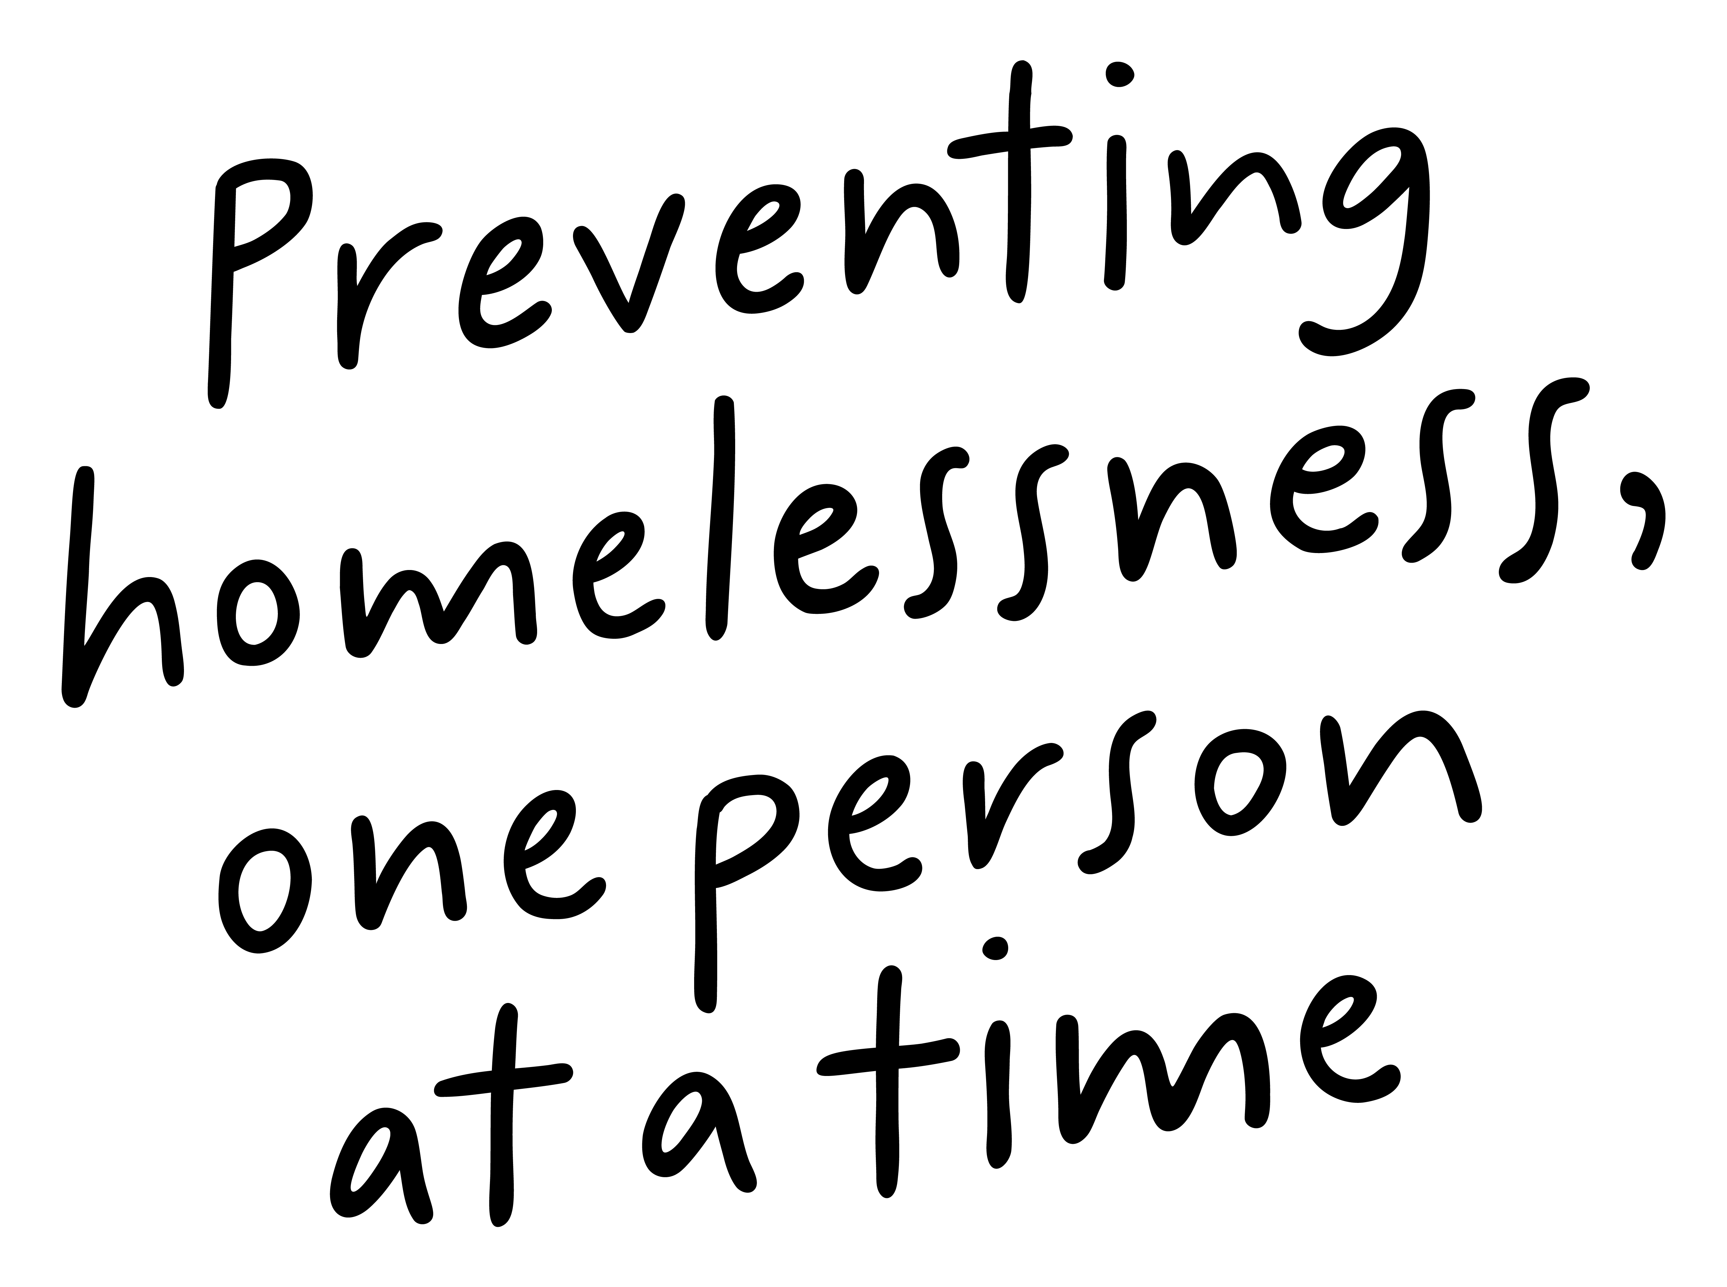
Job Pack
Office Administrator
(August 2025)

Slide 2
Job Purpose
Office Administrator
The Office Administrator forms part of the Strategic Initiatives and Governance Team and will report directly to the Head of Department.
The post holder will provide organised, effective and efficient administration delivery to the support office functions and programmes. They will assist in the delivery of a full and sustainable administration service, as well as providing front line information to people we support, staff, managers, suppliers and contractors and other external agencies.
Head of Strategic Initiatives and Governance
Office Administrator

Slide 3


What’s Inside
4 - 5
Our Vision, Mission and Values
6 - 7
8 - 9
Requirements
10
Role Details
11
Our People Benefits
12
How to Apply
13
14

Slide 4


About Right There
We are Right There, a charity celebrating our 200th anniversary in 2024. We provide tailored support for people, at home, and in the community. We are here for people who are living with the effects of homelessness, poverty, addiction, or family breakdowns. Last year we supported almost 4,000 individuals, helping to prevent them from becoming homeless or separated from the people they love.
We are here to offer the right support at the right time, including breaking down financial barriers; accessing the private rental market; linking up with local health, employment and training services to help people make connections within the community; and, helping people feel happier, safer, and more confident to take steps to improve their own lives.
Every person’s story is unique, and everyone’s route home is different, so we tailor our response to the individual. We want to challenge stereotypes – it doesn’t matter what the situation is – we’re not here to judge, only to help.
Our approach is about creating trusting relationships and nurturing people’s strengths, and our 200 dedicated staff, mentors and volunteers play a crucial role in this.

Slide 5

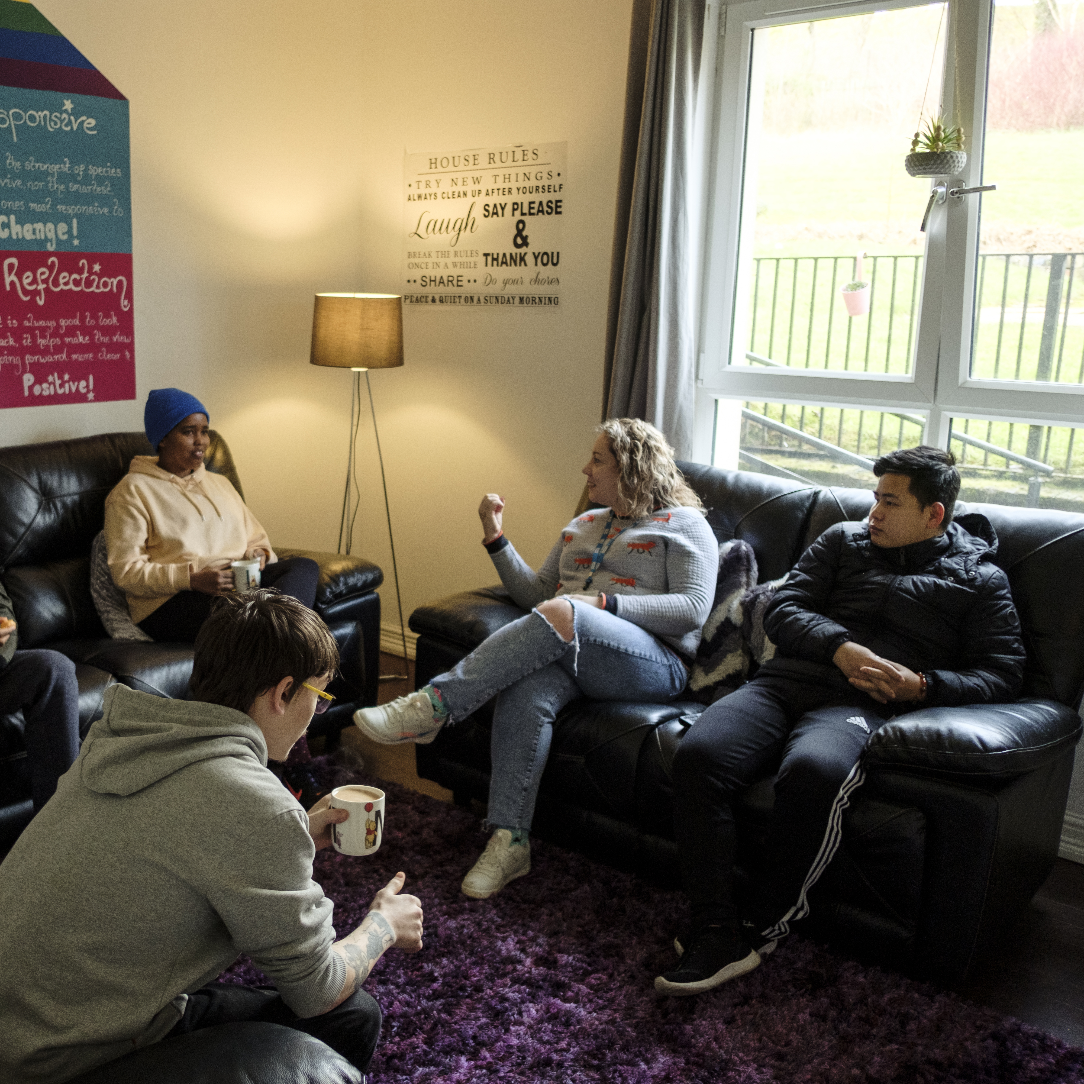
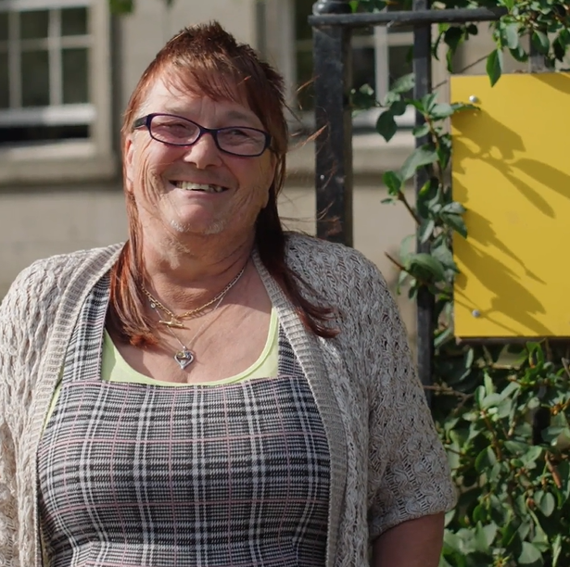
Our key areas of focus
For People
We provide tailored support for children and adults to help individuals and families feel happier, create stronger bonds and stay together.
At Home
We provide safe and supportive places to call home for people of all ages, from any circumstances, for as long as they might need it.
In The Community
We provide the tools for people to live independently and build their lives within their community, creating their own safe and secure homes.

Slide 6

Our Vision
A world where everyone has an equal chance to create a safe and supportive place to call home.
Our Mission
We meet people where
they are in life with no judgement; walking alongside those who need support, and preventing them becoming homeless
or separated from the people they love.

Slide 7







Slide 8
Roles & Responsibilities
Acting as the first point of contact for the organisation, managing front desk operations, and ensuring a welcoming environment for staff, people we support and visitors.
Interacting with members of the public face to face, over the phone and online in a friendly, helpful and informative manner.
Promptly answering and directing phone calls accordingly
Providing full administrative support and effective communication to the Leadership Team, Right There Support Services and colleagues in our programmes.
Arranging travel and accommodation as/when required for Right There staff.
Maintaining office supplies stock levels and order office supplies as required in line with our procurement policy
Maintaining IT asset and telecommunication registers and place orders as directed in line with our procurement policy and asset replacement plan
Supporting the People Team by managing the onboarding and offboarding of staff including assigning them necessary kit and ensuring they are set up on our IT system.
Maintaining and managing an effective centralised administrative system to log all organisational lease’ and contractual obligations
Managing the On-Call Management Horizons Telephone System.
Providing administrative support to scheduled meetings, including agenda preparation and minute taking/action tracking including occasional after hours Board Meetings .
Managing and keeping online diaries and track meeting room bookings
Maintaining the organisational archiving tracker, liaise services and data storage company to arrange uplifts from service and recall storage boxes for destruction in line with our file retention policy.
Creating, maintaining and storing paperwork and documents using online facilities (i.e. SharePoint)
Dealing with email enquiries, using Microsoft Outlook and direct accordingly
Recording, sorting and distributing incoming post and organising and sending outgoing post.
Maintaining an effective correspondence and complaints register, ensuring key dates for response are met.
Any other ad hoc admin duties as requested.
Promoting and represent Right There services positively

Slide 9
Roles & Responsibilities (cont)
Being a part of the Right There team:
Be a proactive team member actively contributing to support services working collaboratively with your colleagues across the organisation.
Be solution focused and actively strive to ensure our teams feel supported.
Attend and participate in training and reflective practice, sharing your learning experiences striving for continuous personal and professional development
Contribute to the organisations' development and improvement with feedback on the review of organisational policies and procedures and local guidelines
Engage with any organisational initiatives or working groups
Adhere to Right There Policies and Procedures

Slide 10

Essential skills and experience
Experience of working in a similar Administrative support role within a busy office environment
Experience of working autonomously
Effective workload planning
Effective coordination of information from a variety of sources
Experience of responding to changing priorities
Experience of managing a task from start to completion
Demonstrates initiative and forward planning
Ability to apply resourceful solutions to challenges
Ability to determine when it is appropriate to escalate an issue
Initiates actions and follows up on matters to achieve outcomes
Good IT skills and proficient in the use of Microsoft 365 packages
Strong written and verbal Communications skills face to face, over the phone and over email
Desirable Knowledge
Administration/IT qualification
Awareness of issues surrounding the charity sector

Slide 11

Role Details
Contract: Full time, permanent, 35 hours per week.
Salary: SCP 19 – 22 (£24,252 - £25,961)
Reporting to: Head of Strategic Initiatives and Governance
Working hours are Monday to Friday – worked flexibly between the hours of 9.00am to 5.00pm depending on the needs of the service, with one-hour unpaid break.
Your core place of work will be in 15 Dava Street, Glasgow G51 2JA
You may be required to work from such other place as the organisation may reasonably require from time to time.
Annual leave entitlement of 210 hours holiday (equivalent to 6 weeks) pro rata per year in the first year rising to 280 hours (equivalent to 8 weeks) pro rata per year in the second. This includes public holidays.
All appointments are subject to a minimum of a 12-week probationary period.
You will be automatically enrolled into the People's Pension in the month that you will complete 3-months of employment , provided you meet the auto-enrolment criteria.
It is the nature of the work of Right There that tasks and responsibilities are, in many circumstances unpredictable and varied. All employees are, therefore, expected to work in a flexible way when the occasion arises.

Slide 12

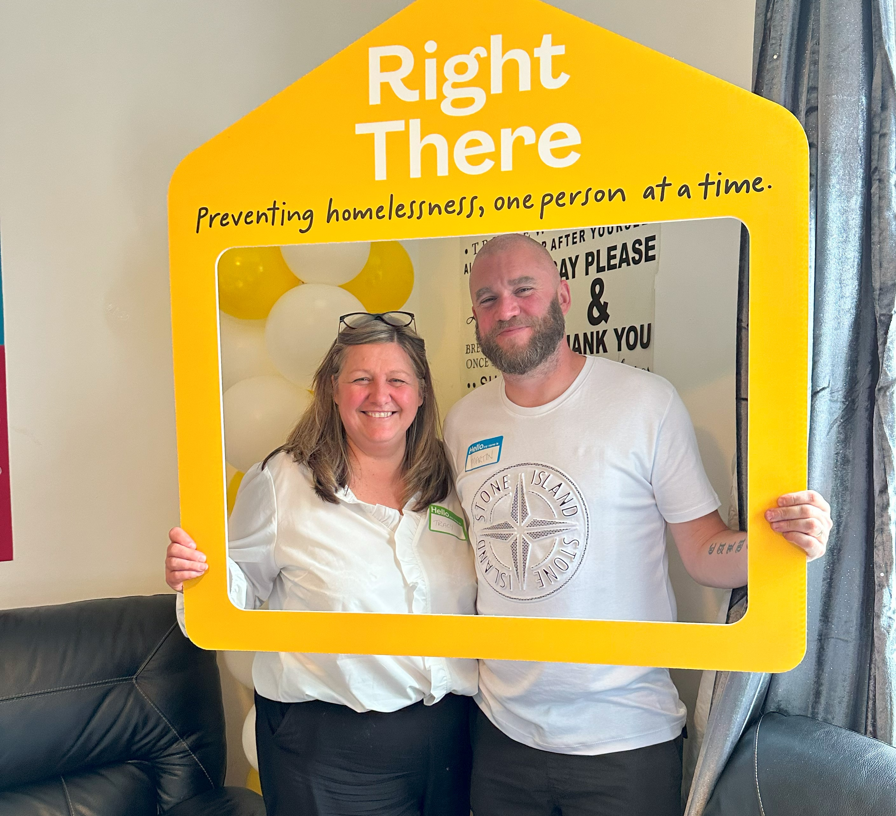
Our People Benefits
We know how dedicated our people are and we want to help you achieve a good work/life balance – and make it easier to enjoy life’s special moments!
That’s why we’ve got a range of enhanced family-friendly and wellbeing benefits to give you some well deserved perks of being a Right There employee.
Benefits include:
Enhanced maternity, paternity, adoption, and shared parental leave
Employee 24-hour counselling and wellbeing services
6 weeks annual leave, rising to 8 after a year (plus you can purchase up to 5 more days)
Life insurance 4x your salary
Dedicated training and development plans
Cycle to work scheme
Refer a Friend

Slide 13
How to Apply
To apply send your CV and a short cover letter outlining your interest in and suitability for the role.
Email recruitment@rightthere.org

Slide 14
Thank you.
Good luck with your application.

