Slide 1

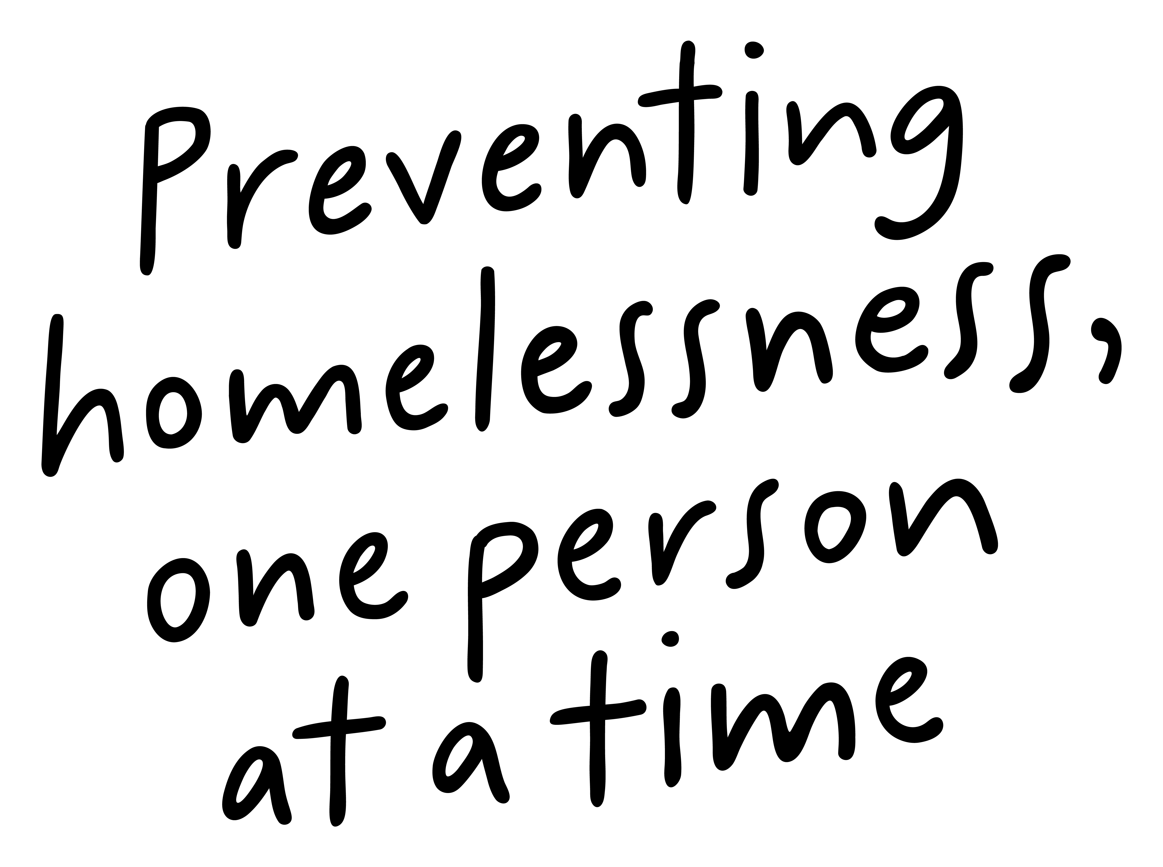
Job Pack
Senior Support Worker
(August 2025)

Slide 2
Job Purpose
Senior Support Worker
Supported Accommodation Inverness is a supported accommodation service for care experienced young people aged 16-26 who are leaving care or at risk of homelessness. We are a trauma informed service and provide support in a person-centred manner meeting the needs of the young person , along with emotional and practical support which is aimed at nurturing essential life skills and promoting independence.
The Senior Support Worker will lead a team of support workers to provide high-quality support, to meet expected standards and quality outcomes for the people we support in Right There Inverness Supported Accommodation programme. This role will be a part of Right There Inverness management team and support programme development, actively creating opportunities for people we support to provide feedback and contribute to this development.
The Senior support worker will work closely with other partners across Inverness, and be involved in multi agency meetings in order to offer the best possible support to people living in supported accommodation
Locality Manager
Registered Manager
Senior Support Worker (current vacancy)
Support Workers

Slide 3

What does our team say?
I first joined Right There in January 2017 as a Casual Support Worker as I was looking for a job that would bring me new challenges and in 2019 I was employed full time as Support Worker . I enjoyed working alongside the people we support to help and guide them build the skills that they would need to be able to live independently in their own tenancy’s.
In 2022 I became the Senior Support Worker , this gave me the opportunity to utilise the skills I had built up as a Support Worker, to continue to support the young people and develop the team and in 2024 I became the Registered Manager.
I have the opportunity to continue building my skills as Right There provides me with the training that is required to help me succeed in making Supported Accommodation Inverness a place for the people we support to thrive.
Registered Manager – Alison Milson

Slide 4


What’s Inside
5-6
Our Vision, Mission and Values
7-8
9-10
Requirements
11-12
Role Details
13
Our People Benefits
14
How to Apply
15
16

Slide 5

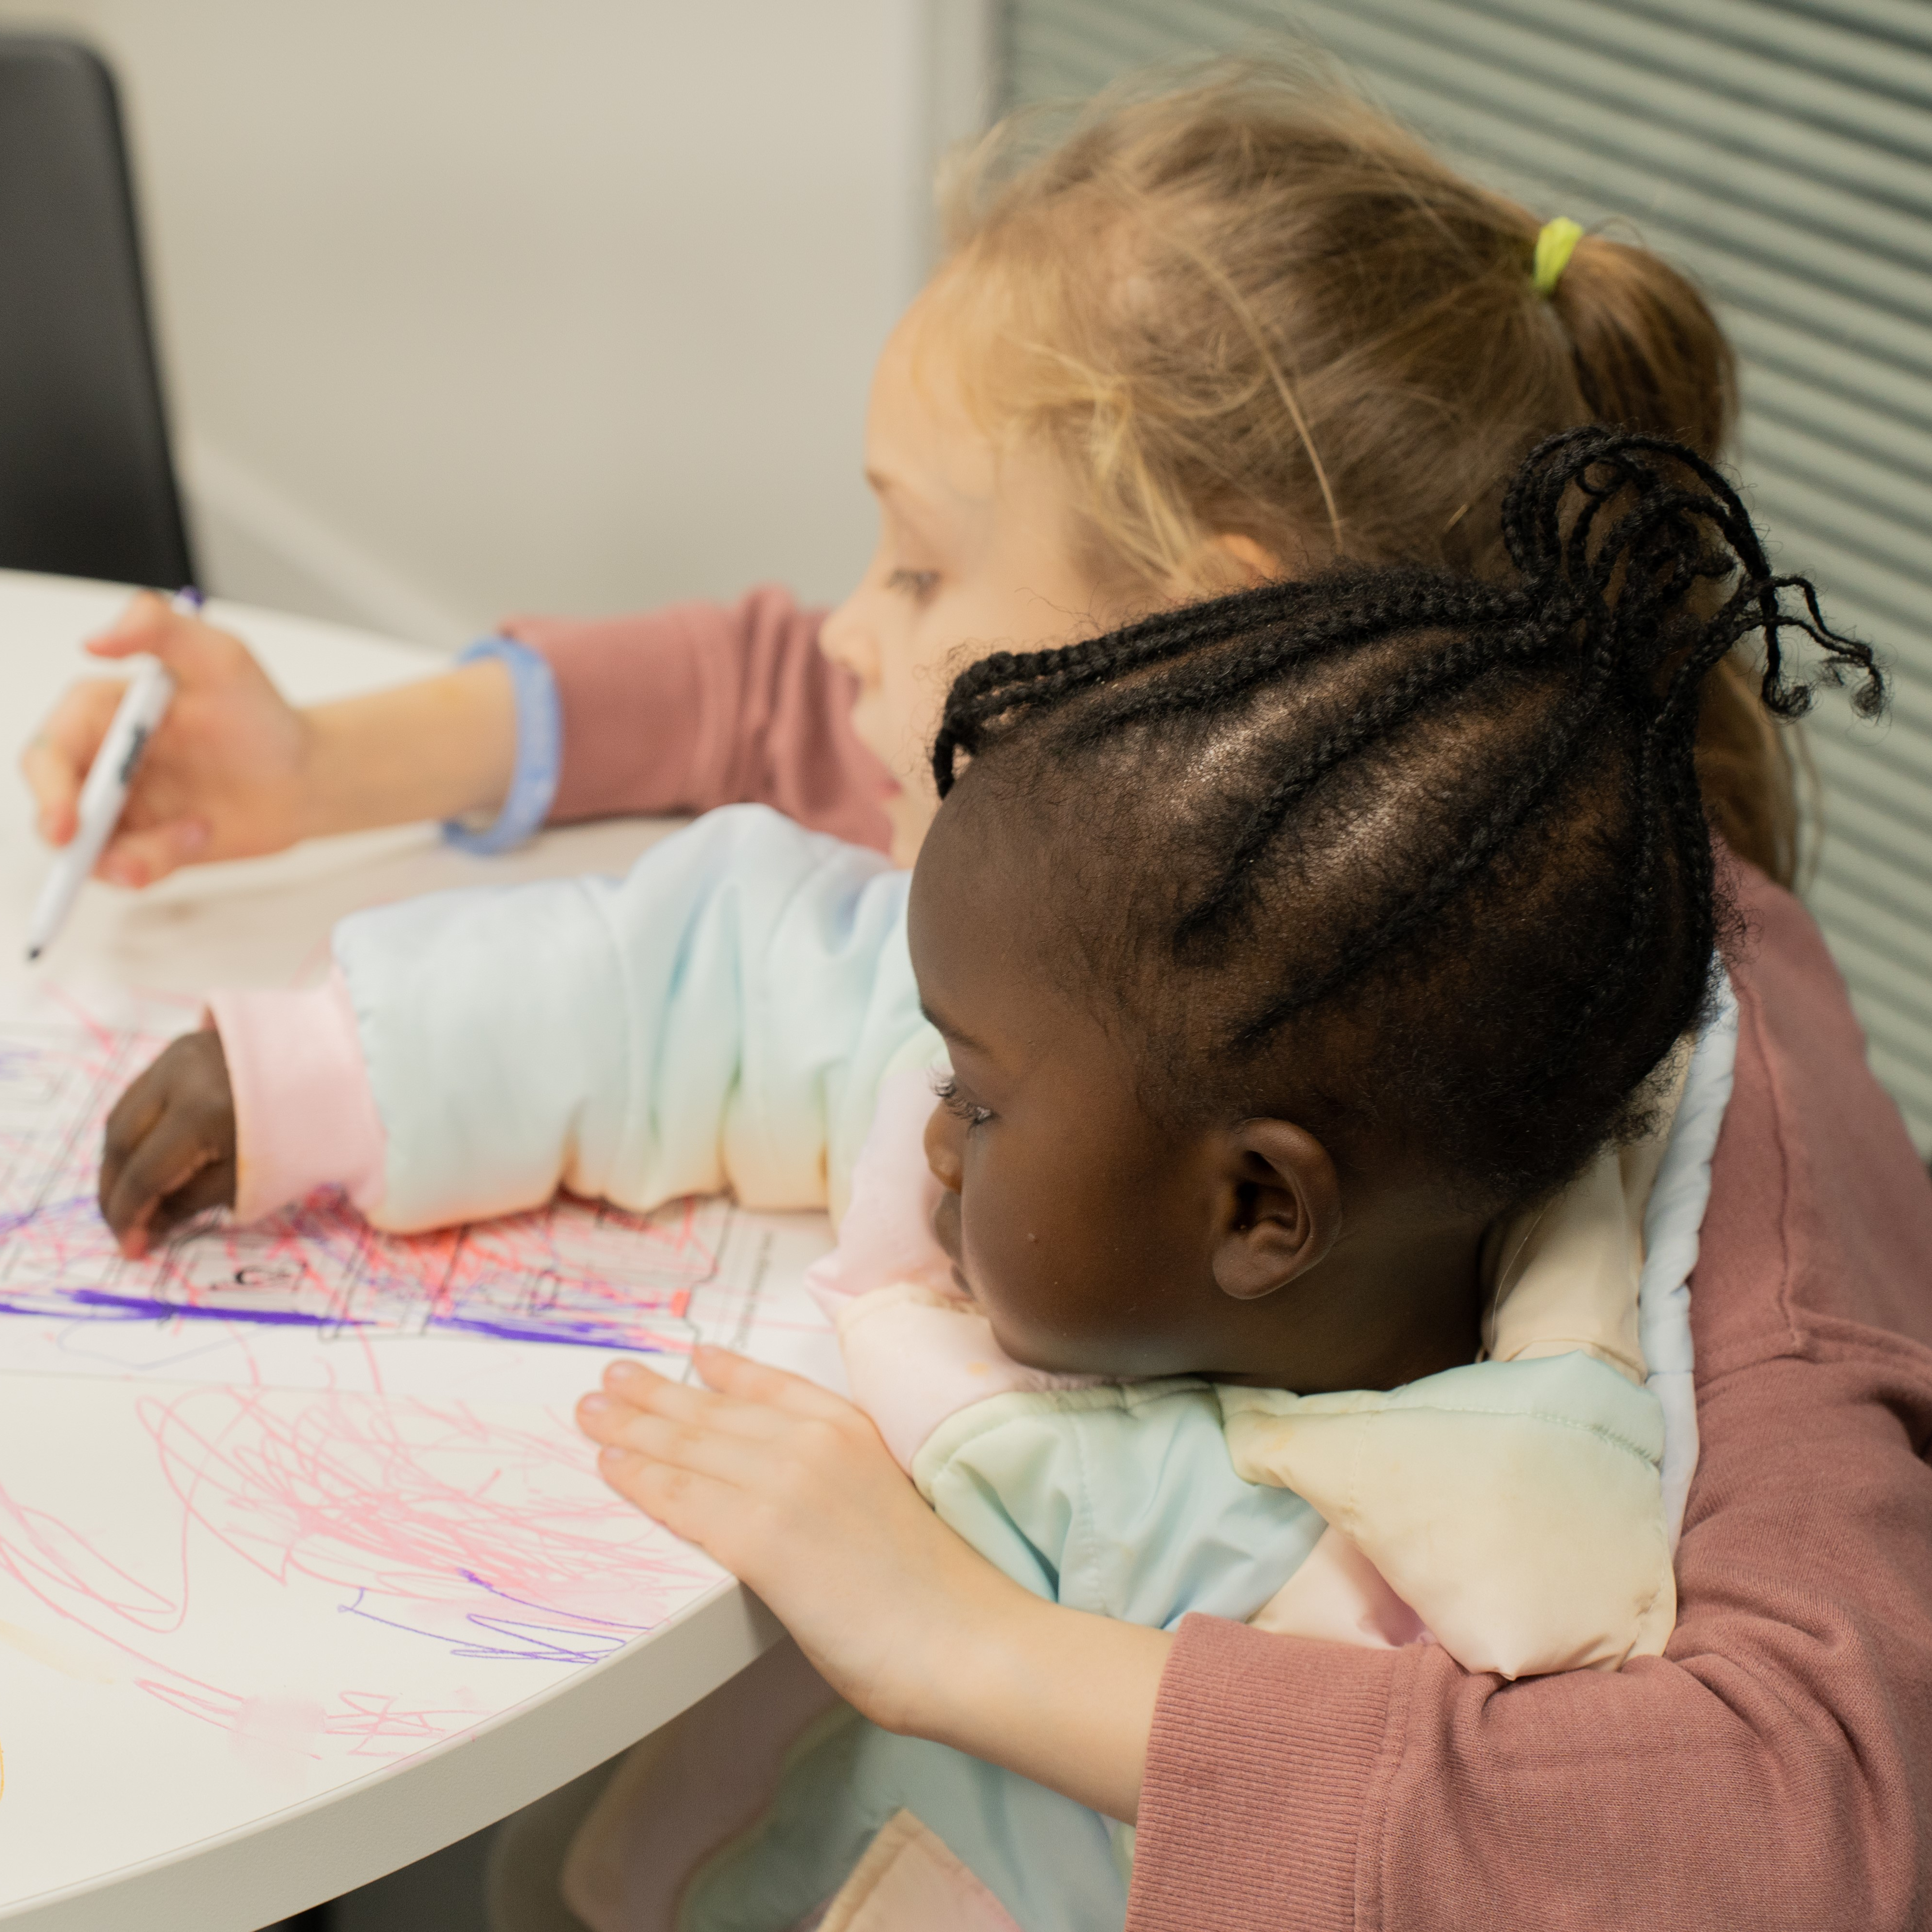
About Right There
We are Right There, a charity celebrating our 200th anniversary in 2024. We provide tailored support for people, at home, and in the community. We are here for people who are living with the effects of homelessness, poverty, addiction, or family breakdowns. Last year we supported almost 4,000 individuals, helping to prevent them from becoming homeless or separated from the people they love.
We are here to offer the right support at the right time, including breaking down financial barriers; accessing the private rental market; linking up with local health, employment and training services to help people make connections within the community; and, helping people feel happier, safer, and more confident to take steps to improve their own lives.
Every person’s story is unique, and everyone’s route home is different, so we tailor our response to the individual. We want to challenge stereotypes – it doesn’t matter what the situation is – we’re not here to judge, only to help.
Our approach is about creating trusting relationships and nurturing people’s strengths, and our 200 dedicated staff, mentors and volunteers play a crucial role in this.

Slide 6
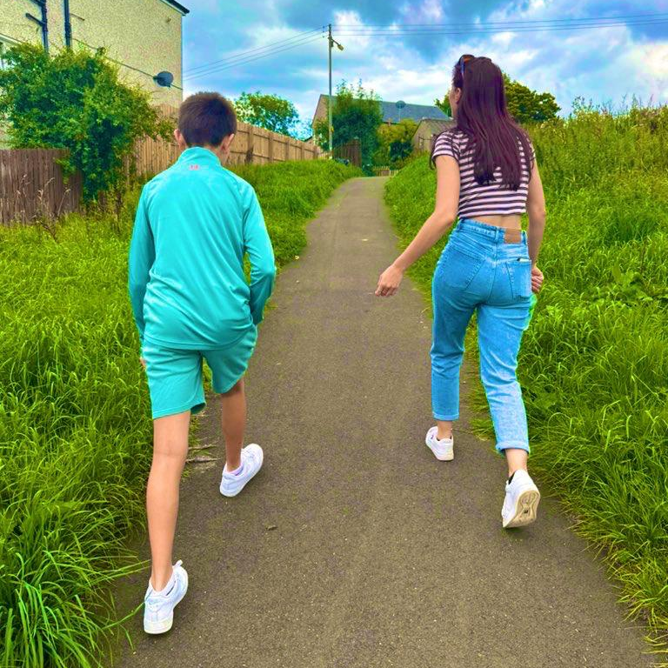
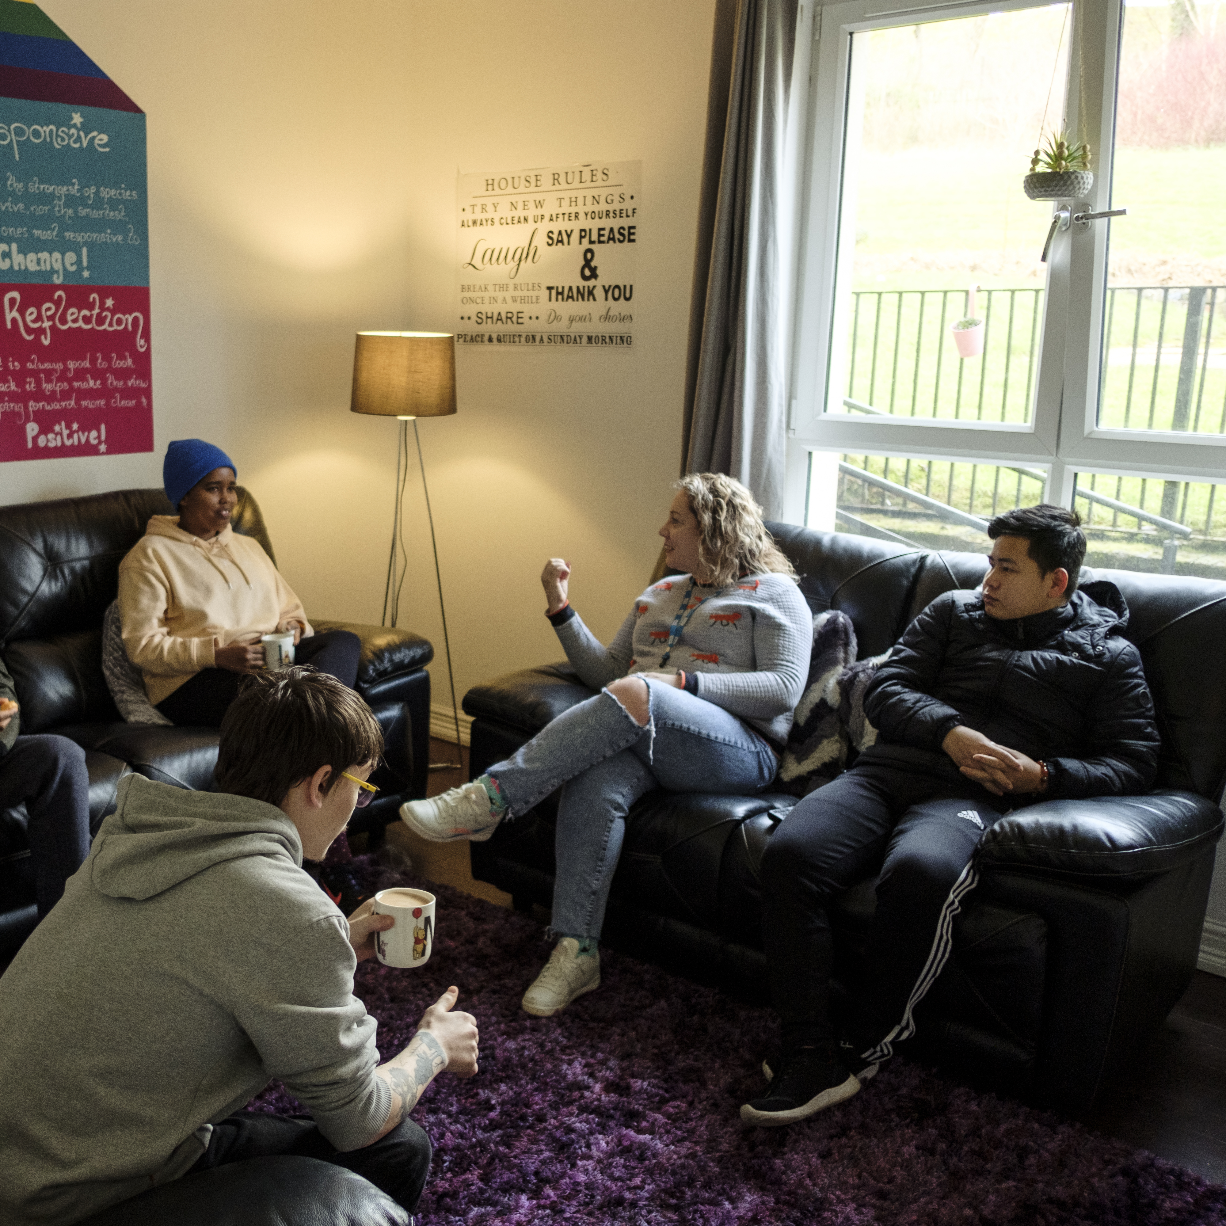
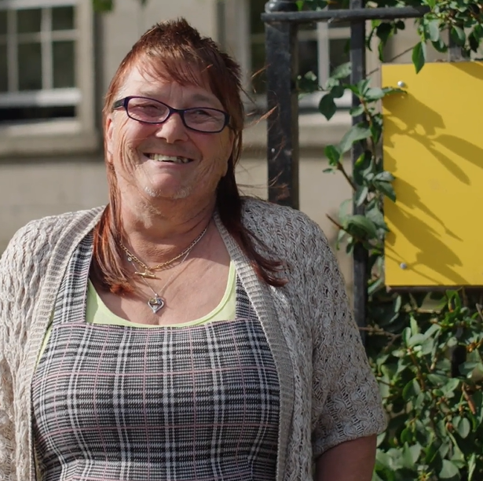
Our key areas of focus
For People
We provide tailored support for children and adults to help individuals and families feel happier, create stronger bonds and stay together.
At Home
We provide safe and supportive places to call home for people of all ages, from any circumstances, for as long as they might need it.
In The Community
We provide the tools for people to live independently and build their lives within their community, creating their own safe and secure homes.

Slide 7
Our Vision
A world where everyone has an equal chance to create a safe and supportive place to call home.
Our Mission
We meet people where
they are in life with no judgement; walking alongside those who need support, and preventing them becoming homeless
or separated from the people they love.

Slide 8


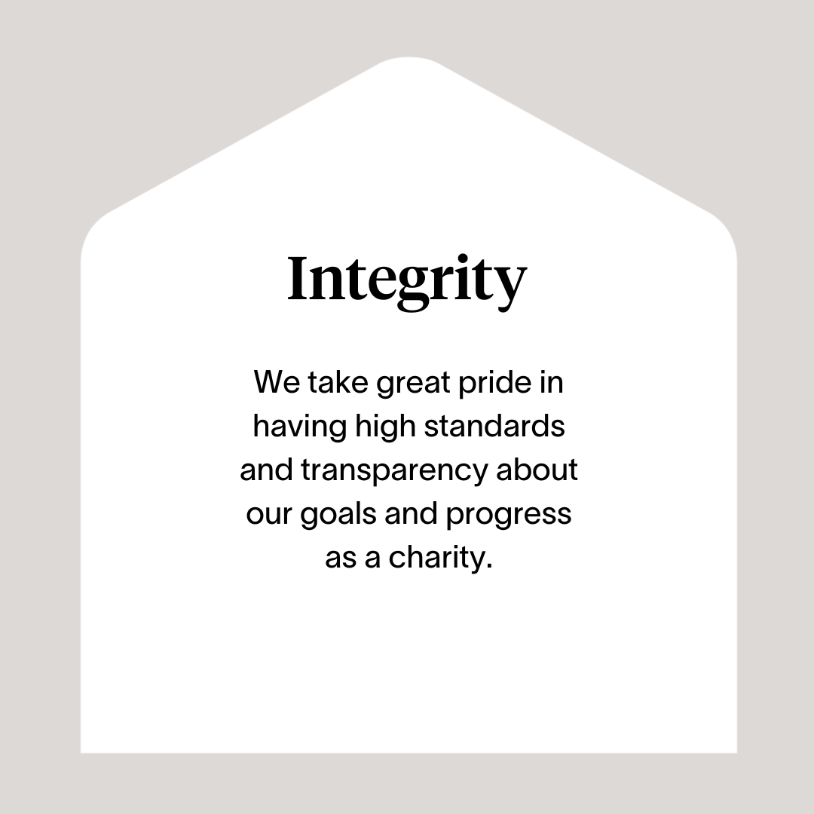
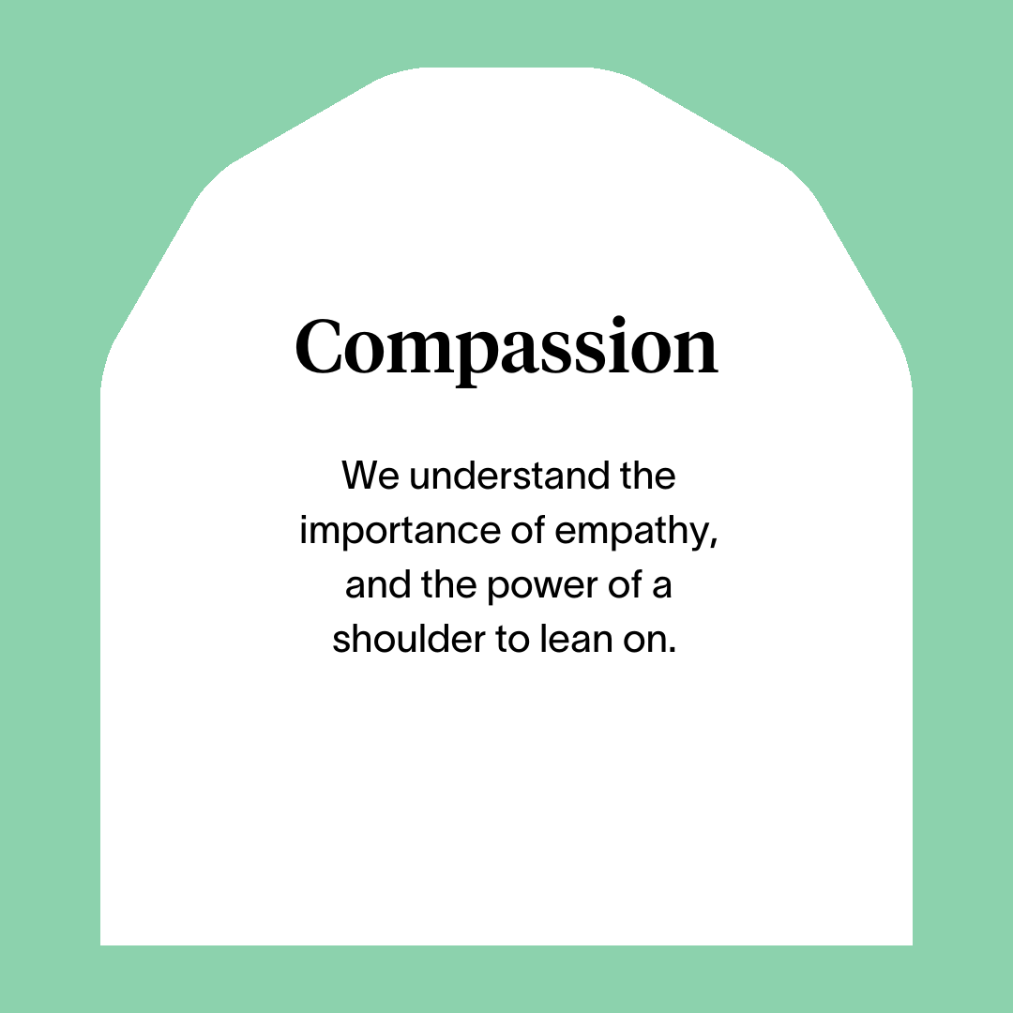



Slide 9
Main Role Responsibilities
Develop positive, respectful and compassionate relationships with the people we support, focusing on their strengths and aspirations as individuals.
Develop positive and supportive relationships with your staff team.
Have a high standard of professional integrity with colleagues and other professionals.
Establish clear professional boundaries with the people we support.
Ensuring person centred planning and unconditional positive regard is undertaken by staff.
Taking a Psychologically Informed Environment (PIE) approach.
Ensuring the needs of the people we support are being met.
Ensuring ‘Keeping You Safe Plans’ for those we support are completed and updated.
Advocating on behalf of the people we support.
Arranging and facilitating regular support and supervision sessions with your team members, utilising best practice in performance management to ensure staff are supported to undertake their roles.
Completing yearly appraisals and personal development plans with your staff team.
Investigate and resolve any complaints made by the people we support.
Ensure staff are using support plans to record and assess the progress of the people you we are supporting.
Support the Service Manager with robust rota planning and staffing cover to ensure all working shifts are covered
Lead the staff team to respond to incidents employing trauma skilled descalation skills, ensuring incident processes are followed to include escalation to senior management
Review and follow up actions in incident reports
Have a detailed knowledge of other relevant services in the local community and establish partnerships with other agencies and the local community to be part of our inhouse activity/wellbeing programme
Ensuring a safe environment for those we support, our employees, and others, including a high standard of accommodation is provided.
Regularly auditing the files of those who we support.

Slide 10
Main Role Responsibilities
Compiling Right There Key Performance Indicators (KPI) and any required local authority returns / reports.
Reporting all required Care Inspectorate notifications.
Developing participation within the service from the people we support.
Investigating any issues of misconduct within the organisation.
Represent Right There to other agencies or services including Local Authority, Social Work, Housing Services and other relevant services

Slide 11
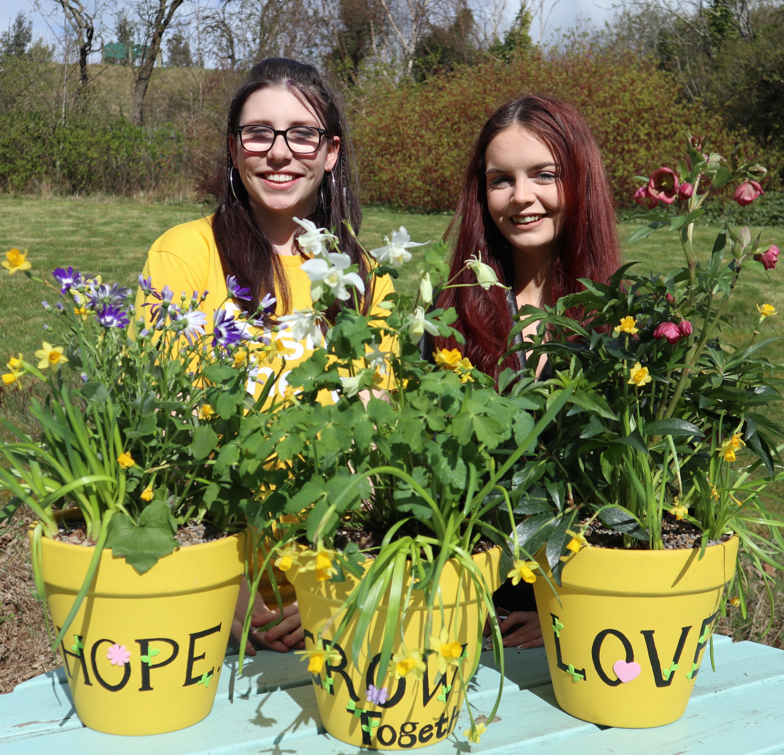
Essential skills and experience
SVQ level 2 H&SC or SCQF equivalent (or are willing to work towards)
Possession of, or willingness to undertake, additional management training in line with the role and SSSC requirements
Experience of working with vulnerable people relevant to this service area
Ability to demonstrate understanding of needs of those we support.
Able to demonstrate experience of person-centred approach to working with people
Ability to manage staffing issues on daily basis (performance, sickness absence, time management)
Ability to support staff to develop skills in assessment, support planning, risk assessment and reviews
Able to demonstrate skills and experience in prioritising staff resources to meet the needs of individuals / group
Understanding of current relevant legislation and policies relating to Throughcare Aftercare; Looked After Children (LAC), housing support and social care
Skills and ability in effective time management and working to deadlines
Ability to compile comprehensive reports as required
Full UK drivers’ licence & use of own vehicle for business use (Note: Employees must hold insurance that covers domestic and business use).
Ability to influence and inform good working practices
Working knowledge of SSSC Codes of Practice
Knowledge and experience of working to Care Inspectorate Standards

Slide 12
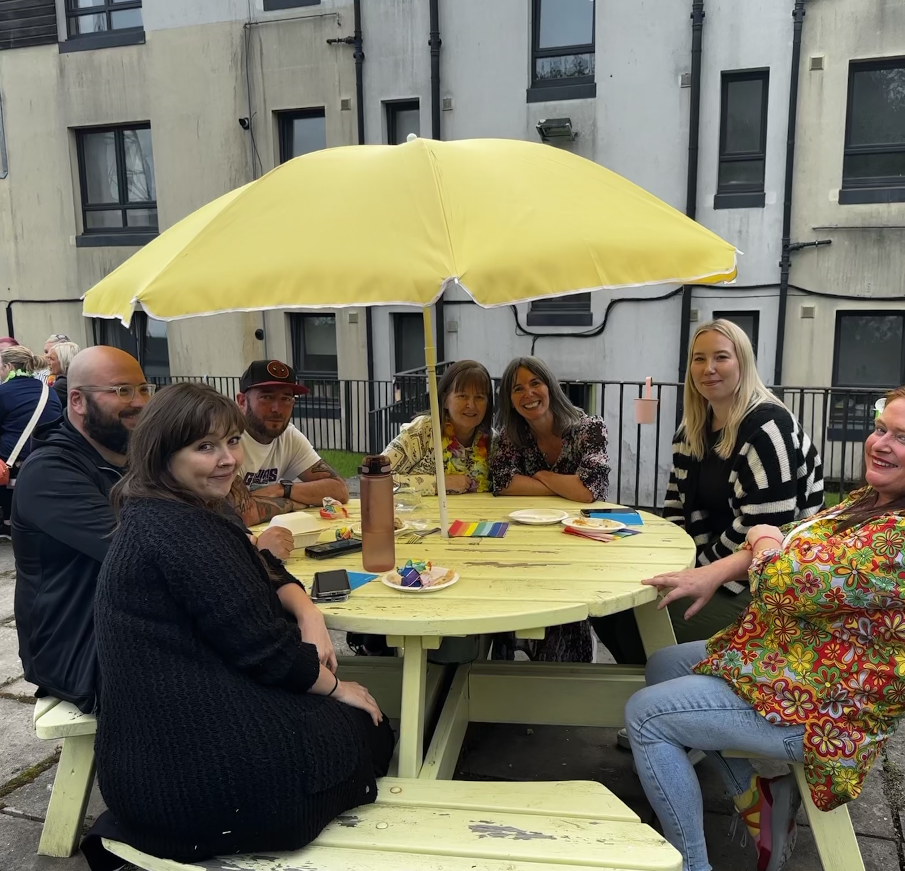
Essential skills and experience
Knowledge of current relevant legislation and policies relating to housing and social care
Skill and ability to implement effective performance measures
Computer literate and competent with Microsoft Office software package
Ability to ensure the service is delivered in accordance with corporate policy and Association objectives
Ability to compile comprehensive reports as required
Desirable qualities
Recognised relevant professional qualification eg Social Work, Housing
Experience of using management information tools for social care
Management experience in Third Sector not-for-profit organisation providing social care and support services
Understanding of the principles of working within a Psychologically Informed Environment (PIE)
Knowledge of local resources and services

Slide 13

Role Details
Contract: Full time, permanent, 39 hours per week.
Salary: SCP 23-26 (£29,737 - £32,632 per annum)
Reporting to: Registered Manager
Working hours are Monday to Sunday, between 08.00-20.00 in shifts which are defined by your line manager on a rolling rota.
Your core place of work will be Old Perth Road, Inverness. You may be required to work from such other place as the organisation may reasonably require from time to time.
You may be required to work from such other place as the organisation may reasonably require from time to time.
Annual leave entitlement of 234 hours holiday (equivalent to 6 weeks) pro rata per year in the first year rising to 310 hours (equivalent to 8 weeks) pro rata per year in the second. This includes public holidays.
All appointments are subject to a minimum of a 12-week probationary period.
You will be automatically enrolled into the People’s Pension. Deductions will be taken from your salary in the month you will complete 3-months of employment
It is the nature of the work of Right There that tasks and responsibilities are, in many circumstances unpredictable and varied. All employees are, therefore, expected to work in a flexible way when the occasion arises.

Slide 14

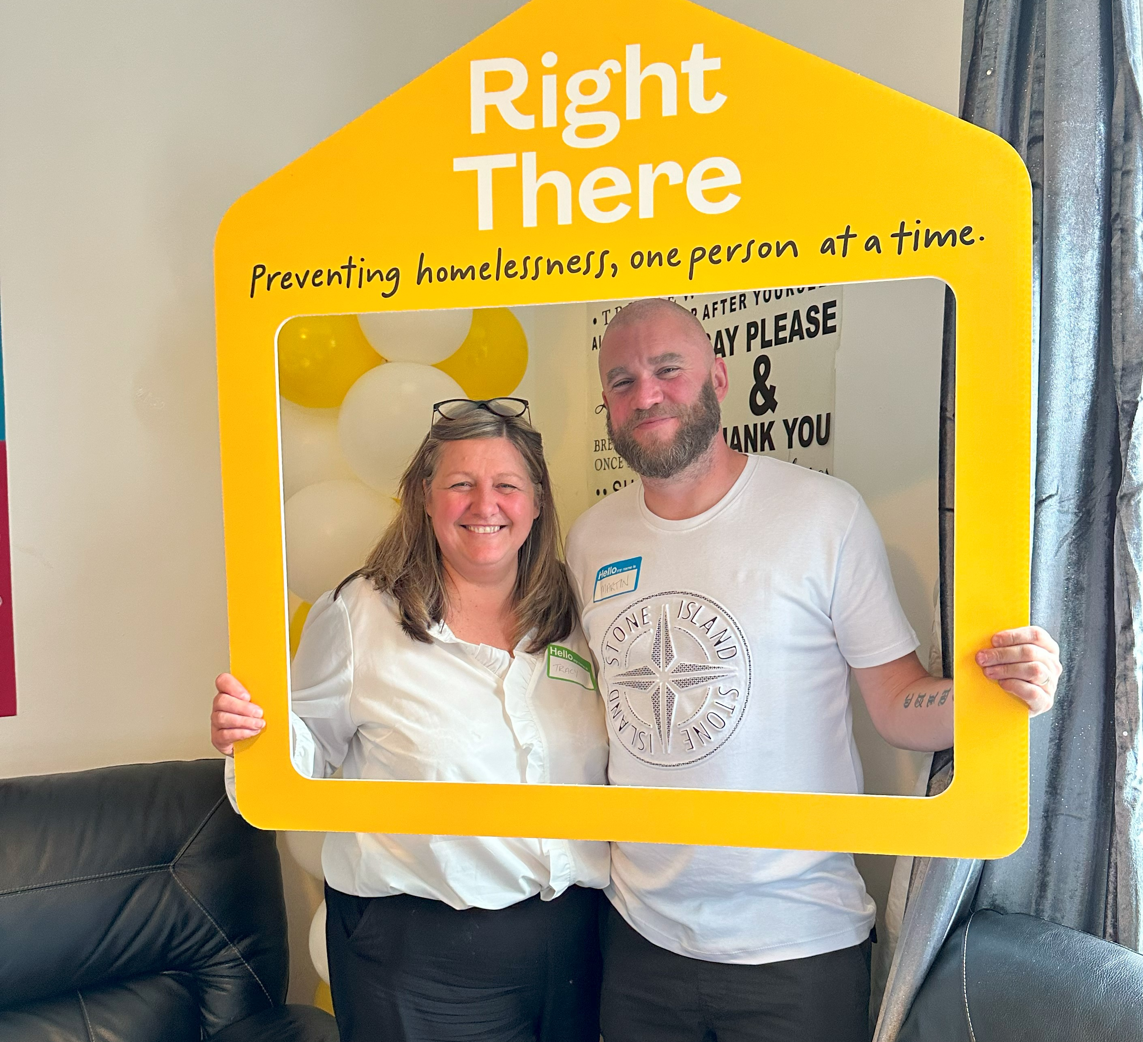
Our People Benefits
We know how dedicated our people are and we want to help you achieve a good work/life balance – and make it easier to enjoy life’s special moments!
That’s why we’ve got a range of enhanced family-friendly and wellbeing benefits to give you some well deserved perks of being a Right There employee.
Benefits include:
Hybrid working – work where is best for you and your role
Enhanced maternity, paternity, adoption, and shared parental leave
Employee 24-hour counselling and wellbeing services
6 weeks annual leave, rising to 8 after a year (plus you can purchase up to 5 more days)
Life insurance 4x your salary
Dedicated training and development plans
Cycle to work scheme
Refer a Friend

Slide 15
How to Apply
To apply send your CV and a short cover letter outlining your interest in and suitability for the role.
Email recruitment@rightthere.org

Slide 16
Thank you.
Good luck with your application.

