Slide 1

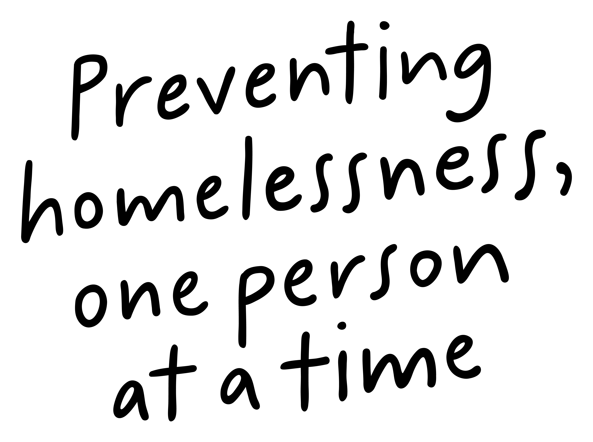
Role Profile
Volunteer Mentor- Adult Mentoring
(August 2025)

Slide 2
Job Purpose
Volunteer Mentor
Our adult mentoring programme encourages personal growth, social connection and sustainable integration within communities for the people we support across the Greater Glasgow and South Lanarkshire areas.
Through one-to-one support the volunteer mentor will help adults aged 18+ that are currently being supported by our Short Term Housing, Supported Accommodation and Outreach programmes to develop skills that will enable them to thrive.
Service Manager
Volunteer Coordinator
Mentors
(volunteers)

Slide 3


What’s Inside
4 - 5
Our Vision, Mission and Values
6 - 7
8
Requirements
19
Role Details
10
Volunteer Benefits
11
How to Apply
12
13

Slide 4

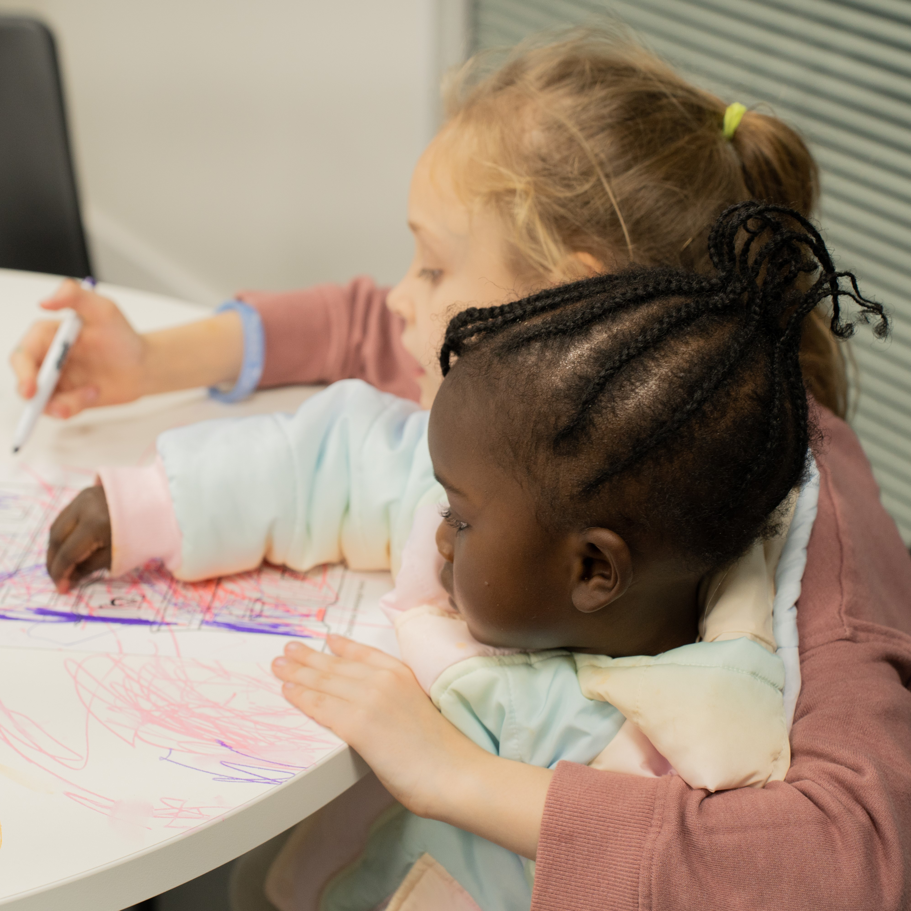
About Right There
We are Right There, a charity having just celebrated our 200th anniversary in 2024. We provide tailored support for people, at home, and in the community. We are here for people who are living with the effects of homelessness, poverty, addiction, or family breakdowns. Last year we supported almost 4,000 individuals, helping to prevent them from becoming homeless or separated from the people they love.
We are here to offer the right support at the right time, including breaking down financial barriers; accessing the private rental market; linking up with local health, employment and training services to help people make connections within the community; and helping people feel happier, safer, and more confident to take steps to improve their own lives.
Every person’s story is unique, and everyone’s route home is different, so we tailor our response to the individual. We want to challenge stereotypes – it doesn’t matter what the situation is – we’re not here to judge, only to help.
Our approach is about creating trusting relationships and nurturing people’s strengths, and our 200 dedicated staff, mentors and volunteers play a crucial role in this.

Slide 5
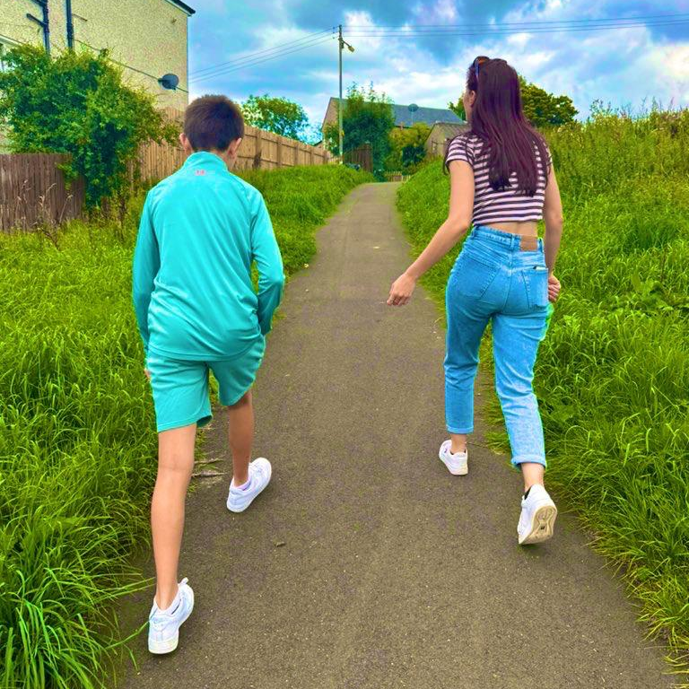
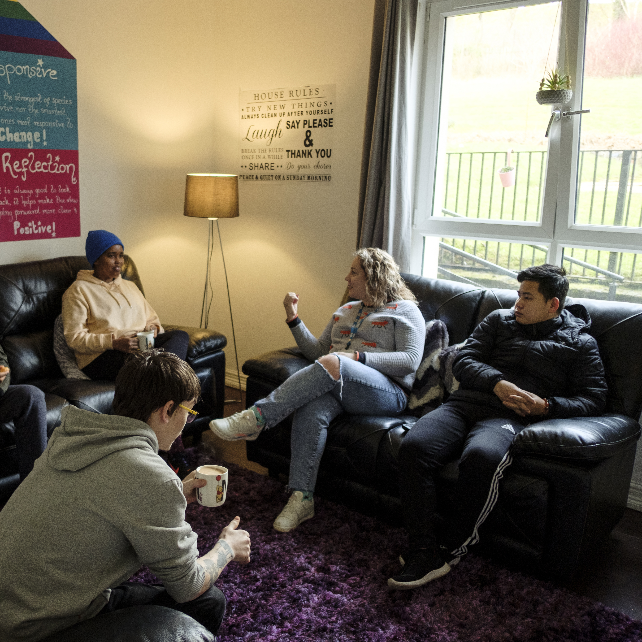
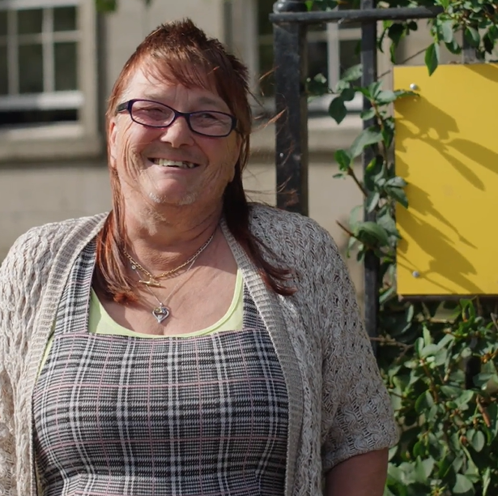
Our key areas of focus
For People
We provide tailored support for children and adults to help individuals and families feel happier, create stronger bonds and stay together.
At Home
We provide safe and supportive places to call home for people of all ages, from any circumstances, for as long as they might need it.
In The Community
We provide the tools for people to live independently and build their lives within their community, creating their own safe and secure homes.

Slide 6

Our Vision
A world where everyone has an equal chance to create a safe and supportive place to call home.
Our Mission
We meet people where
they are in life with no judgement; walking alongside those who need support, and preventing them becoming homeless
or separated from the people they love.

Slide 7



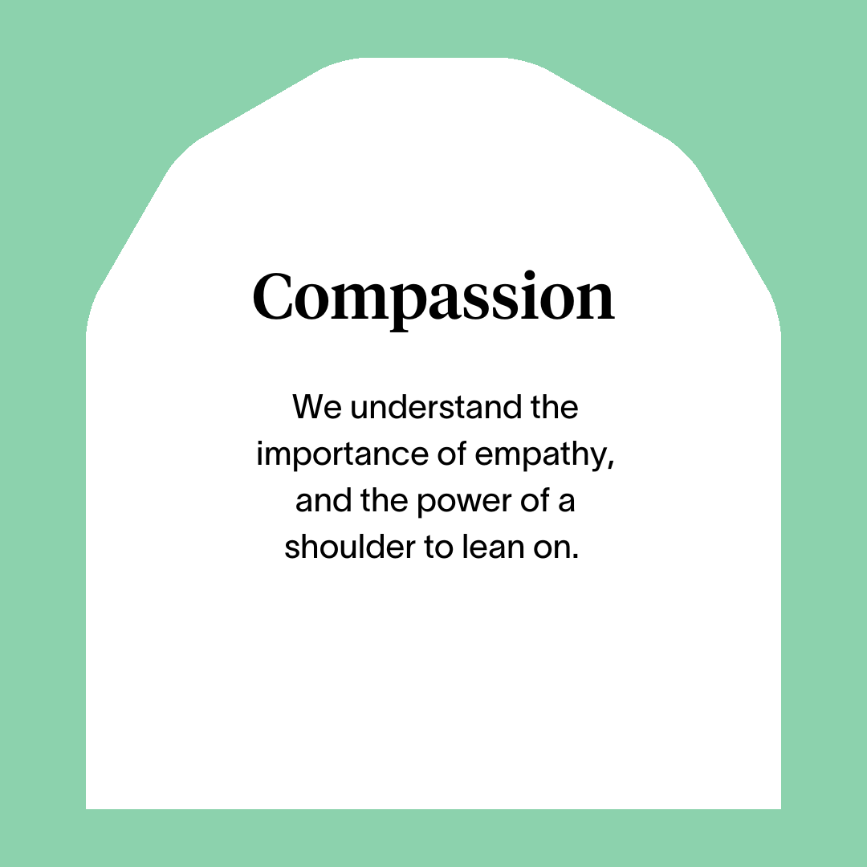



Slide 8
Role Responsibilities
Relationships
Develop good communication and working relationships with mentees, other mentors and Right There team members.
Support mentees in the local community.
Represent Right There to relevant bodies as/when required.
Practice & Service Delivery
Provide appropriate levels of high-quality support to mentees.
Accurately record matters relating to mentees and report as appropriate.
Signpost and refer to other agencies as appropriate.
Ensure you adopt a person-centered approach and participate in reflective practice.
Ensure awareness of service model.
Actively participate in regular support and supervision as well as group meetings to share experiences, exchange and increase knowledge and keep in touch with other mentors and staff.
Personal & Organisational Development
Attend and participate in training and share learning experiences.
Engage in reflective practice.
Feedback on the review of organisational polices & procedures and local guidelines.
Promote and represent Right There services positively.
Strive for continuous personal and professional development.
Volunteer mentors report to the Volunteer Co-ordinator
Volunteer mentors commit to approximately 2 hours per week for minimum of 12 months by mutual agreement between themselves and the mentee.

Slide 9
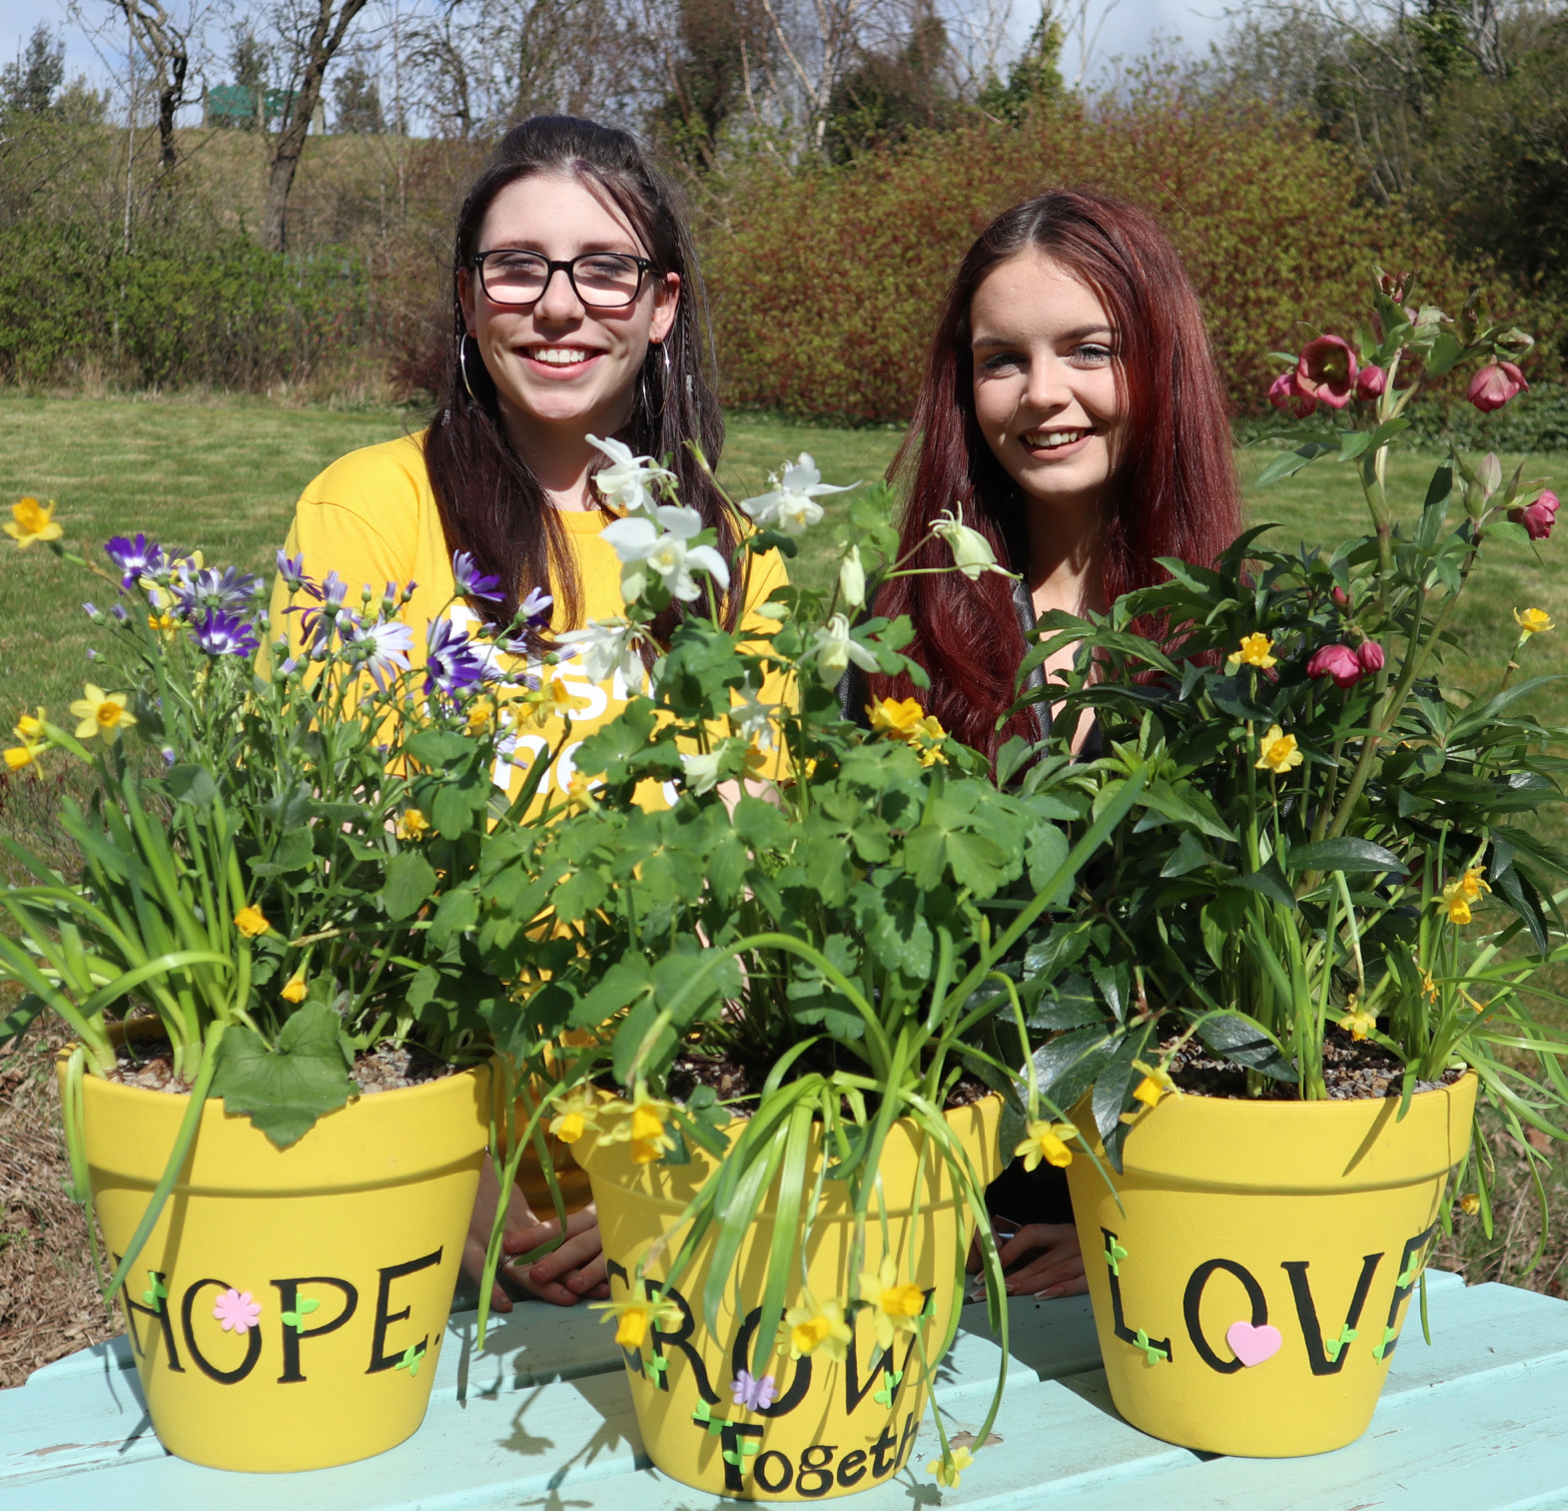
Preferred Candidate Background
  We’re looking for someone who thrives in face-to-face interactions and is confident meeting mentees in community settings. The ideal candidate will:
  Be kind, empathetic, approachable, and able to build trust with individuals from diverse backgrounds.
  Communicate clearly and respectfully, adapting to different environments and situations.
  Be reliable and consistent, with a strong sense of responsibility toward their mentee.
  Maintain confidentiality and professional boundaries at all times.
  Be culturally aware and open-minded, with a genuine interest in supporting others.
  Have a positive, encouraging attitude and a willingness to learn.
  Be comfortable travelling within the community to meet mentees where they are.
  Be available to dedicate up to 2 hours per week or fortnight supporting your mentee

Slide 10

Role Details
Agreement: Voluntary
Salary: Voluntary post without remuneration
Reporting to: Volunteer Coordinator
Up to 3 hours per week or fortnight
Your core place of will be in the Greater Glasgow community and its outskirts including South Lanarkshire.
All related expenses will be covered following the due process for agreed expenses.
It is the nature of the work of Right There that tasks and responsibilities are, in many circumstances unpredictable and varied. All workers including volunteers are, therefore, expected to work in a flexible way when the occasion arises.

Slide 11

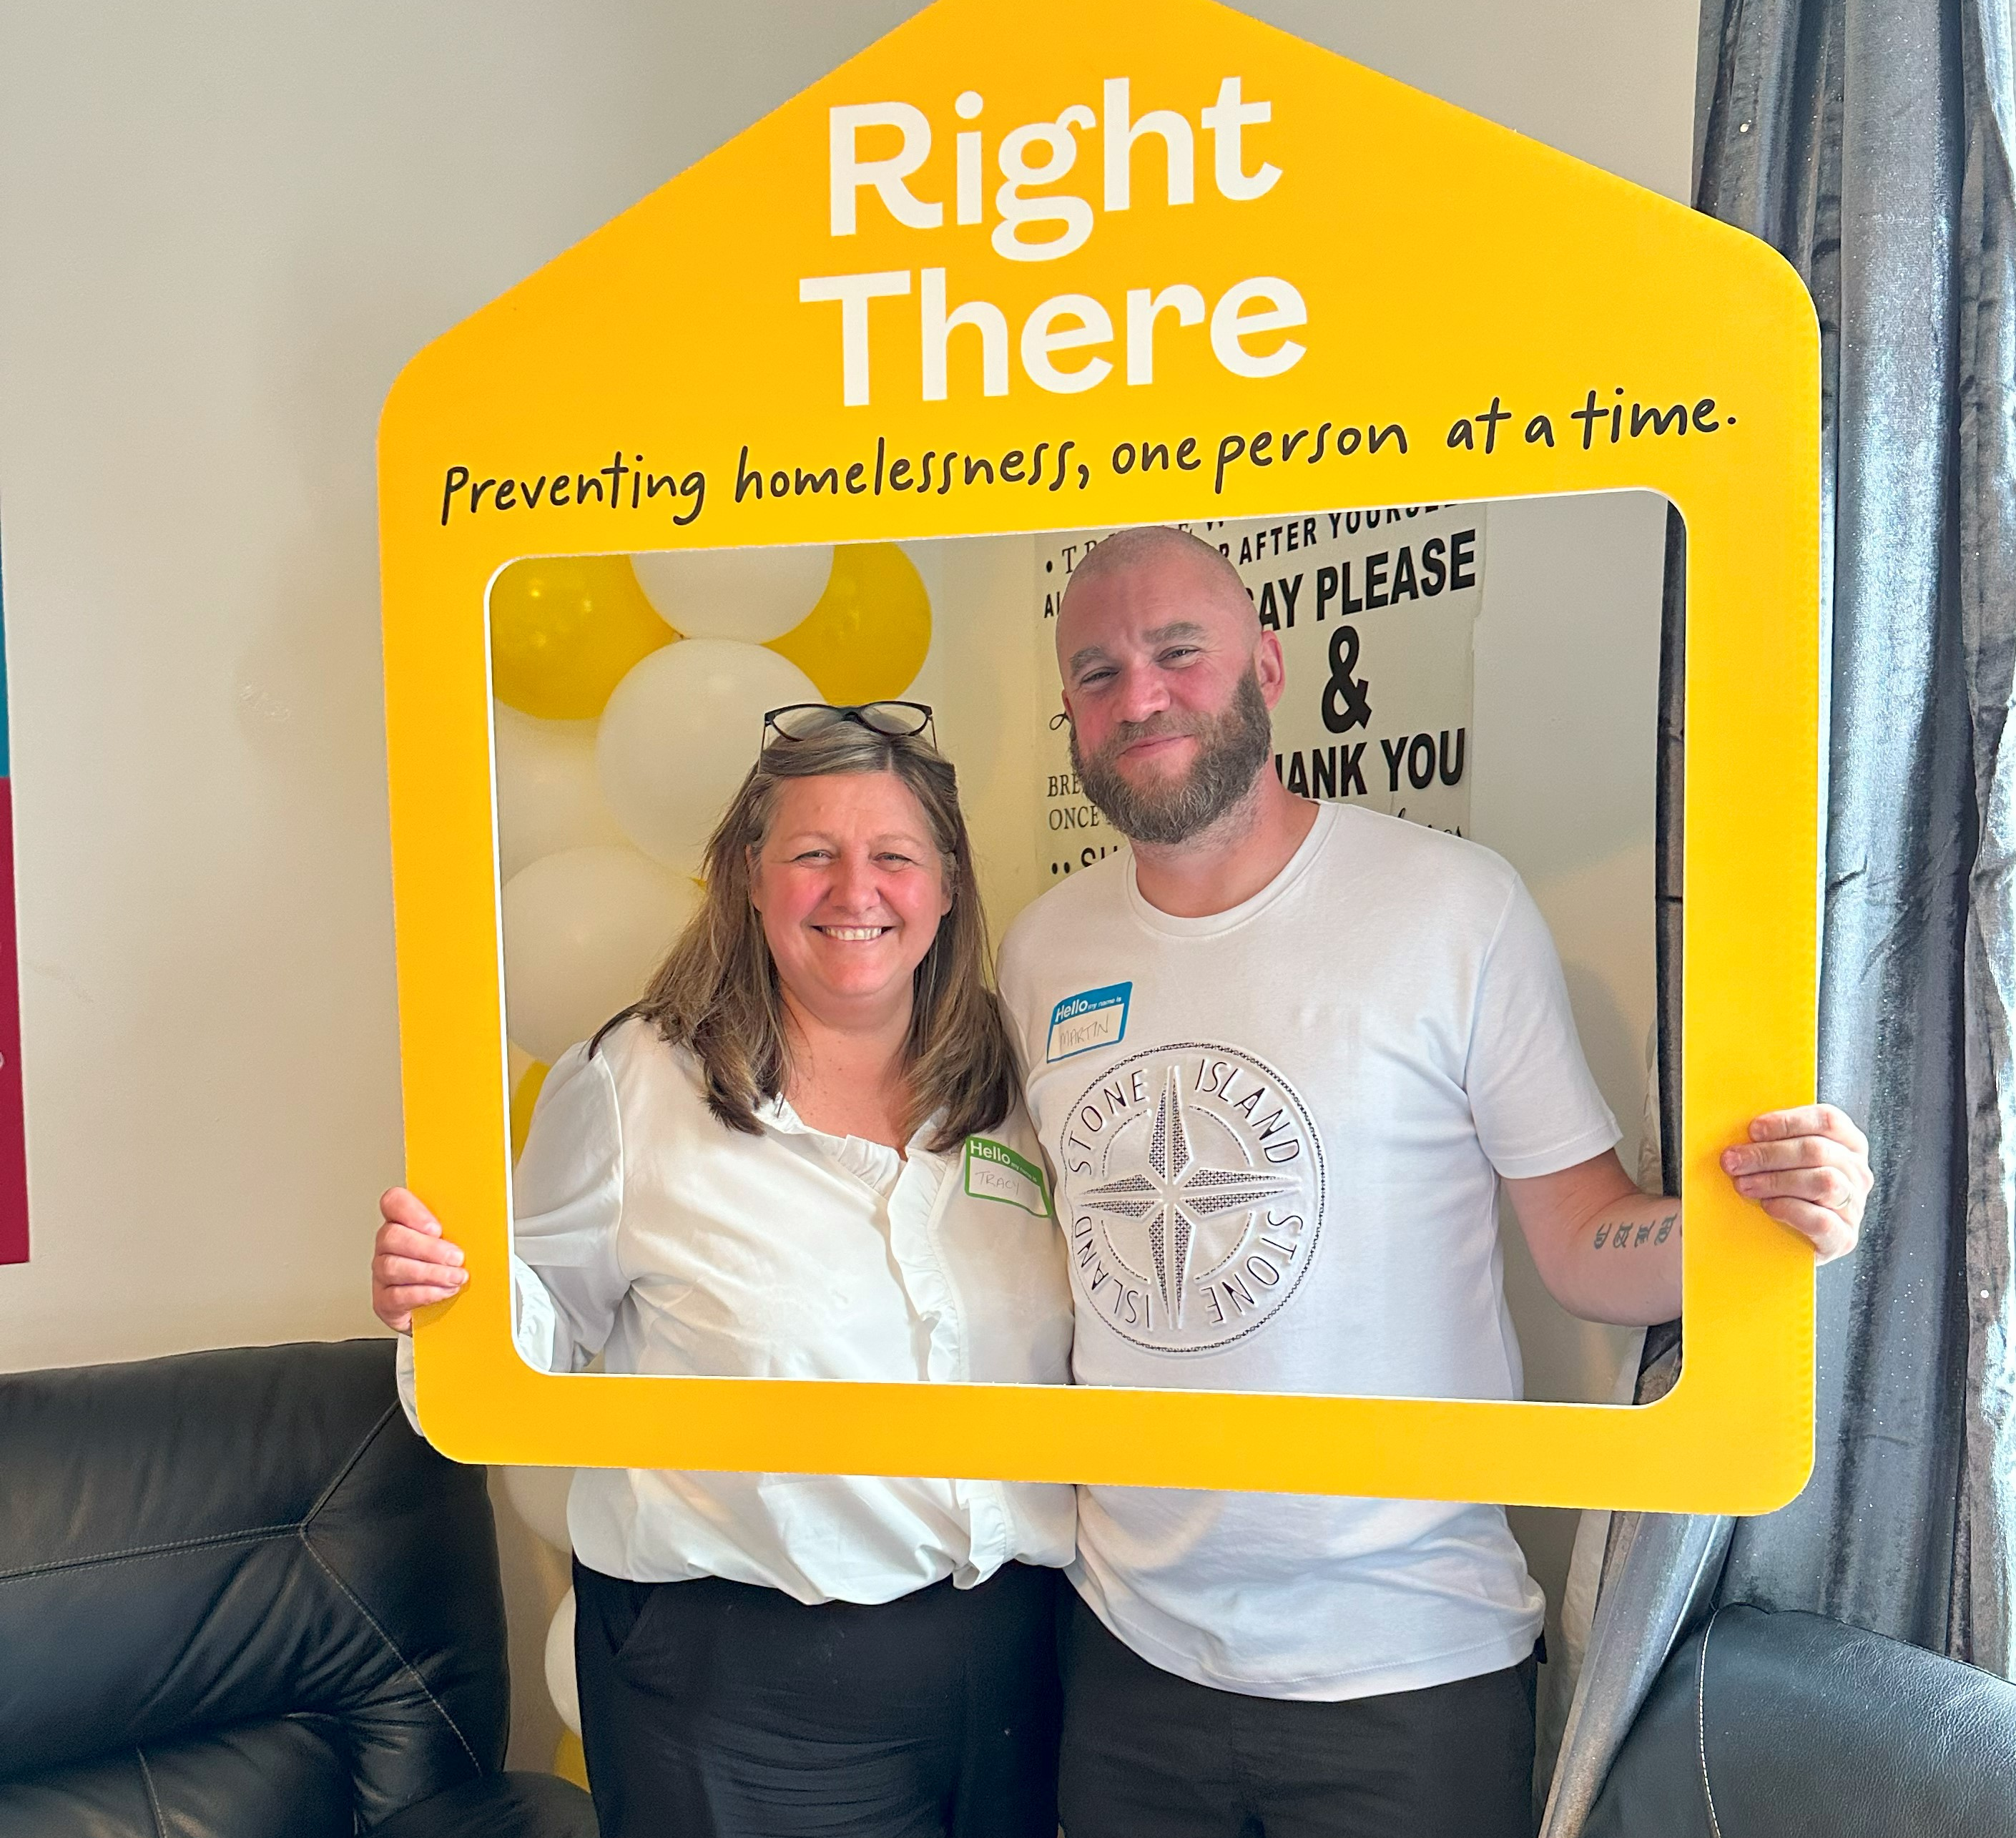
Volunteer Benefits
Benefits include:
Fully trained by our team who will get to know your passions and interests before matching you with one of the adults that we support
Flexible working pattern to suit your personal circumstances whilst reflecting the needs of the people we support
Comprehensive induction
Access to in-house online learning platform
Build a trusted relationship and have a lasting impact on someone’s life.
Enhance your communication, empathy, and interpersonal skills.
Be part of a team of coordinators and fellow mentors who offer guidance and encouragement.
Enjoy regular social events and opportunities to connect with others
Your contribution will be valued and celebrated through recognition initiatives.

Slide 12
Application Process
Send us an email or give us a call expressing your interest. We will follow up with a brief application form and next steps.
mentoring@rightthere.org
07345443441

Slide 13
Thank you.
Good luck with your application.

