Slide 1

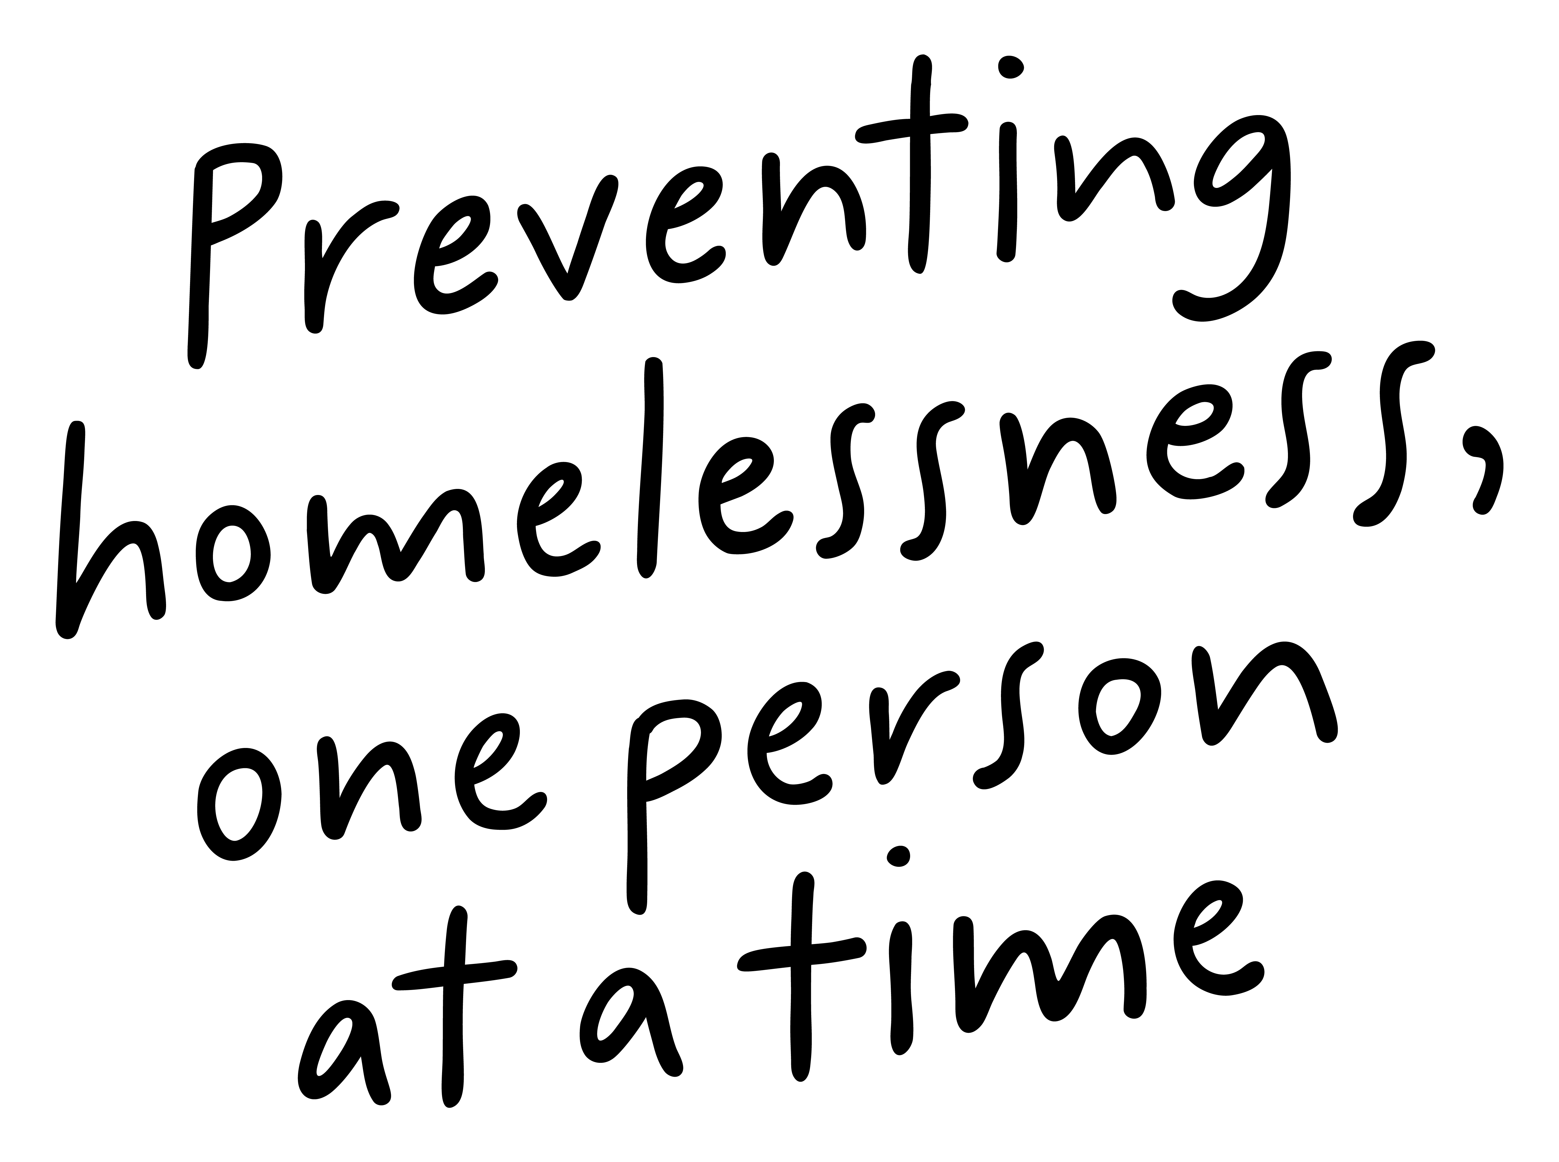
Job Pack Head of Property (October 2025)

Slide 2
Job Purpose Head of Property
The Head of Property is part of our Senior Management team and has principal responsibility for all aspects of property management and asset recycling, including repairs, cyclic planning, asset investment and future strategic planning.
The Head of Property will take an entrepreneurial approach to delivering an excellent customer focussed service, both internally and externally, through our property team and external contractors. The post holder will deliver increased asset performance, continuous improvement and value for money and ensure that all properties are maintained in line with our quality standards, Health and Safety and legislative requirements.
The Head of Property oversees a Property Management Team leading the Health & Safety, maintenance, portfolio management and administrative teams for the function. A key focus of the role is embedding environmentally sustainable practices across all property operations, including maximising the reuse and recycling of furniture and fittings. This is delivered through our eco-conscious property approach and the Furnish Forward recycling shop, launched in June 2025, which champions circular economy principles and reduces waste.
The team is responsible for the management of a portfolio of over 500 properties of various size, predominantly in the Glasgow area and includes general maintenance technicians, drivers, painters and joiners.
Head of Property
Property Admin Manager
Furnish Forward Sales Admin
Property Maintenance and Health and Safety Manager
Property Administrators
Maintenance Supervisors
Maintenance Team

Slide 3


What’s Inside
4-5
Our Vision, Mission and Values
6-7
8-9
Requirements
10-11
Role Details
12
Our People Benefits
13
How to Apply
14
15

Slide 4


About Right There
We are Right There, a charity celebrating our 200th anniversary in 2024. We provide tailored support for people, at home, and in the community. We are here for people who are living with the effects of homelessness, poverty, addiction, or family breakdowns. Last year we supported almost 4,000 individuals, helping to prevent them from becoming homeless or separated from the people they love.
We are here to offer the right support at the right time, including breaking down financial barriers; accessing the private rental market; linking up with local health, employment and training services to help people make connections within the community; and, helping people feel happier, safer, and more confident to take steps to improve their own lives.
Every person’s story is unique, and everyone’s route home is different, so we tailor our response to the individual. We want to challenge stereotypes – it doesn’t matter what the situation is – we’re not here to judge, only to help.
Our approach is about creating trusting relationships and nurturing people’s strengths, and our 200 dedicated staff, mentors and volunteers play a crucial role in this.

Slide 5

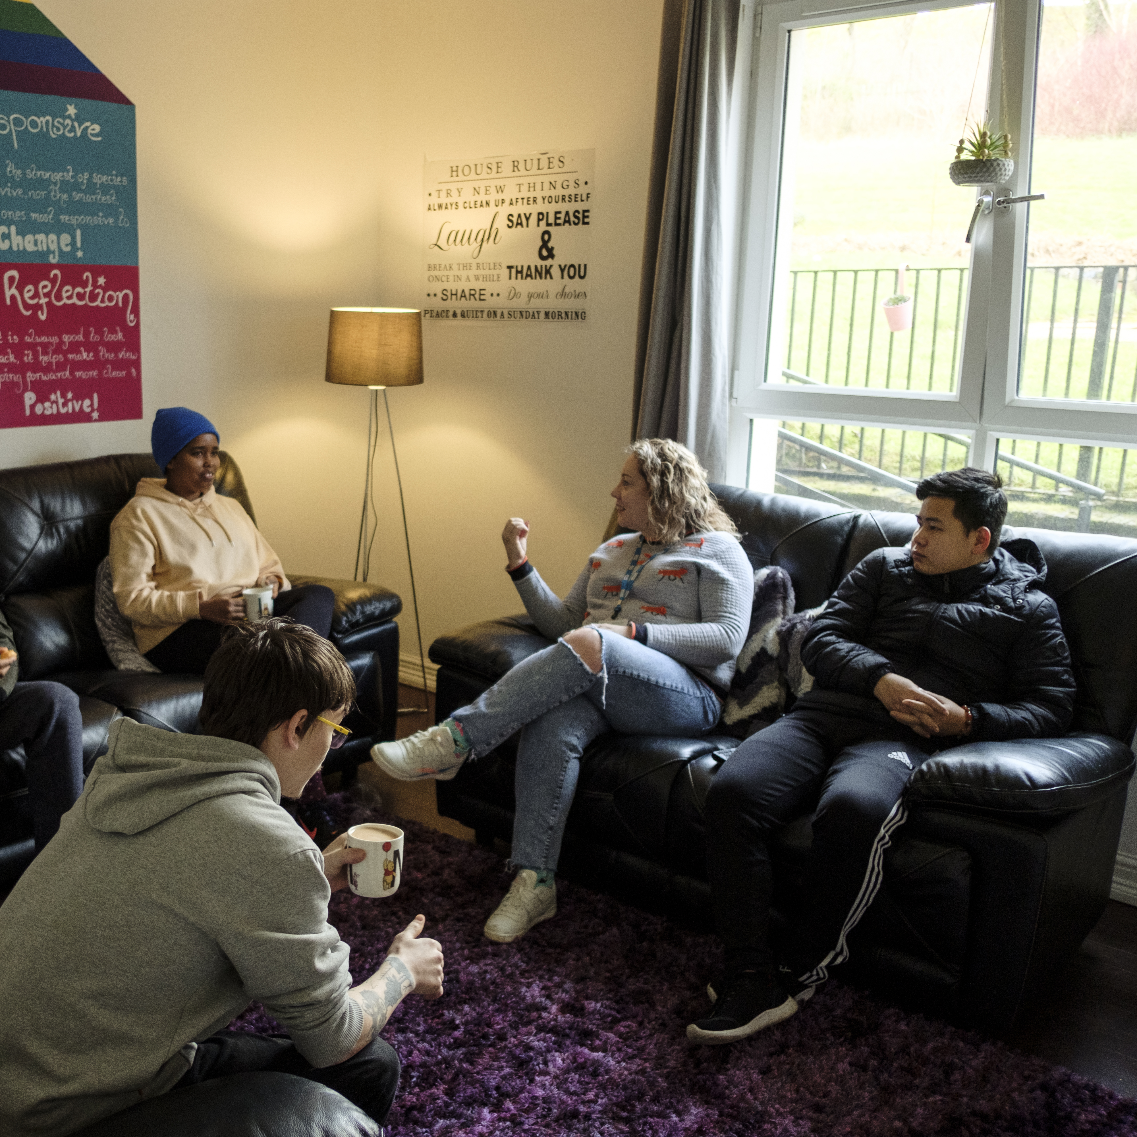
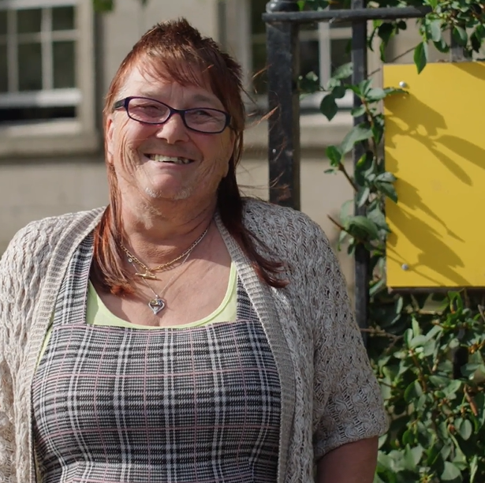
Our key areas of focus
For People
We provide tailored support for children and adults to help individuals and families feel happier, create stronger bonds and stay together.
At Home
We provide safe and supportive places to call home for people of all ages, from any circumstances, for as long as they might need it.
In The Community
We provide the tools for people to live independently and build their lives within their community, creating their own safe and secure homes.

Slide 6

Our Vision A world where everyone has an equal chance to create a safe and supportive place to call home.
Our Mission We meet people where
they are in life with no judgement; walking alongside those who need support, and preventing them becoming homeless
or separated from the people they love.

Slide 7







Slide 8
Main Role Responsibilities
Leadership & Team Development
Lead and manage the Property team, including health & safety, repairs and maintenance, portfolio management, procurement, fleet management, furniture delivery/removal and administrative support.
Maximise the environmental, financial and social impact of our recently launched retail unit Furnish Forward.
Provide strong leadership and act as a role model of Right There’s values to staff, volunteers, and the people we support.
Mentor, support, and develop staff, creating a psychologically safe culture of continuous improvement and compassionate leadership.
Collaborate with colleagues across all levels to monitor, evaluate, and improve service delivery.
Promote reflective practice and engage in ongoing professional development.
Property Strategy & Service Delivery
Lead the development and implementation of the organisation’s Property Investment and Service Plan.
Deliver a customer-focused repairs and maintenance service that prioritises quality, efficiency, and value for money.
Oversee property investment, reactive, planned, and cyclical maintenance programmes.
Provide guidance and support to operational programmes on property-related matters.
Lead delivery and removal of furniture between properties and Furnish Forward.
Have oversight of property records ensuring they are accurate, accessible, and maintained in line with organisational standards.
Compliance, Health & Safety
Ensure all properties meet health and safety legislation, regulations, and best practice standards.
Oversight of health and safety strategies, policies, and procedures across the property function.
Review mechanisms to ensure landlords meet their responsibilities regarding property condition and safety.
Maintain up-to-date knowledge of relevant legislation, sector trends, and developments.
Procurement & Contractor Management
Lead and manage the procurement of properties, ensuring quality standards and budget alignment.
Have responsibility for fleet management including leasing, procuring and maintaining our vehicles.
Engage and manage contractors, consultants, and service providers.
Manage and maintain an approved external contractor list.
Ensure procurement practices align with organisational policies and deliver value for money.

Slide 9
Main Role Responsibilities
Systems, Data & Performance
Oversee housing management software, ensuring it remains fit for purpose and supports decision-making and investment planning.
Develop and maintain systems, policies, and processes that support efficient property operations.
Prepare and provide regular KPI and management reports on operational and financial performance.
Act as the budget holder for the property service, ensuring financial accountability and cost-effectiveness.
Stakeholder Engagement & Organisational Contribution
Build and maintain positive relationships with internal and external stakeholders.
Develop partnerships with external agencies to support service delivery and strategic goals.
Actively contribute to organisational development, policy review, and strategic planning.
Promote Right There’s programmes through agreed channels and represent the organisation professionally.

Slide 10

Essential skills and experience
Excellent knowledge and understanding of the property and building sector
Excellent knowledge of current property standards legislation
Experience of leading a varied team combining compassionate leadership while confidently addressing challenges
Experience of executing system improvements, leading transformation and implementing changes to policy and process
Excellent communicator with business report writing experience
Financially astute with a commercial approach to property management
Excellent written and verbal communication skills across a variety of situations
Ability to collate and analyse data to identify trends and areas for improvement
Highly motivated and organised with excellent planning and project management skills
Good level of IT skills and ability to produce high quality reports and presentations
Ability to manage competing demands and priorities
Ability to work independently, use initiative and be pro-active
Ability to build good working relationships with management, employees and contractors at all levels.

Slide 11
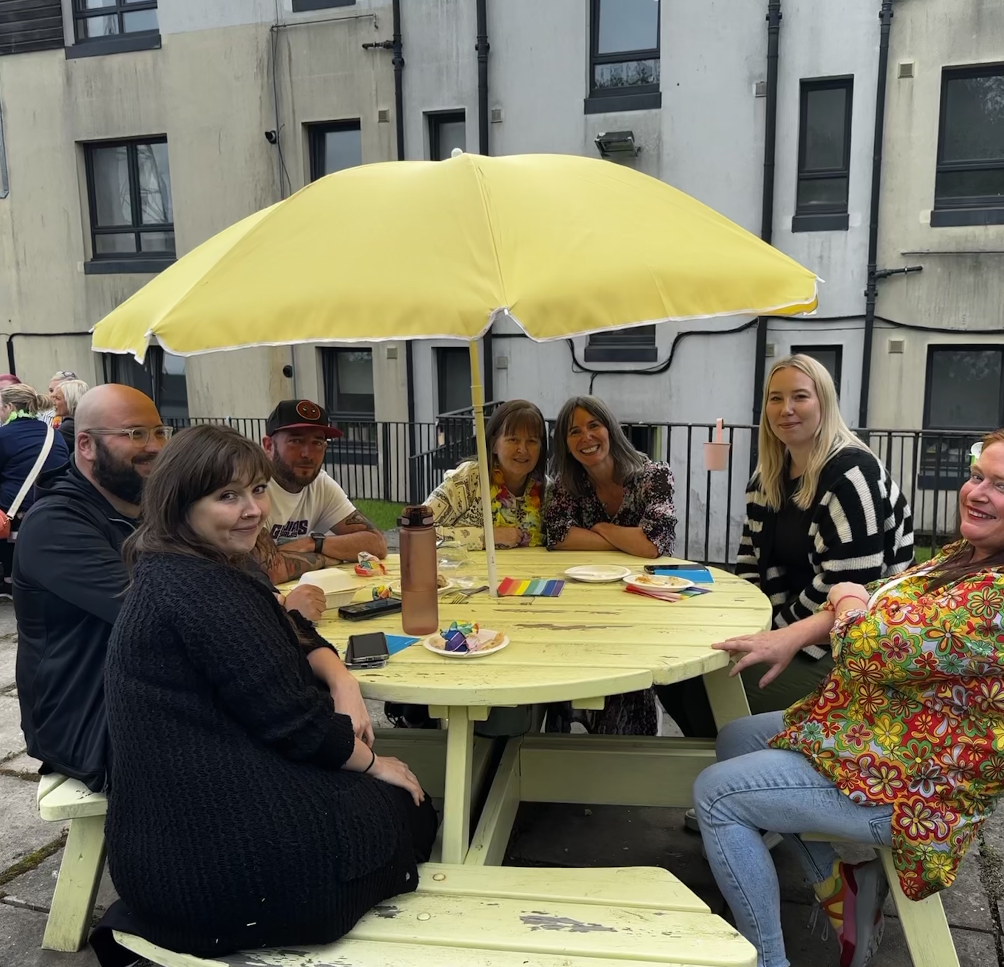
Desirable Knowledge
Degree or relevant professional qualification
Experience of working in a third sector or not for profit organisation providing social care and support services
An understanding of the principles of a Psychologically Informed Environment (PIE)

Slide 12

Role Details
Contract: Full time, permanent, 35 hours per week. Salary: SCP 49-53 (£53,300 - £58,630 per annum) Reporting to: Chief Executive
Working hours are 35 per week worked Monday to Friday between the hours of 8am and 4pm, depending on the needs of the service with 1-hour unpaid break
Your core place of work will Rosemount Business Park, Unit E2, 141-145 Charles Street, Glasgow, G21 2QA
You may be required to work from such other place as the organisation may reasonably require from time to time.
Annual leave entitlement of 210 hours holiday (equivalent to 6 weeks) pro rata per year in the first year rising to 280 hours (equivalent to 8 weeks) pro rata per year in the second. This includes public holidays.
All appointments are subject to a minimum of a 12-week probationary period.
You will be automatically enrolled into the People’s Pension. Deductions will be taken from your salary in the month you will complete 3-months of employment
It is the nature of the work of Right There that tasks and responsibilities are, in many circumstances unpredictable and varied. All employees are, therefore, expected to work in a flexible way when the occasion arises.

Slide 13

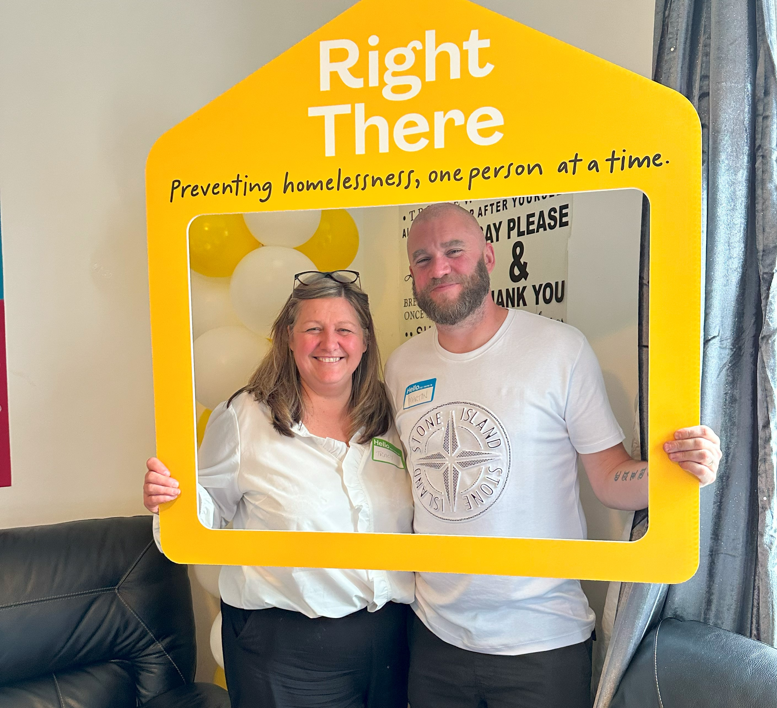
Our People Benefits
We know how dedicated our people are and we want to help you achieve a good work/life balance – and make it easier to enjoy life’s special moments!
That’s why we’ve got a range of enhanced family-friendly and wellbeing benefits to give you some well deserved perks of being a Right There employee. Benefits include:
Enhanced maternity, paternity, adoption, and shared parental leave
Employee 24-hour counselling and wellbeing services
6 weeks annual leave, rising to 8 after a year (plus you can purchase or sell up to 5 more days)
Life insurance 4x your salary
Dedicated training and development plans
Cycle to work scheme
Paid refer a Friend scheme
Company shop discounts

Slide 14
How to Apply
We are partnered with Confero Recruitment Group for this role, please send a tailored cv and cover letter outlining your interest in and suitability for the role to Alasdair Reid
Alasdair@conferorecruitment.co.uk
If you would like to discuss your application, please call Alasdair on 07979 755 512.

Slide 15
Thank you. Good luck with your application.

