Slide 1

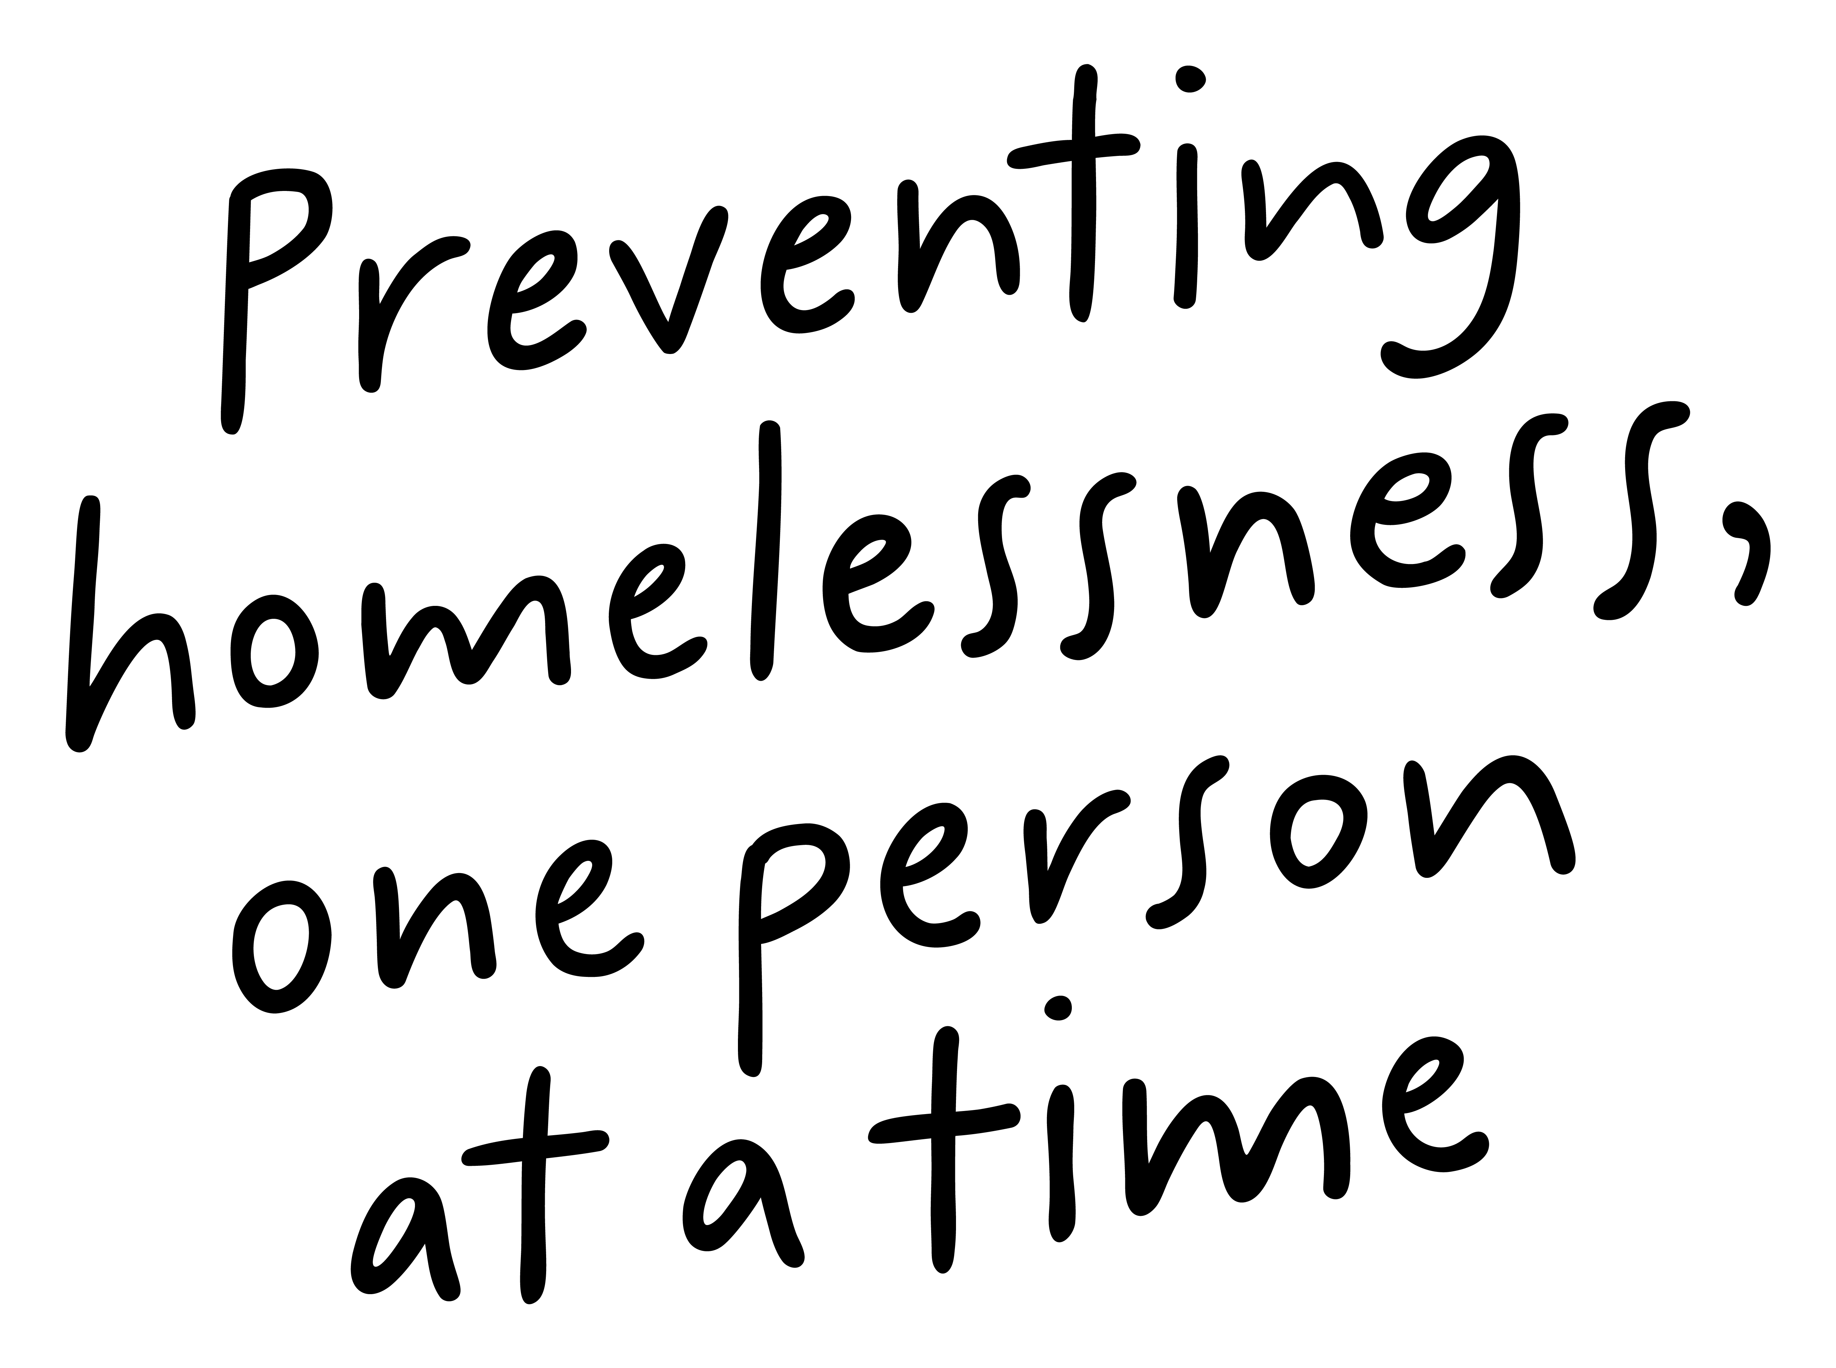
Job Pack Housing Services Manager (September 2025)

Slide 2
Job Purpose Housing Services Manager
The Housing Services Manager is a key delivery position within Right There’s Short-Term Housing Programme, supporting a growing portfolio with currently over 500 tenancies across the city. The postholder will also directly manage, positioning and growth/development of the organisation’s Help to Rent programme, currently provided in Glasgow. The postholder will report directly to the Head of Housing.
The post will provide a highly responsive and professional tenancy and housing management service. Will work flexibly, collaboratively and be a positive member of the housing management team. The postholder will communicate in a proactive manner and with a range of stakeholders. They will lead day to day delivery of the housing management service and work in partnership, specifically with the Glasgow homelessness referral team (Temporary Accommodation Allocation Team)
The Housing Services Manager will lead a team and will drive delivery and performance. They will encourage and support a culture of robust tenancy management delivered with dignity and respect towards tenants, stakeholders and colleagues. A key part of this role will be ensuring that occupancy targets are met and tenancy voids (and associated timelines) are minimised. A significant part of the role with be based on maintaining positive working relations with the Right There Property team.
Head of Housing
Housing Services Manager
Housing Team Lead x 3
Service Manager x 1
Housing Administration Supervisor x 1
Administration Team
Tenant Liaison Worker Teams
Help to Rent Team

Slide 3


What’s Inside
4-5
Our Vision, Mission and Values
6-7
8-11
Requirements
12-13
Role Details
14
Our People Benefits
15
How to Apply
16
17

Slide 4


About Right There
We are Right There, a charity celebrating our 200th anniversary in 2024. We provide tailored support for people, at home, and in the community. We are here for people who are living with the effects of homelessness, poverty, addiction, or family breakdowns. Last year we supported almost 4,000 individuals, helping to prevent them from becoming homeless or separated from the people they love.
We are here to offer the right support at the right time, including breaking down financial barriers; accessing the private rental market; linking up with local health, employment and training services to help people make connections within the community; and, helping people feel happier, safer, and more confident to take steps to improve their own lives.
Every person’s story is unique, and everyone’s route home is different, so we tailor our response to the individual. We want to challenge stereotypes – it doesn’t matter what the situation is – we’re not here to judge, only to help.
Our approach is about creating trusting relationships and nurturing people’s strengths, and our 200 dedicated staff, mentors and volunteers play a crucial role in this.

Slide 5

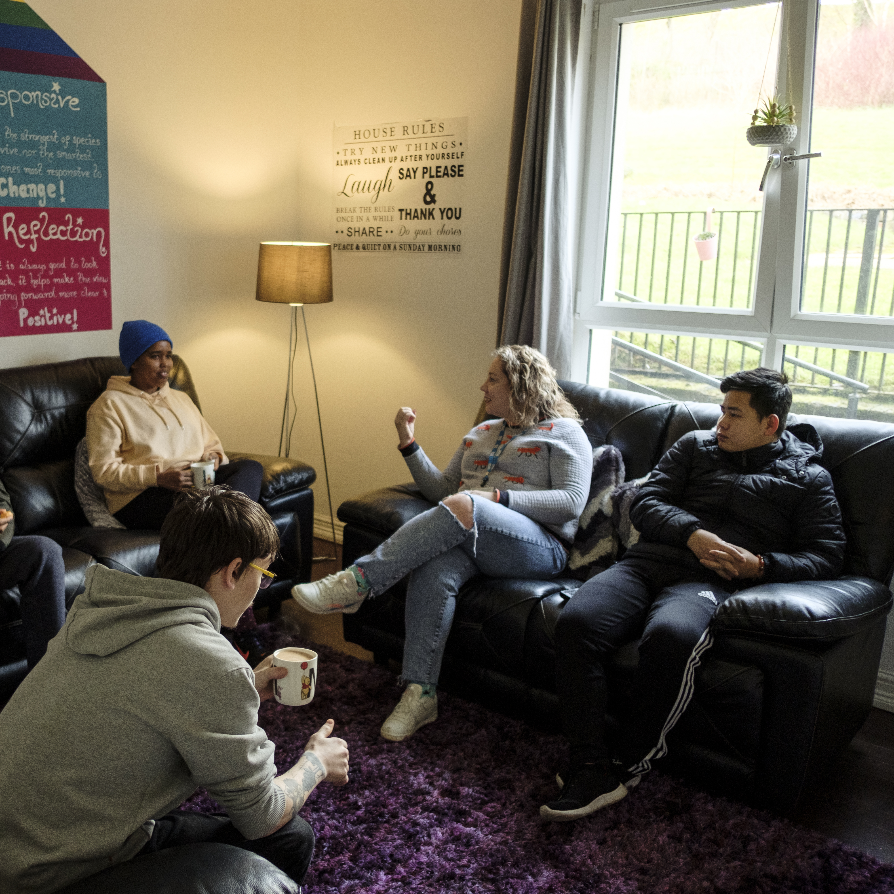
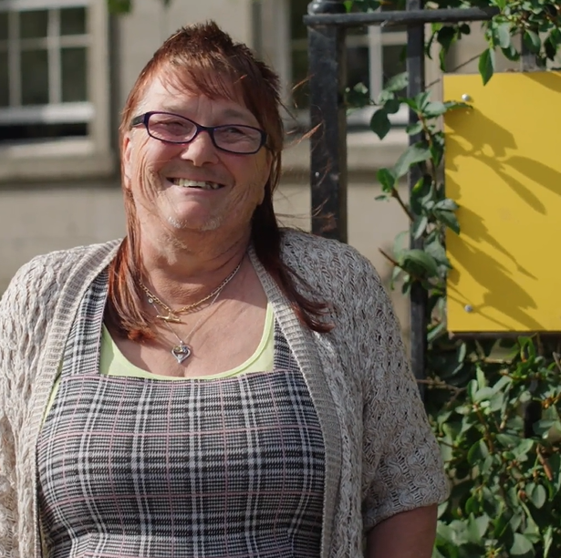
Our key areas of focus
For People
We provide tailored support for children and adults to help individuals and families feel happier, create stronger bonds and stay together.
At Home
We provide safe and supportive places to call home for people of all ages, from any circumstances, for as long as they might need it.
In The Community
We provide the tools for people to live independently and build their lives within their community, creating their own safe and secure homes.

Slide 6

Our Vision A world where everyone has an equal chance to create a safe and supportive place to call home.
Our Mission We meet people where
they are in life with no judgement; walking alongside those who need support, and preventing them becoming homeless
or separated from the people they love.

Slide 7







Slide 8
Main Role Responsibilities
1. Tenancy and Service Management
Ensure tenancy procedures are coordinated and undertaken with regards to the filling of our temporary furnished flats
Ensure that processes between Right There and the Homeless referral teams are detailed and clear
Ensure “Sign Up” arrangements for new tenants are comprehensive and rental rights/tenancy agreements and responsibilities for said tenants are understood and accepted
Responsible for arrangements being organised and/or in place for new tenants requiring additional housing support interventions or equivalent
Ensure all housing benefit checks and follow ups are processed and maintained timeously
Oversee that tenancy inspections are allocated appropriately to Tenancy Liaison Workers and all tenancy checks are completed
Ensure procedures in place to manage and follow up any tenancy or neighbourhood issues and complaints
Maintain tenancy and associated databases with corresponding support plans duly completed and audited
Responsible for administrative functions managed in a prompt manner within the assigned portfolio; data collection, reporting, managing tenant enquiries, complaints and disputes.
Overall operational responsibility for the management and delivery of Short-Term Housing & Help to Rent Programmes.
Tenant Management
Ensure that referrals for Temporary Furnished Flats (TFFs) are processed in a timely and proactive manner and are of a high standard
Assess needs against relevant criteria e.g. location, house size, neighbourhood, family(or other) size
Liaise with HSCP and other stakeholder agencies which may include participating in allocation and ongoing tenant meetings
Manage arrangements for tenant viewings, waiting lists and tenant/property packs
Monitor performance in terms of tenant property inspections and condition management checks
Ensure arrangements in place to monitor tenant needs and changes in circumstances
Ensure vacancy maintenance is organised in close liaison with the property team and associated contractors
Maintain positive working relations with landlords and agents with regards to tenant access and repairs etc

Slide 9
Main Role Responsibilities
People Management
Lead the Short Term Housing and Help to Rent teams with a clear focus on delivery performance and outcome attainment
Lead the teams to deliver great “customer” service
Work in partnership with Right There colleagues; promote clear and singular communication
Embrace a positive working culture working collaboratively, promoting inclusiveness, cooperation, trust and open exchange of ideas to fulfil Right There’s strategic aims supporting line managers and delivery staff to do likewise.
Build your team taking responsibility for recruitment, induction and performance using support and supervision and appraisal tools.
Responsibility for the learning and continued professional development of yourself and your teams, actively encouraging reflective practice for team learning
Be accountable for a safe environment for employees and those people what we support through applying Health and Safety legislation and practices.
Data and Performance
Accountable for service specific data collection, analysis and regular agreed reporting
Deliver on service performance, using KPI data to support decision making and planning for current programmes.
Analyse both external and internal data/information to support future growth, development and planning
Lead and support new initiatives and the development and implementation of policies, procedures and guidelines as they impact on housing management
Lead on policies and processes developments and management as they impact on housing management.

Slide 10
Main Role Responsibilities
Compliance
Responsible for upholding the tenancy standards in line with Glasgow City Council’s letting standards and maintaining these standards across all tenure types
Register with any required government bodies and ensure membership is updated and any attributed costs are paid for
Ensure that all required reports, returns and documentation are up to date, submitted and complete
Ensure that landlords maintain and upkeep tenancies in line with their lease responsibilities and requirements
Maintain control of all Help to Rent arrangements and corresponding deposit-based bonds
External stakeholders
Develop strong working partnerships with external agencies, promoting Right There’s work
Day to day working partnership with key commissioners involved in service review and reporting
Represent Right There to other agencies or services including Local Authorities, Social Work, Housing Services and other relevant services and bodies
Take the lead in programme delivery matters as it applies to all housing management provision, maintaining positive working relations with external stakeholders
Work closely with landlords and/or letting agents across all aspects of tenancy related business, including repairs, voids, tenancy matters
Support relationships and partner with private rented landlords taking part in Right There’s Help to Rent activities, initially across Glasgow (with scope to grow)

Slide 11
Main Role Responsibilities
Finance and Resource Management
Support the compiling and associated management of approved annual budgets
Manage said budgets for all aspects of Short-Term Housing and Help to Rent programmes.
Ensure services operate within financial parameters and targets
Lead and peer support staff in their understanding and responsibilities in development of budgets and managing resources
Responsible for identifying and securing local grant and associated funds that supports activities within services where agreed with Head of Housing.

Slide 12

Essential skills and experience
Qualification in Housing and/or Property Management
Knowledge of current relevant legislation, policies and strategies relating to housing and homelessness
Proven track record in effective coaching and people management
Proven track record in effective service planning, performance management and quality assurance
Experience of managing a service
Knowledge and experience of working to Housing regulation and standards
Ability to lead and take ownership and accountability for a programme.
Proven effective communicator
Ability to build strong professional relationships both within the organisation and externally
Ability to collate and analyse data for decision making purposes
Proven ability in effective planning, prioritisation and organisation
Experience in building, leading and managing a team

Slide 13
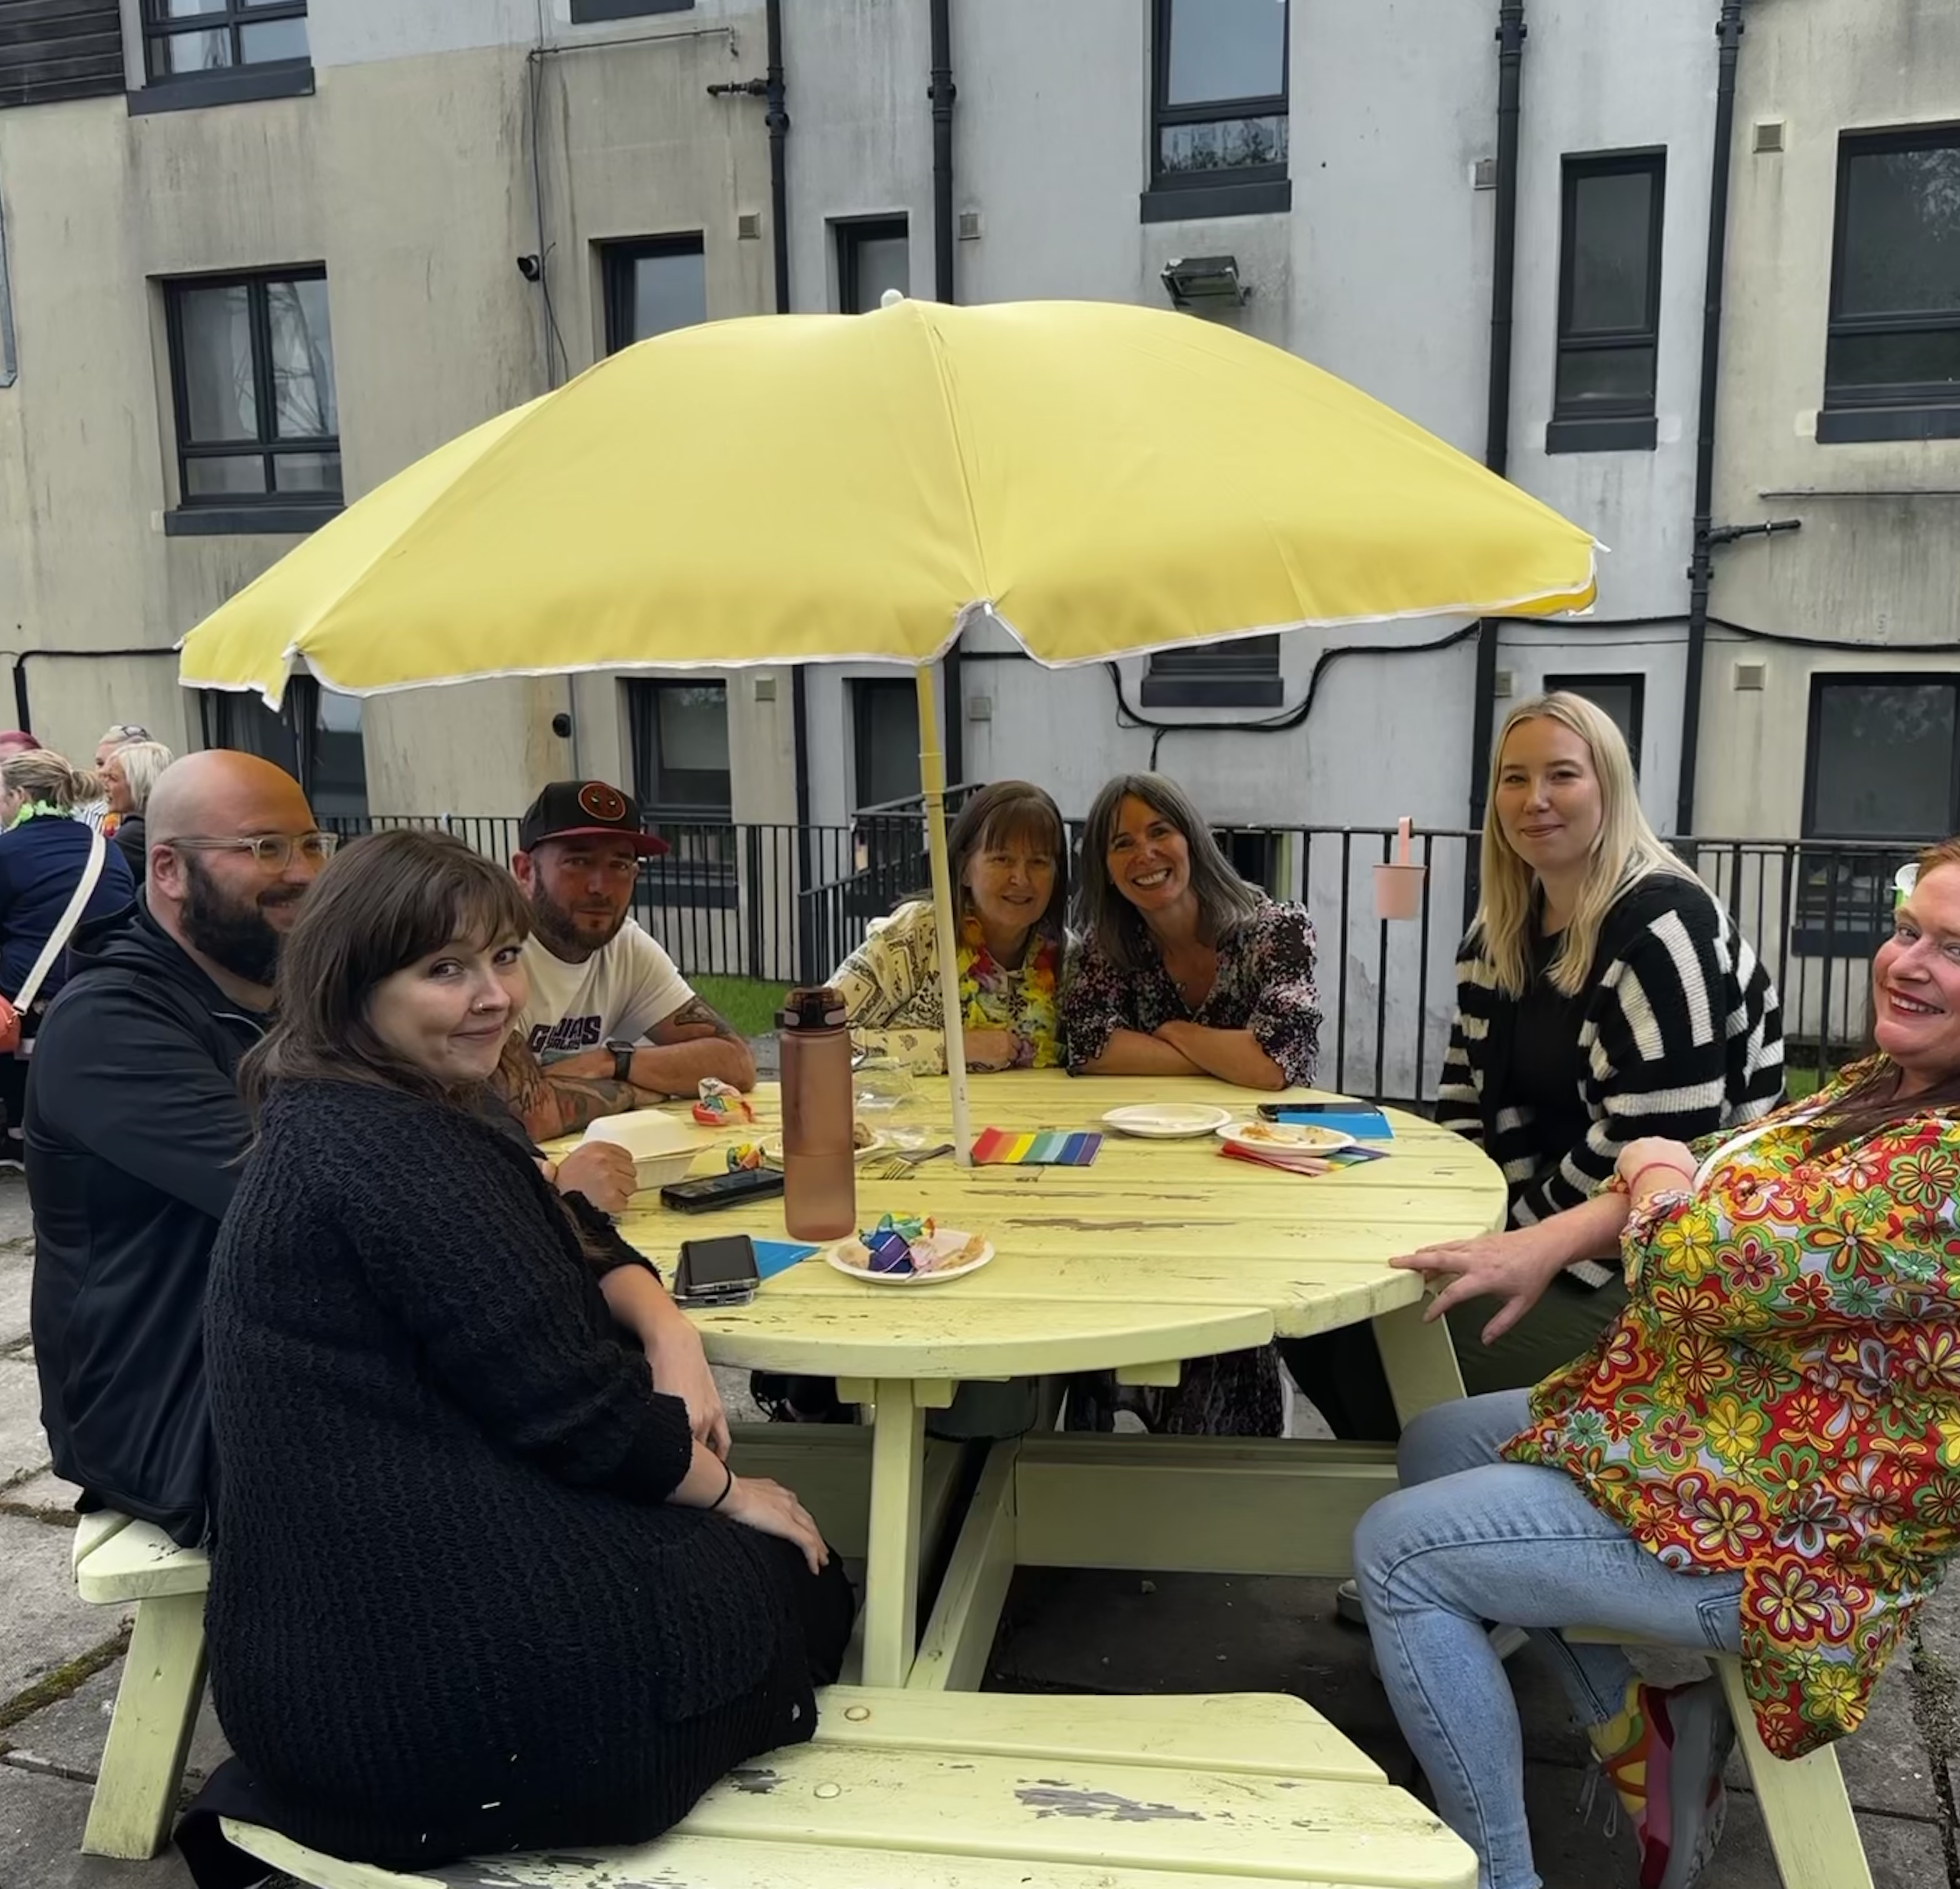
Essential skills and experience
Essential
Experience in setting and managing budgets
Computer literate and competent with Microsoft Office software package
Ability to ensure the service is delivered in accordance with corporate policy and objectives
Knowledge of local services and resources
Ability to respond at short notice to crisis situations
Desirable
Management experience in Third Sector/ Not-for-Profit organisations providing housing, social care and support services
Experience of using management information tools for social care
Understanding of the principles of working within a Psychologically Informed Environment (PIE)

Slide 14

Role Details
Contract: Full time, permanent, 35 hours per week. Salary: SCP 36- 39 £39,285 to £42,892 per annum Reporting to: Head of Housing
Your normal working hours are 35 per week. These hours are usually worked Monday to Friday, and flexibly between the hours of 9.00am to 5.00pm depending on the needs of the service, with one-hour unpaid break. Variations to these hours must be agreed with your line manager
Your core place of work will be Rosemount Business Park, 141 Charles Street, Glasgow, G21 2QA with some travel to 15 Dava Street, Glasgow, G51 2JA when required
You may be required to work from such other place as the organisation may reasonably require from time to time.
Annual leave entitlement of 210 hours holiday (equivalent to 6 weeks) pro rata per year in the first year rising to 280 hours (equivalent to 8 weeks) pro rata per year in the second. This includes public holidays.
All appointments are subject to a minimum of a 12-week probationary period.
You will be automatically enrolled into the People’s Pension. Deductions will be taken from your salary in the month you will complete 3-months of employment
It is the nature of the work of Right There that tasks and responsibilities are, in many circumstances unpredictable and varied. All employees are, therefore, expected to work in a flexible way when the occasion arises.

Slide 15

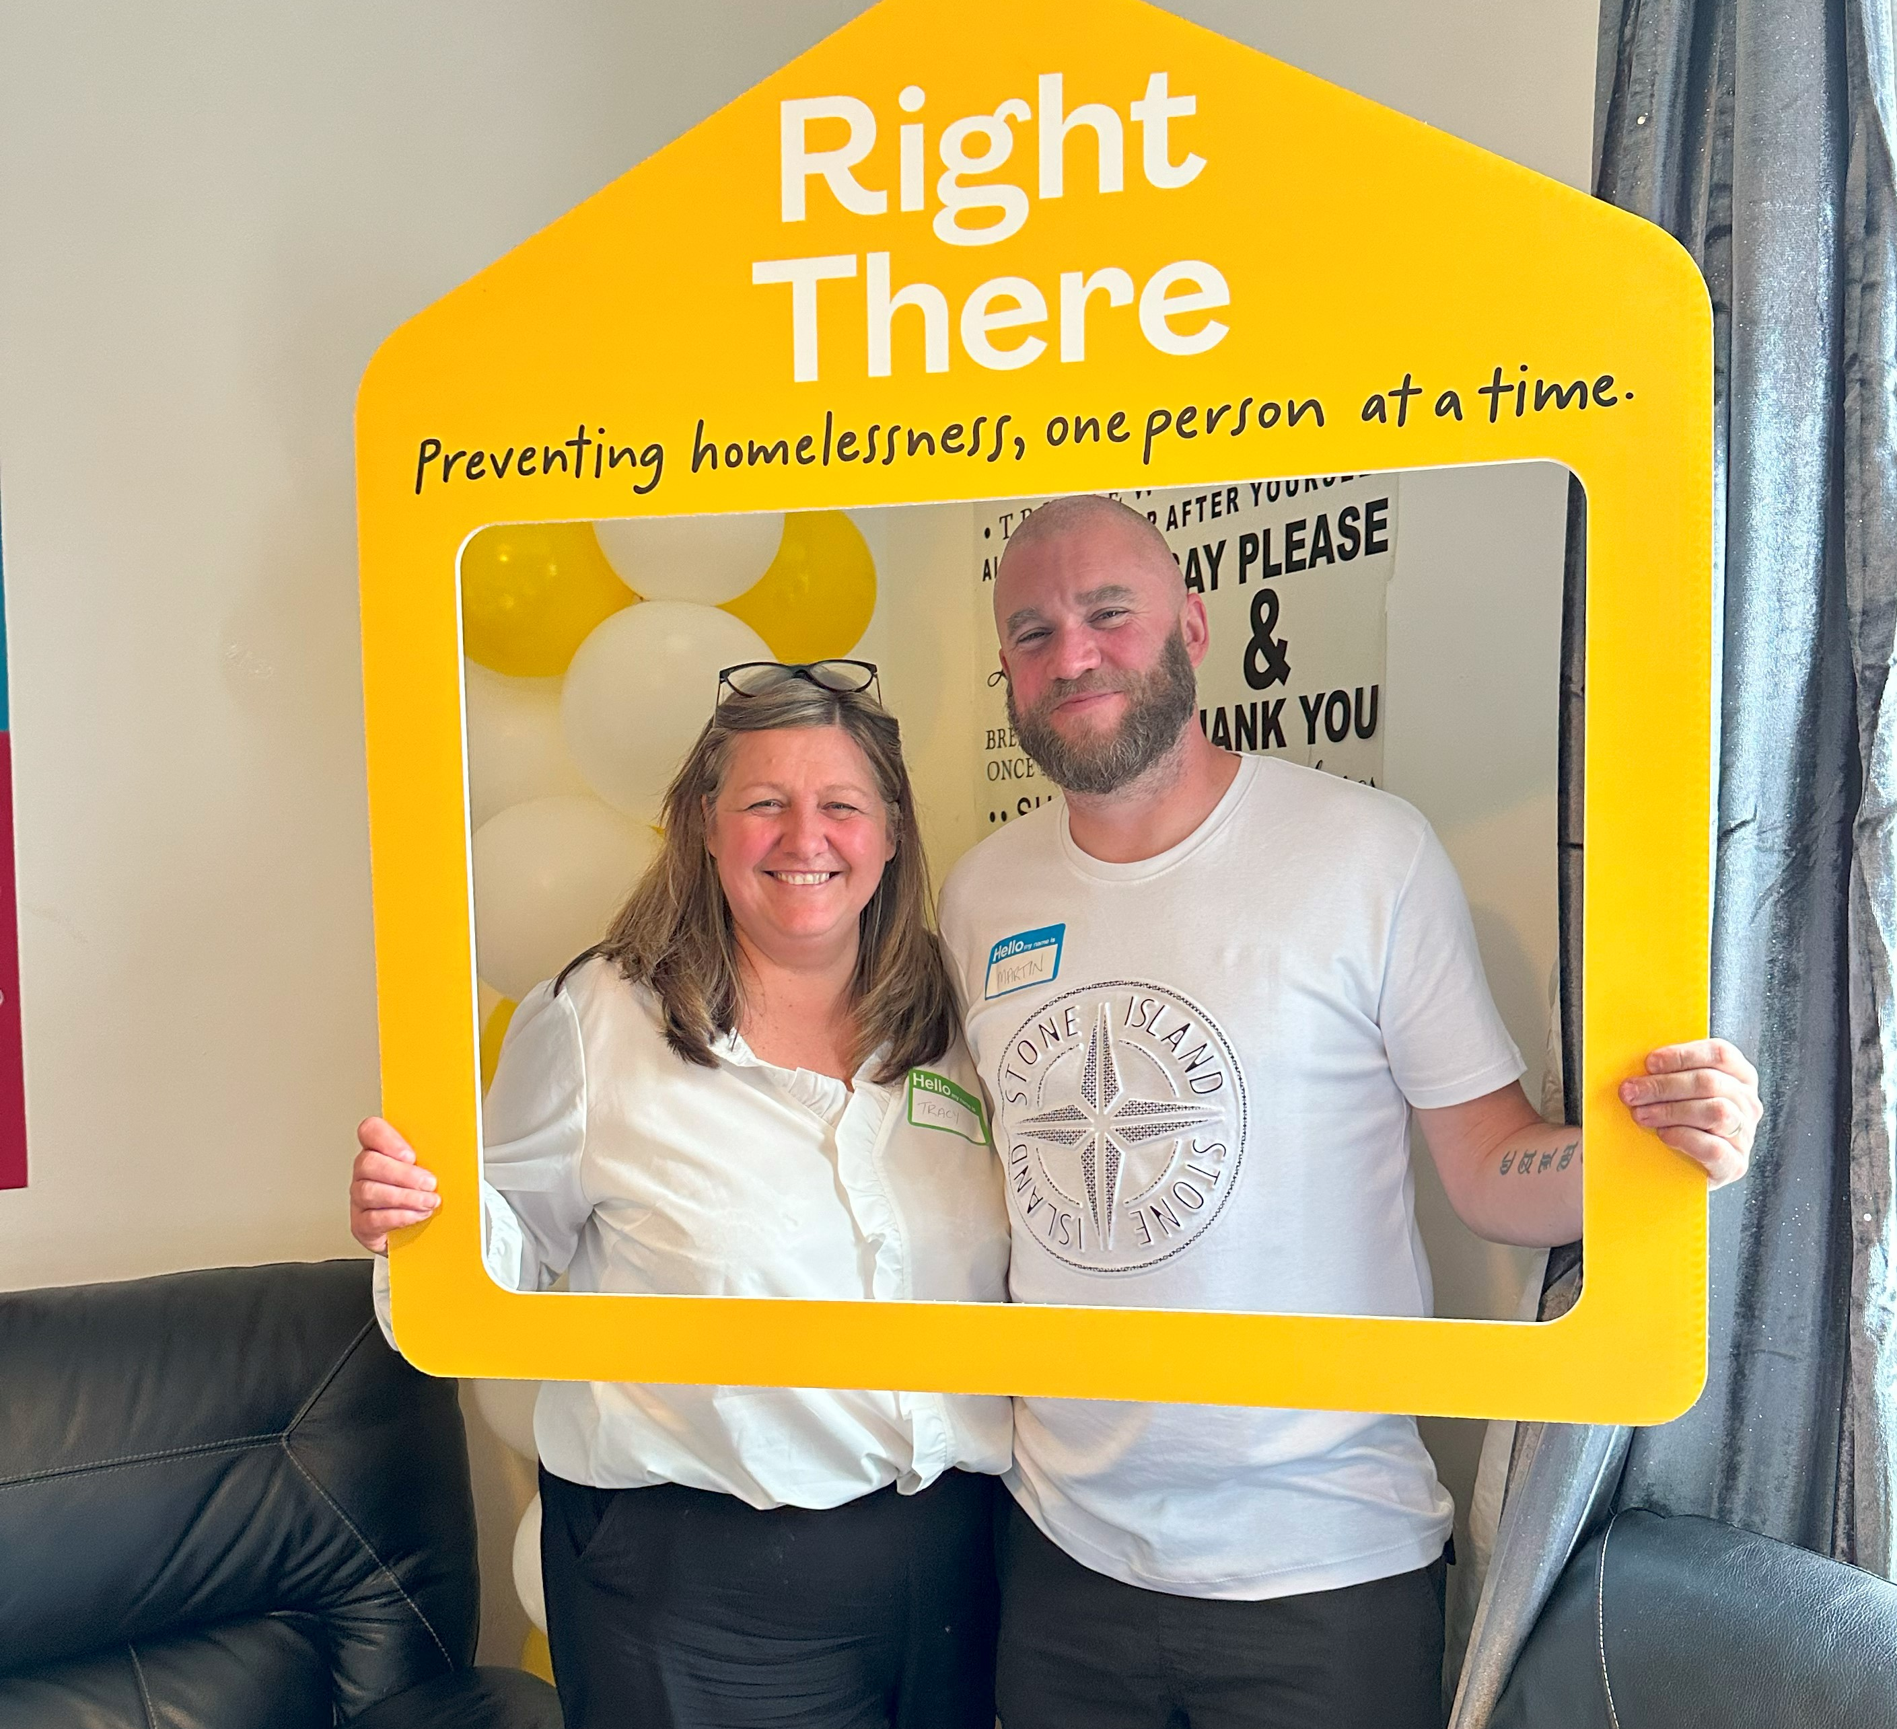
Our People Benefits
We know how dedicated our people are and we want to help you achieve a good work/life balance – and make it easier to enjoy life’s special moments!
That’s why we’ve got a range of enhanced family-friendly and wellbeing benefits to give you some well deserved perks of being a Right There employee. Benefits include:
Hybrid working – work where is best for you and your role
Enhanced maternity, paternity, adoption, and shared parental leave
Employee 24-hour counselling and wellbeing services
6 weeks annual leave, rising to 8 after a year (plus you can purchase up to 5 more days)
Life insurance 4x your salary
Dedicated training and development plans
Cycle to work scheme
Refer a Friend

Slide 16
How to Apply
To apply send your CV and a short cover letter outlining your interest in and suitability for the role.
Email recruitment@rightthere.org

Slide 17
Thank you. Good luck with your application.

