Slide 1

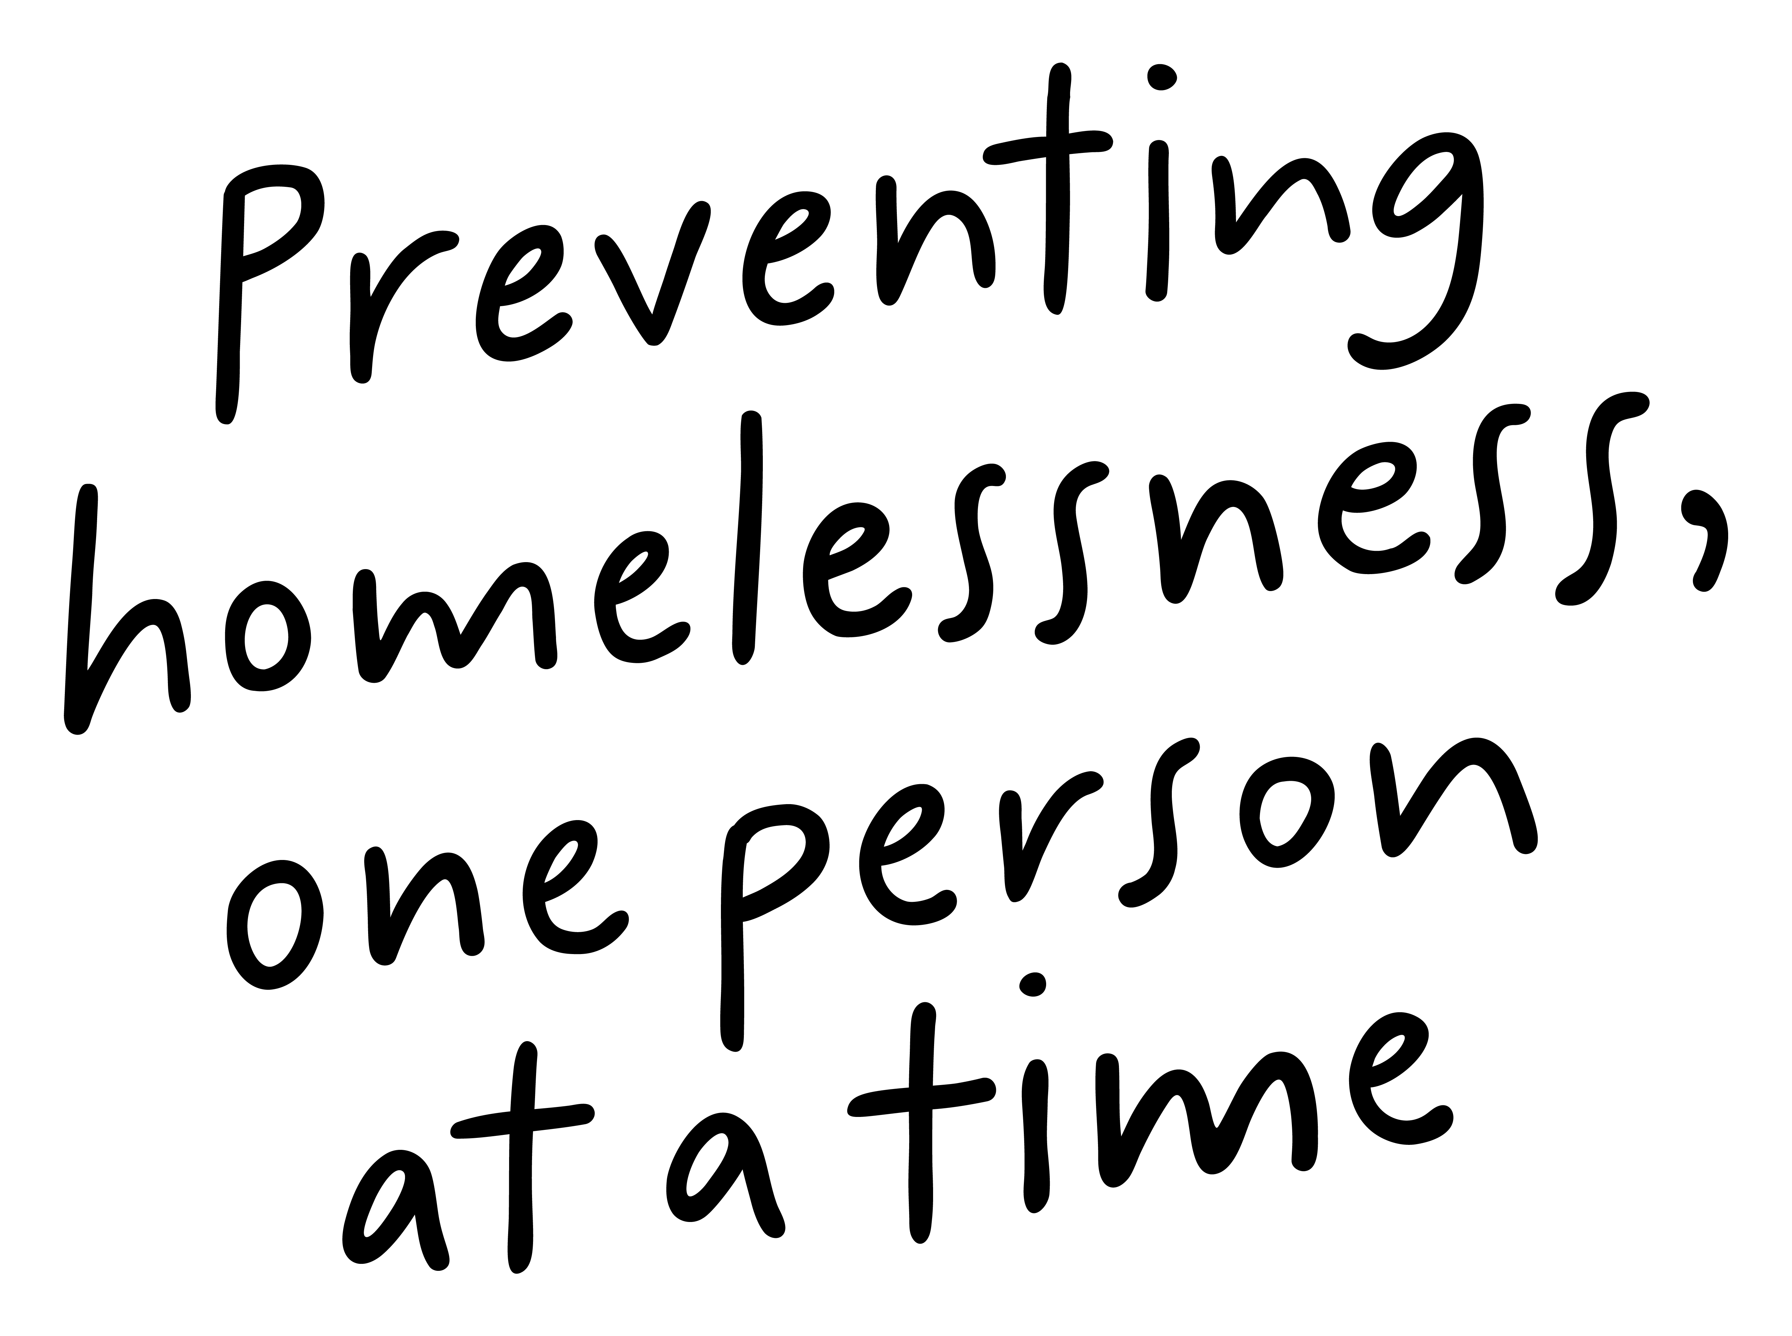
Job Pack Support Worker (September 2025)

Slide 2
Job Purpose Support Worker- Maternity Cover
Supported Accommodation Inverness is a trauma informed supported accommodation service for care experienced young people aged 16-26 who are leaving care or at risk of becoming homeless.
The Support Worker will provide support in a person-centred manner meeting the needs of the young people that we support as well as providing emotional and practical support which is aimed at nurturing essential life skills and promoting independence.
Locality Manager
Registered Manager
Senior Support Worker
Support Workers

Slide 3

What does our team say?
I have worked with Right There for a year and a half and I thoroughly enjoy the variety of each day and the challenges. The staff team all have a wide range of skills, and we all work together as a team. The management team are all very supportive and we all work together to do our best for the people we support . I would highly recommend working with Right There.
Gillian French, Support Worker, Inverness .

Slide 4


What’s Inside
5-6
Our Vision, Mission and Values
7-8
9
Requirements
10
Role Details
11
Our People Benefits
12
How to Apply
13
14

Slide 5


About Right There
We are Right There, a charity celebrating our 200th anniversary in 2024. We provide tailored support for people, at home, and in the community. We are here for people who are living with the effects of homelessness, poverty, addiction, or family breakdowns. Last year we supported almost 4,000 individuals, helping to prevent them from becoming homeless or separated from the people they love.
We are here to offer the right support at the right time, including breaking down financial barriers; accessing the private rental market; linking up with local health, employment and training services to help people make connections within the community; and, helping people feel happier, safer, and more confident to take steps to improve their own lives.
Every person’s story is unique, and everyone’s route home is different, so we tailor our response to the individual. We want to challenge stereotypes – it doesn’t matter what the situation is – we’re not here to judge, only to help.
Our approach is about creating trusting relationships and nurturing people’s strengths, and our 200 dedicated staff, mentors and volunteers play a crucial role in this.

Slide 6
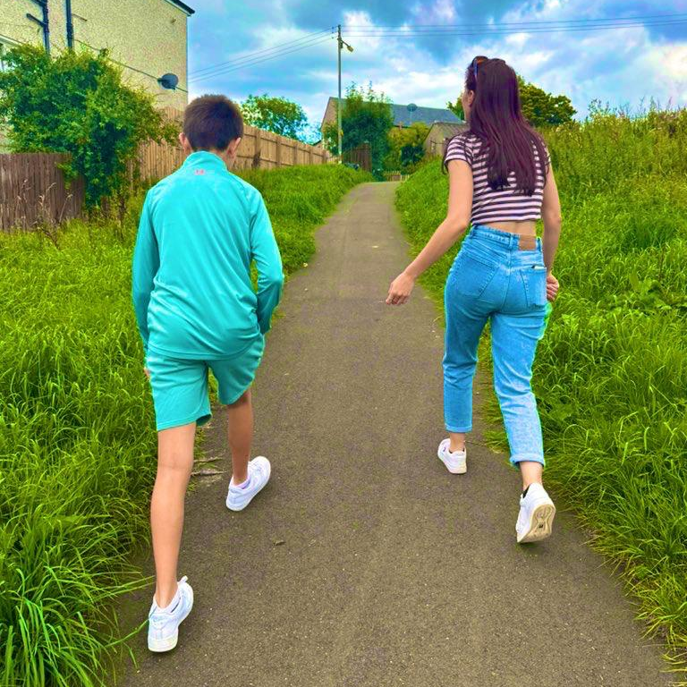
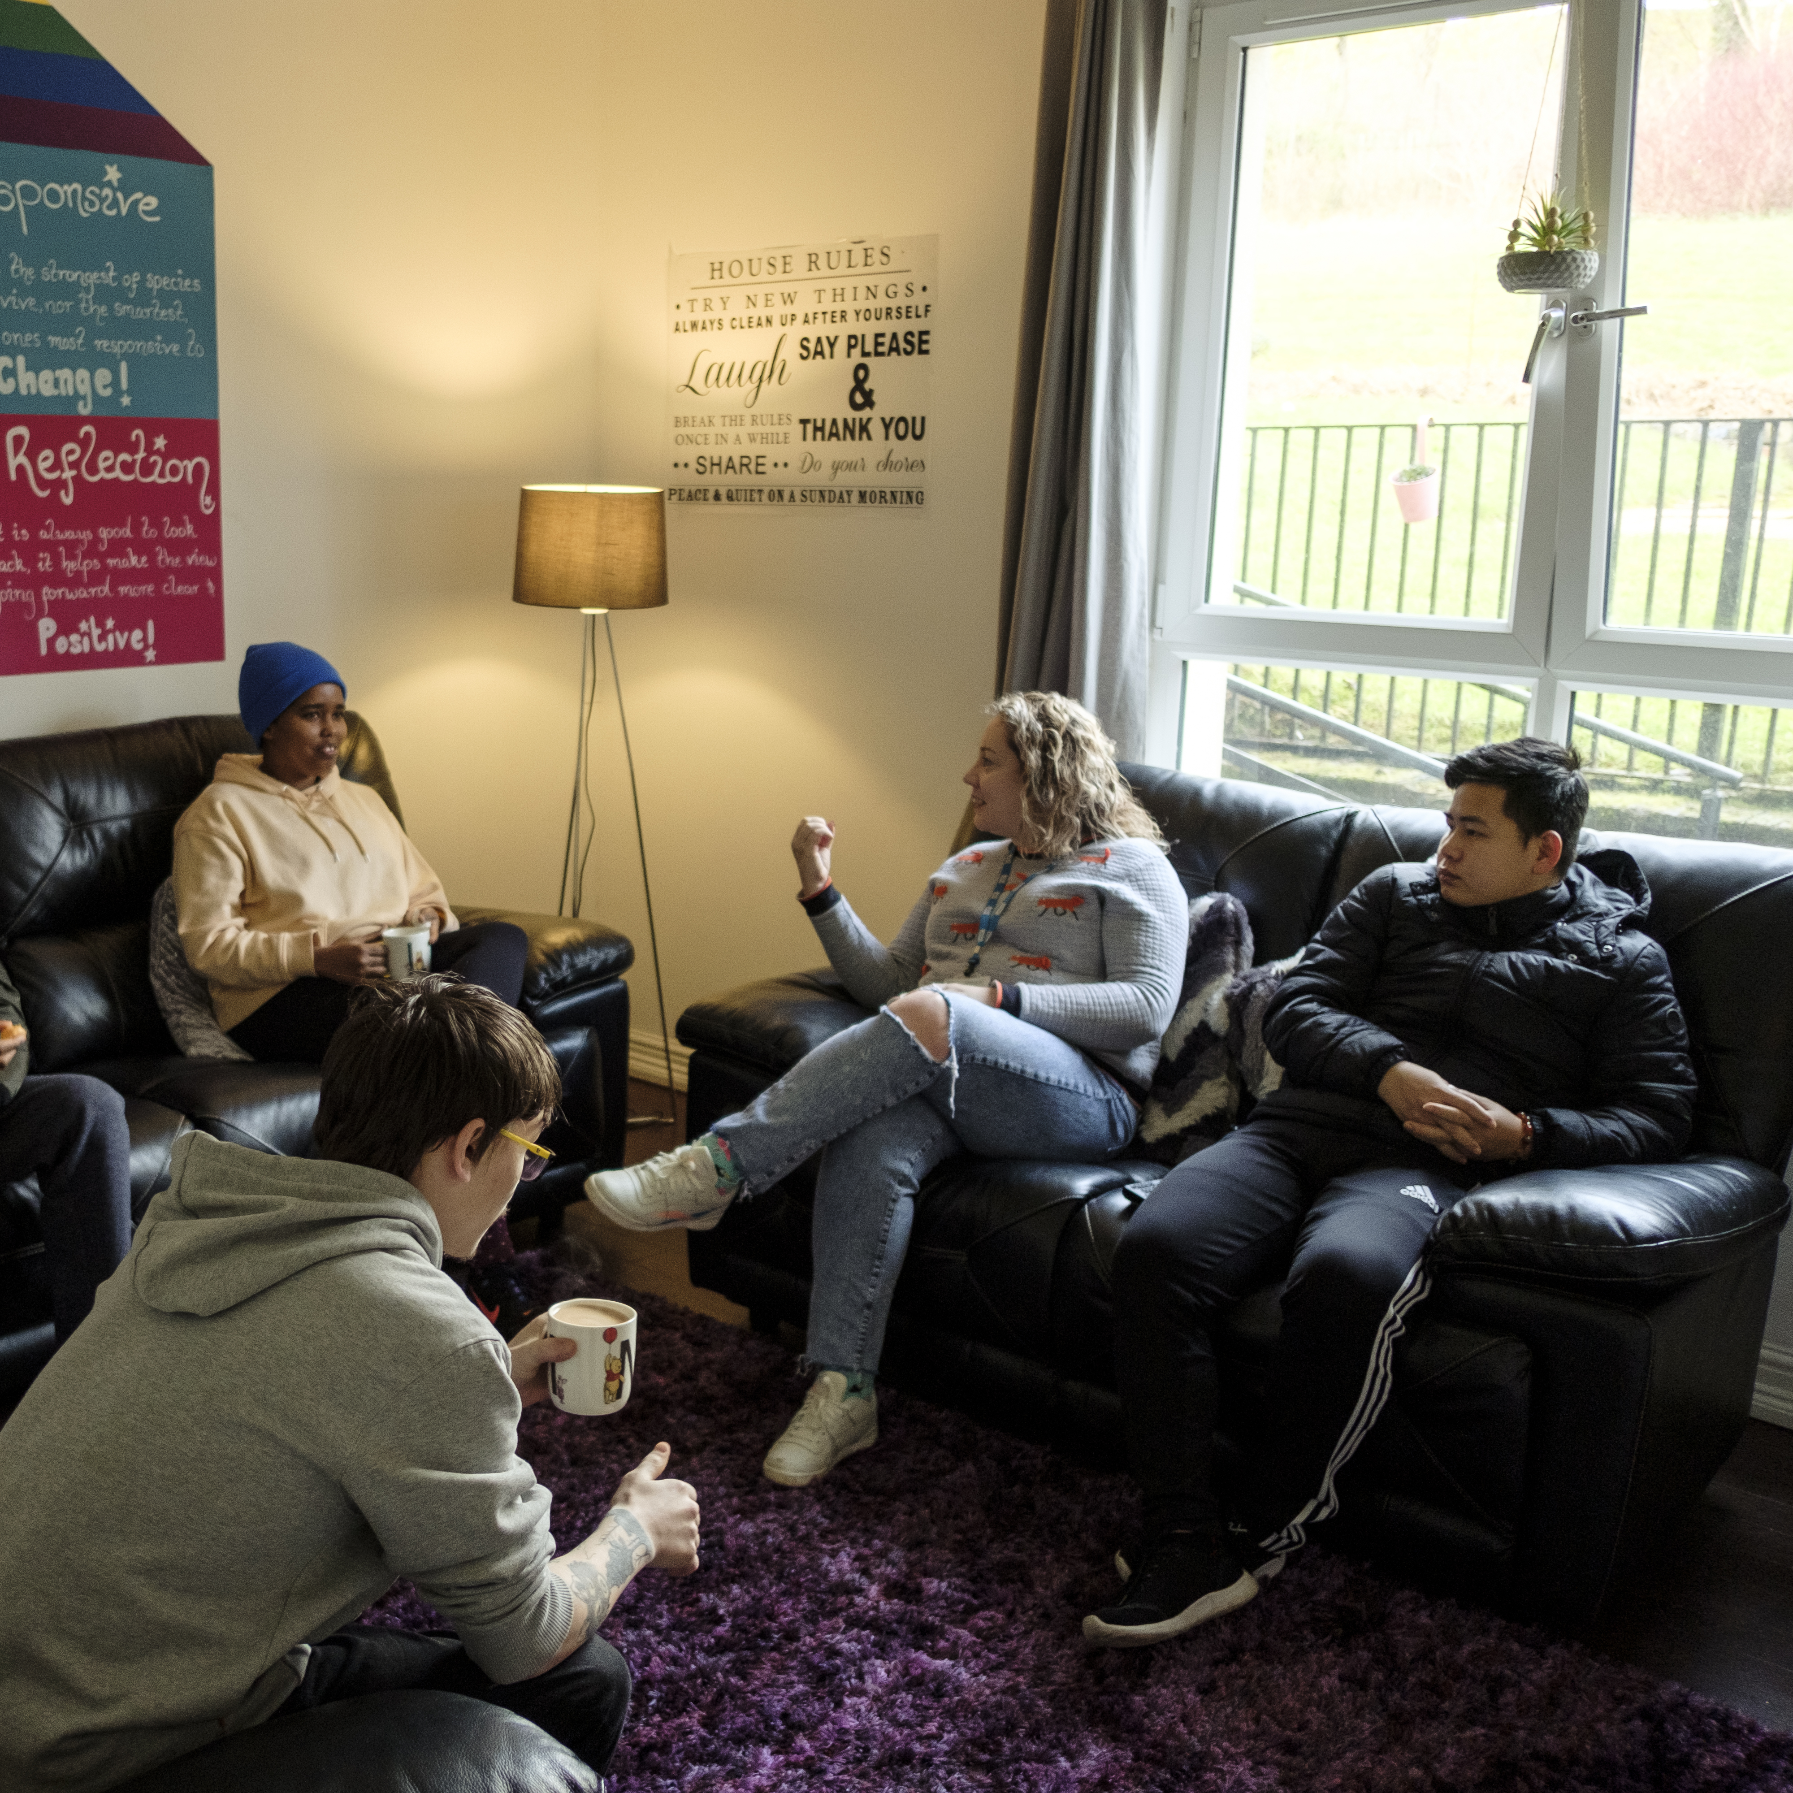
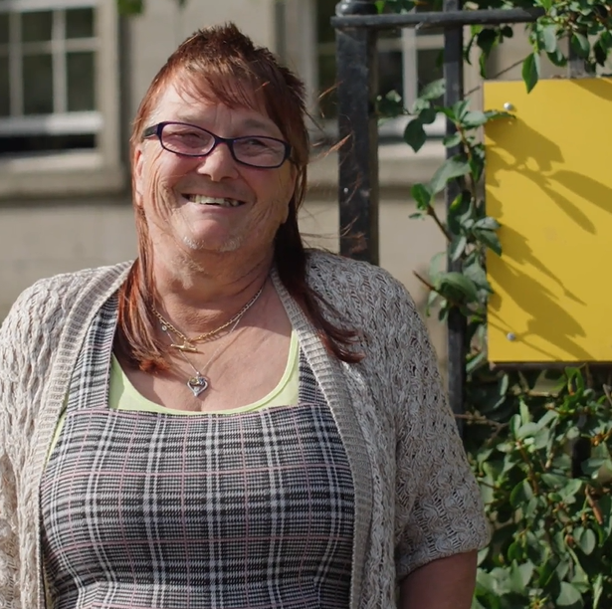
Our key areas of focus
For People
We provide tailored support for children and adults to help individuals and families feel happier, create stronger bonds and stay together.
At Home
We provide safe and supportive places to call home for people of all ages, from any circumstances, for as long as they might need it.
In The Community
We provide the tools for people to live independently and build their lives within their community, creating their own safe and secure homes.

Slide 7
Our Vision A world where everyone has an equal chance to create a safe and supportive place to call home.
Our Mission We meet people where
they are in life with no judgement; walking alongside those who need support, and preventing them becoming homeless
or separated from the people they love.

Slide 8



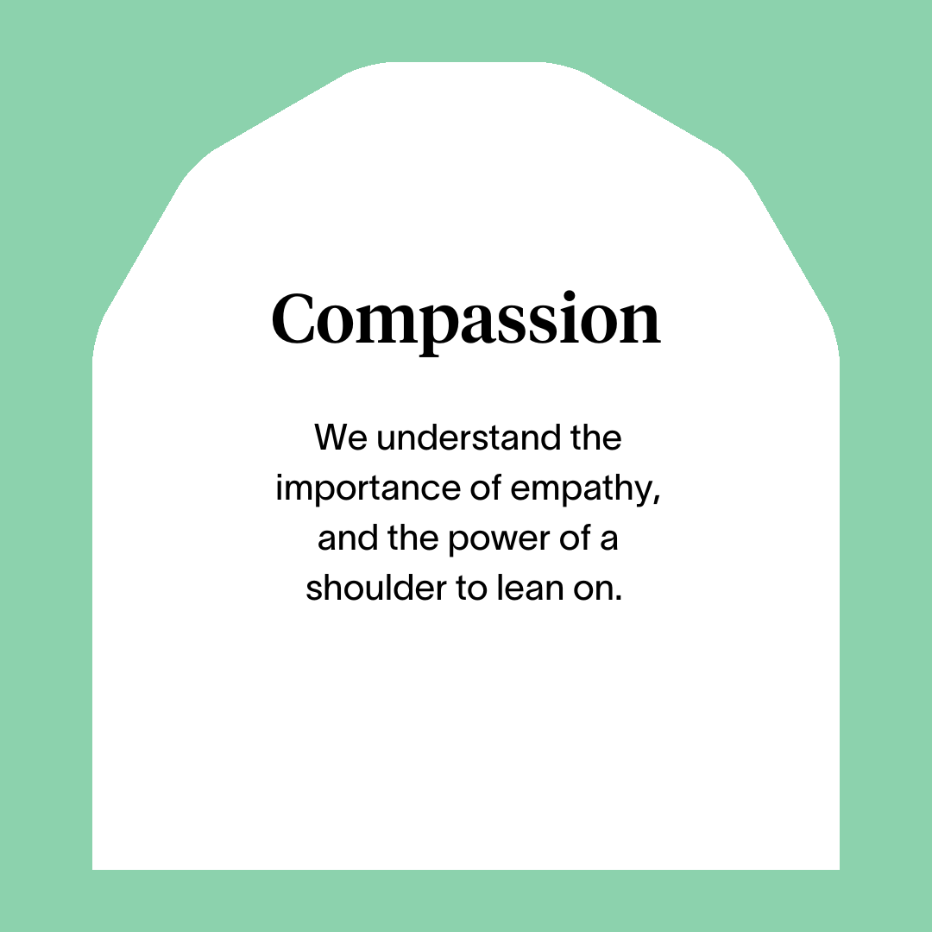



Slide 9
Main Role Responsibilities
Develop positive, respectful and compassionate relationships with the people we support, focusing on their strengths and aspirations as individuals.
Have a high standard of professional integrity with colleagues and other professionals.
Establish clear professional boundaries with the people we support.
Actively practicing person-centred planning and unconditional positive regard.
Taking a Psychologically Informed Environment (PIE) approach.
Arranging and facilitating key work meeting to develop and review support plans in collaboration with the people we support to meet their individual needs both within the programme and out with.
Developing life skills with those we support, including how to maximise income, involvement in meaningful activities, budgeting, shopping, cooking and any other skills that aid to independence.
Advocating on behalf of the people we support.
Assist the people we support with engaging and integrating into the local community and helping them to become active citizens.
Utilising support plans to record and assess the progress of the people you are supporting.
Having knowledge of other relevant programmes and signposting the people we support when required.
Maintaining a safe environment for those we support, colleagues and others.
Undertaking household duties to maintain the accommodation to a high standard.
Planning, implementing and developing workshops or programme activities with those we support.
Compiling and reviewing risk assessments for the people we support.
Promoting involvement in the improvement and development of the programme from the people we support.
Represent Right There to other agencies or programmes including Local Authority, Social Work, Housing Programmes and other relevant programmes
Actively contribute to your programme and the organisation’s development and improvement.
Participate in team meetings.
Attend and participate in training and share learning experiences.
Engage in reflective practice.
Feedback on the review of organisational polices & procedures and local guidelines.
Promote and represent Right There programmes positively.
Strive for continuous personal and professional development.
Engage with any organisational initiatives or working groups such as NHS Healthy Working Lives, Investors in People, the LGBT Charter, etc.

Slide 10
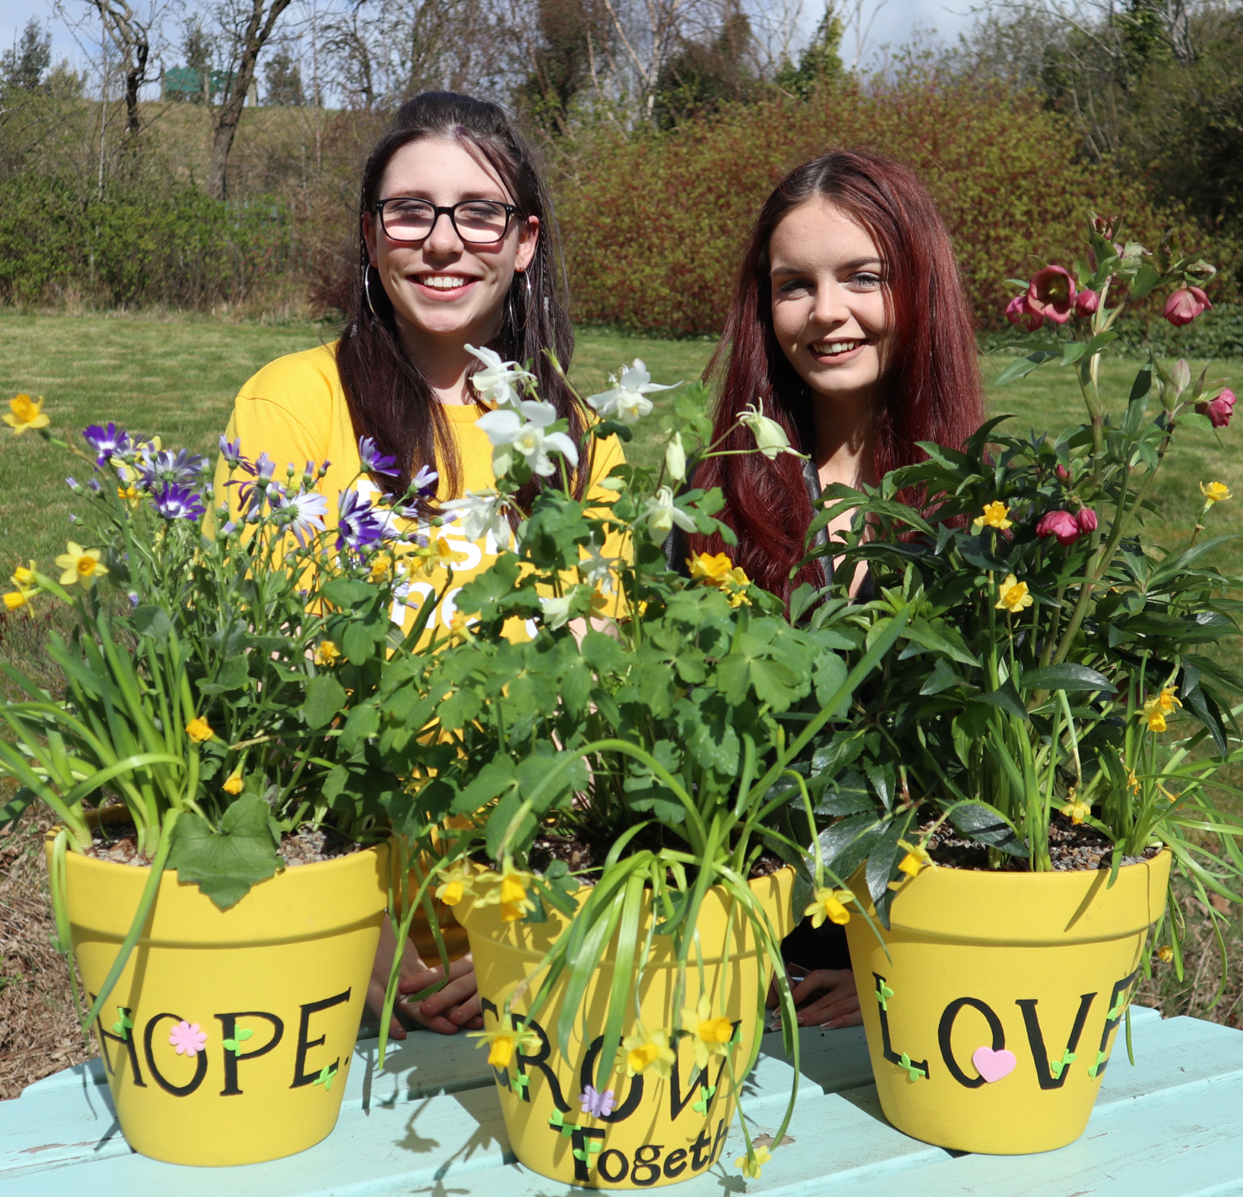
Essential skills and experience
Qualified to SVQ level 2 H&SC or SCQF equivalent (or are willing to work towards)
Knowledge of current relevant legislation and policies relating to housing and social care
Knowledge of issues surrounding homelessness
Experience of crisis work with vulnerable people
Ability to ensure the programme is delivered in accordance with corporate policy and Association objectives
Skills and ability in effective time management and working to deadlines
Ability to compile comprehensive reports as required
Knowledge of local resources and programmes
Flexibility with regards to working patterns
Ability to travel within agreed geographical area
Ability to respond at short notice to crisis situations
Desirable Knowledge
Experience of working in a similar environment
Understanding of the principles of working within a Psychologically Informed Environment (PIE)

Slide 11

Role Details
Contract: Part Time, Fixed Term Contract Salary: SCP 19-22 (£21,826 - £23,365 per annum) plus a sleep-in payment of £10,917 per annum Reporting to: Senior Support Worker
Your normal working hours are an average of 31.5 waking plus 1.75 sleep-in shifts per week. These hours will be worked between Monday to Sunday, in shifts which are defined by your line manager on a rolling rota, over a 52-week period. The rota will be available to you a minimum of one week in advance. You may be required to work different shift times, with reasonable notice, in agreement with your line manager.
Your core place of work will be 75 Old Perth Road, Inverness, IV2
You may be required to work from such other place as the organisation may reasonably require from time to time.
Annual leave entitlement of 280 hours holiday (equivalent to 6 weeks) pro rata per year in the first year rising to 310 hours (equivalent to 8 weeks) pro rata per year in the second. This includes public holidays.
All appointments are subject to a minimum of a 12-week probationary period.
You will be automatically enrolled into the People’s Pension. Deductions will be taken from your salary in the month you will complete 3-months of employment
It is the nature of the work of Right There that tasks and responsibilities are, in many circumstances unpredictable and varied. All employees are, therefore, expected to work in a flexible way when the occasion arises.

Slide 12

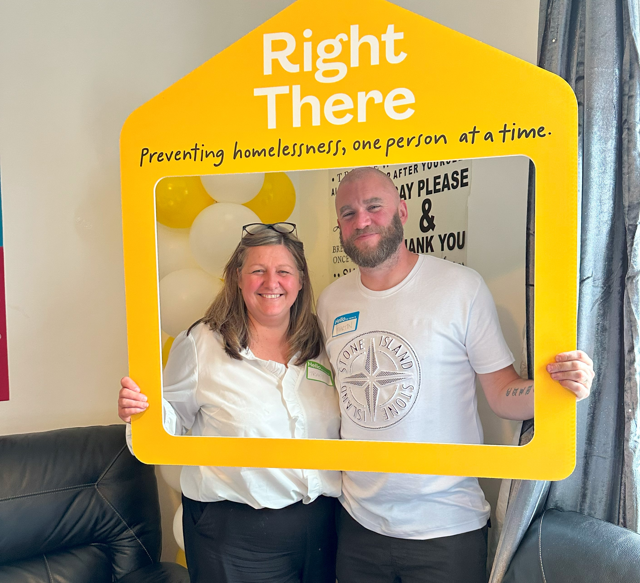
Our People Benefits
We know how dedicated our people are and we want to help you achieve a good work/life balance – and make it easier to enjoy life’s special moments!
That’s why we’ve got a range of enhanced family-friendly and wellbeing benefits to give you some well deserved perks of being a Right There employee. Benefits include:
Hybrid working – work where is best for you and your role
Enhanced maternity, paternity, adoption, and shared parental leave
Employee 24-hour counselling and wellbeing services
6 weeks annual leave, rising to 8 after a year (plus you can purchase up to 5 more days)
Life insurance 4x your salary
Dedicated training and development plans
Cycle to work scheme
Refer a Friend

Slide 13
How to Apply
To apply send your CV and a short cover letter outlining your interest in and suitability for the role.
Email recruitment@rightthere.org

Slide 14
Thank you. Good luck with your application.

